Slide 1
Document-Level Text Simplification USING SIM2SUM APPROACH
Team:
Abhinav Kumar Jha (cs23mtech15001)
Shriram Pradeep (cs23mtech15020)

Slide 2
Content
Problem statement
Related Works
Examples
Dataset Description
Methodology
Evaluation Metrics
References
Report Timeline

Slide 3
PROBLEM STATEMENT
Develop an approach for Document Level Simplification which involves simplifying documents consisting of several sentences by rewriting them into fewer or more sentences.
Text simplification is an important technique that aims to simplify a document to make it more understandable and accessible for people at different educational reading levels, while still retaining the content of the original text.
Challenges:
Simplification must address complex vocabulary and sentence structure, while also condensing information across multiple sentences or paragraphs.
The system should not only simplify individual sentences but also summarize entire documents, ensuring that key information is retained and readability is improved.
Currently, text simplification research has been more focused on sentence simplification. However, various applications in the real world require document level simplification rather than sentence level processing
Usage:
Simplification is essential for aiding non-native speakers, individuals with reading difficulties (e.g., dyslexia), and in educational purposes.
It can also serve as a pre-processing step for other NLP tasks like:
Parsing
Information Extraction
Text Summarization
Machine Translation

Slide 4
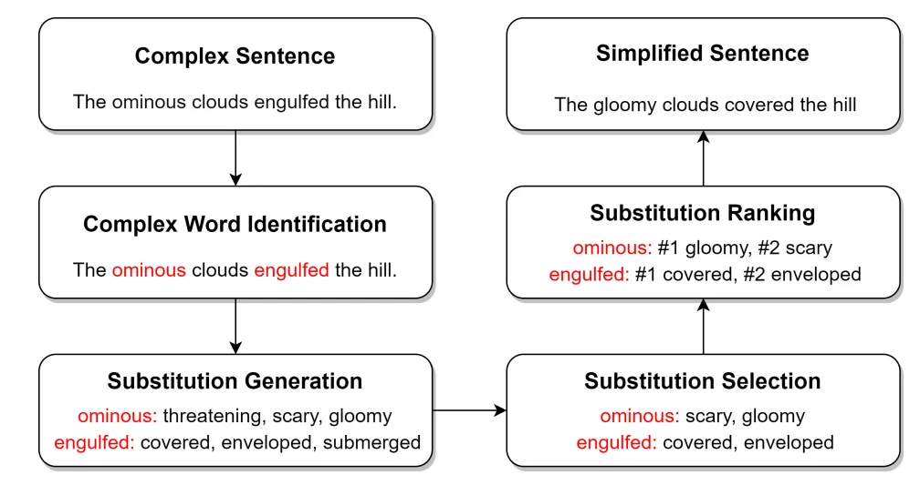
EXAMPLE

Slide 5
EXAMPLE
Example | Original Text | Simplified Text
Example 1 | "Marsupial moles are highly specialized marsupial mammals, known from two species found in the Australian interior." | "Marsupial moles are mammals found in Australia.
Example 2 | "The Phoenix Dwarf is a dwarf irregular galaxy discovered in 1976 by Hans-Emil Schuster." | "Phoenix Dwarf is a galaxy discovered in 1976."

Slide 6
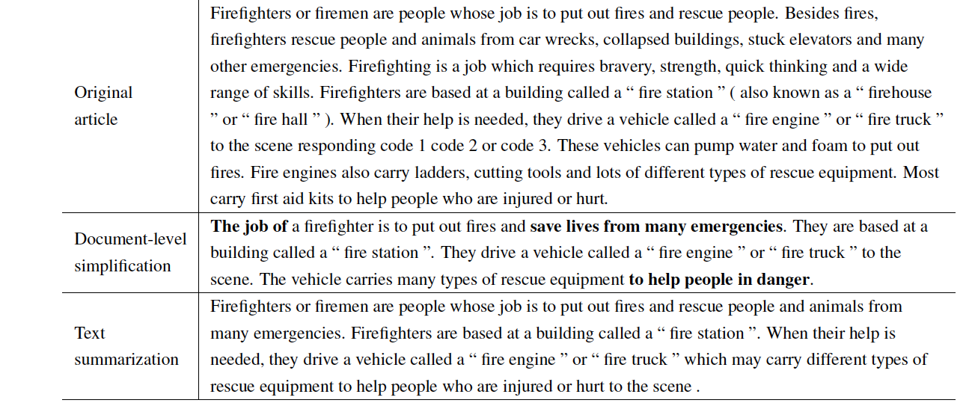
Examples for document-level simplification and text summarization

Slide 7
Related works
Sentence-Level Simplification
Early works in text simplification focused on sentence-level tasks, including lexical and syntactic simplifications.
Simplify individual sentences while retaining the core meaning.
Key Works:
Coster and Kauchak, 2011: early simplification models were based on statistical machine translation(SMT)
Development of Text Level Simplification Datasets for e.g. WikiLarge, TurkCorpus, Newsela,
Xu et al. (2016): Introduced the SARI metric for evaluating sentence simplification, focusing on operations such as adding, deleting, and retaining words.
Zhang & Lapata (2017): Utilized reinforcement learning to optimize simplification, improving readability while preserving meaning.
Sheang & Saggion (2021): Applied the T5 model (Text-To-Text Transfer Transformer) for controllable sentence simplification, introducing specific control tokens for guiding the simplification process.
Neural Text Simplification
Leverage neural network models, particularly sequence-to-sequence models, for automatic simplification.
These models utilize architectures like transformers and RNNs to map complex sentences to simplified versions.
Key Works:
Nisioi et al. (2017): Applied the first neural text simplification model using a sequence-to-sequence framework based on neural networks.
Martin et al. (2021): Proposed MUSS (Multilingual Unsupervised Sentence Simplification), a transformer-based model that simplifies texts across multiple languages using paraphrases.

Slide 8
Related works (contd.)
Document-Level Simplification
Simplify entire documents, maintaining the overall coherence and flow of the text.
Moving beyond sentence simplification to handle larger text units like paragraphs or full documents, ensuring that the text remains coherent.
Key Works:
Alva-Manchego et al. (2019): Proposed document-level simplification, where sentence-level approaches failed to address the need for preserving the global meaning of the text.
Sun et al. (2021): Provided a large-scale dataset called D-Wikipedia ,Introduced D-SARI, a metric designed for document-level simplification, addressing challenges in assessing simplifications that span multiple sentences.

Slide 9
Dataset details
The SIMSUM model is trained and evaluated on two main datasets: D-Wikipedia and Wiki-Doc.
D-Wikipedia:
Content: Derived from Wikipedia, this dataset includes pairs of complex and simplified sentences.
Size:
546,744 complex sentences
349,561 simplified sentences
Key Focus: The dataset is designed to retain the core content of the original sentences while simplifying their language.
Wiki-Doc:
Content: This dataset consists of more extensive document-level pairs.
Size:
258,303 complex sentences
55,885 simplified sentences
Complexity: The average document length is greater than that in D-Wikipedia, making this dataset more challenging for document-level simplification.
Challenges: Wiki-Doc contains misaligned and noisy data, which requires significant preprocessing to clean the dataset.

Slide 10
Preprocessing techniques
Preprocessing is crucial in both datasets to ensure that the model learns from high quality data. The key preprocessing steps in SIMSUM involve filtering and re-alignment
Filtering
Purpose: To remove instances where the simplified text is longer than the complex text, as this contradicts the goal of simplification, which is to make the text shorter and simpler.
Method: Any document pair where the simplified version is significantly longer than the complex version is filtered out.
Realignment (Using Keyword Extraction)
Purpose: Ensuring that the complex and simplified text pairs are semantically aligned.
Method: KeyBERT is used to extract keywords from both the complex and simplified versions of the documents. If the keywords from the complex and simplified versions do not overlap sufficiently, the pair is considered misaligned and is removed from the dataset.
Benefit: This process ensures that the simplified versions correspond to the same content as the complex versions, improving the quality of the training data.

Slide 11
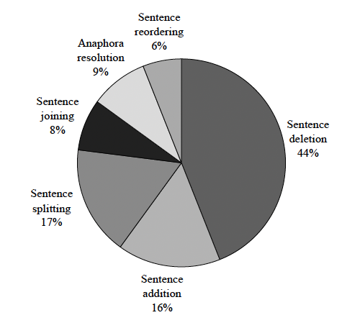
Simplification operations distribution in datasets
Text Simplification involves:
Replacing difficult words with simpler ones.
Shortening long and convoluted sentences.
Reducing the overall complexity of sentence structures.
Eliminating unnecessary jargon.

Slide 12
Examples (Training data issues)
Source | Simplified | Analysis
andouille ( ; ; from vulgar latin verb “ inducere ” , meaning “ to lead in ” ) is a smoked sausage made using pork , originating in france . | andouille is a type of pork sausage . it is spicy (hot in taste ) and smoked . there are different kinds , all with different combinations of pork meat , fat , intestines ( tubes going to the stomach ) , and tripe ( the wall of the stomach ) . andouille sausage first came from france or germany ( no-one is sure )... | In reference, it demonstrates the conceptual simplification, which aims to help people understand easier. However, the simplified referenced article is much longer than the source article, and it also contains impossible deduced information.
sushun ’s reign spanned the years from 587 through 592 . | the conventionally accepted names and sequence of the early emperors were not to be confirmed as “ traditional ” until the reign of emperor kammu , who was the 50th monarch of the yamato dynasty . | This is a miss-aligned pair and should be removed from the dataset.
andradina is a municipality of the state of s.o paulo , brazil.the population is 57,250 ( 2015 est . ) in an area of 964.23 km..the municipality contains the andradina biological reserve , a strictly protected area.the municipality can be accessed mainly by rodovia marechal c.ndido rondon/br-300 ( marechal rondon highway ) . | edi carlo dias mar.al ( born 13 september 1974 ) is a brazilian football player . he plays for korona kielce . | Source article is mainly about a state named andradina, but the reference actually describes a Brazilian football player. This pair is definitely not aligned correctly.

Slide 13
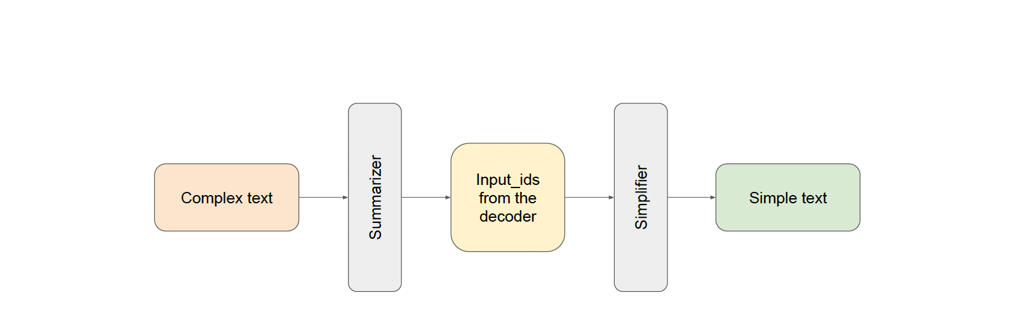
Approach -SIMSUM
SIM2SUM is a two-stage process for doing simplification and includes a Summarizer transformer and a Simplifier transformer, which jointly aim to address the document level simplification task trained in an end-to-end fashion.
The generated output of the Summarizer is fed to the Simplifier without tokenizer’s decoding
We use pre-trained T5 and BART models for both the summarization and simplification stages in SIM2SUM. The simplification stage can be fine-tuned using the Wiki-Doc or Wiki Large datasets to enhance performance.

Slide 14
Keyword Prompting
Keyword Prompting is a technique used to guide the text simplification process by ensuring that the most important terms from the original text are preserved in the simplified version
We can extract important key phrases and their importance score which can be appended to the input sentence to produce better embedding to focus more on key phrases to simplify majorly. It includes the following steps
Extract Keywords: A keyword extraction tool (e.g., KeyBERT) is used to identify the most salient words or phrases from the original text.
Incorporate Keywords into the Input: The extracted keywords are added as prompts to the input text before feeding it into the simplification model. Two possible strategies:
kw_score: Keywords are extracted along with their salience scores and included before the input text.
kw_sep: Keywords are added separately, followed by an end-of-sequence (EOS) token to guide the model on which words to prioritize.
Simplification with Guided Attention:
The model is trained or fine-tuned to give higher attention to the keywords during simplification, ensuring that these critical words are either retained or replaced with simpler synonyms while maintaining the core meaning of the original text.
Example: For the sentence "The Phoenix Dwarf is a dwarf irregular galaxy discovered in 1976 by Hans-Emil Schuster," the keywords might be "Phoenix Dwarf", "galaxy", and "discovered in 1976."

Slide 15

Loss function
One of the most common approaches for training sequence-to-sequence Transformer models is the use of standard maximum likelihood measures and the cross-entropy loss
This method can be improved with an additional loss term that forces the model to generate texts more similar to targets.
L1 represents the cross entropy loss term
LCossim is the additional term added to generate texts similar to targets
λ > 0 is the hyperparameter for changing the degree of contribution of the additional term.
Activations functions used in the model is ReLU

Slide 16

Embedding similarity (Additional term)
Embedding similarity is introduced in SIMSUM to ensure that the simplified text generated by the Simplifier is semantically close to the summary generated by the Summarizer. The goal is to preserve the meaning while simplifying and summarizing the content.
Steps Involved in calculating embedding Similarity:
Summariser output: After the summarizer generates a summary from the complex document, the hidden state embeddings for the generated summary are extracted. These embeddings capture the meaning and context of the summary. It is represented by Hsum
Simplifier output: The target output is passed through the simplifier, and its hidden state embeddings are extracted. It is represented by Htgt
Cosine similarity: Our idea is to increase the similarity between the final output’s embeddings and the target’s embeddings during training.

Slide 17
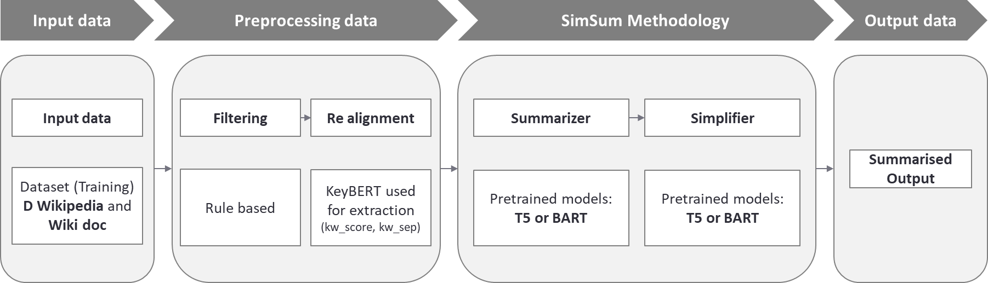
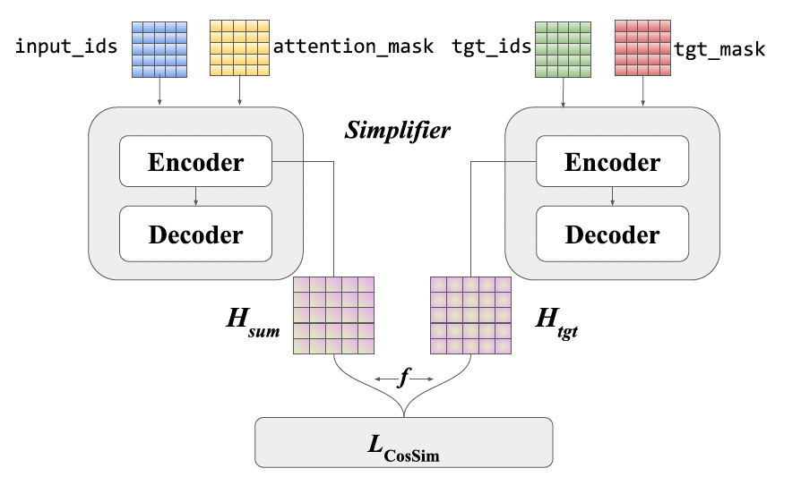
architecture
Figure 1: Simsum Architecture
Figure 2 : The embedding similarity computation process

Slide 18

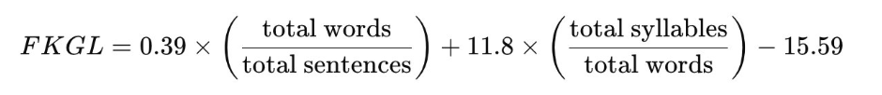
Evaluation Metrics
SARI: Measures the quality of simplifications by comparing the system's output to both the original sentence (complex version) and the reference simplified sentences. The SARI score is computed based on the precision and recall of the sentences that are kept, added, and deleted.
Sari = (F1_add + F1_keep + P_del) / 3
where F1_add: n-gram F1 score for add operation F1_keep: n-gram F1 score for keep operation P_del: n-gram precision score for delete operation n = 4
D-SARI: Introduces additional penalty factors for text length and helps account for structure beyond individual sentences. A modified version of SARI adapted for document level specification​
D-SARI = (Dkeep + Ddel + Dadd) /3
Bleau Score: Is a metric for evaluating the quality of machine-generated translations by comparing them to one or more reference translations.​
FKGL Score: The FKGL score is a readability test designed to indicate how difficult a passage is to understand based on sentence length and word complexity.​ It estimates the U.S. school grade level required to comprehend a given text, based on sentence length and word complexity.​

Slide 19
references
Sim2Sum SIMSUM: Document-level Text Simplification via Simultaneous Summarization(Sofira et al)
Document-Level Text Simplification: Dataset, Criteria and Baseline(Sun,Wan)
Evaluating Document Simplification: On the Importance of Separately Assessing Simplicity and Meaning Preservation (CripWell et al)
Graph-based Model Using Text Simplification (Xu,Pan 2021)

Slide 20
Report Timelines
14th October – 25th October : Dataset preparation
26th October – 3rd November: Summarization and Simplification Code Implementation
4th November – 10th November: Model Training and Testing
11th November – 17th November: Results Preparation
18th November-24th November: Report Preparation and Buffer Week for adjustments

