Slide 1
AUTOMATIC STANCE DETECTION
By: Abhinav Kumar Jha

Slide 2


Slide 3
Problem Statement
The problem is about “stance detection,” which involves comparing a headline with a
body of text from a news article to determine what relationship (if any) exists between the
two. There are 4 possible classifications:
• The article text agrees with the headline.
• The article text disagrees with the headline.
• The article text is a discussion of the headline, without taking a position on it.
• The article text is unrelated to the headline (i.e. it doesn’t address the same topic).

Slide 4
Dataset Overview
The datasets for our task are provided by the Fake News Challenge organization. The complete
training set consists of 50,000 “stance” tuples, with each tuple consisting of:
A headline (word count 2-40)
The (integer) ID of an article.
Article Body. Length range from 2 to nearly 5000 words.
• The true stance of the headline with respect to the article. (This is one of the four classes
outlined earlier: agree, disagree, discuss, and unrelated.)
https://github.com/FakeNewsChallenge/fnc-1

Slide 5
Features Extracted from text
1.Cosine Similarity
2.KL Divergence Score
3.Google News Cue Words Embedding
4.Google Word 2 Vec word embeddings
5.N Gram Model
5.1 Unigram
5.2 Bigram
5.3 Trigram
6. Word Weightage scorers
6.1 TF -IDF
6.2 Skip Gram Model
6.3 Common Bag of Words

Slide 6

Vector Representation
Initially, each document (headlines and article bodies) are vectorised into tf-idf form.
Before this is possible, we need to learn the idf weights of every word in the collection. This is done by going through all documents and building a dictionary of (word -> in how many documents does that word appears). This is the document frequency (df) score of each word.
To get the idf score of each word, its df score is inverted and smoothed with the following function :

Slide 7
Computing tf-idf -:
Then, we can compute the tf-idf values of each word in a document.
First, the term frequency of the word is counted (e.g. if the word ‘glove’ appears twice in a document d, the tf of glove is 2), then this tf value is multiplied by the idf weight of said word (e.g. if the idf of ‘glove’ is 1.25, then its tf-idf value in d is 2*1.25=2.5).
This tf-idf representation of each document is saved as a (word->tf-idf) value dictionary (e.g. ‘glove’->2.5).

Slide 8
GloVe: Global Vectors for Word Representation -:
Then, to make these tf-idf representations comparable, we used GLoVe pre-trained word vectors (https://nlp.stanford.edu/projects/glove/) to convert these tf-idf representations to fixed-length vectors based on the learned ‘meaning’ of each word.
GLoVe provides a mapping of six billion English words to a 50-dimensional vector, trained on Wikipedia and Gigaword.

Slide 9

converting a document to a GLoVe vector -:
To convert a document to a GLoVe vector, the (scalar) tf-idf value of each word in the document is multiplied by the GLoVe vector associated with the word, which is summed together and normalised for document length:

Slide 10

Computing cosine similarity of GLoVe vectors for all headline-body pairs -:
The GLoVe vector representation of documents is used as a feature by calculating the cosine similarity of the GLoVe vector representation of each article’s headline and body.
The cosine similarity of two similar-length vectors are computed with:
Where H = GLoVe vector representation of headline,
B = GLoVe vector representation of body, and len(glove) is the dimensionality of the GLoVe vector representation used (in this case 50).

Slide 11
Return values of Cosine Similarity -:
This feature returns a real value between -1.0 and 1.0 .
higher = words in headline and body are more similar
lower = words in headline and body are more different.

Slide 12
Language Model Representation (KL-Divergence) -:
Another feature that we are using is the KL-Divergence of the language model representations of the headline and the article body.
This is a measure of how divergent (i.e. different) are the language (i.e. words) being used in the headline and the body.
To convert a document to a (simple, unigram) language model, we compute the probability of each word occurring in the document, by using the occurrence of the word:
Whereas eps is a small value ( 0.1) used to ‘smoothen’ the language model

Slide 13
Computing the KL-Divergence of language model (LM) representations of the headline and the body
KL-divergence is a measure of how different two probability distributions are. In this case, KL-divergence is used to measure the divergence between the language model of each article’s headline and body.
This formula is defined as:
This feature returns a positive real value (in practice between 0.0 and ~3.0, but in theory uncapped), where the higher the value is, the more divergent the language model (i.e. words used) in the article’s headline and body are.

Slide 14

Additional Features (N-gram overlap) -:
N-gram overlap is a measure of how many times n-grams that occur on the article’s headline re-occur on the article’s body.
For each article (headline-body pair), I counted n-gram overlaps up to 3-grams (i.e. count no. of words in headline that re-occur on body + no. of sequence of 2-words in the headline that re-occur in body + no. of sequence of 3-words in the headline that re-occur in body).
N-gram overlap returns a real value between 0.0 and 1.0 (higher = words in headline and body are more similar, lower = words are more different).

Slide 15

MLP Result

Slide 16
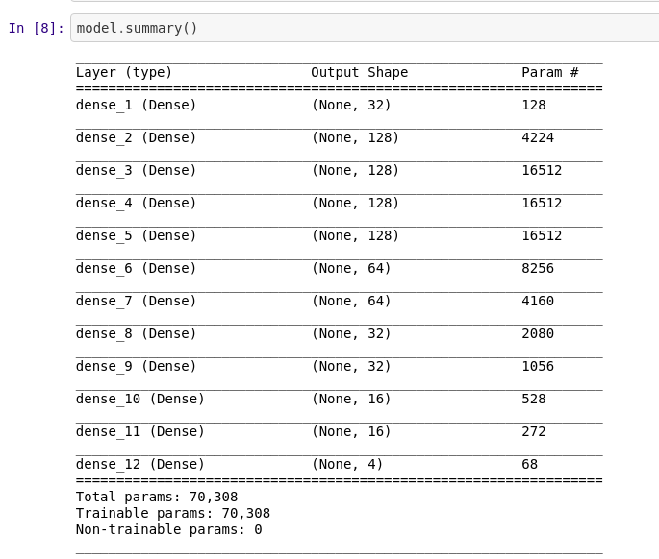
Dense layer Model architecture

Slide 17
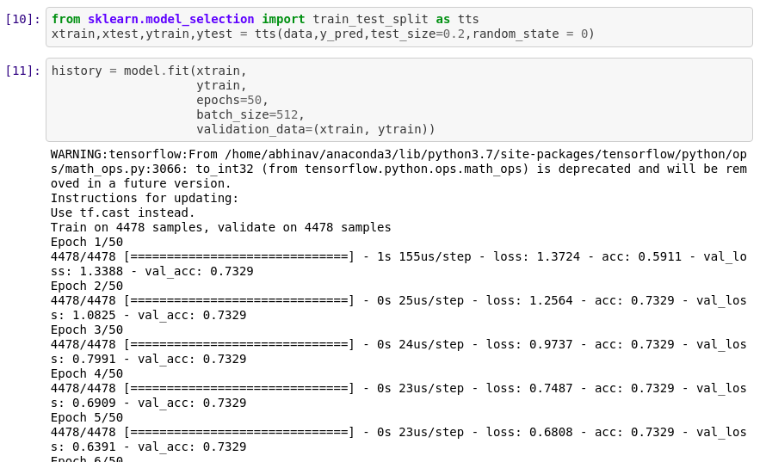

Slide 18
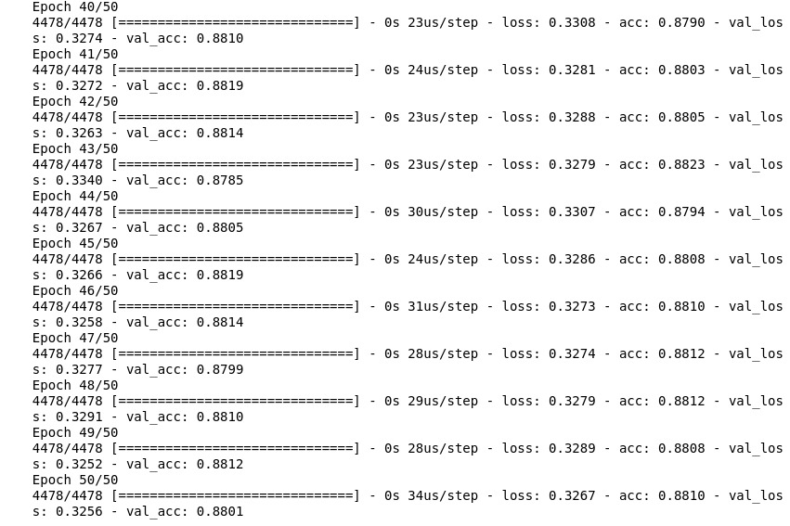

Slide 19
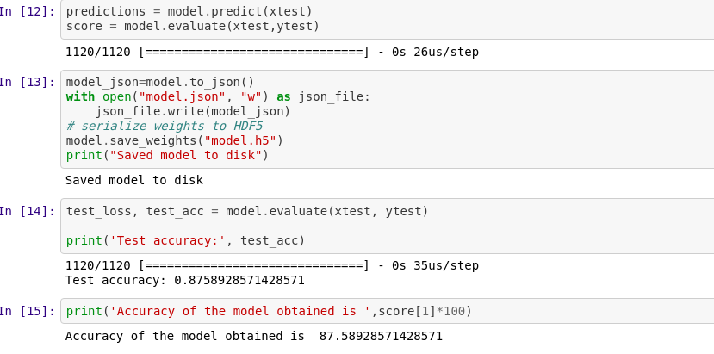

Slide 20
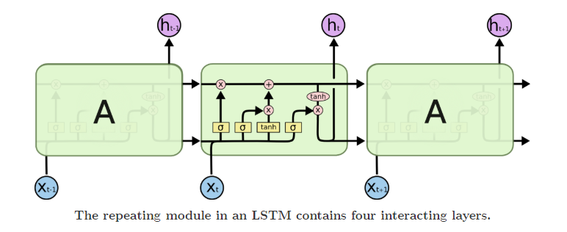
LSTM architecture

Slide 21
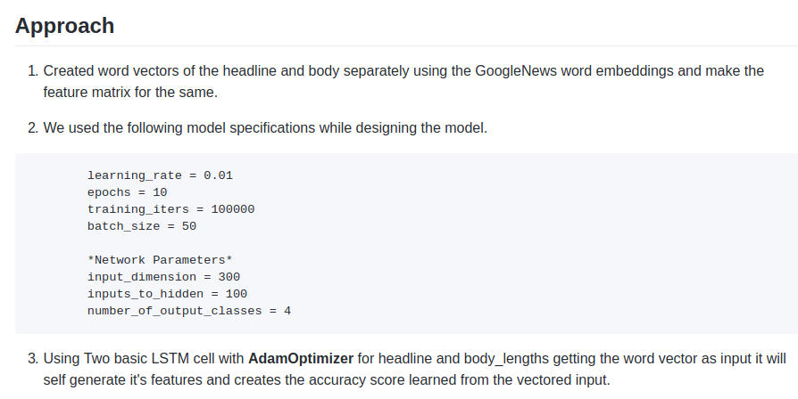

Slide 22
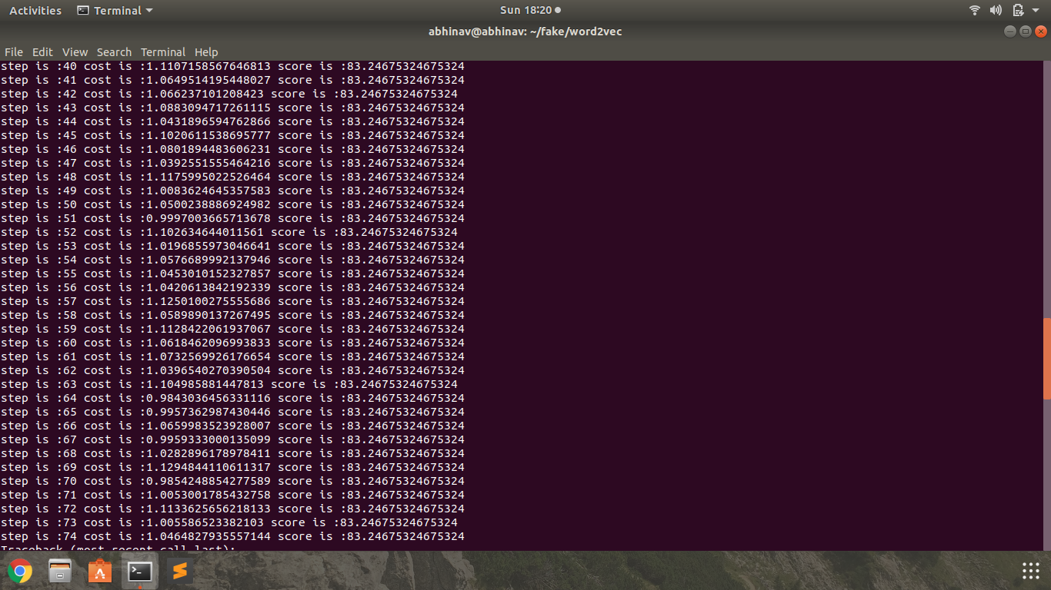
LSTM RESULT

Slide 23
Previous Works
Ferreira and Vlachos [5] used the “Emergent” dataset and applied Logistic Regression to identify compare rumored claims against news articles that had been previously labeled by journalists with the goal of predicting the stance of the article towards the rumor.
This team summarized each article into a headline and used a logistic regression model with features representing the article and claim to classify the combination of article and claim as either “for,” “against,” or “observing,” with a final accuracy level of 73%.

Slide 24
References
TensorFlow: Large-scale machine learning on heterogeneous systems, 2015. URL http://tensorflow.org/.
A. Agrawal, D. Chin, and K. Chen. Cosine siamese models for stance detection, 2017. URL http://web.stanford.edu/class/cs224n/reports/2759862.pdf
B. Galbraith, H. Iqbal, H. van Veen, D. Rao, J. Thorne, and Y. Pan. A baseline implementation for FNC-1, 2017. URL https://github.com/FakeNewsChallenge/fnc-1-baseline.
N. Srivastava, G. Hinton, A. Krizhevsky, I. Sutskever, and R. Salakhutdinov. Dropout: A simple way to prevent neural networks from overfitting. Journal of Machine Learning Research, 2014.
Stance Detection in Fake News: A Combined Feature Representation.Bilal Ghanem,Paulo Rasom

