Slide 1
Balanced Clustering Contrastive Learning for Long-tailed Visual Recognition
Springer Pattern Analysis and Applications (2025)
Presented by:- Abhinav Kumar Jha (cs23mtech15001)
TA:- Khin Cho Win
Course Instructor:- Prof C. Krishna Mohan

Slide 2
CONTENT
Problem statement
Challenges
Previous Works
Approach
Architecture
Loss Function
Dataset Details
Implementation Setup
Evaluation Metrics
Limitations
Results
Future Work
References

Slide 3
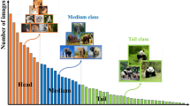
PROBLEM STATEMENT
To develop an approach to effectively learn balanced feature representations in long-tailed visual recognition.
In Long Tailed distributions head classes dominate the training data, and tail classes suffer from severe data scarcity, leads to poor generalization.

Slide 4
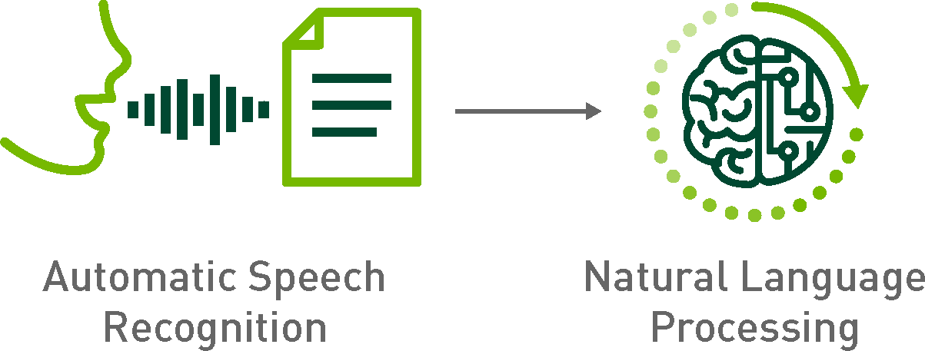

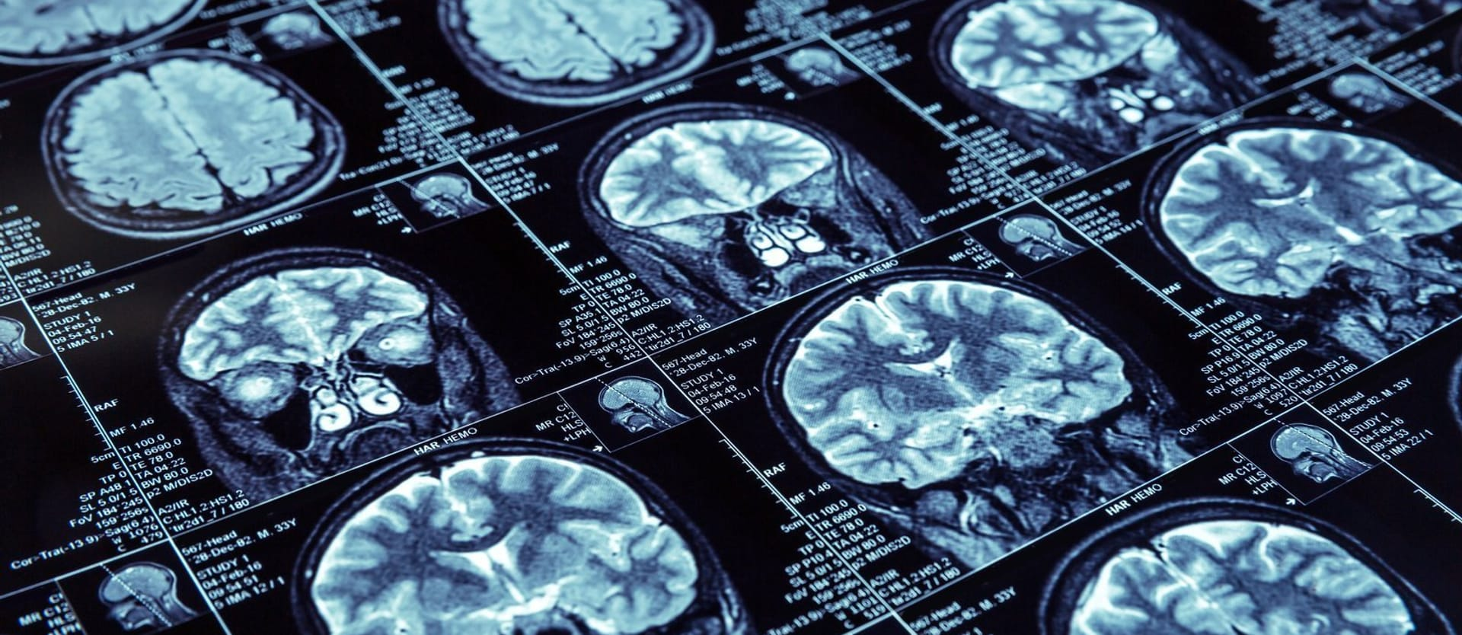
Applications
Natural Language Processing
Fraud Detection
Medical Diagnosis & Healthcare

Slide 5
CHALLENGES
Model Biases towards Head Classes: Standard Cross entropy loss minimizes overall loss which prioritizes head classes
Improper Feature Learning for Tail Classes: Underrepresentation of tail class samples and improper representations
Difficulty in Hard Negative & Hard Positive Mining: Not enough diversity, makes hard sample mining difficult.
Overfitting on Tail Classes: Memorization of tail classes due to oversampling instead of learning general features resulting in poor generalization

Slide 6
PREVIOUS WORKS
Re-Sampling and Re-Weighting
(Peng, H et al., 2023. Dynamic re-weighting for long-tailed semi-supervised learning):
Over-samples minority classes or giving more importance to minority classes during training to counteract imbalance.
Balanced Contrastive Learning (BCL)( Zhu J Et. al (2022) Balanced contrastive learning for long-tailed visual recognition )
Introduces a balanced contrastive loss function to improve visual recognition in long-tailed datasets.
Uses class-complement to ensure every class appears in each mini-batch, improving representation learning.
Parametric Contrastive Learning (PaCo) (Cui J, Zhong Z, Liu S, Yu B, Jia J (2021) Parametric contrastive learning)
Uses class-wise learnable centres to rebalance optimization in contrastive learning.
Addresses the issue of tail classes clustering too closely with similar classes.
Enhances feature separation for minority classes

Slide 7
RELATED WORKS (CONTD.)
Adaptive Hierarchical Representation Learning (AHRL)(Li B (2022) Adaptive hierarchical representation learning for long-tailed object detection )
Implements hierarchical partitioning of the feature space
Uses multi-scale representation learning to ensure robust tail class recognition.
Joint Representation and Classifier Learning (JRCL)(Guan Q, Li Z, Zhang J, Huang Y, Zhao Y (2023) Joint representation and classifier learning for long-tailed image classification)
Tackles the joint problem of feature learning and classifier optimization in LT scenarios.
Binary distribution consistency loss (to ensure tail class generalization).Multi-classification loss (to improve classifier robustness).

Slide 8
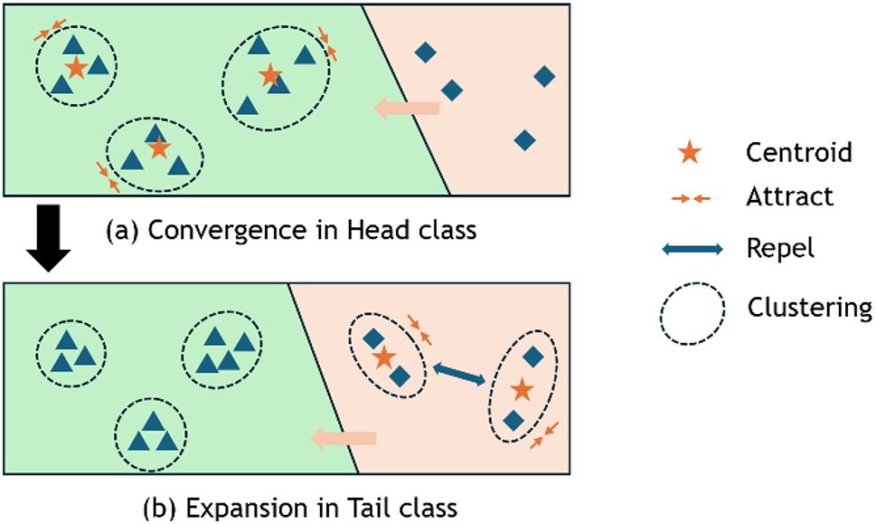
APPROACH -BCCL
Convergence in Head Class
Head classes (green region) have abundant samples, forming compact and well-clustered feature representations.
Centroids (stars) pull similar samples closer (dashed arrows) for intra-class consistency so as to minimize Centroid Loss
Expansion in Tail Class
Tail classes (peach region) suffer from feature collapse due to fewer samples.
Introduces Centroid Loss which diverges the feature space for tail classes
More equitable distribution of feature space reduces dominance of head classes.

Slide 9
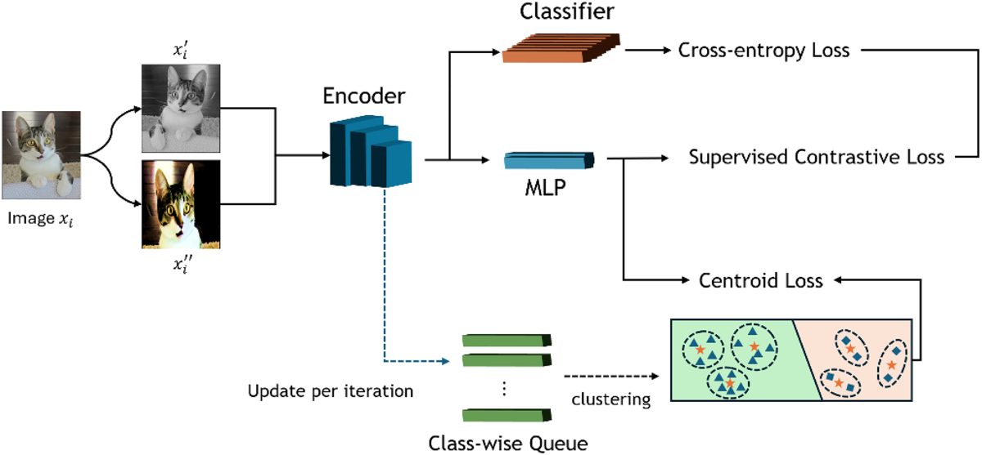
ARCHITECTURE
📌 Key Components
🔹 Input & Augmentation
🔹 Feature Extraction: Encoder extracts relevant features from input images
🔹 Class wise Queue based Clustering and Centroid Extraction: : Applies k-means clustering to fixed length queue and generate multiple centroids per class.
📌 Multi-Objective Training
✅ Cross-Entropy Loss: Trains classifier for accurate predictions.
✅ Supervised Contrastive Loss: Pulls similar samples together, pushes different ones apart.
✅ Centroid Loss: Uses clustering to balance head and tail class feature spaces.
Figure : BCCL Architecture

Slide 10
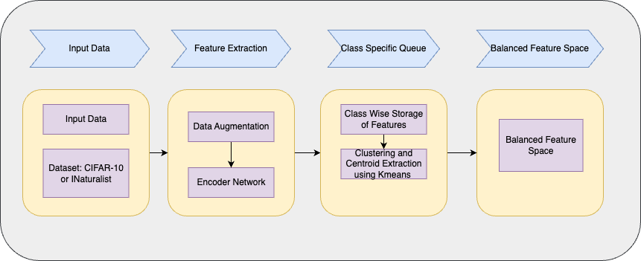
ARCHITECTURE-CONTINUED
Figure : BCCL Architecture

Slide 11

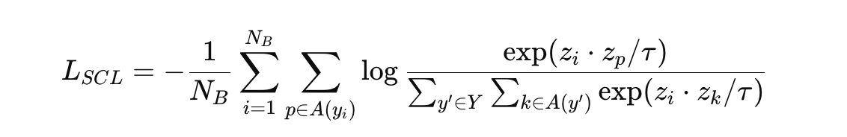

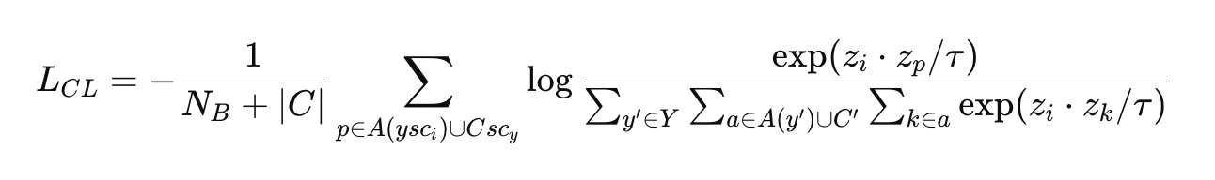
LOSS FUNCTION
Four key loss functions are used to address class imbalance and feature space bias in long-tailed distributions as follows
Feature vectors from the same class to be closer while separating different class samples.
Balances inter-class separability but may still introduce bias in long-tailed (LT) distributions
Compresses the feature space for head classes while expanding it for tail classes, ensuring a more balanced representation.
Addresses feature space imbalance by adjusting the distances between feature centroids and samples.
Reduces bias introduced by SCL, making feature distribution more uniform across classes.

Slide 12

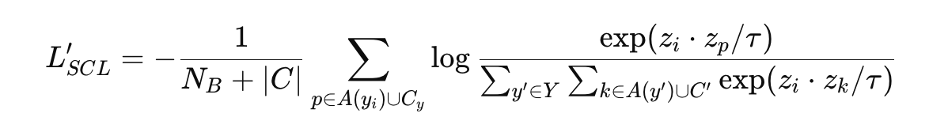

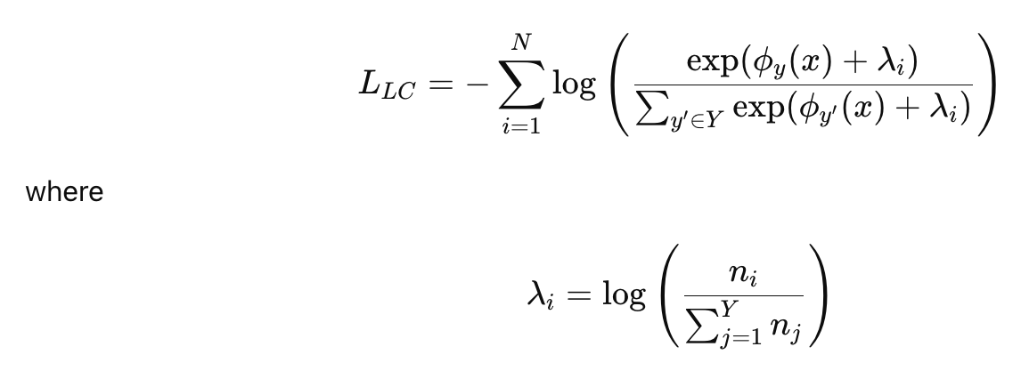
LOSS FUNCTION-CONTINUED
Adjusts mini-batch class imbalance by incorporating class-wise centroids into the contrastive loss.
Ensures that all classes contribute to the learning process, preventing class dominance in loss computation.
Helps mitigate underrepresentation of rare classes in mini-batches.
Mitigates classifier bias caused by class imbalance in long-tailed datasets.
Adjusts decision boundaries in both training and testing phases, making classification fairer.
Ensures that rare classes are not overshadowed by frequent classes.

Slide 13

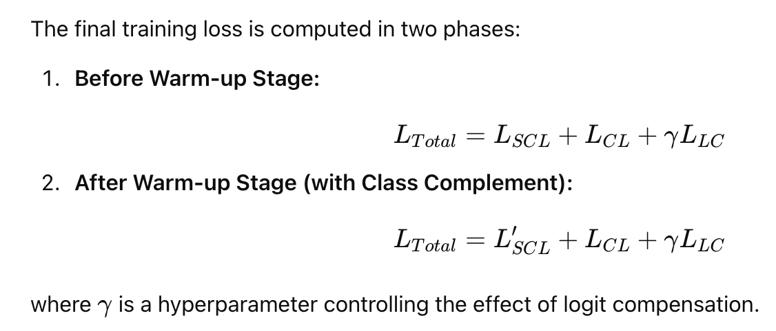
LOSS FUNCTION-CONTINUED
Early-stage features are noisy and not all classes appear in mini-batches therefore a warm up stage is needed to improve feature representations and ensure reliable clustering.
Before warm-up: SCL + LC for strong features, reduced classifier bias.
After warm-up: Lscl + CL for balanced feature space, better class separability.

Slide 14
DATASET DETAILS
The paper evaluates its proposed BCCL method on four long-tailed datasets
Dataset | Base Dataset | # Classes | Total Images | Training Set | Testing Set | Imbalance Ratio (IR) | Distribution Type
CIFAR-10-LT | CIFAR-10 | 10 | 60,000 | 50,000 | 10,000 | 100, 50, 10 | Synthetic LT
CIFAR-100-LT | CIFAR-100 | 100 | 60,000 | 50,000 | 10,000 | 100, 50, 10 | Synthetic LT
ImageNet-LT | ImageNet | 1,000 | 186,160 | 115,846 | 50,000 | Using Pareto Distribution Alpha=αp = 6. | Real-World LT
iNaturalist 2018 | iNaturalist | 8,142 | 437,513 | - | - | - | Real-World LT

Slide 15
Implementation Setup
Dataset | Classes | Model | Batch Size | Epochs | Optimizer | Learning Rate | Weight Decay | Warm-up Stage
CIFAR-10-LT | 10 | ResNet-32 | 512 | 200 | SGD (momentum 0.9) | 0.15 (cosine decay) | 5e-4 | First 20 epochs
CIFAR-100-LT | 100 | ResNet-32 | 512 | 200 | SGD (momentum 0.9) | 0.15 (cosine decay) | 5e-4 | First 20 epochs
ImageNet-LT | 1,000 | ResNet-50 | 256 | 100 | SGD (momentum 0.9) | 0.2 (cosine decay) | 5e-4 | First 10 epochs
iNaturalist 2018 | 8,142 | ResNeXt-50-32 × 4d | 256 | 100 | SGD (momentum 0.9) | 0.2 (cosine decay) | 1e-4 | First 10 epochs

Slide 16
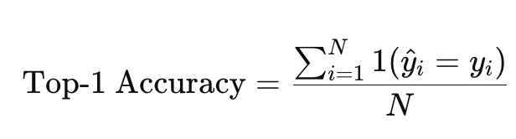
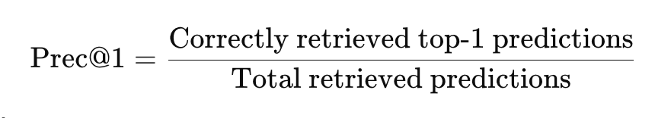

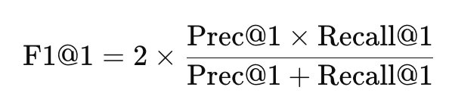
EVALUATION METRICS
Top-1 Accuracy:
Precision @1
Recall @1
F1 Score @1

Slide 17
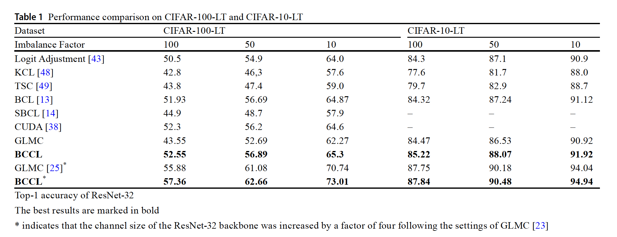
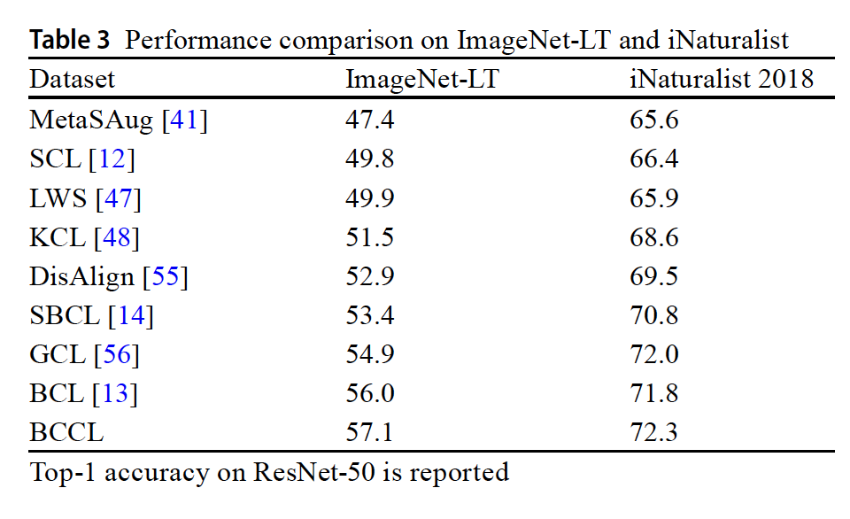
RESULTS

Slide 18
LIMITATIONS
Dependency on Initial Feature Representations: In the early stages of training, the feature representations are not well-formed, requiring a warm-up phase. If not properly handled, this phase may impact convergence and model stability.
Scalability to High-Dimensional Features: Applying k-means clustering on high-dimensional feature spaces may introduce inefficiencies, and the quality of clustering could degrade as the number of classes increases
Hyperparameter Sensitivity: The effectiveness of BCCL depends on hyperparameters like queue size M and logit compensation factor . Fine-tuning these values is necessary, which can be time-consuming
Computational Overhead: The queue-based clustering and centroid extraction process require additional memory and computation, making it resource-intensive specially for large scale datasets

Slide 19
FUTURE WORK
Re-generation of results as mentioned in the paper
Applying the concepts developed on other domains with imbalanced feature space for e.g facial expression detection.
Work on improving on the limitations as present in the current approach

Slide 20
REFERENCES
Chu, P., Bian, X., Liu, S. and Ling, H., 2020. Feature space augmentation for long-tailed data. In Computer Vision–ECCV 2020: 16th European Conference, Glasgow, UK, August 23–28, 2020, Proceedings, Part XXIX 16 (pp. 694-710). Springer International Publishing.Zhu J, Wang Z, Chen J, Chen YP, P, Jiang YG (2022) Balanced contrastive learning for long-tailed visual recognition
Hou, C., Zhang, J., Wang, H. and Zhou, T., 2023. Subclass-balancing contrastive learning for long-tailed recognition. In Proceedings of the IEEE/CVF International Conference on Computer Vision (pp. 5395-5407).
Cui, J., Zhong, Z., Liu, S., Yu, B. and Jia, J., 2021. Parametric contrastive learning. In Proceedings of the IEEE/CVF international conference on computer vision (pp. 715-724).
Cui, J., Zhong, Z., Liu, S., Yu, B. and Jia, J., 2021. Parametric contrastive learning. In Proceedings of the IEEE/CVF international conference on computer vision (pp. 715-724)
Guan, Q., Li, Z., Zhang, J., Huang, Y. and Zhao, Y., 2023. Joint representation and classifier learning for long-tailed image classification. Image and Vision Computing, 137, p.104759.

