Slide 1

About me
Currently working as Associate Tech Lead @Publicis Groupe
Worked as Senior Software Design Engineer-Analytics @Newgen Software Technologies Limited
B.Tech in CSE from Jamia Millia Islamia.

Slide 2
Document Information Extraction
Objective: To discuss various document information extraction problems and approaches to solve them for different document types using machine learning.

Slide 3
Sectors Impacted
Finance and Banking
Healthcare and Life Sciences
Legal and Compliance
Ecommerce and Retail
Insurance

Slide 4
Types of Documents
Documents
Structured
Unstructured
Semi Structured

Slide 5
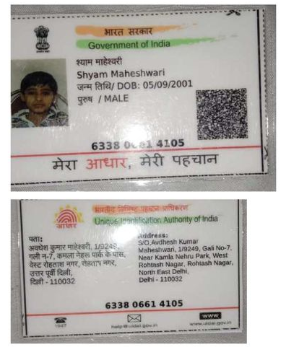
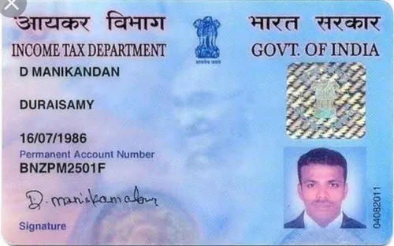
Structured Documents
Has consistent layout and follow a particular structure for key and associated value .
Aadhar card
Driving License
Pan Card
Ration Card,etc

Slide 6
Approach1- Template/Location based OCR
Documents
Template Matching
Preprocessing
Extraction
Template Creation
Pros
Less complex and fast implementation
Cons
Lots of Manual work in template creation
Coordinate value varies as the pixel of the image changes
Not robust to changes in structure/templates

Slide 7
Approach2-Text detection using YOLO
Image Division: The input image is divided into a grid of cells, typically with a fixed size (e.g., 13x13 or 19x19 grid).
Anchor Boxes: YOLO determines a set of anchor boxes of different shapes and sizes using techniques like k-means clustering
Predictions:
For each bounding box, YOLO predicts the following information:Coordinates: (x, y) of the box's center, width (w), and height (h).
Confidence Score: Represents the probability of the box containing an object.
Class Probabilities: Probability distribution over different object classes.

Slide 8
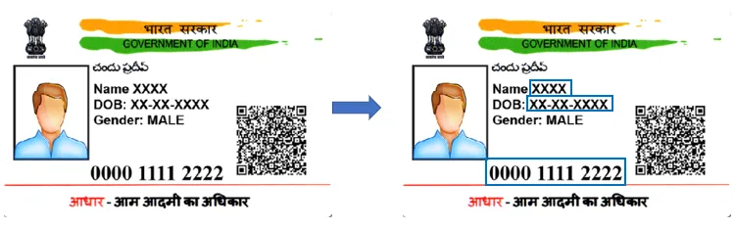
Stage 1: Annotating Data

Slide 9
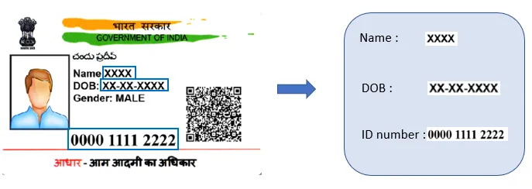
Model training - YOLO Step-2

Slide 10
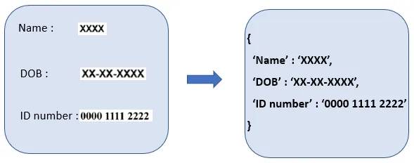
Model Inference - YOLO Step-3

Slide 11
Advantages and Drawbacks- YOLO
Pros
Runs fast as only single time pass of an image is done
Robust to layout changes
Works well with low resolution images
Cons
Does not work well in detecting small objects/text
Does not carry the semantic textual understanding

Slide 12
Unstructured Documents
Relevant information is stored in the sentences,paragraphs and does not follow any rules,format or any spatial structure
Contracts
Drafts
Reports
Articles

Slide 13
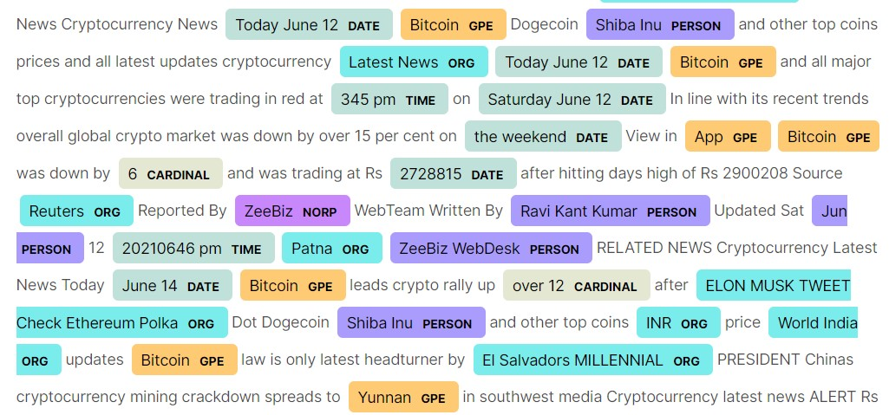
Approach1 – Named Entity Recognition
It involves identifying named entities in text and extracting relevant information associated with those entities

Slide 14
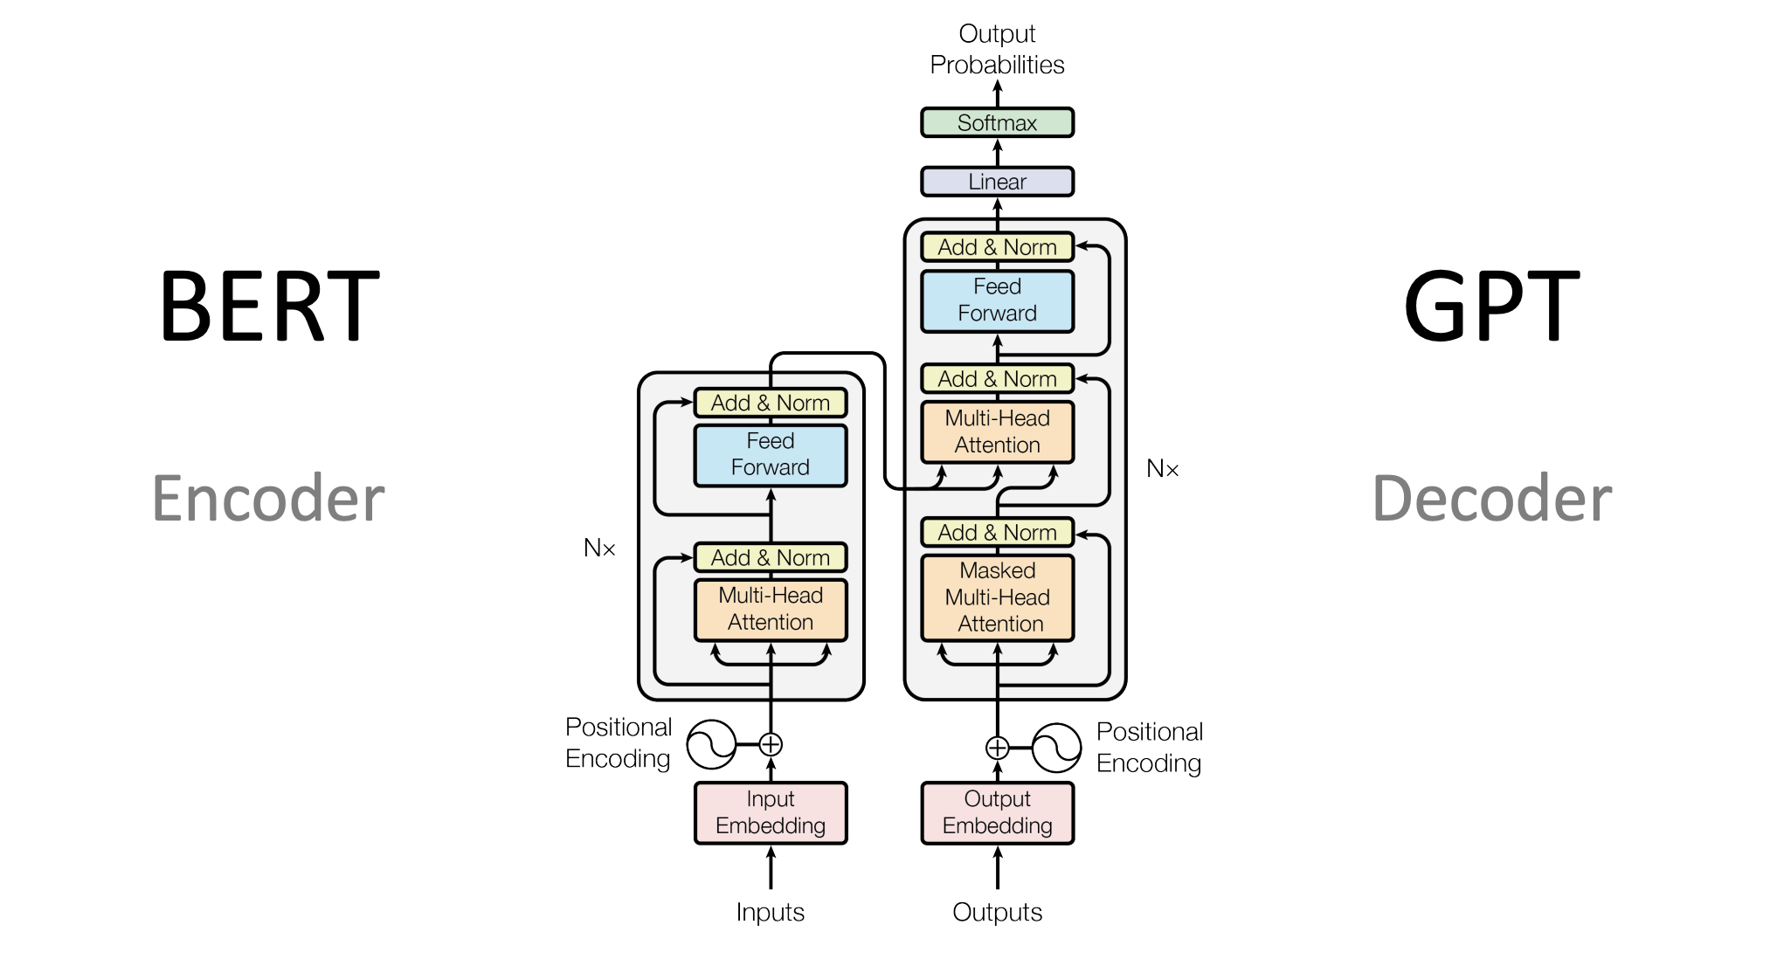
Approach 2- Large language Models
Large language models, such as BERT, GPT-3 can be leveraged for information extraction from documents by combining their natural language processing capabilities with additional techniques.
BERT can be used for Question Answering, NER etc.
GPT models can be used for text generation, filling up the blank fields in a draft/contract documents.

Slide 15
Semi Structured Documents
Forms like Form16,Form-2106
Certificates
Insurance Certificates
Certificate of Origin
Certificate of Lending
Bills
Bill of Lading
Bill of Exchange

Slide 16
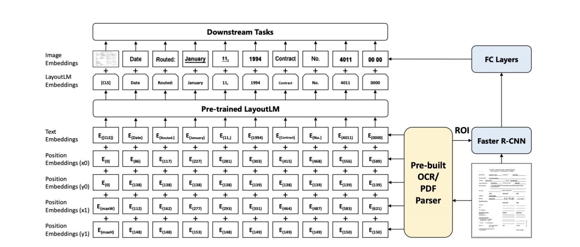
LayoutLMV2
It combines the power of pretrained language models with visual information to understand and extract meaningful information from documents
It does information extraction in following steps
Image Processing: does the of the document image
Creating Text and Visual Embeddings: It uses BERT for creating text embeddings and F-RCNN for Visual Embeddings
Spatial Encoding: It encodes the spatial features such as coordinates, bounding boxes, or relative distances between text and visual elements.
Token-Level Classification: performs token-level classification to identify the type or category of each token in the document
Entity Extraction: extracts entities or information from the document based on the token-level classification and context.

Slide 17
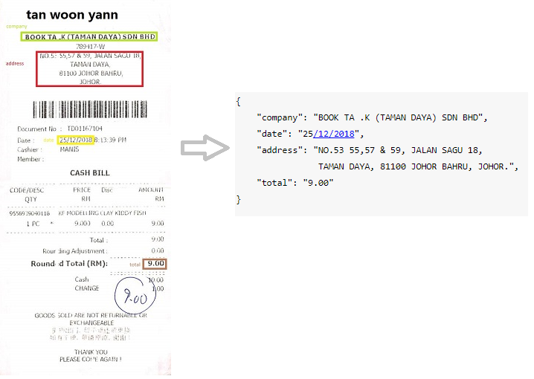
Why LayoutLMV2
Integrated Text and Layout Understanding: LayoutLM combines the power of pretrained language models with visual information and spatial layout understanding.
End-to-End Approach: It encompasses tasks such as text recognition, object detection, entity recognition, and relationship extraction
State-of-the-Art Performance: LayoutLM has achieved state-of-the-art performance on various benchmarks and competitions related to document understanding and information extraction.

Slide 18
Address Extraction -DBSCAN
DBSCAN((Density-Based Spatial Clustering of Applications with Noise) is used to group data points(i.e ocr coordinates) based on their density and helps in forming bigger relevant blocks which can be further used to filter corresponding information
Documents
OCR Coordinates
Clustering(DB Scan)
Bounding Blocks
Block wise Text Extraction

Slide 19

Q and A

