Slide 1
Document-Level Text Simplification USING SIMSUM APPROACH
Team:
Abhinav Kumar Jha (cs23mtech15001)
Shriram Pradeep (cs23mtech15020)

Slide 2
Content
Problem statement
Preprocessing techniques
Approach
Methodology
Evaluation Metrics
Implementation details
Results
Observations
Limitations
References

Slide 3
PROBLEM STATEMENT
Develop an approach for Document Level Simplification which involves simplifying documents consisting of several sentences by rewriting them into fewer or more sentences.
Text simplification is an important technique that aims to simplify a document to make it more understandable and accessible for people at different educational reading levels, while still retaining the content of the original text.
Challenges
Simplification must address complex vocabulary and sentence structure, while also condensing information across multiple sentences or paragraphs.
The system should not only simplify individual sentences but also summarize entire documents, ensuring that key information is retained, and readability is improved.
Currently, text simplification research has been more focused on sentence simplification. However, various applications in the real world require document level simplification rather than sentence level processing
Usage
Simplification is essential for aiding non-native speakers, individuals with reading difficulties (e.g., dyslexia), and in educational purposes.
It can also serve as a pre-processing step for other NLP tasks like:
Parsing
Information Extraction
Text Summarization
Machine Translation

Slide 4
EXAMPLE
Example | Original Text | Simplified Text
Example 1 | "Marsupial moles are highly specialized marsupial mammals, known from two species found in the Australian interior." | "Marsupial moles are mammals found in Australia.
Example 2 | "The Phoenix Dwarf is a dwarf irregular galaxy discovered in 1976 by Hans-Emil Schuster." | "Phoenix Dwarf is a galaxy discovered in 1976."

Slide 5
Preprocessing techniques
Preprocessing is crucial in both datasets to ensure that the model learns from high quality data. The key preprocessing steps in SIMSUM involve filtering and re-alignment
Filtering
Method: Any document pair where the simplified version is significantly longer than the complex version is filtered out.
Dataset Extracted out after filtering
Realignment (Using Keyword Extraction)
Purpose: Ensuring that the complex and simplified text pairs are semantically aligned.
Method: KeyBERT is used to extract keywords from both the complex and simplified versions of the documents. If the keywords from the complex and simplified versions do not overlap sufficiently, the pair is considered misaligned and is removed from the dataset.
Dataset Size after Filtering and Refinement
 | Training Set | Validation Set | Test Set
WikiDoc | 6,476 (13.54%) | 797 (13.33%) | 802 (13.42%)
D-Wikipedia | 39,017 (29.55%) | 894 (29.80%) | 2,377 (29.71%)
 | Training Set | Validation Set | Test Set
Wiki-Doc | 13,973 samples | 1,768 samples | 1,704 samples
D-Wikipedia | 97,074 samples | 2,183 samples | 5,836 samples

Slide 6
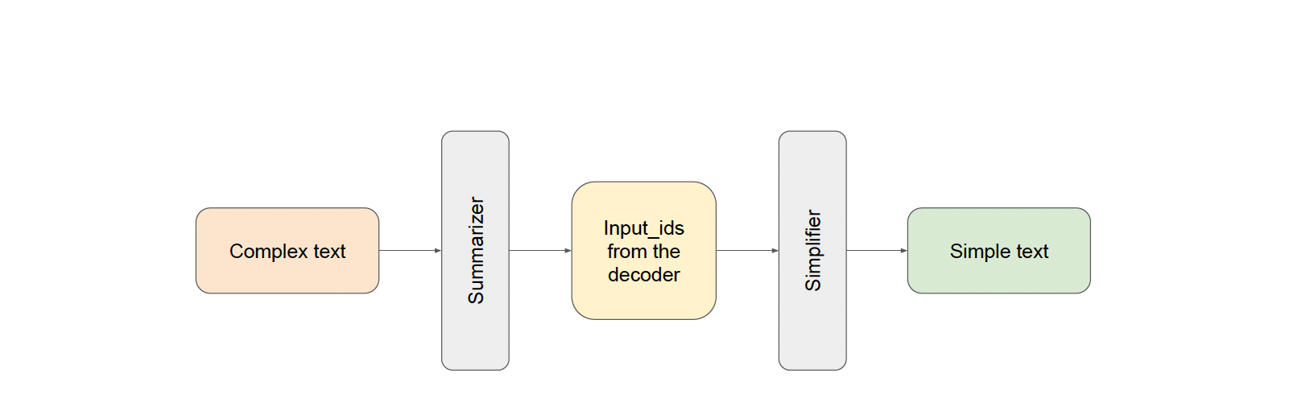
Approach -SIMSUM
SIM2SUM is a two-stage process for doing simplification and includes a Summarizer transformer and a Simplifier transformer, which jointly aim to address the document level simplification task trained in an end-to-end fashion.
The generated output of the Summarizer is fed to the Simplifier without tokenizer’s decoding
We use pre-trained T5 and BART models for both the summarization and simplification stages in SIM2SUM. The simplification stage is fine-tuned using the Wiki-Doc or Wiki Large datasets to enhance performance.

Slide 7
Keyword Prompting
Keyword Prompting is a technique used to guide the text simplification process by ensuring that the most important terms from the original text are preserved in the simplified version
It leverages KeyBERT, a BERT-based keyword extraction tool, to generate prompts using extracted keywords from input text.
Extracts top keywords using KeyBERT.Keywords are ranked based on their relevance scores.
Parameters:
top_n: Number of keywords to extract.
diversity: Controls the variety of extracted keywords.
Prompt Strategies:
1. kw_score :
Combines keywords with their relevance scores in the format: keyword:score.
Example: keyword1:0.85 keyword2:0.75 Input text.
2. kw_sep:
Joins keywords using a separator (</s>).
Example: keyword1 </s> keyword2 </s> Input text.
Parameters like top_n and diversity allow fine-tuning for different applications.

Slide 8

Loss function
One of the most common approaches for training sequence-to-sequence Transformer models is the use of the cross-entropy loss
This method can be improved with an additional loss term that forces the model to generate texts more similar to targets.
L1 represents the cross-entropy loss term
LCossim is the additional term added to generate texts similar to targets
λ > 0 is the hyperparameter for changing the degree of contribution of the additional term

Slide 9

Embedding similarity (Additional term)
Embedding similarity is introduced in SIMSUM to ensure that the simplified text generated by the Simplifier is semantically close to the summary generated by the Summarizer. The goal is to preserve the meaning while simplifying and summarizing the content.
Steps Involved in calculating embedding Similarity:
Summariser output: After the summarizer generates a summary from the complex document, the hidden state embeddings for the generated summary are extracted. These embeddings capture the meaning and context of the summary. It is represented by Hsum
Simplifier output: The target output is passed through the simplifier, and its hidden state embeddings are extracted. It is represented by Htgt
Cosine similarity: Our idea is to increase the similarity between the final output’s embeddings and the target’s embeddings during training.

Slide 10
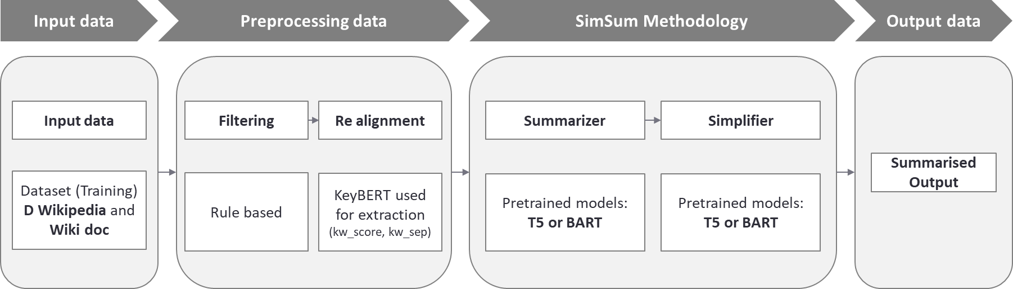
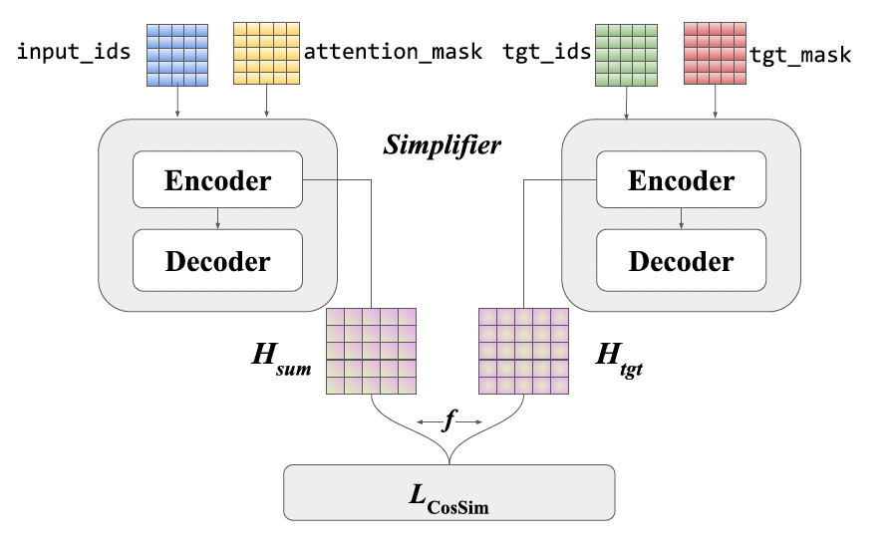
Methodology
Figure 1: Simsum Architecture
Figure 2 : The embedding similarity computation process

Slide 11

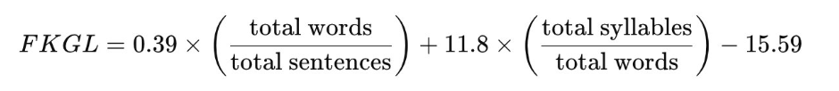
Evaluation Metrics
SARI: Measures the quality of simplifications by comparing the system's output to both the original sentence (complex version) and the reference simplified sentences. The SARI score is computed based on the precision and recall of the sentences that are kept, added, and deleted.
Sari = (F1_add + F1_keep + P_del) / 3
where F1_add: n-gram F1 score for add operation F1_keep: n-gram F1 score for keep operation P_del: n-gram precision score for delete operation n = 4
FKGL Score: The FKGL score is a readability test designed to indicate how difficult a passage is to understand based on sentence length and word complexity.​ It estimates the U.S. school grade level required to comprehend a given text, based on sentence length and word complexity.​

Slide 12
Implementation details
The code was run on Google Colab as it took longer to run in local machines
T4 GPU machines are used. The specifications are:
Memory - 51 Gb
GPU - 15 Gb
We made 30 model runs with average run time of 3 hours 30 mins
The process took 6 days to complete for all the model architecture variations
Model was trained for 10 epochs for both T5 and BART with baseline and simsum architectures
Percentage of data used
Wiki-doc
Train – 10%
Validation – 50%
D-Wikipedia
Train – 2%
Validation – 10%
Leveraged the updated versions of baseline models which resulted in improved performance metrics

Slide 13
SIMSUM model performance compared with the baselines
 | D-Wikipedia |  | Wiki-Doc
Model name | SARI | FKGL | SARI | FKGL
BART | 0.49 | 7.89 | 0.49 | 8.33
SimSum (BART) | 0.54 | 7.16 | 0.50 | 8.47
T5 | 0.48 | 7.72 | 0.49 | 8.13
SimSum (T5) | 0.51 | 7.47 | 0.50 | 8.04
Pre-trained models used:
BART baseline uses facebook/bart-base
BART simsum uses facebook/bart-base
Summariser model - ainize/bart-base-cnn
Simplifier model - facebook/bart-base
T5 baseline and simsum uses t5-base

Slide 14
SIMSUM model comparison of lambda values
 | D-Wikipedia |  | Wiki-Doc
Lambda | SARI | FKGL | SARI | FKGL
0 | 0.509 | 7.160 | 0.500 | 8.474
0.001 | 0.539 | 7.161 | 0.500 | 8.474
0.01 | 0.539 | 7.200 | 0.500 | 8.454
0.1 | 0.539 | 7.155 | 0.500 | 8.474
0.5 | 0.540 | 7.160 | 0.500 | 8.474
1 | 0.535 | 7.231 | 0.502 | 8.524
BART simsum is used to generate the above results for different lambda values of 0, 0.0001, 0.01, 0.1, 0.5, 1

Slide 15
SIMSUM model comparison of PROMPTING STRATEGY
 |  |  | D-Wikipedia |  | Wiki-Doc
Prompting strategy | Diversity | Top keywords used | SARI | FKGL | SARI | FKGL
kw_score | 0.5 | 5 | 0.550 | 6.971 | 0.511 | 8.452
kw_score | 0.7 | 5 | 0.544 | 7.015 | 0.511 | 8.449
kw_score | 0.9 | 5 | 0.547 | 7.030 | 0.511 | 8.454
kw_score | 0.5 | 6 | 0.548 | 7.031 | 0.511 | 8.465
kw_score | 0.7 | 6 | 0.546 | 6.968 | 0.511 | 8.419
kw_score | 0.9 | 6 | 0.546 | 6.968 | 0.511 | 8.465
BART simsum is used to generate the above results
Prompty strategy used is kw_score
Diversity values tested [0.5, 0.7, 0.9]
Top keywords used [5, 6]

Slide 16
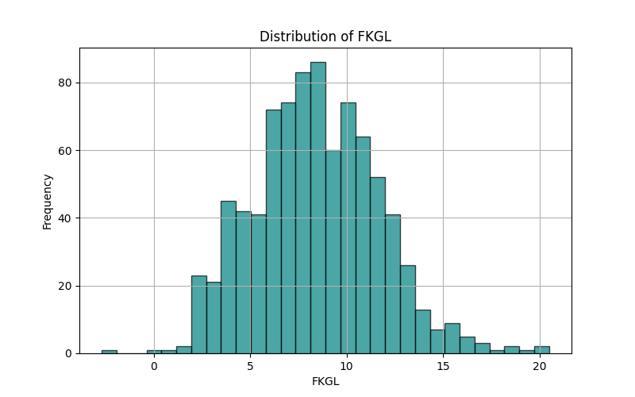
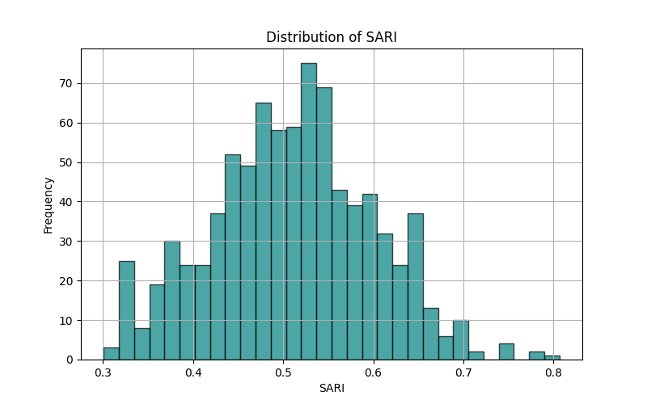
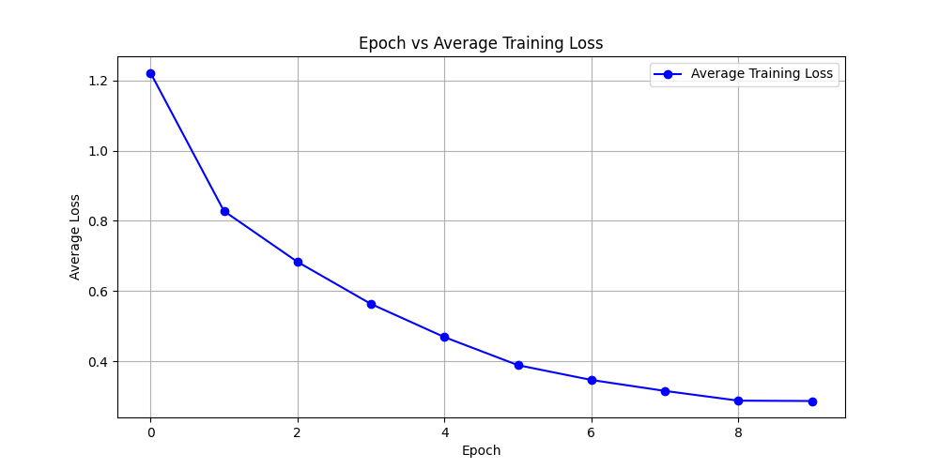
BART simsum on WIKI-DOC dataset
Distribution of FKGL scores
Distribution of SARI scores
Training loss across 10 epochs

Slide 17
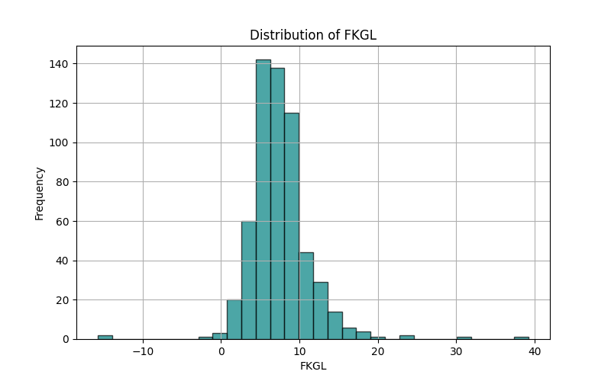
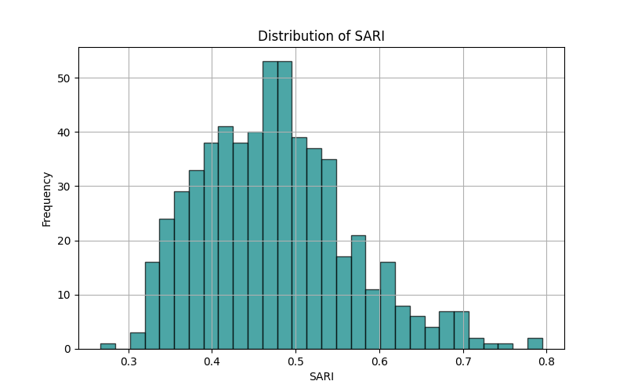
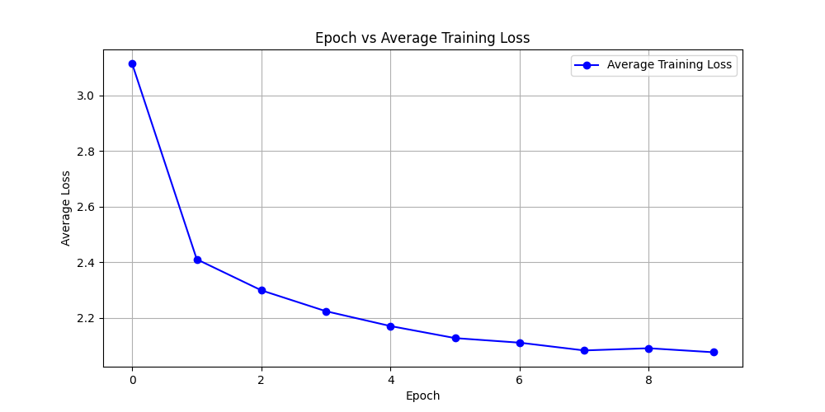
t5 simsum on d-wikipedia dataset
Distribution of FKGL scores
Distribution of SARI scores
Training loss across 10 epochs

Slide 18
Examples
Input | Output | Details
Puerto Cabezas ( Bilwi in Miskito ) is a municipality in , and capital of , the North Atlantic Coast department ( Regi√É n Aut√É noma del Atl√É ntico Norte ) of Nicaragua . The municipality and the entire region are indigenous lands . The city of Bilwi is part of The Community of Karata , including land north of Bilwi which borders The Community of Ten Communities . The owners are the various community groups who have demarcated their particular land areas . The Universidad de las Regiones Aut√É nomas de la Costa Caribe Nicarag√É 1\/4 ense ( URACCAN ) has a campus in Puerto Cabezas as well as in several other locations in RAAN and RAAS . The culture , like the rest of Nicaragua 's Caribbean coast , has a very prominent Caribbean influence . Hurricane Felix hit Puerto Cabezas on September 4 , 2007 , killing about 100 people . Puerto Cabezas is sister city to Burlington , Vermont , USA , and has been since the mid-1980s . They also have a sister city in Sweden , which is Lulea | Puerto Cabezas is a city in the state of Nicaragua in the United States of America. | The reference here is: Puerto Cabezas is a city in Nicaragua . SARI Score: 0.778942769768457 Dataset: Wiki-Doc
telescopium is a minor constellation in the southern celestial hemisphere , one of twelve named in the 18th century by french astronomer nicolas-louis de lacaille and one of several depicting scientific instruments . its name is a latinized form of the greek word for telescope . telescopium was later much reduced in size by francis baily and benjamin gould.the brightest star in the constellation is alpha telescopii , a blue-white subgiant with an apparent magnitude of 3.5 , followed by the orange giant star zeta telescopii at magnitude 4.1 . eta and pz telescopii are two young star systems with debris disks and brown dwarf companions . telescopium hosts two unusual stars with very little hydrogen that are likely to be the result of two merged white dwarfs : pv telescopii , also known as hd 168476 , is a hot blue extreme helium star , while rs telescopii is an r coronae borealis variable . rr telescopii is a cataclysmic variable that brightened as a nova to magnitude 6 in 1948 . telescopium also hosts the first known visible star system with a black hole , qv telescopii ( hr 6819 ) , which appears as a variable star with magnitude 5.32 to 5.39 . | telescopium is a minor constellation in the southern celestial hemisphere of the sun.it is the brightest star in the constellation of the same name.the constellation of telescopium has a diameter of about. | The reference here is: telescopium is a constellation in the southern sky . SARI Score: 0.792296296296296 Dataset: D-wikipedia

Slide 19
Observations
Simultaneous training of Summarizer and Simplification module results in better metrics beating the previous benchmarks,
Keyword Prompting strategy with optimum value of k=5 and div_score=0.5 improves the result focusing on relevant tokens.
All Simsum models outperform the both Bart and T5 finetuned baselines on all metrics
Simsum model with BART as the baseline outperforms the other variations
Optimum value of Lambda ranges between 0.001 to 0.5
Simplifier results in better SARI and FKGL scores on D-Wiki i.e shorter avg length per article

Slide 20
Limitations
Bias in Training Data: As the training data consists less number of sentences with large token length hence simplification operation may be biased towards shorter sentences
Metrics Misalignment: Common evaluation metrics like BLEU,FKGL may not fully capture the quality of simplifications, as they prioritize surface-level similarity over readability or informativeness
Difficulty with Complex Language: The model may struggle to simplify dense, technical, or metaphorical language.
User-Specific Preferences: The model might not account for individual user preferences, such as the desired level of simplification or focus on specific details.
Scalability Issues: Handling large-scale datasets or diverse languages may require substantial computational resources and fine-tuning.

Slide 21
references
Sim2Sum SIMSUM: Document-level Text Simplification via Simultaneous Summarization(Sofira et al)
Document-Level Text Simplification: Dataset, Criteria and Baseline(Sun,Wan)
Evaluating Document Simplification: On the Importance of Separately Assessing Simplicity and Meaning Preservation (CripWell et al)
Graph-based Model Using Text Simplification (Xu,Pan 2021)

