Slide 1
Task 4: Dashboard Design
Data Analyst Internship
Abhinav Srivastava

Slide 2
Dataset Overview
Source: Kaggle Sales Dataset https://www.kaggle.com/datasets/shantanugarg274/sales-dataset
Total Rows: 1194
Key Fields: Amount, Profit, Category, Sub-Category, State, City, Date, Profit Margin (Made with Dax)
Data Period: 2021 to 2025

Slide 3
KPIs Chosen
Total Sales (SUM of Amount)
Total Profit (SUM of Profit)
Total Quantity (SUM of Quantity)
Profit Margin (Profit / Sales)

Slide 4
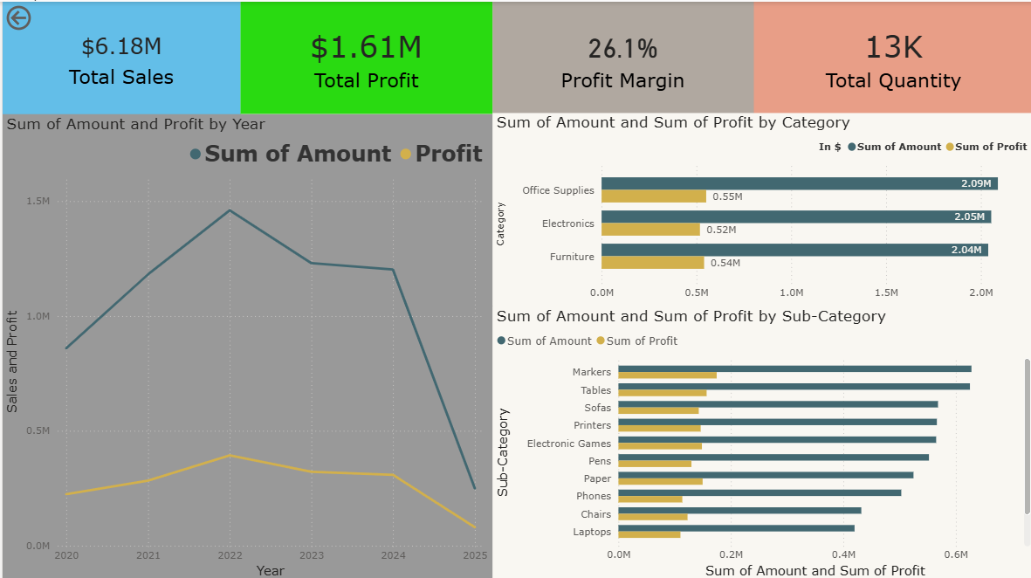
Dashboard Snapshots
KPIs and Trends

Slide 5
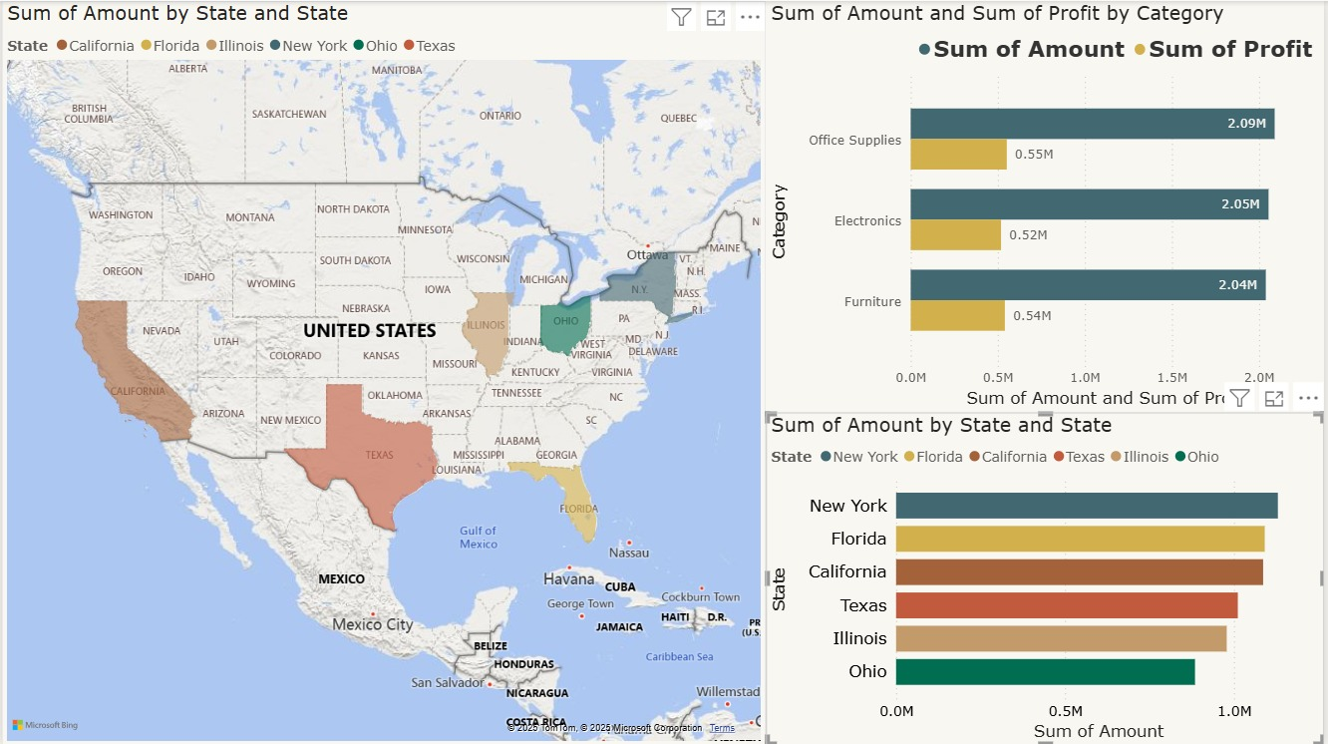
Sales By Location and Category

Slide 6
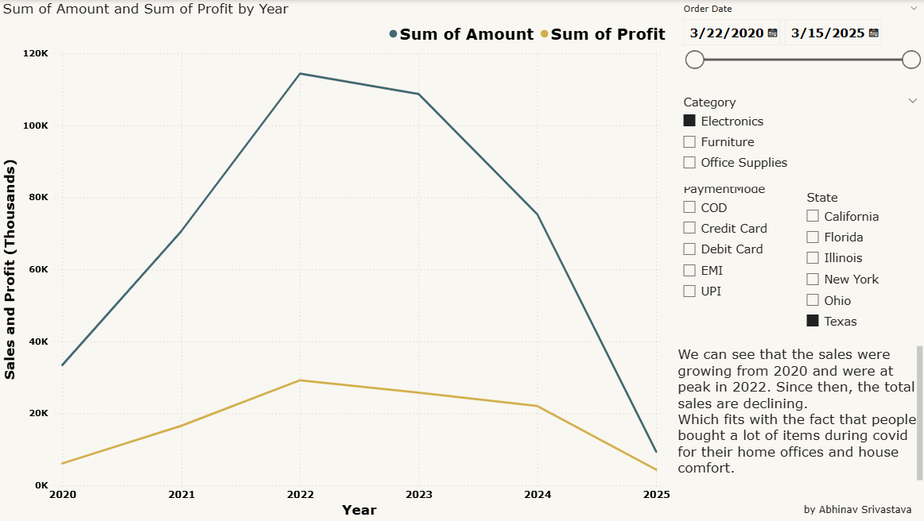
Interactive Slicers

Slide 7
Key Insights
Furniture had the highest profit margin among all categories.
Sales peaked in December 2022.
Debit Card was the most used payment method.
Top-performing states: New York and Florida
New adveritising strategies might be helpful to attract customers.

Slide 8
Tools & Skills Used
Power BI: Data modeling, DAX measures, visual design
Data Analysis: KPI selection, trend & category analysis
Visualization Principles: Consistency, interactivity, clarity

