Slide 1
STOCK
ANALYSIS
PROJECT BY: ABHINAV ANIL AWCHITTE

Slide 2
PROBLEM STATEMENT
To Understand The Risk Associated With Stocks , There Must Be Proper Analysis Of Stocks Before Buying And Selling It.
Exploring Just Tip Of The Iceberg For The Stock Market Analysis As Technical Analysis Of Stock Is A Vast Field

Slide 3

TYPES OF ANALYSIS
Fundamental analysis evaluates stocks by attempting to measure their intrinsic value and industry conditions to the financial strength and management of individual companies. Earnings, expenses, assets,
Technical analysis dentify opportunities by looking at statistical trends, such as movements in a stock's price and volume

Slide 4
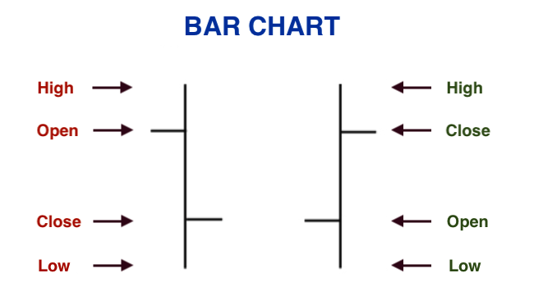
DATA DESCRIPTION
OPEN
HIGH
CLOSE
LOW
OPEN
HIGH
CLOSE
LOW

Slide 5
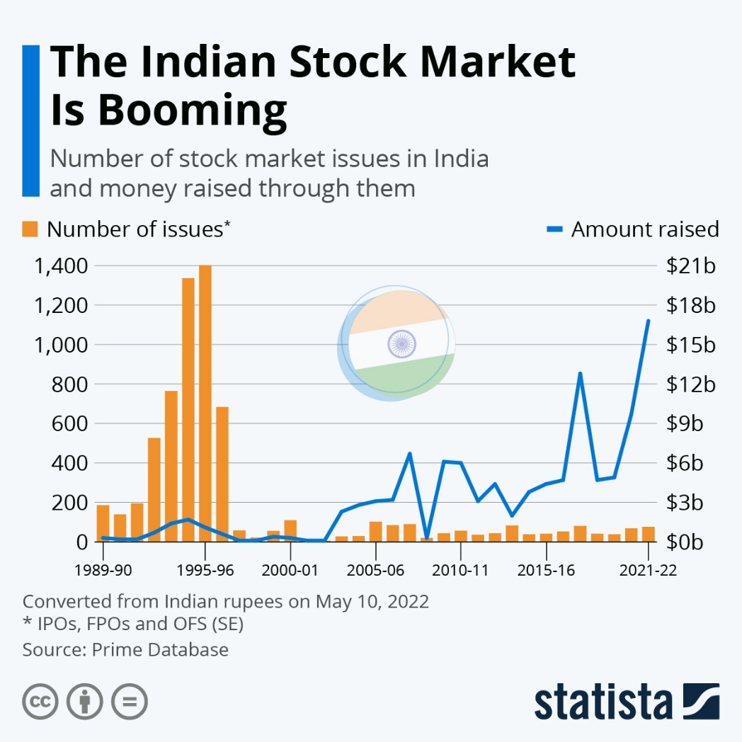
An index serves as a benchmark to measure the performance of the market and a stock with respect to the index. NSE index Nifty comprises of 50 stocks and BSE index Sensex comprises of 30 stocks .
As the value of the stocks within an index change, the index value also changes.

Slide 6
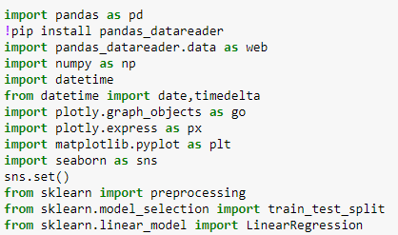
IMPORTING LIBRARIES:

Slide 7

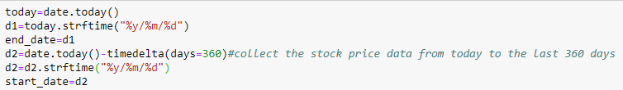
DATE AND TIME
equity derivatives expire on the last Thursday of each month. So rollovers can happen till the close of trading hours on that day. Most rollovers begin a week before expiry and end till the last minute. Usually, contracts are rolled over to the next month.
Looking a little deeper one may have takeaways in terms of the sectors & stocks that the participation is paying attention to.

Slide 8
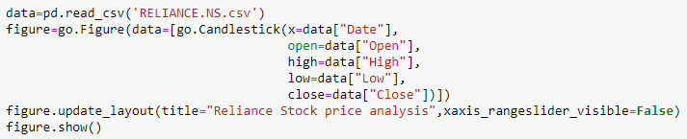
IMPORTING DATA:
OPEN
HIGH
CLOSE
LOW
OPEN
HIGH
CLOSE
LOW

Slide 9
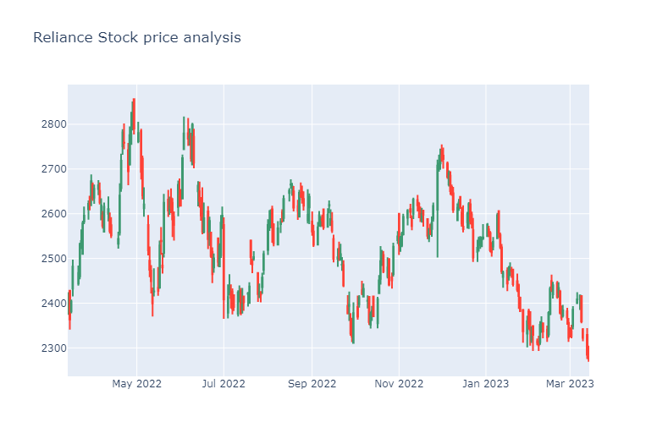
VISUALIZATION

Slide 10
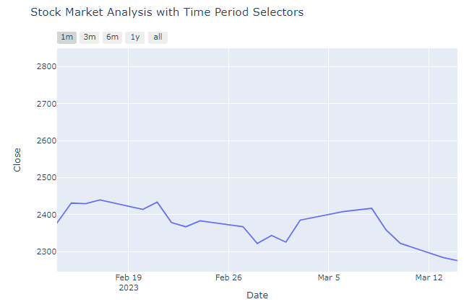
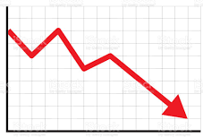

ANALYSIS OF STOCK
ONE MONTH BASED ANALYSIS

Slide 11
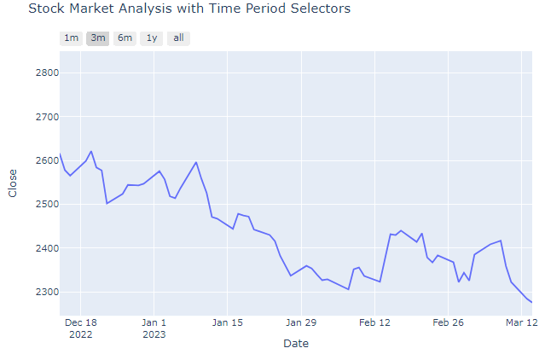

ANALYSIS OF STOCK
THREE MONTH BASED ANALYSIS

Slide 12
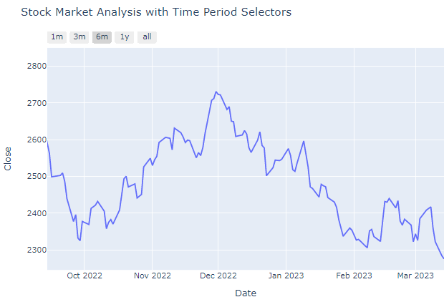



ANALYSIS OF STOCK
SIX MONTH BASED ANALYSIS

Slide 13
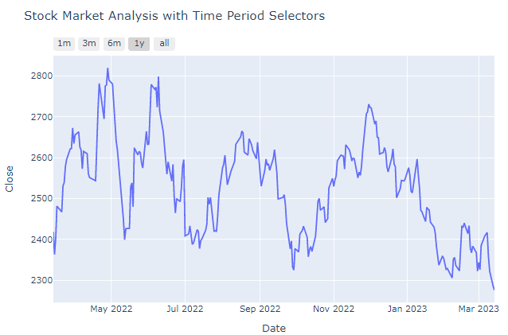

ANALYSIS OF STOCK
ONE YEAR BASED ANALYSIS

Slide 14
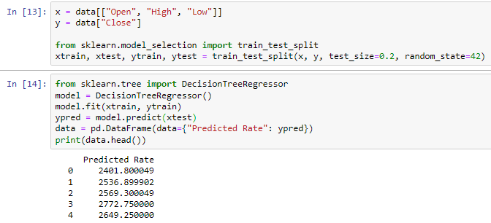
PREDICTION

Slide 15
REFFERNCE
https://finance.yahoo.com/quote/RELIANCE.NS?p=RELIANCE.NS&ncid=yahooproperties_peoplealso_km0o32z3jzm

Slide 16
THANK YOU

