Slide 1

PRICE ANALYSIS: AIRBNB CHICAGO LISTINGS
ABHINAV SACHDEVA

Slide 2
PROCESS FOLLOWED
Obtain the data
Subset the data
Clean the data
Exploring the data
Deciding the Dependent Variable
Univariate & Bivariate Analysis
Deciding on IV
Feature Engineering
Regression
Evaluate Results
Conclusion
Adding Extra Data
PREPARE DATA
ANALYZE DATA

Slide 3
DATA
Population: The data is taken from Inside Airbnb site which is sourced from publicly available information from the Airbnb site.
There’s no fixed time frame given for our data.
The original dataset had 5207 observations and 95 variables. Most of it was text, so, we ignored those.
We have randomly sampled our data from the population

Slide 4
DATA
4018 observation, 27 variables
Numeric Variables: 14 - price, number_of_reviews, availability_365, bathrooms - walkscore, no_of_crime_reported
Factor Variables: 13 - cancellation_policy, accomodates - chicago_region, gender, multiple_host
Control Variable

Slide 5
DATA CLEANING
Converted minimum of nights to 1 and More than 1
Converted cancellation policy to 3 levels – flexible, moderate, strict
Introduced Chicago region – East, West, North, South instead of analyzing on 50+ neighborhoods
Feature Engineering to bring in variables like gender, multiple hosts
Added external data- walkscore, number of crimes reported

Slide 6
LIMITATIONS
Time of the year of the Chicago listings not given. So, can’t take seasonality into account
Price has been taken at a single point of time
Sentiments of the reviews are not given

Slide 7
RESEARCH QUESTION
Which are the top 3 important factors that affect the price of a listing in a Chicago neighborhood ?

Slide 8
HYPOTHESES
The average number of reviews across the Chicago region is same
The cancellation policy is uniform across the gender of the hosts
The price of a listing in a Chicago region is higher when the number of reviews are more

Slide 9
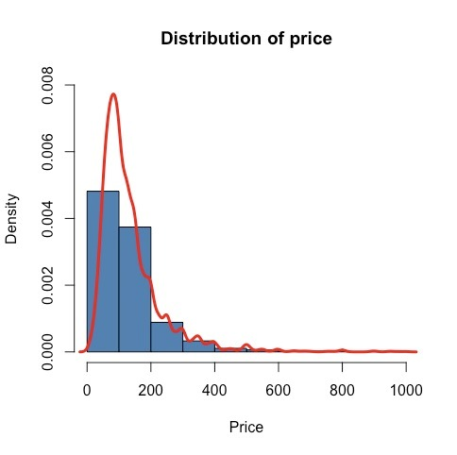
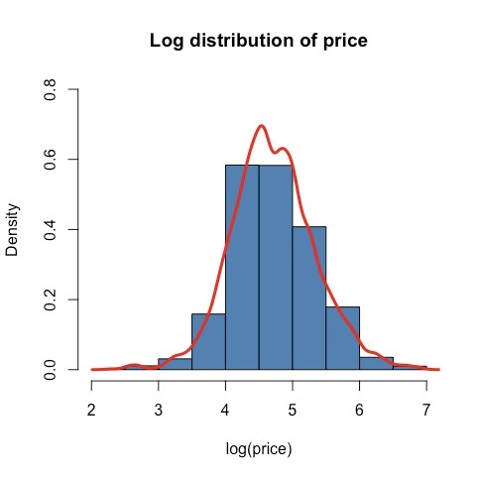
UNIVARIATE ANALYSIS
PRICE (Dependent Variable) -> Needs to be normally distributed to perform regression
RIGHT SKEWED
NORMAL
LOG - TRANSFORMATION

Slide 10
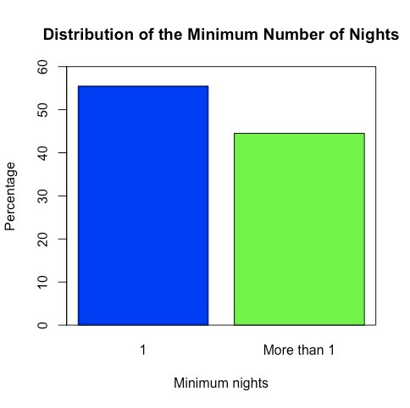
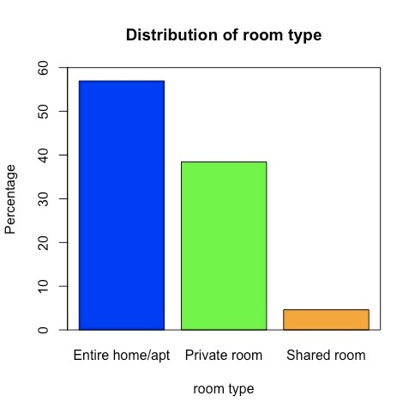
UNIVARIATE ANALYSIS

Slide 11
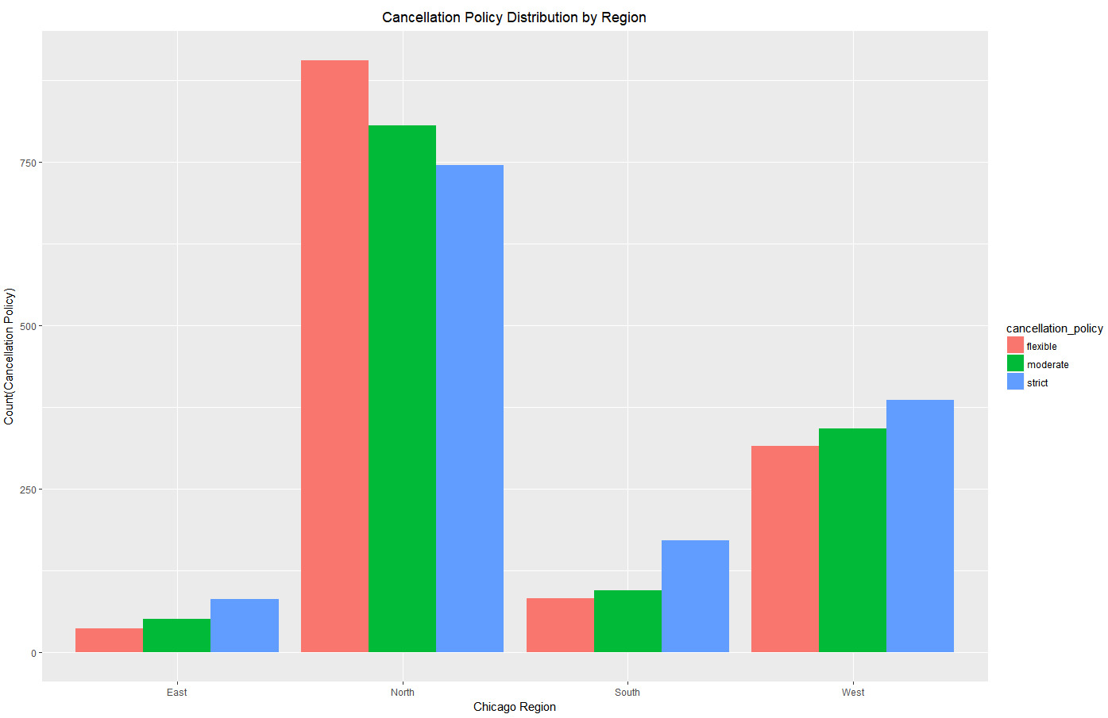
BIVARIATE ANALYSIS
CANCELLATION POLICY DISTRIBUTION BY REGION

Slide 12
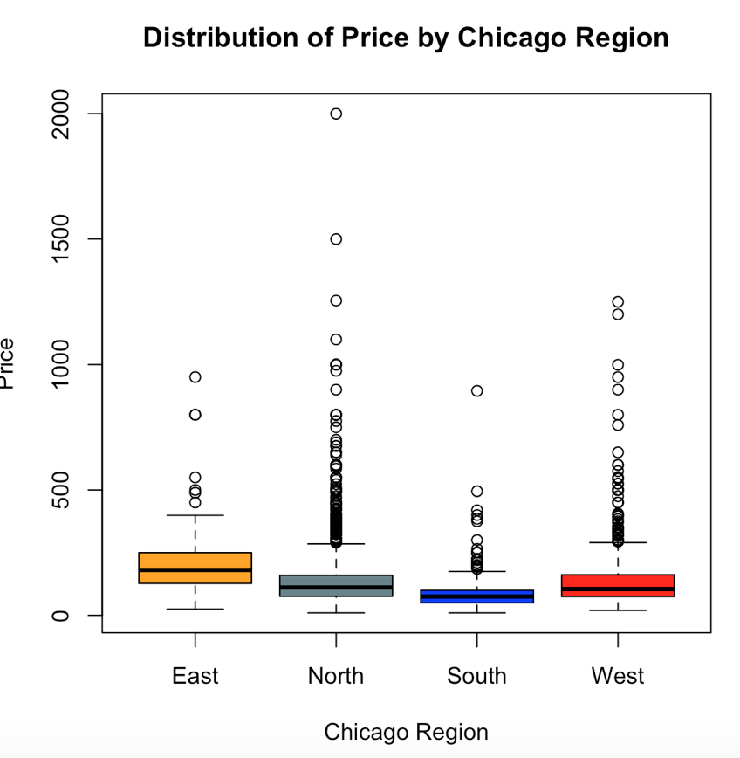
BIVARIATE ANALYSIS

Slide 13
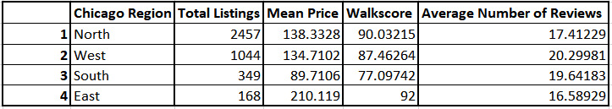
STATISTICAL SUMMARY

Slide 14
STATISTICAL TESTS FOR CHECKING HYPOTHESES
Hypothesis 1 -> H0: The average number of reviews across the Chicago region is same Ha: The average number of reviews across the Chicago region is not same
Used ANOVA for this. Obtained a p-value of 0.0207
Used the post-Tuckey to analyze further - Found out that only West – North region results were significant with p-value of 0.021 meaning that average number of reviews across West & North region are different.
Other regions had a high p-value, so, we fail to reject the null hypothesis

Slide 15
STATISTICAL TESTS FOR CHECKING HYPOTHESES
Hypothesis 2 -> The price of a listing in a Chicago region is higher when the number of reviews are more
For this, we just used the Correlation test to see if this was the case because we had no information about the sentiments of our reviews
We got a correlation coefficient of -0.1. Although, this isn’t very high, but atleast gives an idea that reviews probably were more on the negative side as it is inversely proportional to the price of the listing

Slide 16
STATISTICAL TESTS FOR CHECKING HYPOTHESES
Hypothesis 3 -> H0: The cancellation policy is uniform across the gender of the hosts Ha: The cancellation policy is not uniform across the gender of the hosts
For this, we used the Chi-sq test and obtained a very low p-value of 0.00003 meaning we will reject our null hypothesis

Slide 17
REGRESSION ANALYSIS: MODEL 1
Ran 3 models
Model 1: Dependent Variable : price Independent Variables: accommodates, number of reviews, cancellation policy, Chicago region, gender, bathrooms, number of crime reported, walkscore Adjusted R-squared value = 43.86 % , p-value < 0.00002

Slide 18
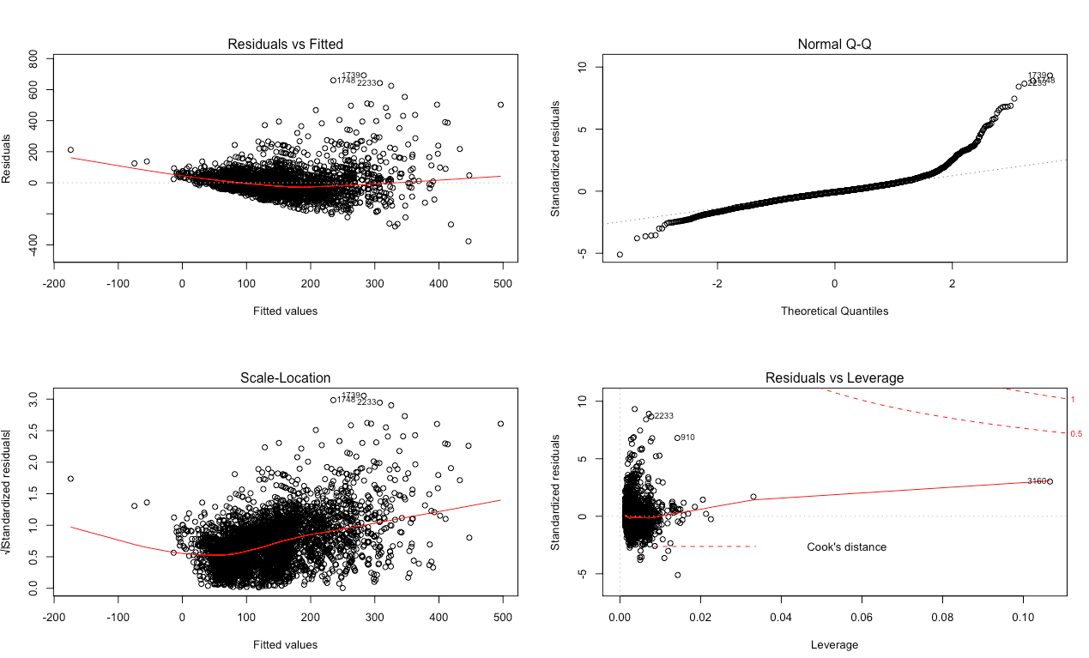
DIAGNOSITC PLOTS : MODEL 1

Slide 19
REGRESSION ANALYSIS: MODEL 2
Model 2: Dependent Variable: log(price) Independent Variables: accommodates, number of reviews, cancellation policy, Chicago region, gender, bathrooms, number of crime reported, walkscore Adjusted R-squared value = 49.38 % , p-value < 0.000002

Slide 20
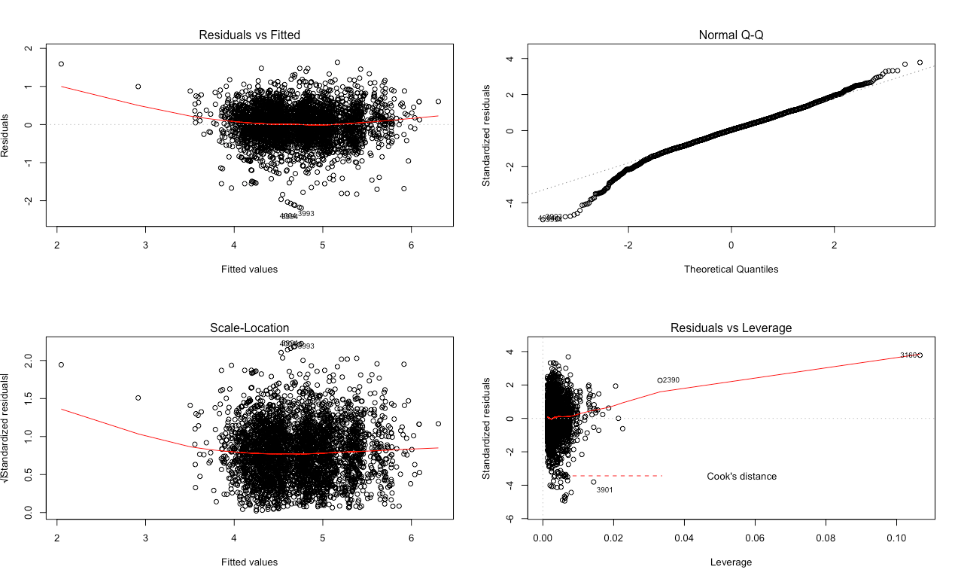
DIAGNOSITC PLOTS : MODEL 2

Slide 21
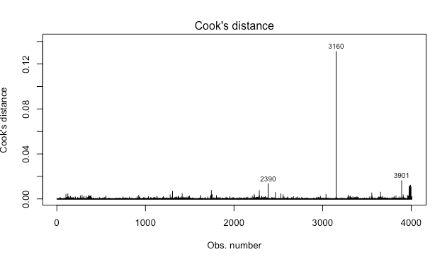
Checking for influential outliers
* Individually checked all these outliers. * Removed these 3 outliers * Ran model 3

Slide 22
REGRESSION ANALYSIS: MODEL 3
Model 3: Dependent Variable: log(price) Independent Variables: accommodates, number of reviews, cancellation policy, Chicago region, gender, bathrooms, number of crime reported, walkscore Adjusted R-squared value = 49.77 % , p-value < 0.000002 An improvement of 0.39% !

Slide 23
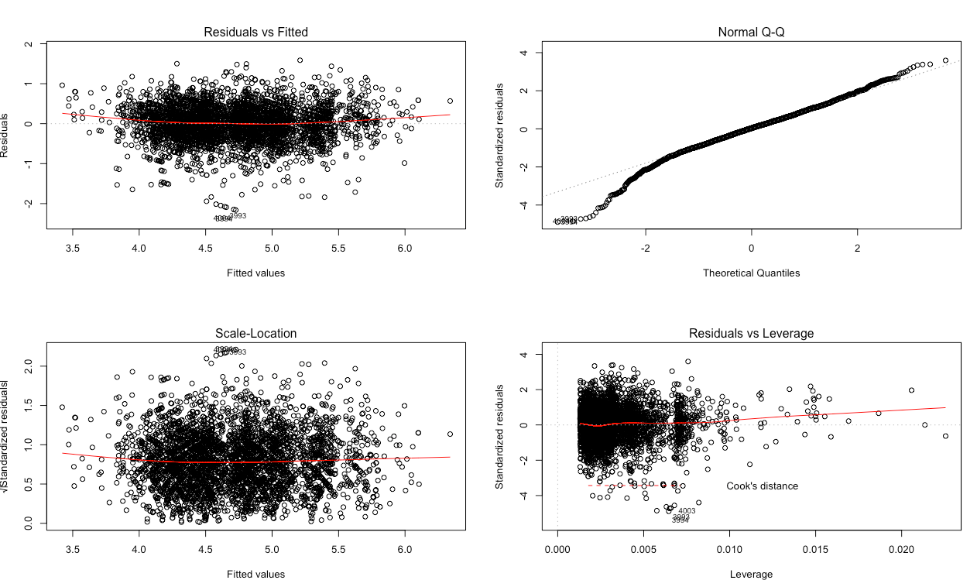
DIAGNOSITC PLOTS : MODEL 3

Slide 24
RESULTS: RELEVATIVE IMPORTANCE
1) Accommodates 2) Bathrooms 3) Walkscore 4) Number of Crimes Reported

Slide 25
LESSONS LEARNT
The number of accommodates a listing offers is the most important thing
The number of bathrooms is a very important factor for determining the price
The surrounding around the listing matter a lot
Safety is important

Slide 26
SOME INTERESTING RESULTS
No difference in the average number of reviews for a listing posted by a male compared to the one posted by a female.
There’s a difference in the cancellation policy of females as compared to the males
There’s an association between the minimum number of nights & accommodates. A larger group never preferred to book a listing offering a minimum number of night = 1

