Slide 1


Introduction to Java
Java is a powerful and widely used programming language. Its versatility and robust features make it a popular choice for developers worldwide.
By Abhinav Dyan Samantara

Slide 2

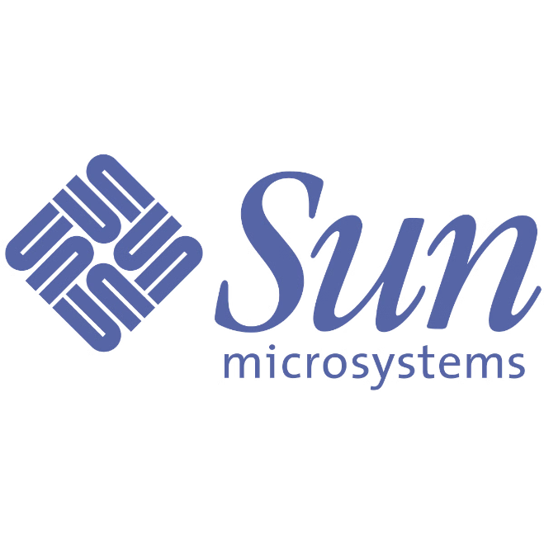
History of Java
1
Early 1990s
James Gosling and a team at Sun Microsystems began developing Java as a language for interactive television.
2
1995
Java was released to the public as a platform-independent programming language.
3
1998
Java 2 was released, marking a significant upgrade with new features and APIs.
4
2006
Sun Microsystems was acquired by Oracle, which continues to develop and maintain Java.

Slide 3
Java's Creators and Founding
James Gosling
Sun Microsystems
Oak
The "father of Java," Gosling led the development team at Sun Microsystems.
The company that created Java, Sun Microsystems played a pivotal role in its early development and widespread adoption.
The initial name for the language, later renamed to Java due to a trademark conflict.

Slide 4

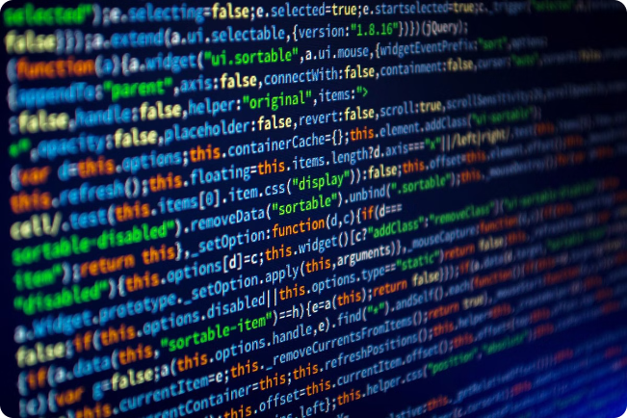
Java's Key Features
1
Platform Independence
Java code can run on any platform with a Java Virtual Machine (JVM) installed.
2
Object-Oriented Programming (OOP)
Java follows OOP principles, promoting modularity and code reusability.
3
Strong Typing
Java requires explicit data types, reducing errors and improving code readability.
4
Automatic Memory Management
Java uses garbage collection to manage memory, simplifying development and reducing memory leaks.

Slide 5
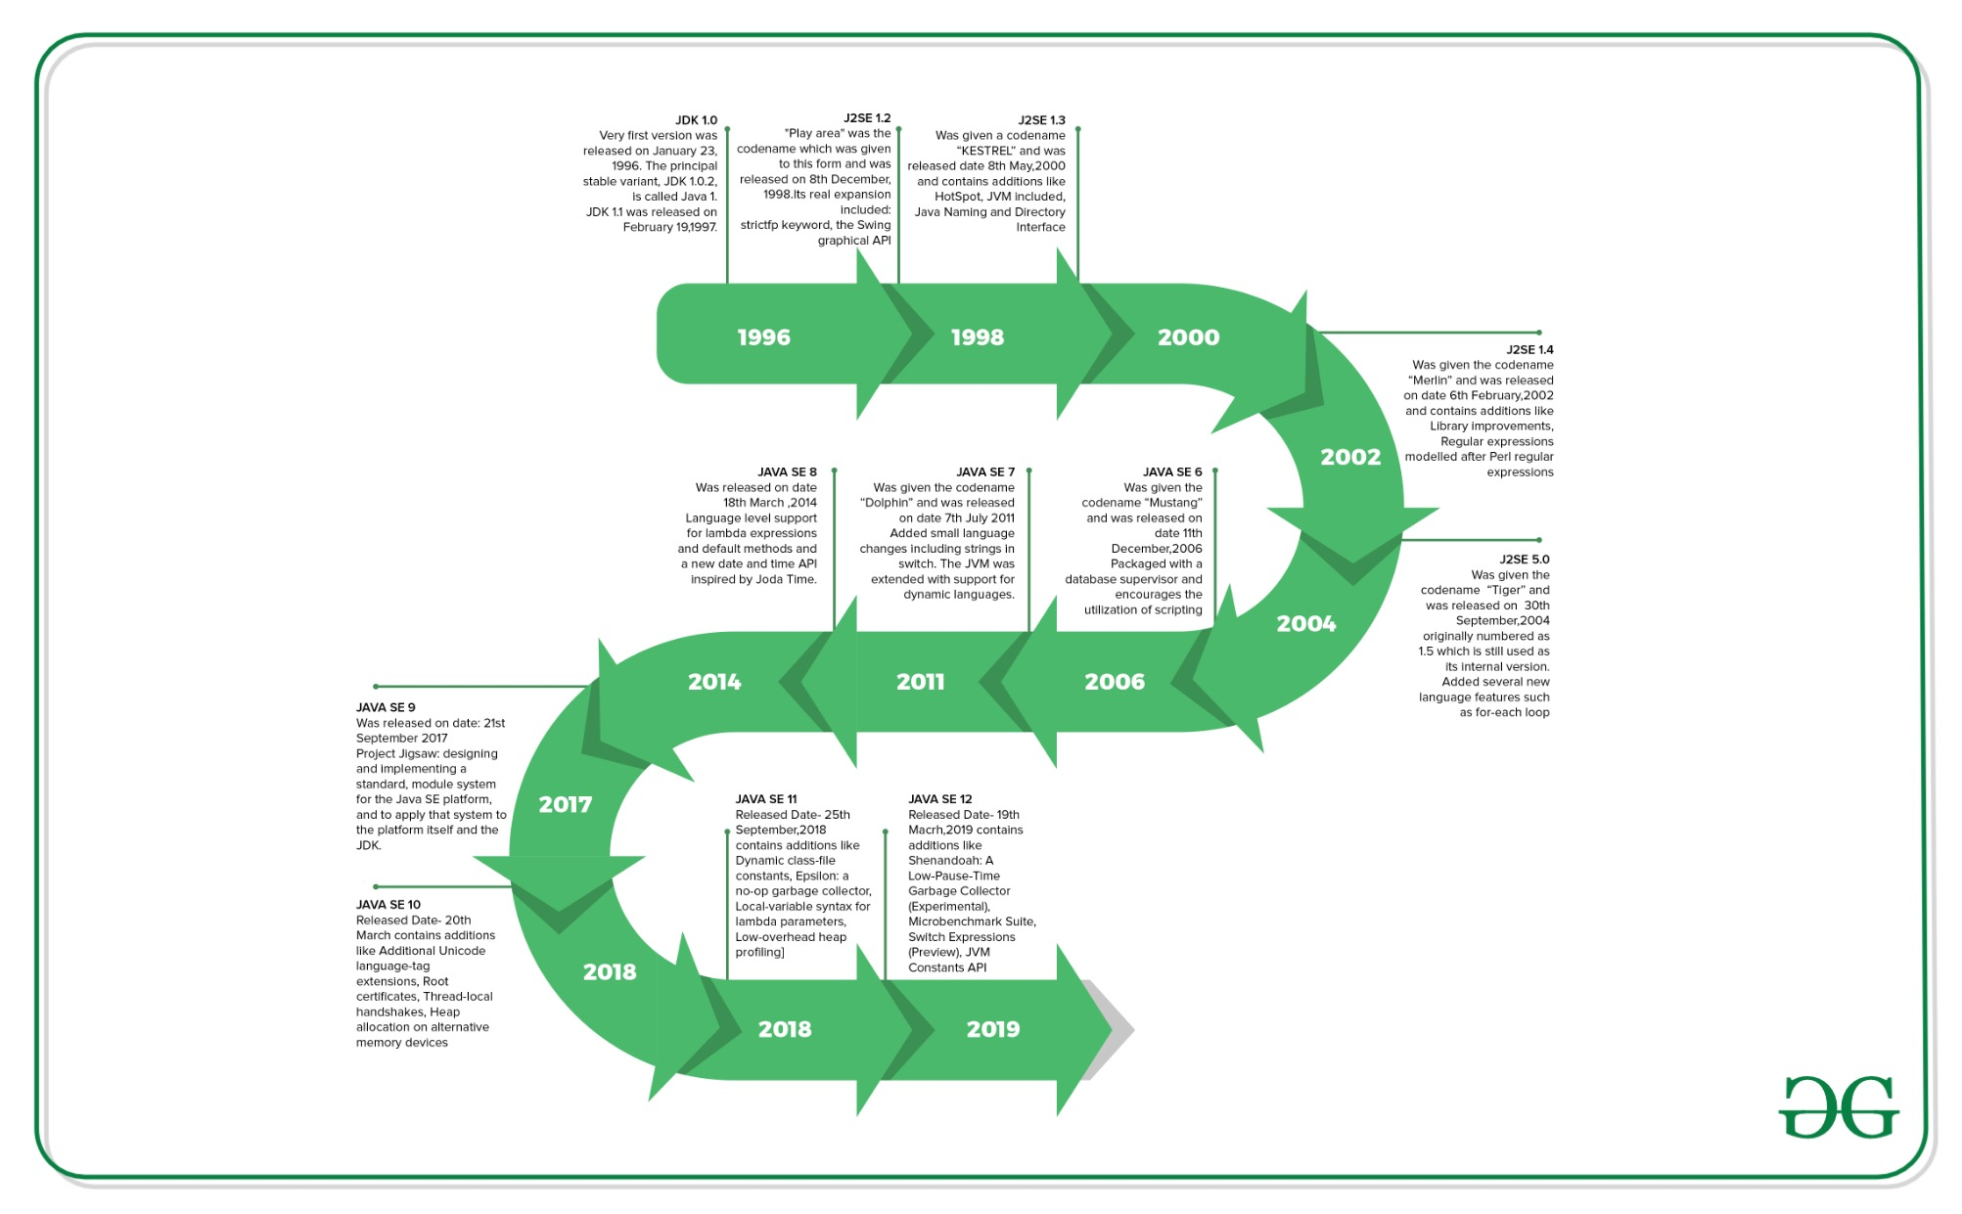
Java's Evolution and Versions

Slide 6


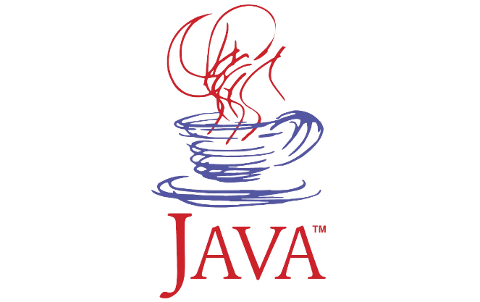



Java's Widespread Adoption
Desktop Applications
Java has been used to build a wide range of desktop applications, from games to business software.
Mobile Applications
Android, the popular mobile operating system, is built on a Java-based runtime environment.
Web Applications
Java is a powerful language for building web applications, especially server-side development.
Cloud Computing
Java is widely used in cloud computing, enabling scalable and reliable applications.

Slide 7


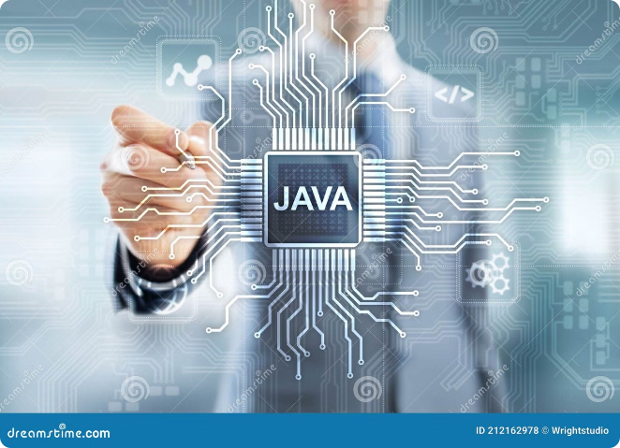
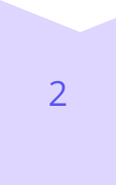
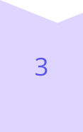

Java's Applications and Use Cases
Enterprise Software
Java is ideal for building complex enterprise systems, such as banking and financial applications.
Big Data and Analytics
Java frameworks and libraries are used for processing and analyzing massive datasets.
Scientific Computing
Java is used in scientific research for simulations, data analysis, and modeling.
Gaming
Java is a popular choice for developing games, from simple mobile games to complex PC games.

Slide 8
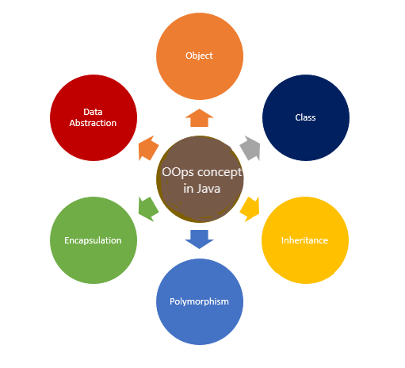
OOPs in JAVA

Slide 9
1. CLASS
A class is a user-defined blueprint or prototype from which objects are created. It represents the set of properties or methods that are common to all objects of one type. Using classes, you can create multiple objects with the same behavior instead of writing their code multiple times. This includes classes for objects occurring more than once in your code. In general, class declarations can include these components in order:
Modifiers: A class can be public or have default access (Refer to this for details).
Class name: The class name should begin with the initial letter capitalized by convention.
Superclass (if any): The name of the class’s parent (superclass), if any, preceded by the keyword extends. A class can only extend (subclass) one parent.
Interfaces (if any): A comma-separated list of interfaces implemented by the class, if any, preceded by the keyword implements. A class can implement more than one interface.
Body: The class body is surrounded by braces, { }.

Slide 10
2. OBJECTS
An object is a basic unit of Object-Oriented Programming that represents real-life entities. A typical Java program creates many objects, which as you know, interact by invoking methods. The objects are what perform your code, they are the part of your code visible to the viewer/user. An object mainly consists of:
State: It is represented by the attributes of an object. It also reflects the properties of an object.
Behavior: It is represented by the methods of an object. It also reflects the response of an object to other objects.
Identity: It is a unique name given to an object that enables it to interact with other objects.
Method: A method is a collection of statements that perform some specific task and return the result to the caller. A method can perform some specific task without returning anything. Methods allow us to reuse the code without retyping it, which is why they are considered time savers.

Slide 11
3. ENCAPSULATION
Definition: Encapsulation bundles data (variables) and methods (functions) into a single unit, a class.
Purpose: Restricts direct access to object components to protect data integrity.
Mechanism: Uses public methods (getters and setters) to control access.
Benefit: Hides internal representation, providing a clear interface for interaction.

Slide 12
4. INHERITANCE
Definition: Allows one class (subclass) to inherit properties and methods from another class (superclass).
Purpose: Promotes code reusability and establishes a hierarchical class relationship.
Mechanism: Achieved using the extends keyword.
Benefit: Subclasses can extend or modify superclass functionalities, creating more specific classes without rewriting code.

Slide 13
5. POLYMORPHISM
Definition: Allows objects to be treated as instances of their parent class rather than their actual class.
Common Use: Parent class reference used to refer to a child class object.
Types:
Compile-time (Method Overloading): Multiple methods with the same name but different parameters in the same class.
Runtime (Method Overriding): Subclass provides a specific implementation of a method already defined in its superclass.

Slide 14
6. ABSTRACTION
Definition: Hides complex implementation details, showing only essential features.
Mechanism: Achieved using abstract classes and interfaces.
Abstract Classes: Cannot be instantiated; may contain abstract methods that must be implemented by subclasses.
Interfaces: Define a contract for what a class can do without specifying how. Implementing classes must provide implementations for all interface methods.
Benefit: Separates what an object does from how it does it.

Slide 15
THANK YOU

