Slide 1

Impact Hackathon Project
AI-Powered GitHub & JIRA Insights Dashboard
Presented by:
Lahu Pachpol (lp23781@citi.com)
Pratik Deshpande (pv36825@citi.com)
Abhinav Raj (ar32759@citi.com)
Dhanashree Pawar (dp49267@citi.com )

Slide 2
Problem Statement
Modern software development teams rely heavily on GitHub for code management and JIRA for issue tracking, but these two critical systems remain disconnected for most organizations. As a result, developers, testers, and project managers face the following challenges:
1️⃣ No AI-Driven Insights for Fast Decision Making
Traditional dashboards only show raw data.
Teams need intelligence — not just information.
Missing capabilities.
  Natural-language chatbot answers
  Pattern recognition (developer workload, bottlenecks, progress trends)
2️⃣Difficulty Identifying Risks & Blockers Early
Blockers remain unnoticed until meetings.
There is no single dashboard that can instantly answer:
  “What’s blocking the development team?”
This lack of visibility leads to delivery delays.
🔍 In Summary —
This project is a modern engineering productivity tool that unifies GitHub commit analytics, JIRA issue tracking, and a powerful LLM-based AI chatbot into a single interactive dashboard. It also includes an intelligent Regression Test Case Generator that analyzes code changes, commit metadata, and JIRA-linked tasks to automatically identify impacted components and recommend relevant regression test cases. This will save CI/CD time and accelerates release cycles.
2

Slide 3
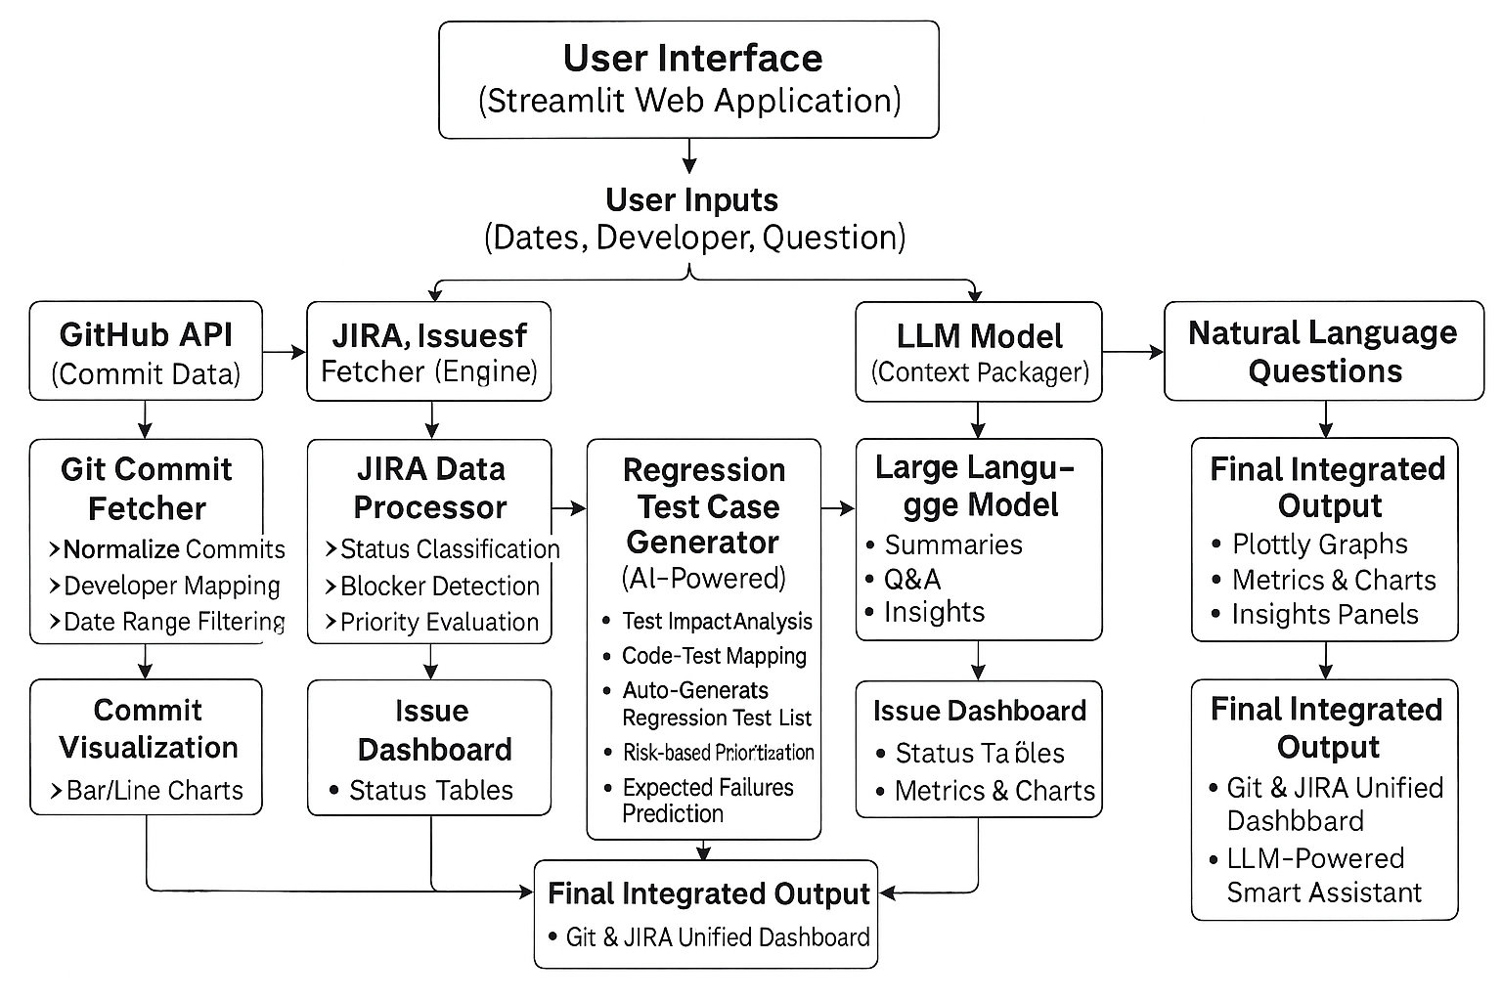
Project Architecture & Working

Slide 4
Importance & Future Scope
AI-Driven Regression Test Case Prediction
Automatic Documentation Generation
Chatbot → Full Project Analyst
The chatbot evolves into a full AI project analyst capable of:
Predicting delivery delays
Recommending developers for tasks
Detecting duplicate JIRA issues
Summarizing weekly progress in natural language
Automatically analyze Git commit changes and generate a prioritized list of regression test cases likely to be impacted. This saves CI/CD time and accelerates release cycles.
Generate release notes, architecture diagrams, and technical change summaries directly from commit logs and JIRA updates.
Intelligent Sprint Planning Assistant
Real-Time Project Health Monitoring
Multi-Repo & Multi-Team Scaling
Use AI to read JIRA issues + Git history and recommend sprint capacity, developer allocation, and risk prediction before planning begins.
AI can track blockers, delays, productivity, and code churn to provide early warnings before issues become critical.
Extend the dashboard to handle multiple repositories and teams, with cross-team impact analysis and organization-wide insights.
KEY INSIGHTS
3

Slide 5

Thank You
Email
Lahu Pachpol (lp23781@citi.com)
Pratik Deshpande (pv36825@citi.com)
Abhinav Raj (ar32759@citi.com)
Dhanashree Pawar (dp49267@citi.com )

