Slide 1
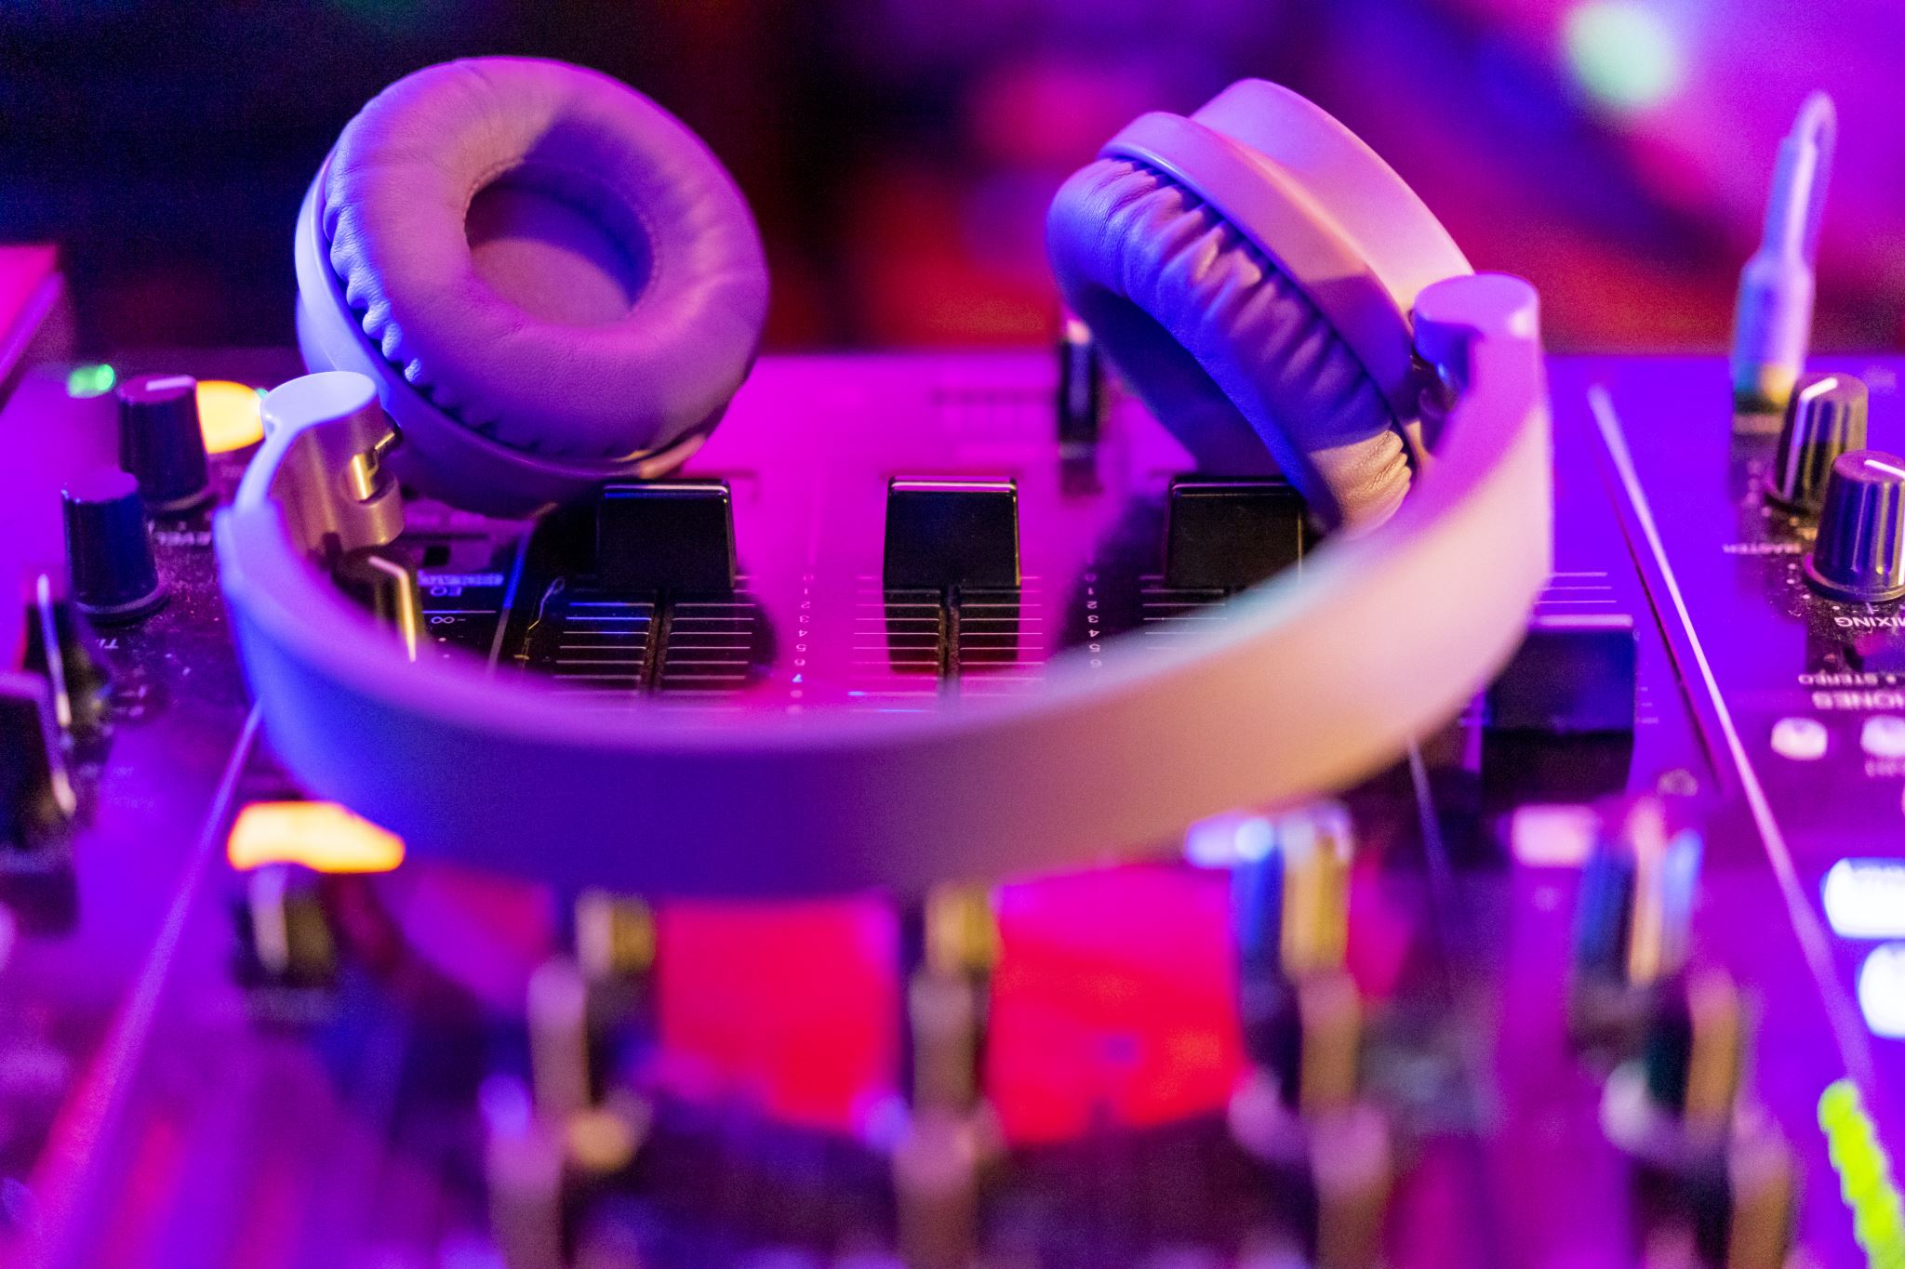

SoundScape: Your Personalized Audio Environment
Smart, Soothing Sounds for Focus, Relaxation, and Sleep
-Abhinav Reddy Janapana

Slide 2
What is SoundScape? 1)SoundScape is a free smart app and portable device that creates calming background sounds using AI. 2) This product helps users focus, relax, sleep better, meditate, or study by adjusting sounds to match their mood and environment

Slide 3
Key Features
Smart Soundscapes: Automatically changes sound based on your surroundings
Multiple Modes: Designed for daily needs such as Focus, Sleep, Study, Relax, Meditation, calm, Nature etc.
Free and Easy to Use: No subscription for some modes with a user-friendly design
Portable Device: Use it at home, work, or while traveling
High-Quality Sounds: Natural, clear, and soothing audio
Long-Term Learning: Becomes more accurate the more you use it

Slide 4
How It Works
It Learns Your Routine: Adapts to your lifestyle
AI-Powered: Creates soundscapes that match your current mood
Trains Over Time: The more you use it, the smarter it becomes
Real-Time Adjustments: Changes as your environment or mood shifts
Simple Steps to Use:
1. Open app or turn on device
2. Pick a mode
3. Play the sound
4. Relax, study, sleep, or focus with ease

Slide 5
Why Use SoundScape?
Problem: Social media and digital life cause stress, distractions, and poor sleep.
SoundScape Helps You:
- Block noise and online distractions
- Calm your mind for better sleep
- Reduce stress and improve focus
- Welcomes the silence and experience inner peace within you

Slide 6
Positive Impact & Market Potential
- Improves Sleep & Focus
Promotes Relaxation
Uses Sustainable and Non Toxic Materials
Suitable for a Wide Range of Users: Including Students, Professionals, Parents, and Teens
Meets the Strong Consumer Desire for Wellness, Mental Health, and Digital Balance Products.
Scalable for Use in Various Environments: Including Homes, Schools, Libraries, and Public Spaces

Slide 7
Investment Opportunity
Sound That Changes With You: Our Product Adapts to Your Day and Helps You Feel Better
We have Builded a Tool for Health Through Music.
SoundScape Capitalizes on the Growing Consumer Focus on Self-Care and Well-being.
Because stress and anxiety are on the rise, more people want mental wellness tools. This means there's a big market for SoundScape

Slide 8

