Slide 1
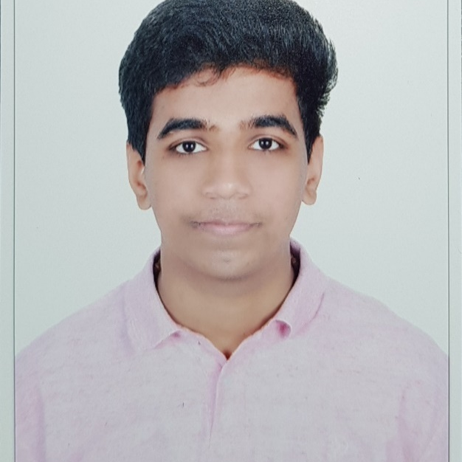

ABHINAV UNNIYATTIL
Senior Analyst/Software Engineer
Bachelor of Technology,
Computer Science Engineering
2018 - 2022
Mumbai
abhinav.unniyattil@capgemini.com
Skills
+91 9846851993
C# | Basics, OOPS, Exception Handling, Arrays, Collection and Generics, Delegates and Events, File Io and Serialization.
.NET Framework | ADO.NET, ASP.NET with MVC4 and WEB API, Entity Framework.
Database | SQL Server, MySQL
Tools | GIT, SWAGGER
UI Technology | HTML5, CSS & Angular
Java | Basic, OOPS, Exception Handling, Arrays
C | Basics
A5
Full Stack Developer
Understanding of RDBMS concepts using SQL Server.
Practical understanding of C# and SQL concept using Visual Studio and SQL Server.
Hands on experience in developing applications using .NET Framework, ADO.NET Core
Understanding of HTML5, CSS and Angular CLI.
On-Demand Car Wash System
Completed end to end case study of On-Demand Car Wash System which is a Web Based Application. It is implemented, understanding the growing automobile market and the need to provide services for cleaning and maintaining them. It’s main objective is to act as a bridge between the customers in need of the service and washers who are ready to provide the service. The customers can register themselves and avail the wash services and the washers will be registered by the application admin and will receive notifications regarding the orders which will be handled on acceptance.
Technologies used:
ANGULAR
ASP.NET CORE
Microsoft SQL Server
https://github.com/Abhinav221100

