Slide 1


LogicLLM
AI-powered code review and optimization--powered by Qwen

Slide 2
What is LogicLLM?
LogicLLM is a full-stack AI code reviewer that leverages NVIDIA's API with the qwen/qwen2.5-coder-32b-instruct model to analyze, debug, and optimize your code.
Frontend
Backend
AI Engine
React + Vite
Node.js + Express
NVIDIA API
Port 3000
Port 3001
Qwen 2.5 Coder 32B

Slide 3
How LogicLLM Works
A five-step pipeline that transforms your code into actionable insights.
01
02
03
User Input
Validation
AI Processing
Developer pastes code into the UI
Input sanitization and language detection
NVIDIA API call with qwen/qwen2.5-coder-32b-instruct model
04
05
JSON Parsing
UI Display
Response parsed into structured format
Results rendered with quality score and recommendations

Slide 4






What You Get Back
Language Detection
Bugs List
Automatically identifies programming language
Comprehensive list of identified issues
Improvements
Explanation
Suggestions for code enhancement
Plain-English breakdown of code logic
Optimized Code
Quality Score
Refactored version ready to implement
0–100 rating with processing time

Slide 5
Quality Score Formula
Start at 100 points. Deductions applied for each issue found.
Base Score
Per Bug
100 points
-5 points
Per Improvement
Minimum
-2 points
0 points

Slide 6
Technology Stack
Component
Technology
Frontend
React + Vite
Backend
Node.js + Express
AI API
NVIDIA OpenAI API
Model
Qwen 2.5 Coder 32B
Robust Error Handling
Smart fallback generator prevents crashes on AI, network, or parsing errors. Always returns valid JSON.
Structured Logging
Tagged log format [timestamp] [LEVEL] [TAG] message with levels: INFO, DEBUG, SUCCESS, WARN, ERROR
API Endpoints
GET /health — Health check
POST /api/analyze — Code analysis with request/response examples

Slide 7
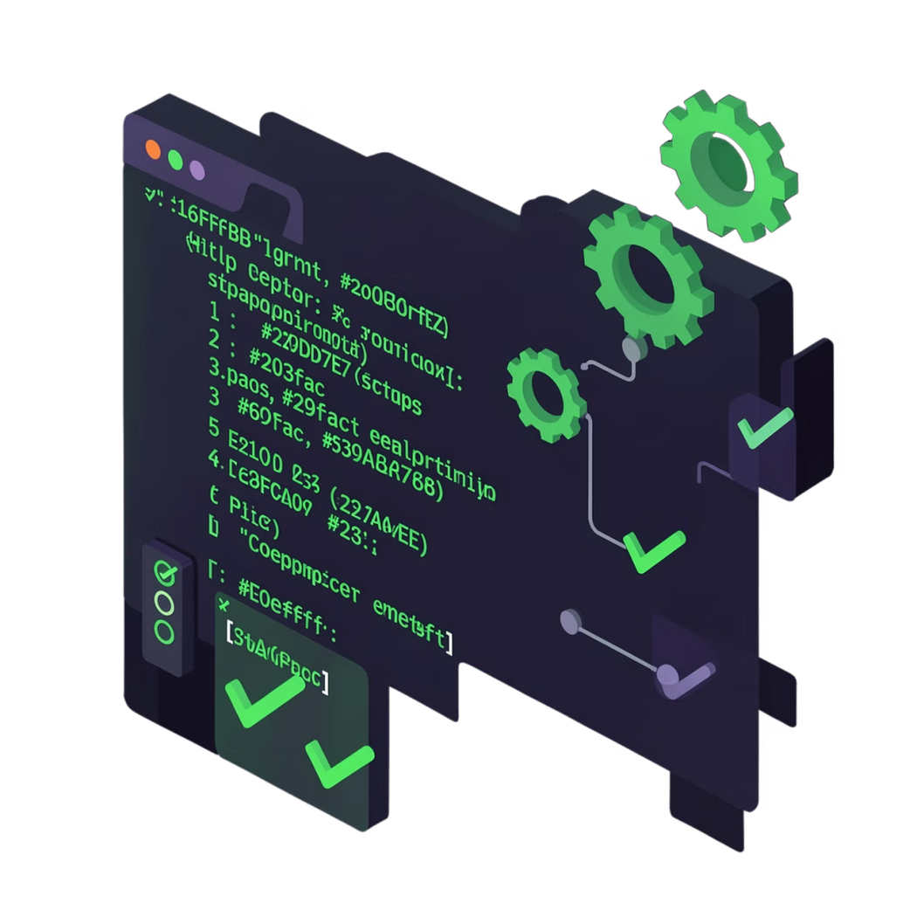

Getting Started
Configure API Key
Add NVIDIA_API_KEY to .env file
Launch Application
Run node runner.js start
Access UI
Open localhost:3000 in browser

