Slide 1





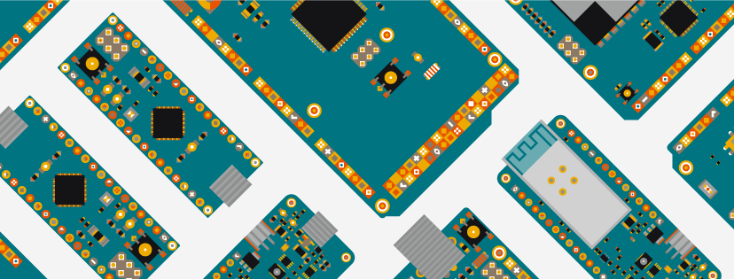


WORKSHOP ON ARDUINO
BY : Abhinav
8434928102
abhinav33303@gmail.com

Slide 2
Abhinav :
From Uem Kolkata , CSE department , 3rd Year and part of Urecon Team , member of Instution Innovation council and Member of IETE Student chaper UEMK
Working on Arduino and similar microcontrollers from more than 5 years.
Made more than 100 Projects Including all small and big projects.
Published some Research papers and filed some patents also.
Know your instructor

Slide 3
Ritayan Dhara :
He is a 3rd year student of ECE department of UEM kolkata. He is a highly experienced guy , Represented and won many prizes for our institute . He is having many projects related to robotics , heavy weight robots , high torque robots , machine learning and computer vision.
Know your co instructors

Slide 4
HISTORY OF ARDUINO

Slide 5
INITIAL HISTORY
1.
Was a college project in 2005.
Project of some students from instute of Ivrea in Italy(IDII).
Aim : To creat a low cost hardware and software which will help kids, adults , mango people and profesionals to create their own devices.

Slide 6
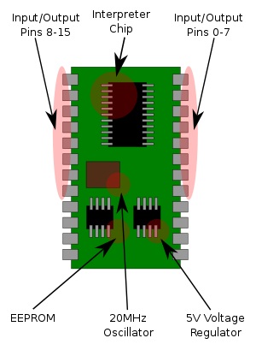
Need for new device
2.
At that time students have only 1 option for developing systems.
That was : BASIC STAMP Microcontroller.
Problem : too costly arount 50$ . (2,173₹ acording to rate exchange of 2005.)

Slide 7
Who and how
3.
In 2003 , Hernando Barragán created the development platform Wiring as a Master's thesis project at IDII, under the supervision of Massimo Banzi and Casey Reas.
Casey Reas a co-Creator of Processing IDE .
Wiring IDE Aim : Low cost tools for creating digital projects by non-Engineers
whats inside Wiring IDE ?
lets see...................................................................................

Slide 8
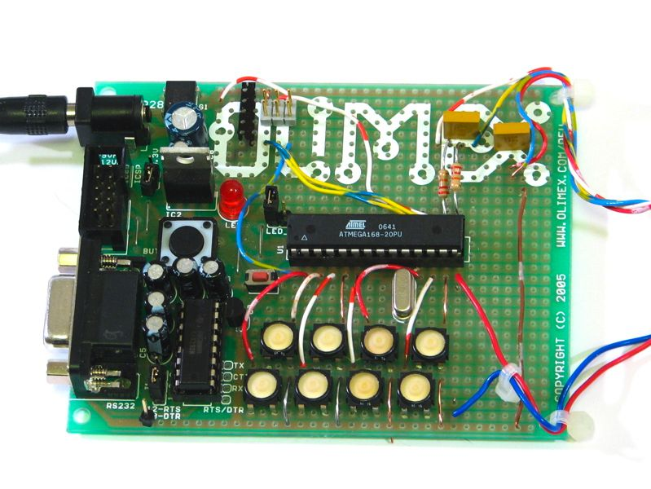
who and how
3.
wiring only works for a custom pcb made by using atmega168 microcontroller.

Slide 9
Arduino Final history
4.
In 2005
Two new guys( Massimo Banzi, with David Mellis) made a custom hardware from Atmega8 microprocessor and added it's support to wiring IDE.
These guys named their project Arduino.
and this way arduino was created .
Core members of arduino = (members of wiring ide project)+ (member of
Arduino projects)

Slide 10
Who can use arduino ?
5.
Licensed under a CC-BY-SA license,
it means any one can manufacture and sell these board and also make systems using Arduino and sell them.
for example : Adafruit : a company sells different sensors and arduino boards.

Slide 11


Slide 12
Now lets start learning

Slide 13
Basic Electronics Components

Slide 14
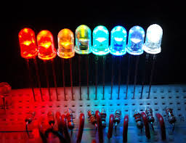
Led's
1.
Name : Light emmiting diode
Produces light when dc voltage is applied
rating : 1.5 to 3.2v and 20 mA
we use register with led

Slide 15
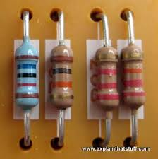
Registers.
2.
we use registers to reduce the current flow , in divider circuits etc..
we measure it in Ohms.
we use it with leds to reduce the current rush ..... lets see it in our simulator.

Slide 16
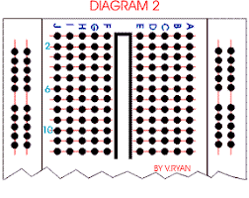
Breadboard.
3.
used for testing circuits .
sholderless connections.
first and last 2 rows are connected vertically.
and all other holes are connected horizontally.

Slide 17
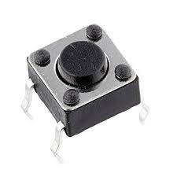
Push-button.
4.
kind of a switch.
works as it name:
push the button - circuit on.
leave it circuit off
lets see how it works on simulator.

Slide 18
Don't worry we will learn about more components later.

Slide 19


Slide 20
Let's start arduino Programng

Slide 21
Now before moving further
let's Understand Arduino Uno

Slide 22
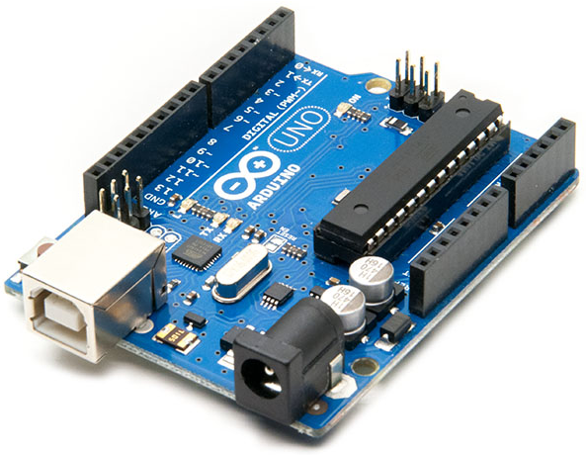
Arduino Uno
2.
Arduino Uno is a one of the arduino board
Pins : digital I/O pins : 14
Analog input pins : 6
working voltage : max 5v & 500mA through usb
12v & 2A through dc jack
and 5v 1A through Vin pin.

Slide 23
Lets learn about all the pins of arduino

Slide 24
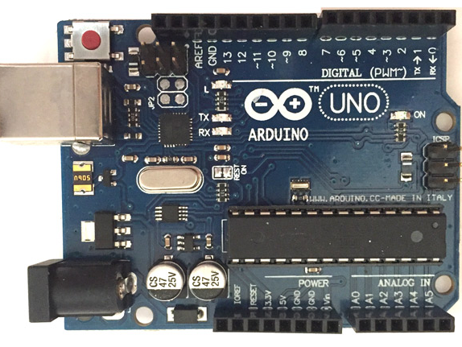
Pin Configration in Arduino

Slide 25
TYPES OF PINS
01
Power Pins
03
Digital Pins
02
Analog Pins

Slide 26
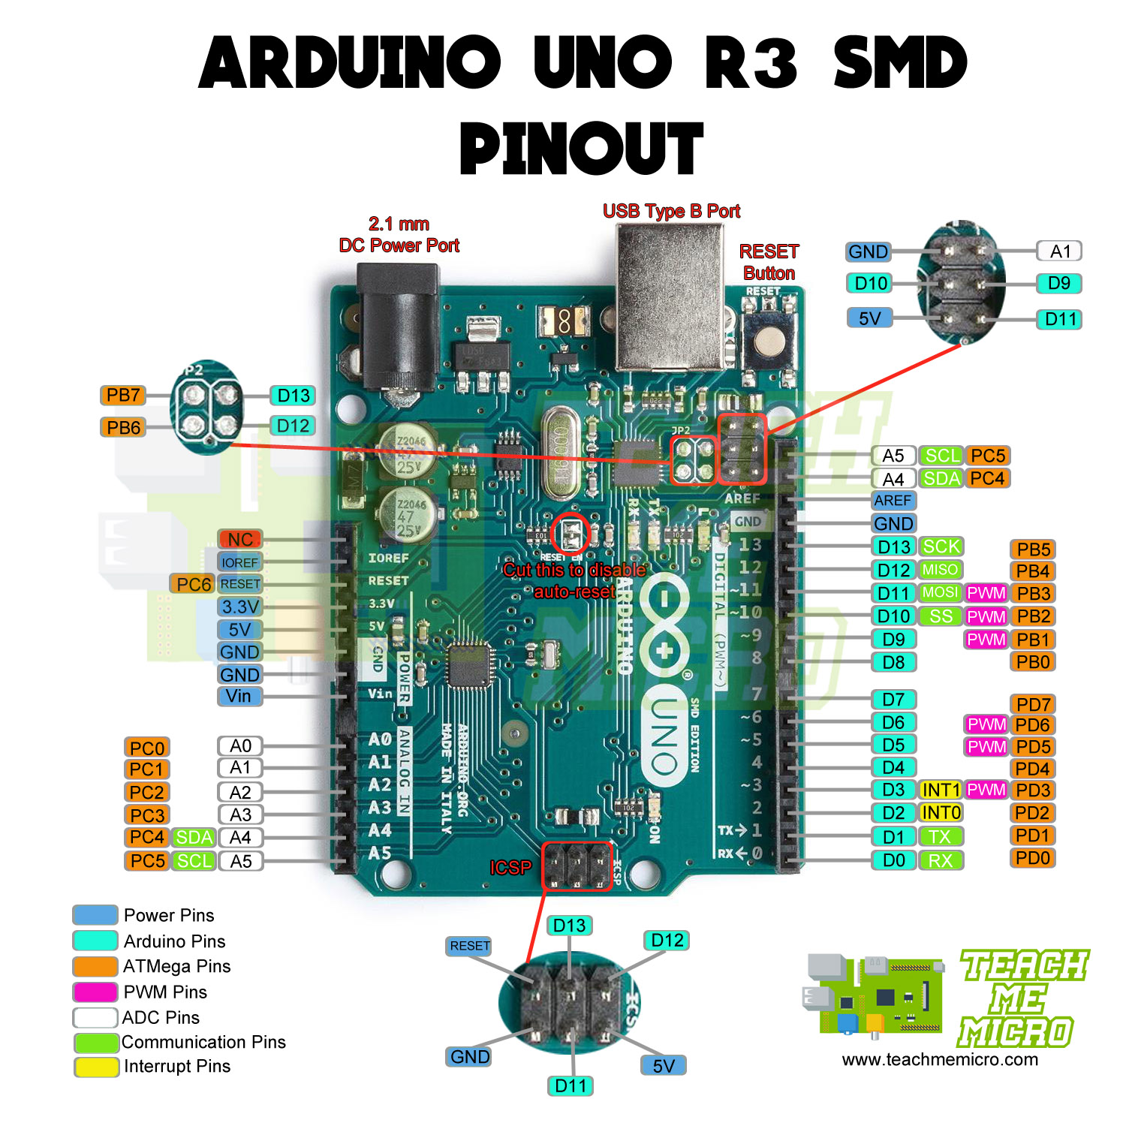
01
POWER PINS
1. 5v Pin
2. 3.3v Pin
3. Reset Pin
4.Ground Pin
5. Vin Pin (INPUT )

Slide 27
02
ANALOG PINS
These pins are used for capturing analog
inputs from sensors.
6 analog pins
A4 = SDA(serial data)
A5 = SCL(serial clock)
A4 and A5 pins are used for
I2C comunications

Slide 28
03
DIGITAL PINS
PIN 0 AND 1
Pin 0 = RX (Reciver )
Pin 1 = TX (Transmitter)
Pin (0,1) used for serial communication.
means read data from another sensor/device
NOTE :
Don't connect any output device to these pins.

Slide 29
04
PWM PINS
6 PWM Pins (3 ,5 ,6, 9 ,10 , 11)
PWM pins are represented by '~' .
PWM = PULSE WIDTH MODULATION
In simple language change voltage between 0V to 5V

Slide 30
05
DIGITAL PINS
Used for Digital output means for on and off
in computer language these pins have 2 states
either 0 or 1. (0 = 0V and 1 = 5V)

Slide 31


Slide 32
Programing basics.
1.
concept you know before starting
1. functions.
2. working of if and else conditions.
3. basics of c/c++ .
Most important :
don't forget to use semicolon ;

Slide 33
Lets see how Arduino ide and tinkercad works.

Slide 34
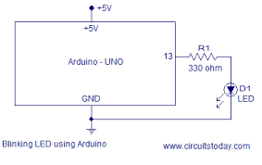
Blink the Led .
2.
OBJECTIVE :
To turn on the led for 1 second and then turn it off for the next 1 second using arduino board.
STRATEGY:
step 1 : Make the circuit
Step 2 : Program it
(moving to simulator)

Slide 35
Other Projects
3.
2. Led dimmer with arduino.
Objective : increase/ decrease the brightness of the led's using a knob.
3. Push button with arduino.
Objective : use 2 leds, turn green led on when button is pressed otherwise turn on red led.
4. Dc motor with arduino.
Objective : use a dc motor with arduino and controll its speed.

Slide 36
Sensors and modules

Slide 37
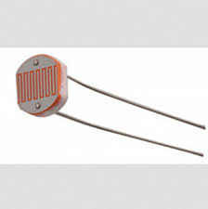
LDR with ARDUINO

Slide 38
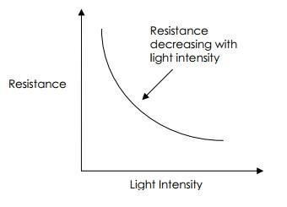
1. What is a LDR ?
LDR is short name of Light dependent resistance . It is a kind of variable resistance whose resistance varries with intensity of light . when there is low light it resistance is very high and vise versa .
Light : 400 ohms
No light : 9,000 ohms (9 kilo ohms)
These values are aprox . values deffer from ldr to ldr

Slide 39
2. How to connect LDR with Arduino
Let's see.............

Slide 40
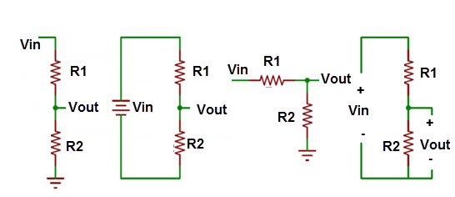
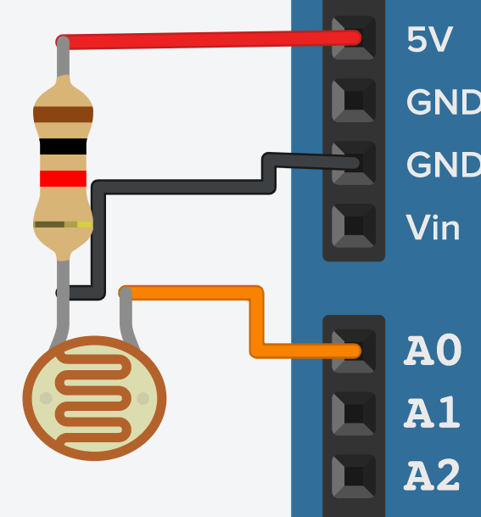
3 . why Voltage divider configration ?
We use voltage divider configration to get reference voltage . But why because theoriticaly at no light , resistance of LDR is 9000 ohms whichis too much . so we use voltage divider configration.
Describing Voltage divider law in brief :
+
Vin
-
Vout= Vin x (R1 / R1+R2)
R1
few calcution
Vin = 5 v
R1 = 1000 ohm
R2 :
day = 400 ohms
night = 9,000 ohms
+ Vout (A0)
R2

Slide 41
( )
Vout = R1
Vin
___________
R1+R2
Light intensitiy = High :
Vout = 5 [1000 / (1,000+400)]
= 5 (1000 / 1,400)
= 3.57 V or analog value = 728
Light intensitiy = LOW :
Vout = 5 [1,000/ (1,000+9,000)]
= 5 (1,000/ 10,000)
= 0.5 V or analog value = 102

Slide 42
Lets do programming.........

Slide 43
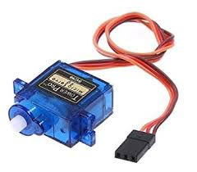
SERVO MOTORS

Slide 44
WHAT IS A SERVO MOTOR
It is a type of motor whose motion can be controlled in terms of angle . for example 15 degrees ,90 degrees etc.

Slide 45
Types of servo motors
There are manly 2 type of servo motors
1. 180 degree servo motors
2. 360 degree / continous servo motors

Slide 46
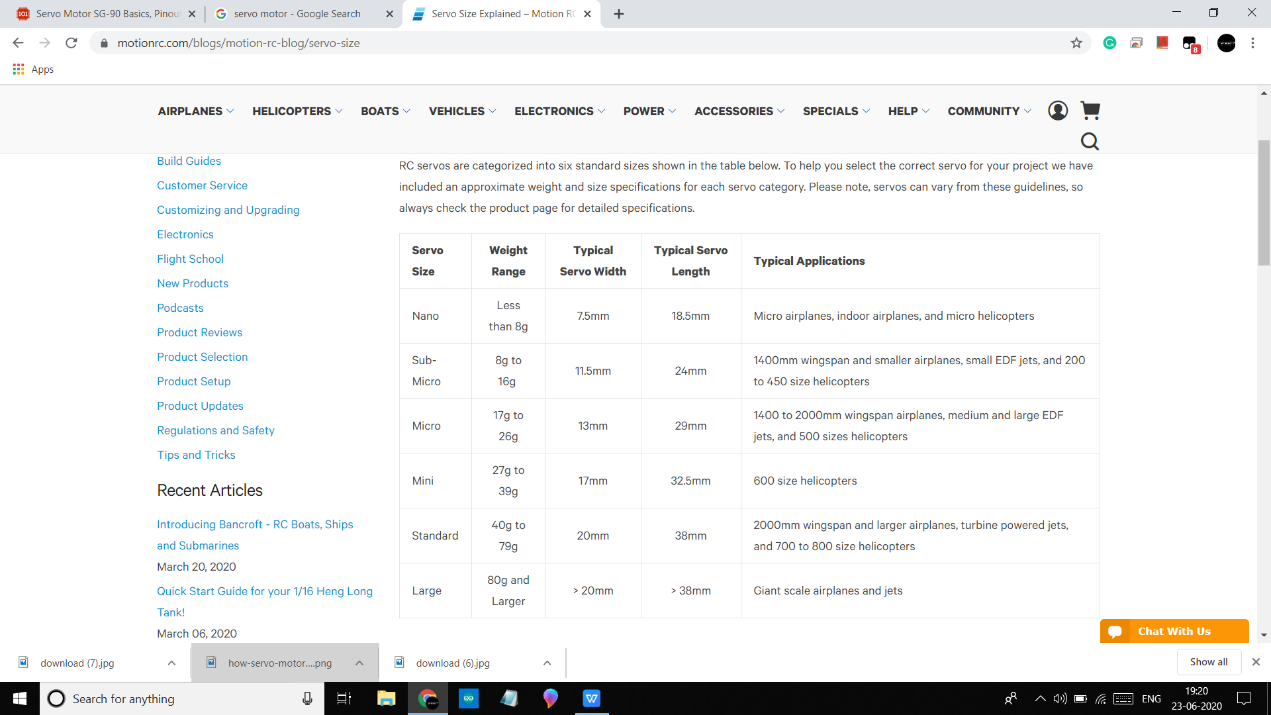
Different sizes of servo motors

Slide 47
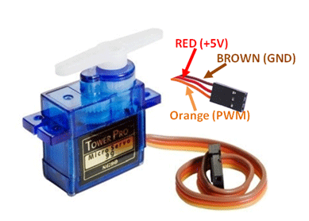
How to interface Servo motors with arduino
Pin configration of servo motor

Slide 48
Now lets learn its programming

Slide 49
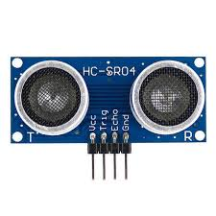
Ultrasonic Sensor

Slide 50
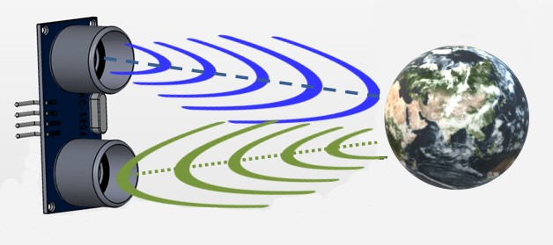
How Ultrasonic sensors work ?
Sends a high frequency sound (ultrasound) and wait for sound to reflect back.
count how much time it takes to come back .(we can call this echo )
speed = distance /time . so,
Time = distance / speed

Slide 51
Speed of ultrasound = 340 m/s
or 0.034 cm / micro sec
lets say object is at 1 cm away so
distance = 2cm (because ultrasound will cover twice the distance )
time = 2/ 0.034 = 58.8 micro sec.

Slide 52
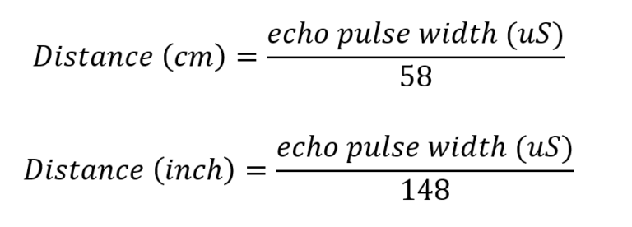
microcontrollers calculation.

Slide 53
Our sensor HC- SR04
HC-SR04 Specifications
Working Voltage: DC 5V
Working Current: 15mA
Working Frequency: 40Hz
Max Range: 4m
Min Range: 2cm
Measuring Angle: 15 degree

Slide 54
Projects :
Digital scale
Parking sensor
Blind stick
I.O.T projects .....like distance avoiding bot , water level indicators etc...

Slide 55
Pin configration :
Vcc : +5 v
Trig : Transmitter pin(Output pin)
Echo : Reciever pin (Input pin)
Gnd : Ground pin

Slide 56
Circuit Digram
lets see ....

Slide 57
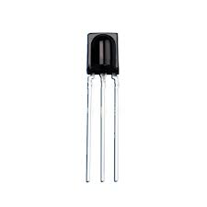
IR Sensor

Slide 58
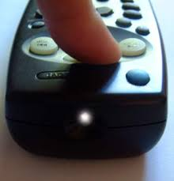
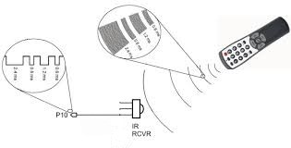
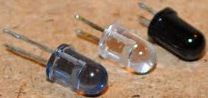
Working of remotes

Slide 59
Universal IR Reciever
we will interface universal IR sensor with arduino to control arduino from any remote .
some common ir recivers we use :
TSOP1838 , VS1838 etc ..

Slide 60
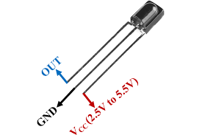
Circuit digram and pin configration
Lets see circuit diagram....

Slide 61
Arduino programming.

Slide 62
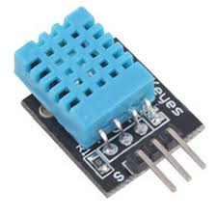
DHT 11/22

Slide 63
Basics of DHT 11 / 22 sensors
DHT stands for Digital Humidity and temprature
IT is a temprature and Humidity sensor .
you can get the temprature and humidity of the surrounding using this sensor.
Very low cost and simple to use sensor .

Slide 64
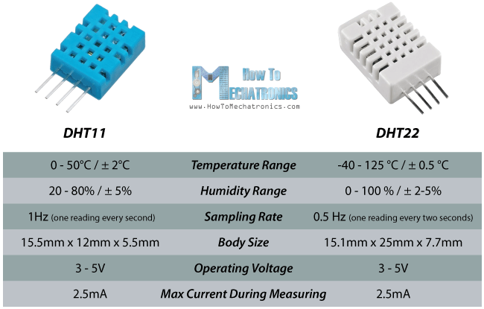
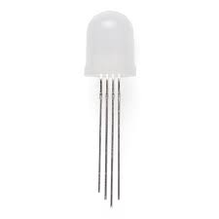
Difference between DHT 11 and 22

Slide 65
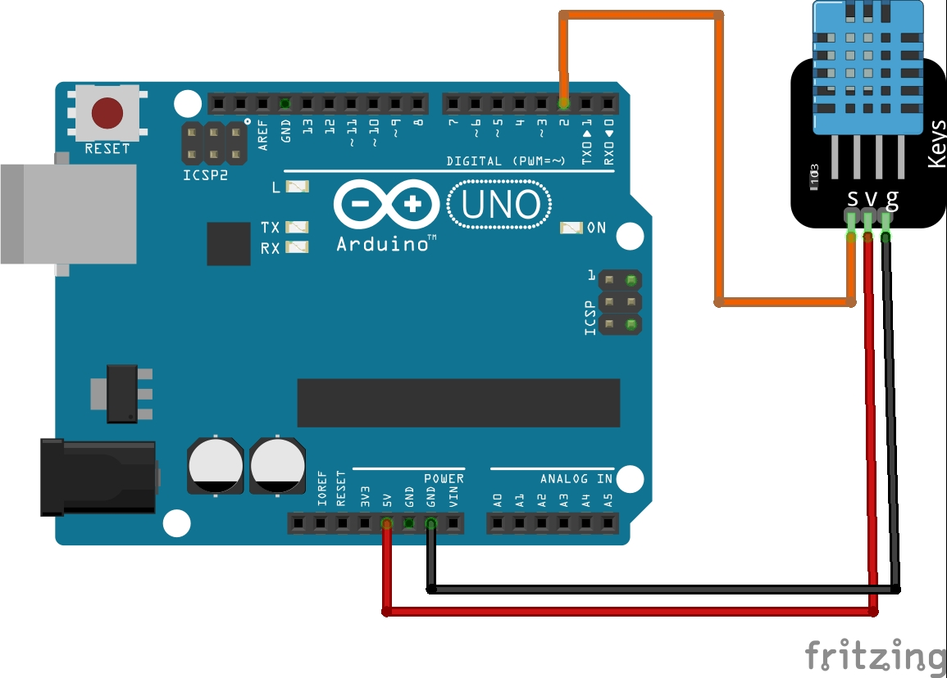
Circuit Digram

Slide 66
Lets see coding...........

Slide 67
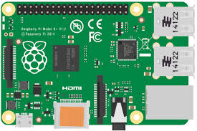
Next level to Arduino
Raspberry pi

Slide 68
what is it
1.
IT is a low cost computer .
to use it you need a tv monitor, keyboar and mouse.
you can browse internet , play games,make spreadsheets and program its GPIO pins through programming language like Python.
comes in different specifications and sizes.

Slide 69
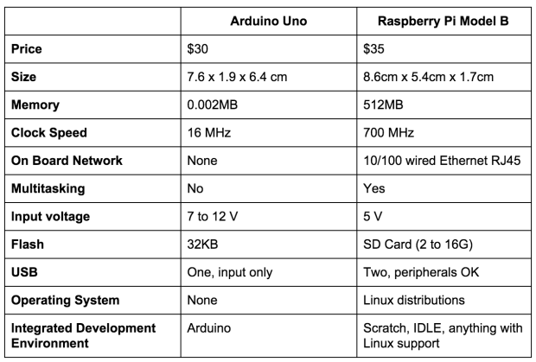
Difference between arduino and Pi
2.

Slide 70
Summery of this workshop
1.
Covered :
History of arduino.
How to use Arduino IDE and Tinkercad plateform.
Basic electronic components and uses with arduino.
Made some projects and learned more about programming with arduino.
Seen science behind some sensors and how to interface them with arduino.
Seen next step to arduino i.e. : Raspberry pi.
difference between Arduino and Pi.

Slide 71
Thank you
From

