Slide 1



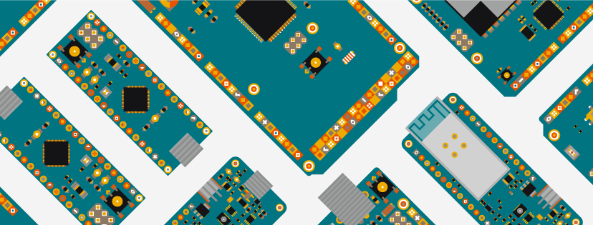


WORKSHOP ON ARDUINO
BY : Abhinav
8434928102
abhinav33303@gmail.com

Slide 2
HISTORY OF ARDUINO

Slide 3
INITIAL HISTORY
1.
Was a project in 2005.
Project of some students from instute of Ivrea in Italy.
Aim : To creat a low cost hardware and software which will help kids, adults , mango people and profesionals to create their own devices.

Slide 4
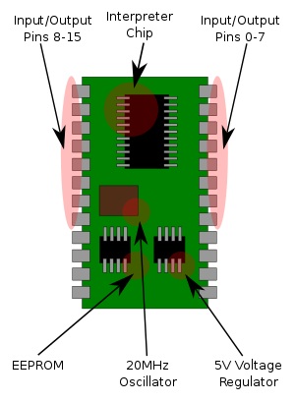
Need for new device
2.
At that time students have only 1 option for developing systems.
That was : BASIC STAMP Microcontroller.
Problem : too costly arount 50$ . (2,173₹ acording to rate exchange of 2005.)

Slide 5
Who and how
3.
In 2003 , Hernando Barragán created the development platform Wiring as a Master's thesis project at IDII, under the supervision of Massimo Banzi and Casey Reas.
Casey Reas a co-Creator of Processing IDE .
Wiring IDE Aim : Low cost tools for creating digital projects by non-Engineers
whats inside Wiring IDE ?
lets see...................................................................................

Slide 6
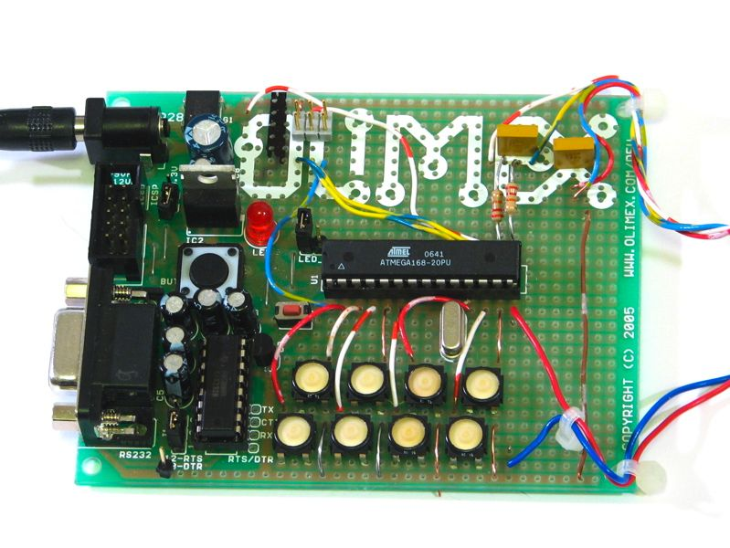
who and how
3.
wiring only works for a custom pcb made by using atmega168 microcontroller.

Slide 7
Arduino Final history
4.
In 2005
Two new guys( Massimo Banzi, with David Mellis) made a custom hardware from Atmega8 microprocessor and added it's support to wiring IDE.
These guys named their project Arduino.
and this way arduino was created .
Core members of arduino = (members of wiring ide project)+ (member of
Arduino projects)

Slide 8
Who can use arduino ?
5.
Licensed under a CC-BY-SA license,
it means any one can manufacture and sell these board and also make systems using Arduino and sell them.
for example : Adafruit : a company sells different sensors and arduino boards.

Slide 9


Slide 10
Now lets start learning

Slide 11
Basic Electronics Components

Slide 12
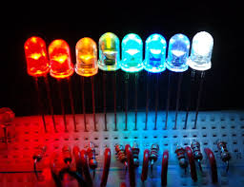
Led's
1.
Name : Light emmiting diode
Produces light when dc voltage is applied
rating : 1.5 to 3.2v and 20 mA
we use register with led

Slide 13
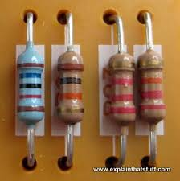
Registers.
2.
we use registers to reduce the current flow , in divider circuits etc..
we measure it in Ohms.
we use it with leds to reduce the current rush ..... lets see it in our simulator.

Slide 14
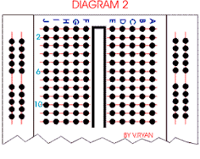
Breadboard.
3.
used for testing circuits .
sholderless connections.
first and last 2 rows are connected vertically.
and all other holes are connected horizontally.

Slide 15
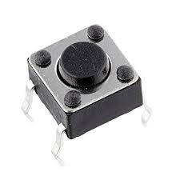
Push-button.
4.
kind of a switch.
works as it name:
push the button - circuit on.
leave it circuit off
lets see how it works on simulator.

Slide 16
Don't worry we will learn about more components later.

Slide 17


Slide 18
Let's start arduino Programng

Slide 19
Now before moving further
let's Understand Arduino Uno

Slide 20
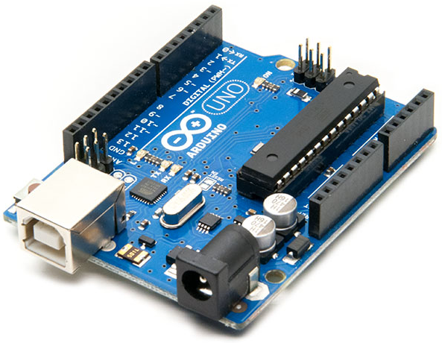
Arduino Uno
2.
Arduino Uno is a one of the arduino board
Pins : digital I/O pins : 14
Analog input pins : 6
working voltage : max 5v & 500mA through usb
12v & 2A through dc jack
and 5v 1A through Vin pin.

Slide 21
Lets learn about all the pins of arduino

Slide 22
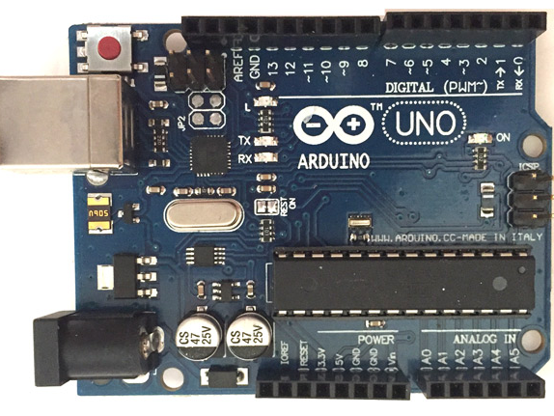
Pin Configration in Arduino

Slide 23
TYPES OF PINS
01
Power Pins
03
Digital Pins
02
Analog Pins

Slide 24
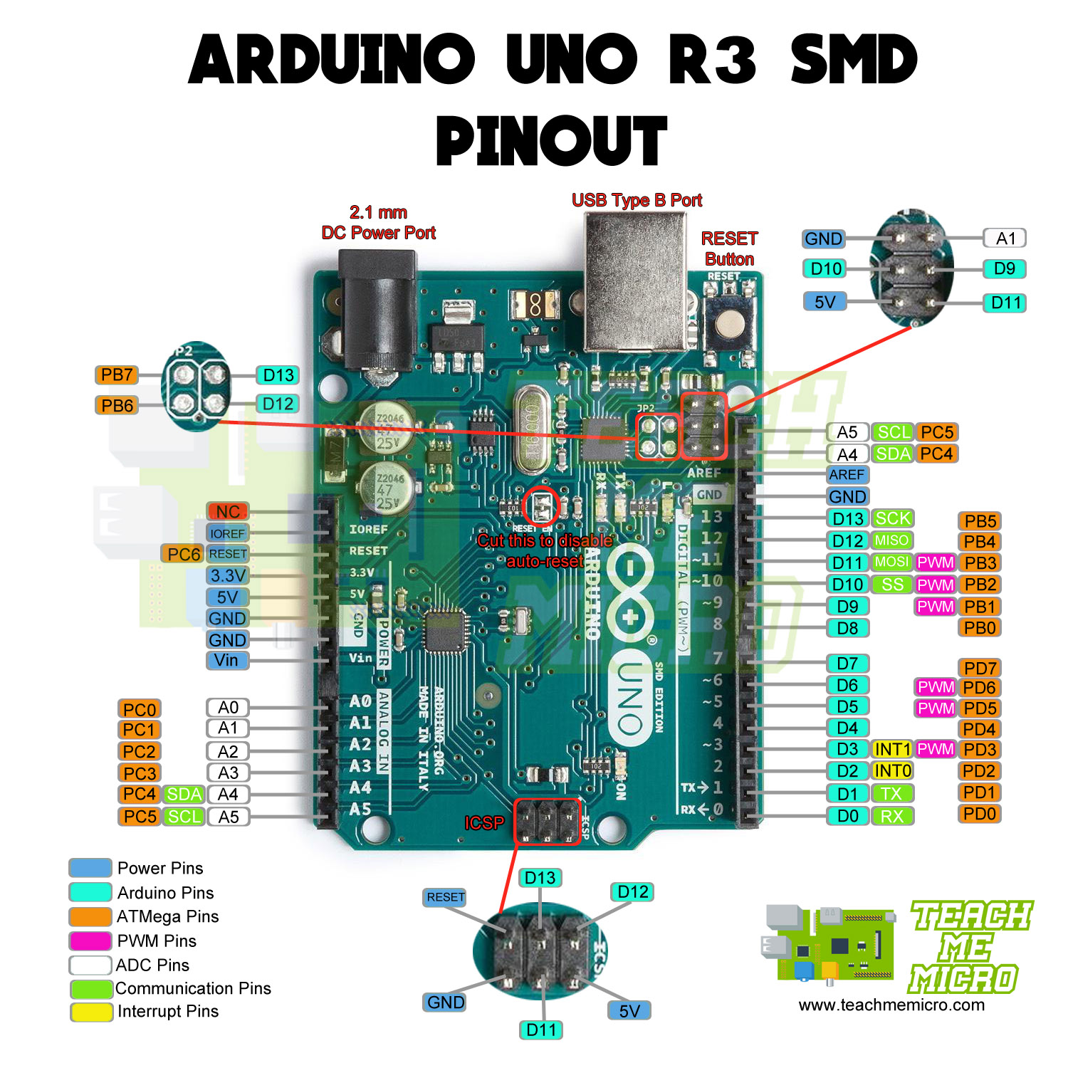
01
POWER PINS
1. 5v Pin
2. 3.3v Pin
3. Reset Pin
4.Ground Pin
5. Vin Pin (INPUT )

Slide 25
02
ANALOG PINS
These pins are used for capturing analog
inputs from sensors.
6 analog pins
A4 = SDA(serial data)
A5 = SCL(serial clock)
A4 and A5 pins are used for
I2C comunications

Slide 26
03
DIGITAL PINS
PIN 0 AND 1
Pin 0 = RX (Reciver )
Pin 1 = TX (Transmitter)
Pin (0,1) used for serial communication.
means read data from another sensor/device
NOTE :
Don't connect any output device to these pins.

Slide 27
04
PWM PINS
6 PWM Pins (3 ,5 ,6, 9 ,10 , 11)
PWM pins are represented by '~' .
PWM = PULSE WIDTH MODULATION
In simple language change voltage between 0V to 5V

Slide 28
05
DIGITAL PINS
Used for Digital output means for on and off
in computer language these pins have 2 states
either 0 or 1. (0 = 0V and 1 = 5V)

Slide 29


Slide 30
Programing basics.
1.
concept you know before starting
1. functions.
2. working of if and else conditions.
3. basics of c/c++ .
Most important :
don't forget to use semicolon ;

Slide 31
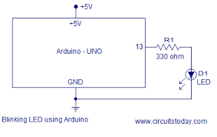
Blink the Led .
2.
OBJECTIVE :
To turn on the led for 1 second and then turn it off for the next 1 second using arduino board.
STRATEGY:
step 1 : Make the circuit
Step 2 : Program it
(moving to simulator)

Slide 32
Other Projects
3.
2. Led dimmer with arduino.
Objective : increase/ decrease the brightness of the led's using a knob.
3. Push button with arduino.
Objective : use 2 leds, turn green led on when button is pressed otherwise turn on red led.
4. Dc motor with arduino.
Objective : use a dc motor with arduino and controll its speed.

Slide 33
Sensors and modules

Slide 34
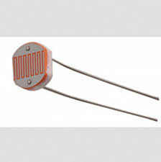
LDR with ARDUINO

Slide 35
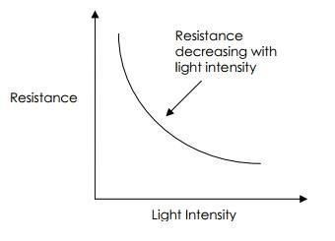
1. What is a LDR ?
LDR is short name of Light dependent resistance . It is a kind of variable resistance whose resistance varries with intensity of light . when there is low light it resistance is very high and vise versa .
Light : 400 ohms
No light : 9,000 ohms (9 kilo ohms)
These values are aprox . values deffer from ldr to ldr

Slide 36
2. How to connect LDR with Arduino
Let's see.............

Slide 37
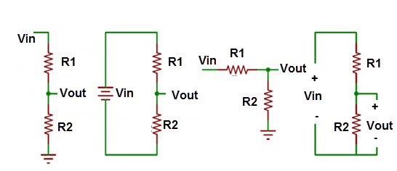
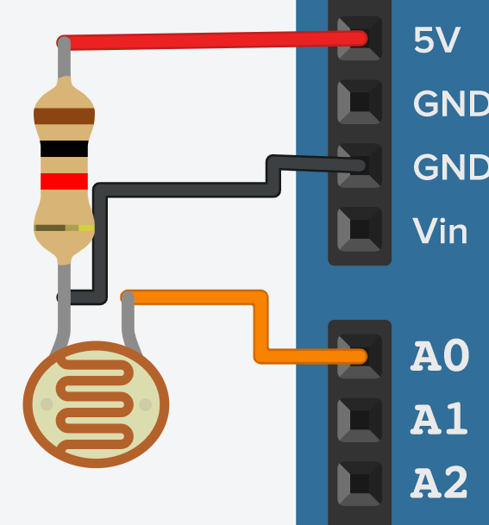
3 . why Voltage divider configration ?
We use voltage divider configration to get reference voltage . But why because theoriticaly at no light , resistance of LDR is 9000 ohms whichis too much . so we use voltage divider configration.
Describing Voltage divider law in brief :
+
Vin
-
Vout= Vin x (R1 / R1+R2)
R1
few calcution
Vin = 5 v
R1 = 1000 ohm
R2 :
day = 400 ohms
night = 9,000 ohms
+ Vout (A0)
R2

Slide 38
( )
Vout = R1
Vin
___________
R1+R2
Light intensitiy = High :
Vout = 5 [1000 / (1,000+400)]
= 5 (1000 / 1,400)
= 3.57 V or analog value = 728
Light intensitiy = LOW :
Vout = 5 [1,000/ (1,000+9,000)]
= 5 (1,000/ 10,000)
= 0.5 V or analog value = 102

Slide 39
Lets do programming.........

Slide 40
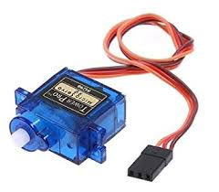
SERVO MOTORS

Slide 41
WHAT IS A SERVO MOTOR
It is a type of motor whose motion can be controlled in terms of angle . for example 15 degrees ,90 degrees etc.

Slide 42
Types of servo motors
There are manly 2 type of servo motors
1. 180 degree servo motors
2. 360 degree / continous servo motors

Slide 43
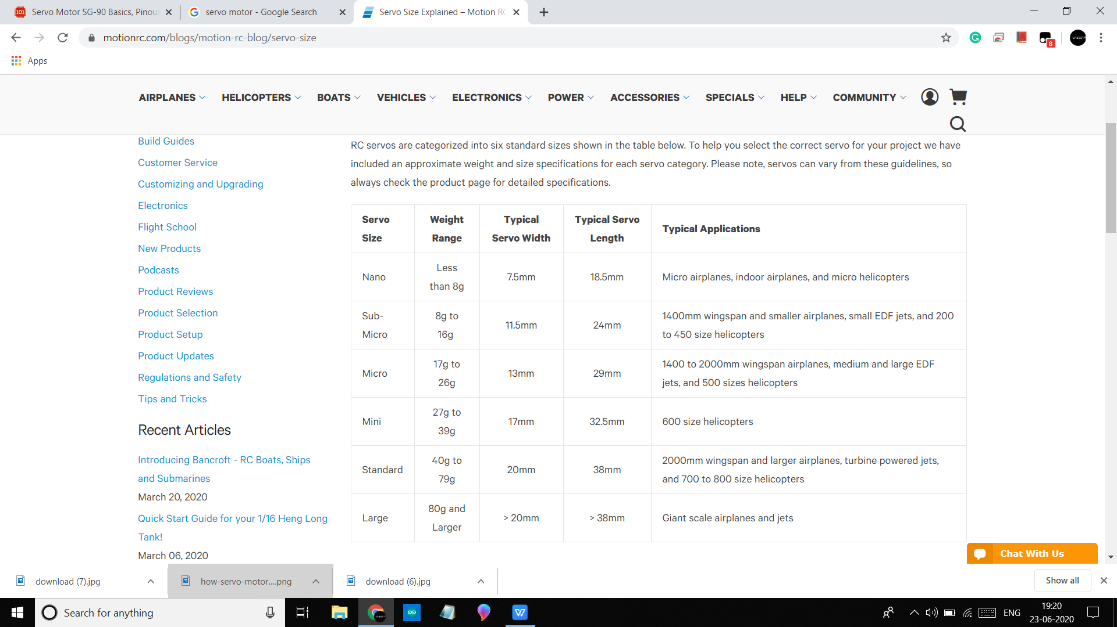
Different sizes of servo motors

Slide 44
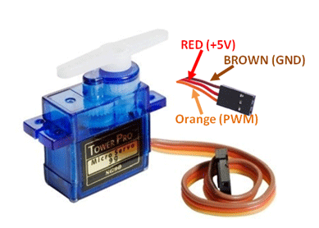
How to interface Servo motors with arduino
Pin configration of servo motor

Slide 45
Now lets learn its programming

Slide 46
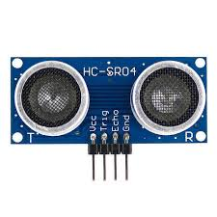
Ultrasonic Sensor

Slide 47
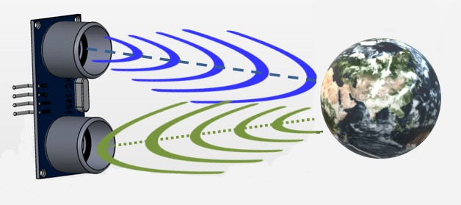
How Ultrasonic sensors work ?
Sends a high frequency sound (ultrasound) and wait for sound to reflect back.
count how much time it takes to come back .(we can call this echo )
speed = distance /time . so,
Time = distance / speed

Slide 48
Speed of ultrasound = 340 m/s
or 0.034 cm / micro sec
lets say object is at 1 cm away so
distance = 2cm (because ultrasound will cover twice the distance )
time = 2/ 0.034 = 58.8 micro sec.

Slide 49
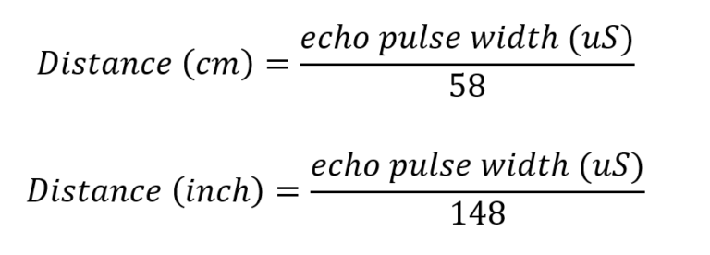
microcontrollers calculation.

Slide 50
Our sensor HC- SR04
HC-SR04 Specifications
Working Voltage: DC 5V
Working Current: 15mA
Working Frequency: 40Hz
Max Range: 4m
Min Range: 2cm
Measuring Angle: 15 degree

Slide 51
Projects :
Digital scale
Parking sensor
Blind stick
I.O.T projects .....like distance avoiding bot , water level indicators etc...

Slide 52
Pin configration :
Vcc : +5 v
Trig : Transmitter pin(Output pin)
Echo : Reciever pin (Input pin)
Gnd : Ground pin

Slide 53
Circuit Digram
lets see ....

