Slide 1

I am Abhinav Bisht.
I’m in class 8.
I have made this ppt to introduce my family to you.

Slide 2

SO, LET’S START!

Slide 3
My Family members
(leadErsHip-wise)
1.GRAND-FATHER:- (LATE)MR.ANAND .S. BISHT
2.GRAND-MOTHER:- MRS.BHAGWATI BISHT
3.FATHER:- MR.ANUP .S. BISHT
4.UNCLE(CHACHA JI):- MR.PRATAP .S. BISHT
5.MOTHER:- MRS.DURGA BISHT
6.AUNT(CHACHI JI):- MRS.DIPIKA BISHT
7.I:- ABHINAV BISHT
8.MY SISTER:- MANIKARNIKA BISHT
9.MY SISTER:- AARADHYA BISHT
10.MY SISTER:- VEDANSHI BISHT

Slide 4
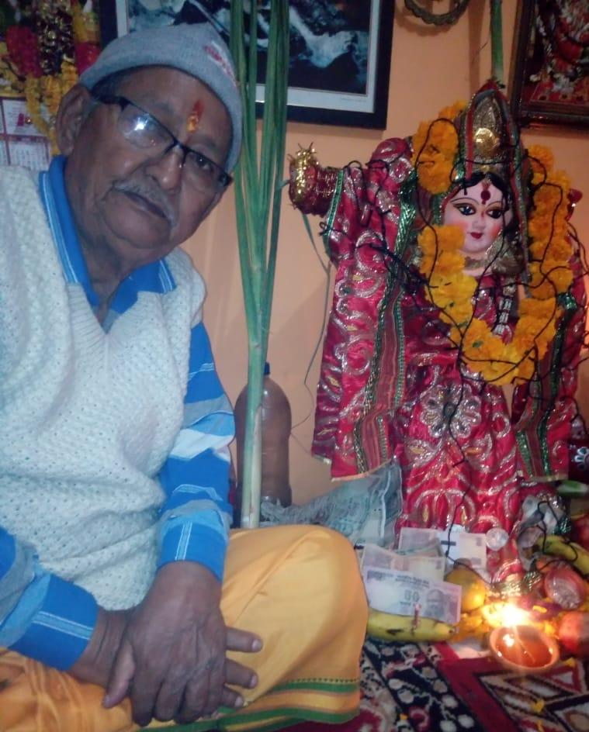
MY GRAND-FATHER

Slide 5
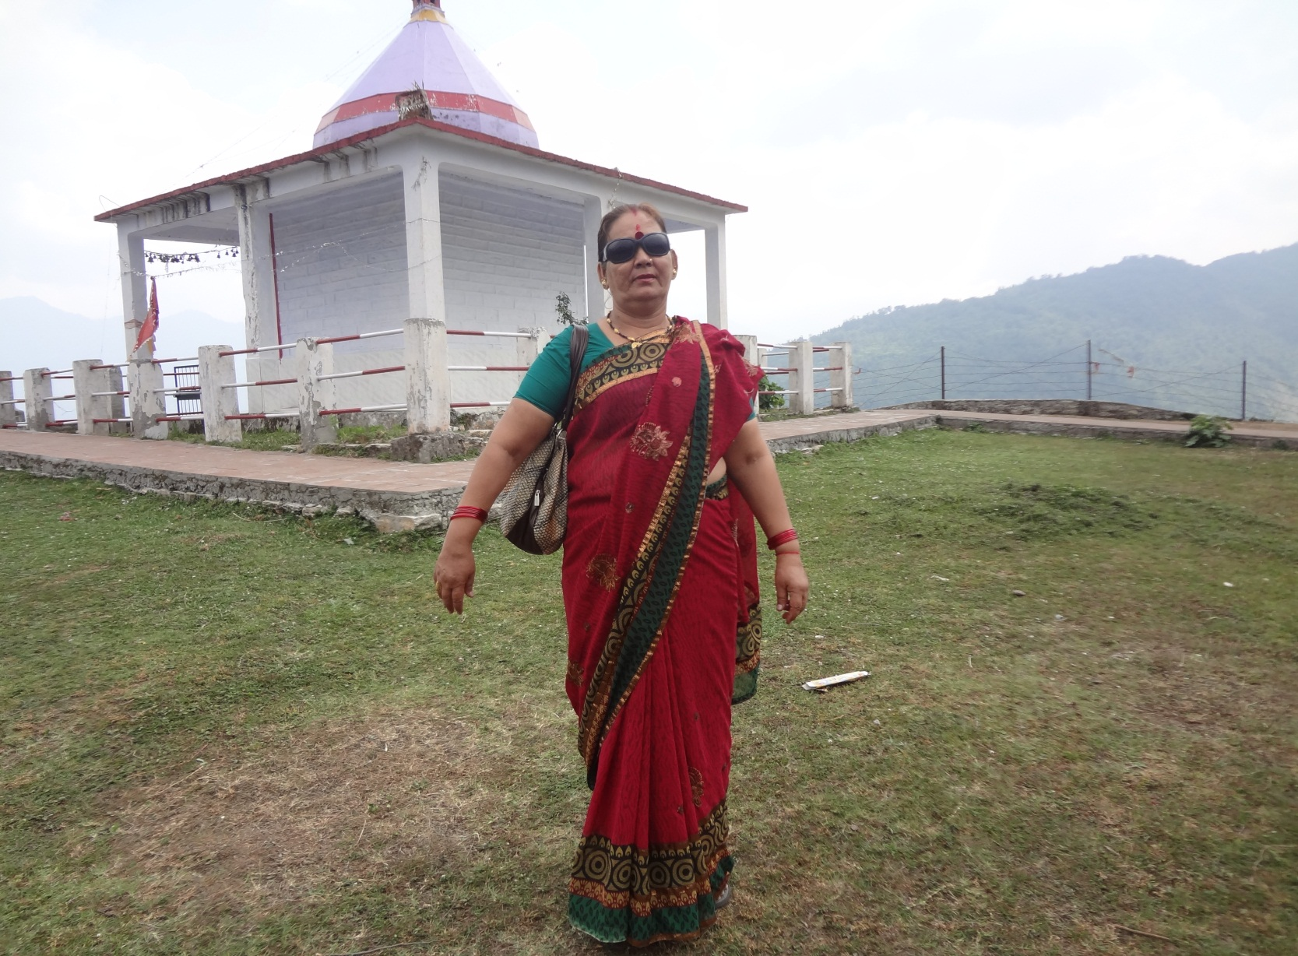
MY GRAND-MOTHER

Slide 6
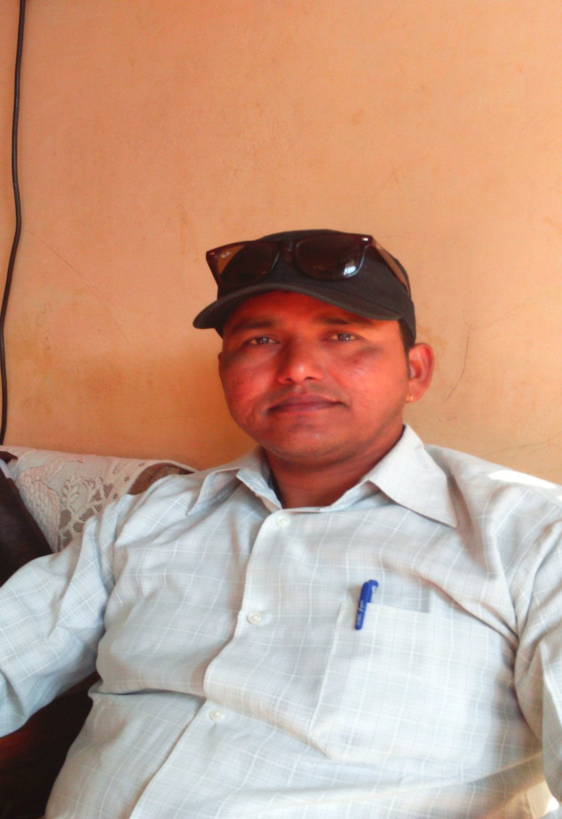
MY FATHER

Slide 7
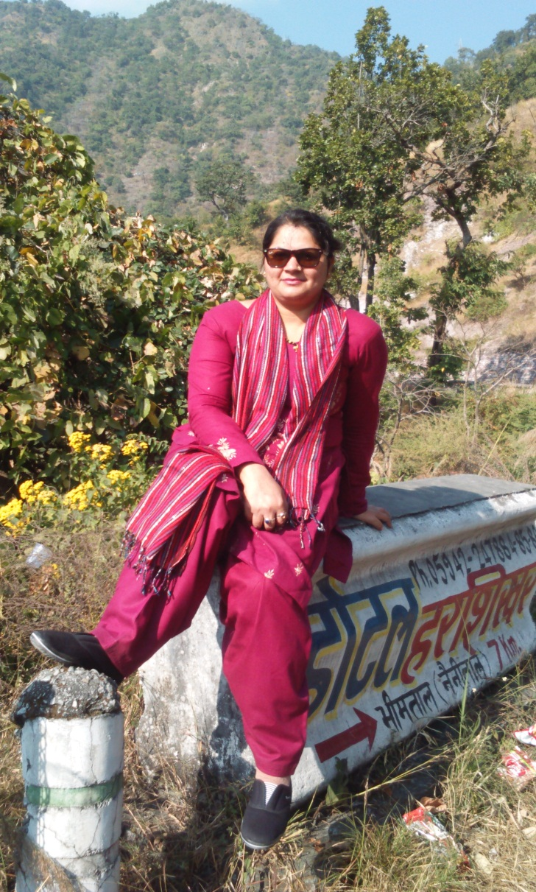
MY MOTHER

Slide 8
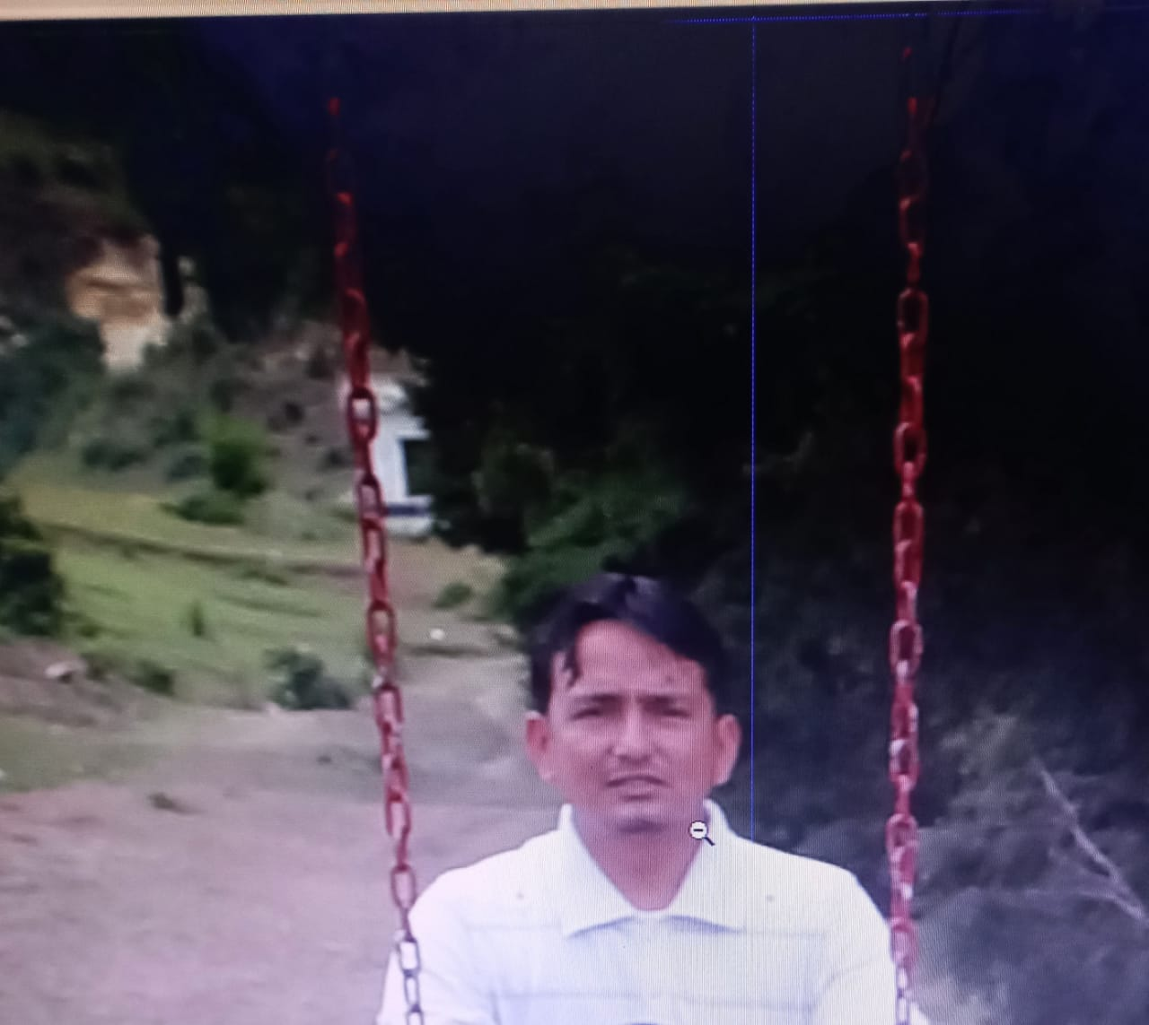
MY UNCLE

Slide 9
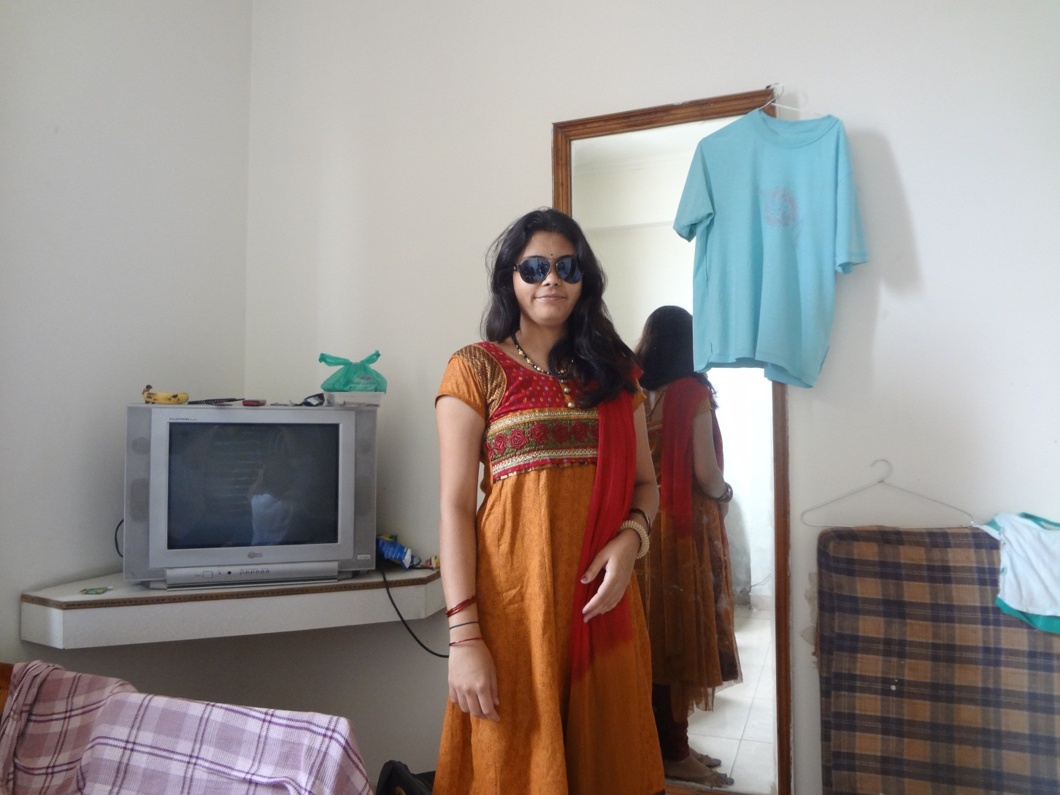
MY AUNT

Slide 10
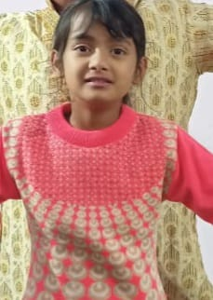
MY SISTER(MANIKARNIKA)

Slide 11
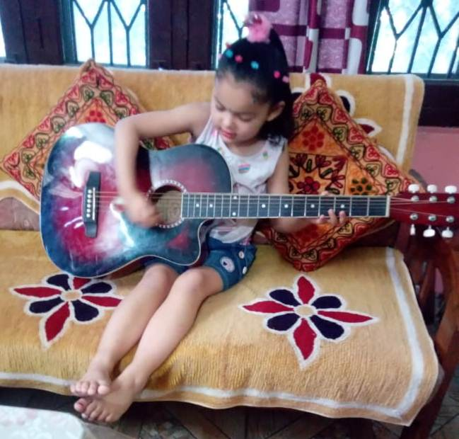
MY SISTER(AARADHYA)

Slide 12
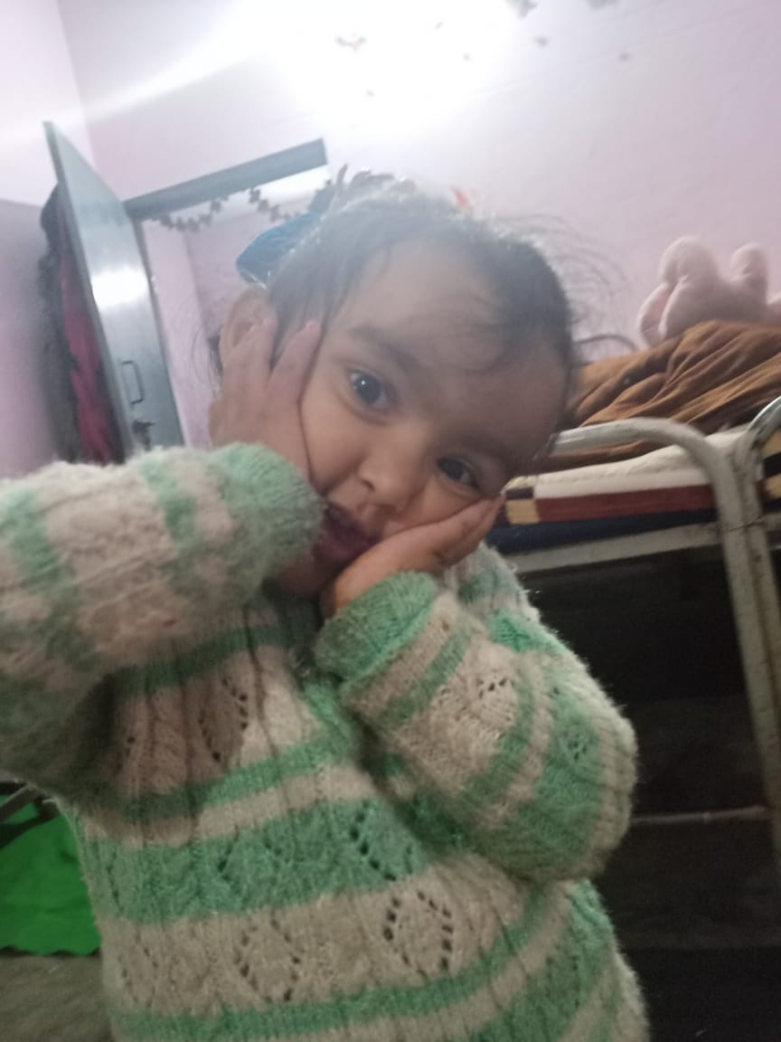
MY SISTER(VEDANSHI)

Slide 13
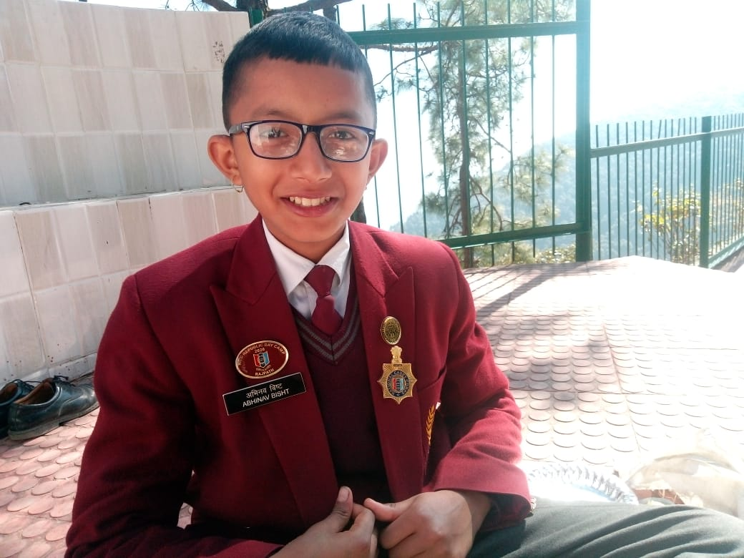
AND AT THE LAST,
I

Slide 14
Back to screen

