Slide 1
RESTAURANT RECOMMENDATION SYSTEM
IR Project: Group 20
Submitted By:Thanmayee Matha
Abhinav garg
Riya garg
Komaljyot kaur
Saksham nautiyal

Slide 2
Problem statement:
A highly effective restaurant recommendation systema well-liked service whose precision and elegance keep expanding every day. Our restaurant recommendation algorithm seeks to include user evaluations, past dining encounters, and restaurant attributes including location, cuisine, price range, ambiance, and ratings.
In order to give users personalised restaurant recommendations, the system uses hybrid filtering, which combines the outcomes of collaborative filtering to identify similar users based on their past dining experiences and ratings, recommend restaurants that the user might like, and recommend restaurants that match the user's preferences based on restaurant features such as location, cuisine, price range, ambiance, and ratings.
Additionally, the system offers a user-friendly interface that makes it simple for consumers to look up and find new eateries based on their interests and suggestions.

Slide 3
Motivation:
Conventional means of locating restaurants, including asking around or pursuing internet review sites, can take a lot of time and may not offer choices that are specifically tailored to the user's tastes and region.
Users may experience dissatisfaction and decision fatigue by the conventional means.
The main people who are going to benefit from this recommendation system are the tourists, who are new to a city.
Most of the tourists always love to visit famous restaurants in a particular city during their visit.So this motivated us to create a restaurant recommendation system .

Slide 4
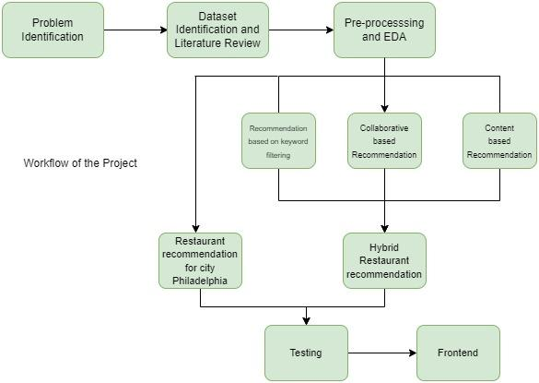
WORK FLOW OF PROJECT

Slide 5
Dataset:
The data we used comes from the following link: http://www.yelp.com/dataset_challenge..
It contains following data:
● 1.6M reviews and 500K tips by 366K users for 61K businesses
● 481K business attributes, e.g., hours, parking availability, ambience.
● Social network of 366K users for a total of 2.9M social edges.
● Aggregated check-ins over time for each of the 61K businesses

Slide 6
Exploratory Data Analysis:
On performing exploratory data analysis we got the following insights from the data:
We found that McDonald's and Subway are the most popular restaurants in all states.(Figure 1)
City Philadelphia has the maximum number of restaurants.(Figure 2)
We see that locations of businesses are concentrated in clusters. These clusters must be big cities.(Figure 3)
We analyzed that our data has businesses from certain cities of U.S. and not all over U.S(Figure 4)
Checked how rating and reviews are related to each other as these are important factors for restaurant recommendation.We can see that as the rating increases from 1.0 to 4.0, the number of reviews tends to increases as well. However, as rating increases further, especially from 4.5 to 5.0, the number of review shrinks.(Figure 5)
We also found the top 10 5-star restaurants sorted by review count(Figure 6)
Restaurants with TakeOut, AcceptCreditCard, GoodForKids, Reservation, GoodForGroups, BusinessParking, HasTV, Alcohol, BikeParking, Delivery,, Attire are more popular

Slide 7
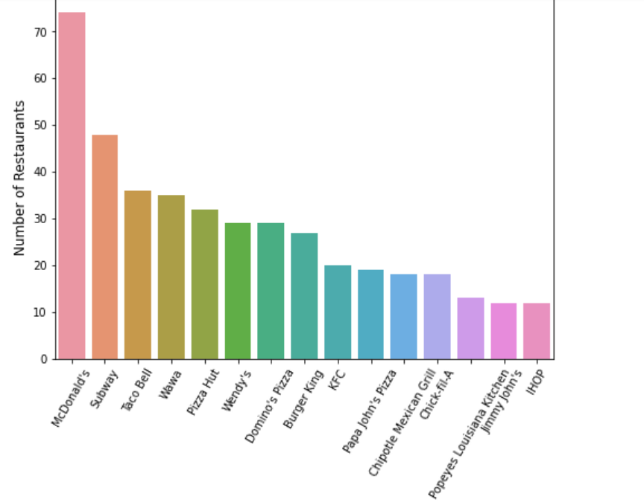
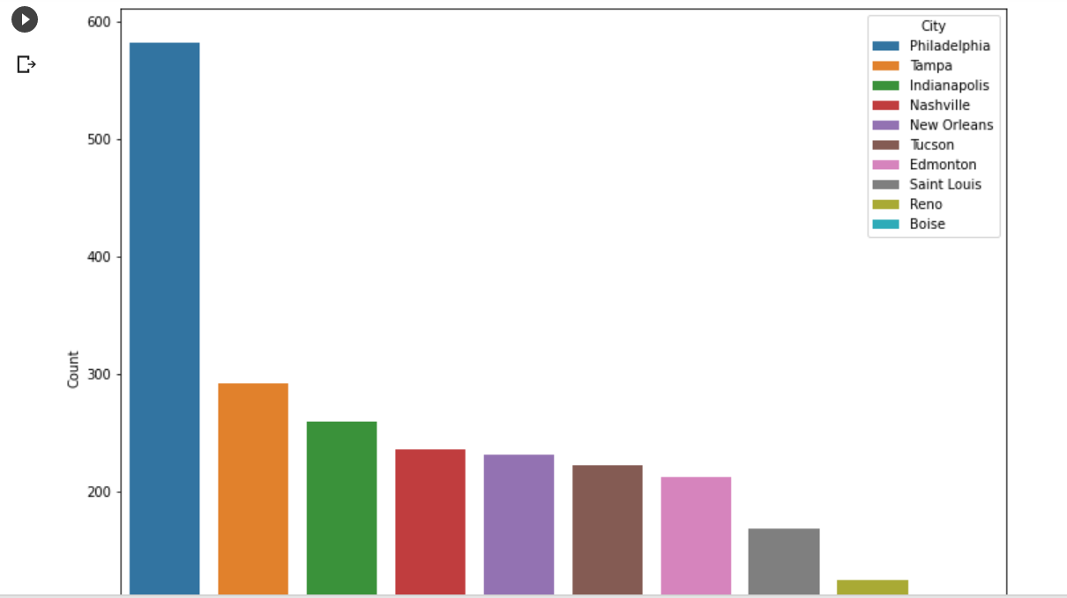
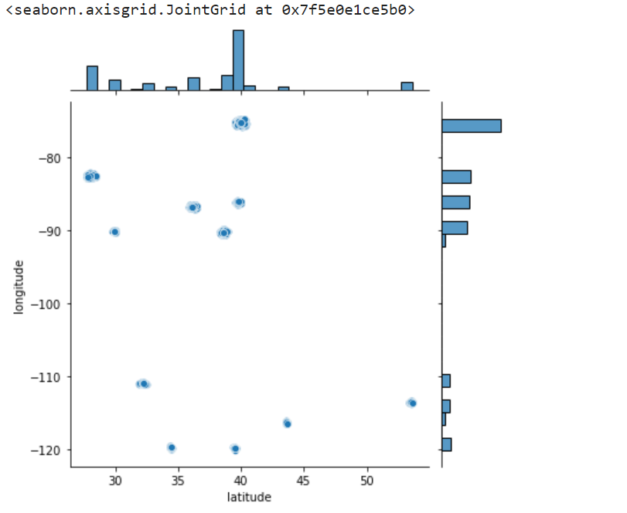
Exploratory Data Analysis:
Figure1
Figure 2
Figure 3
Figure1

Slide 8
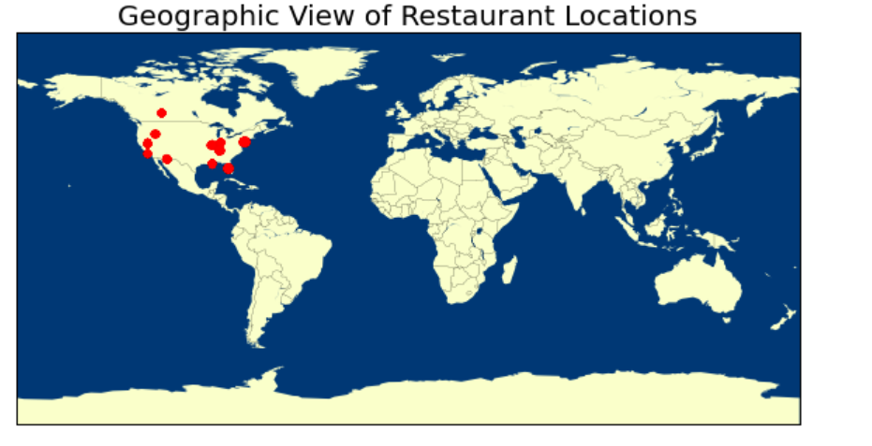
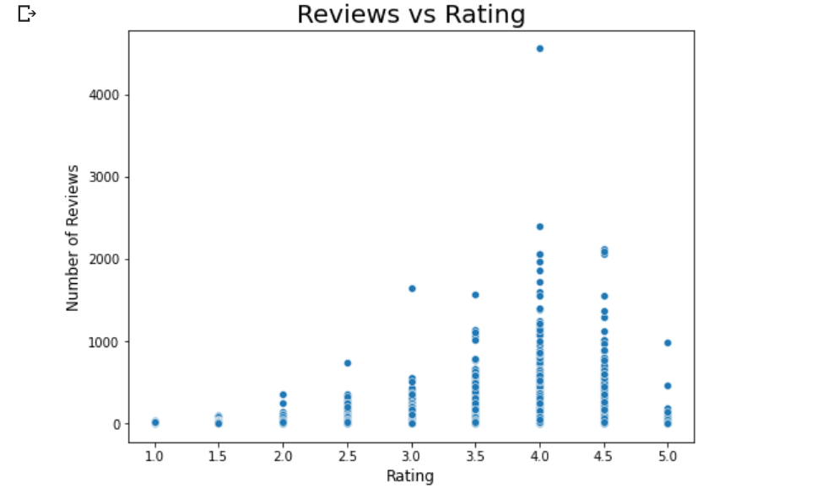
Exploratory Data Analysis:
Figure 4
Figure 5

Slide 9
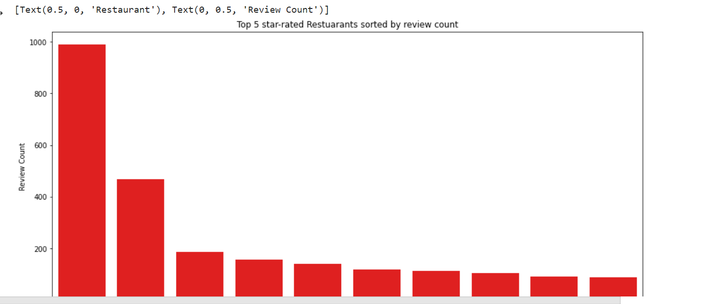
Exploratory Data Analysis:
Figure 6

Slide 10
Exploratory Data Analysis:
We also analyzed the number of reviews in a year and the most used time to give reviews.(Figure 7)
We found that no reviews recorded are minimum in the morning.(Figure 8)
Overtime users become less harsh reviewers.
Half of the restaurants have less than 20 check ins, even less than the reviews, indicating that check in is not a widely used feature on Yelp.
The popularity of reviews shows a steady upward trend since the beginning in 2004 with seasonal fluctuations, whereas the popularity of tips (No. of tips) increases in the first four years after its introduction (2009-2013) and slowly dives down thereafter. Therefore tips are not as popular as reviews.(Figure 9)

Slide 11
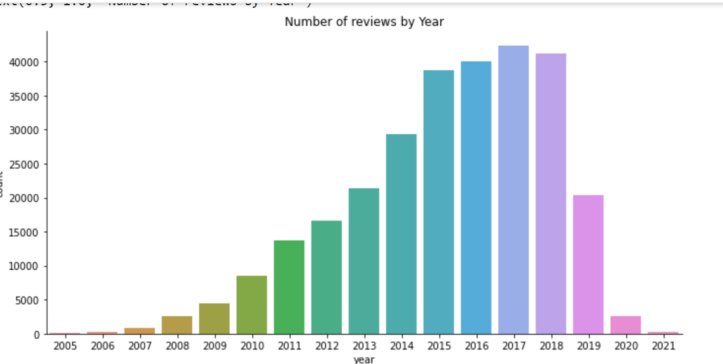
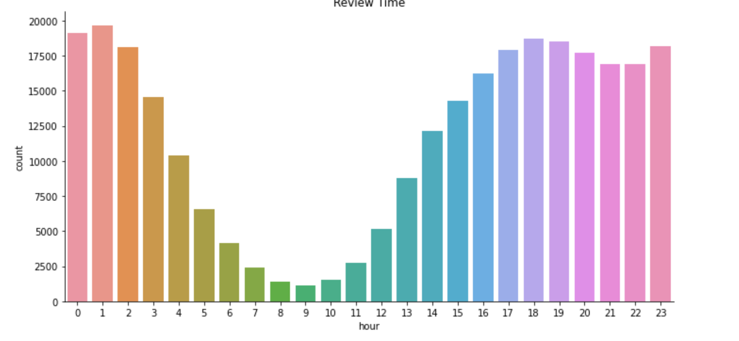
Exploratory Data Analysis:
Figure 7
Figure 8

Slide 12
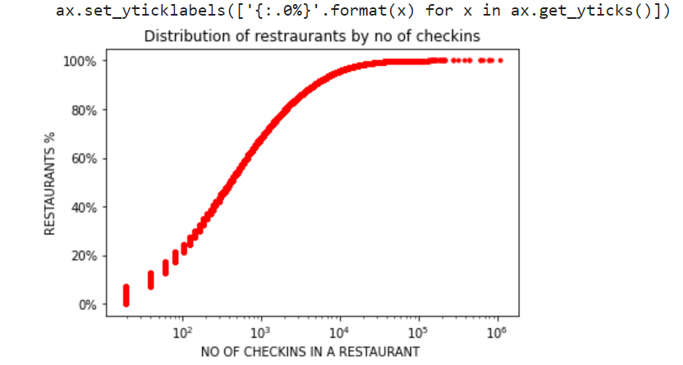
Exploratory Data Analysis:
Figure 9

Slide 13
Methodology:
We plan to develop a hybrid recommendation system formed by the following:
Recommendation based on restaurant location and feature based keyword filtering.
Collaborative filtering based recommendation
Personalized restaurant content based filtering recommendation module
We also built a separate recommendation system for Philadelphia city users.

Slide 14
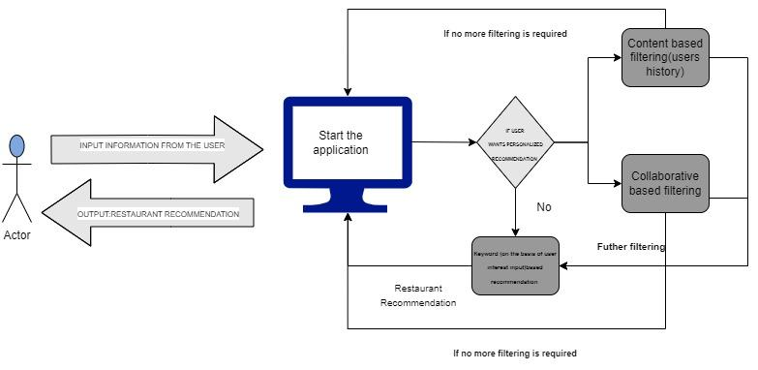
FLOW CHART FROM USER’S POINT OF VIEW:

Slide 15
Evaluation metrics:
Accuracy of rating prediction: RMSE(root mean squared error):
RMSE is a measure of the difference between the predicted ratings and the actual ratings of the restaurants. It is a widely used metric in recommendation systems as it gives a measure of the accuracy of the predicted ratings. The formula for RMSE is given as:
sqrt(sum((predicted_rating - actual_rating)^2) / n)
Effectiveness of recommendation ranking: NDCG(Normalized Discounted Cumulative Gain):nDCG is a widely used metric in recommendation systems that takes into account the relevance and ranking of the recommended items. It measures the quality of the ranking of recommended items, where a higher score indicates better performance. The formula for nDCG is given as:nDCG@k = DCG@k / IDCG@k
Where k: The number of recommended items to consider
DCG@k: Discounted Cumulative Gain at k, which is the sum of the relevance scores of the top k recommended items
IDCG@k: Ideal Discounted Cumulative Gain at k, which is the DCG@k when the recommended items are in perfect order based on relevance
The model used to predict ratings for test sets with new users and businesses as well as testsets without new users or businesses ('testset 2').
Following the computation of NDCG@top10 and NDCG@5, the recommendation ranking is constructed for each user in the testset based on the projected ratings in decreasing order.

Slide 16
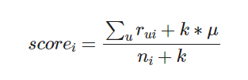
Recommendation Based On Restaurant Location and Feature Based Keyword Filtering:
The non- personalization recommendation based on restaurant location and feature based keyword filtering facilitates combining restaurant feature-based (cuisine, style, pricing) and location-based (zip code, city, state) keyword filtering of the restaurant catalog. The filtered catalog is ranked according to the user's preferred ranking criteria to produce the tailored suggestions.
A function that calculates the geodesic distances between two spots on a globe given their coordinates was created in order to determine the distance between a restaurant and the user's point of interest.
An adjusted rating score is introduced as an improved metric to replace the original restaurant average star rating.

Slide 17
Collaborative based filtering:
In the collaborative filtering based recommendation module ,personalized restaurant recommendations are supported given the distinct user id. The user-unrated restaurants from the catalog are ranked by the ratings anticipated by the model and returned as personalized suggestions. The personalization is computed based on the user's and all other users' rating histories of all Yelp establishments.
Several matrix factorization models are prototyped in order to develop the module. The collaborative recommender module has used the optimised SVD with bias model since it provides the best RMSE for rating prediction on an unknown testset.
Performance given by different models:
Simple SVD: -2.0039
SVD with bias -1.2305
Grid search (SVD):1.23
NMF without bias -1.41
NMF with bias-1.55
NMF using scikit learn-2.79
NMF model(grid search optimization):1.4037
Average nDCG achieved by our best model at nDCG@5 AND nDCG@10 is 0.96 and 0.94 respectively.

Slide 18
Content based Filtering:
In the personalized restaurant content-based recommender module, personalized restaurant recommendations are supported given the distinct user id. User-unrated restaurants from the catalog are ranked by similarity score and returned as personalized recommendations. The personalization is computed based on the similarity between the user's preference indicated by historical ratings and all restaurants' features extracted from a rich set of Yelp restaurant review texts.
Based on the cosine similarity between the restaurant and user feature vectors, we computed restaurant and user feature vectors, and a similarity score was created. According to similarity ratings, we ordered open restaurants in descending order.
Average nDCG achieved by our best model at nDCG@5 AND nDCG@10 is 0.86 and 0.85 respectively.

Slide 19
Philadelphia recommender:
We also made a recommender of restaurants in Philadelphia using the review data of 2017-21 with business data using the above stated methods .
Input given is user_id.
EXAMPLE:

Slide 20
Demonstration and Results:

Slide 21
Demonstration and Results:

Slide 22
Future work:
Personalization based on tips and check ins can also be integrated.
More recent reviews are seen as more reliable than earlier reviews since factors like restaurant ownership, food quality, service, and the environment can all change over time. Therefore, by including the age relevance of the rating, the rating measure may be further enhanced.

Slide 23
References:
[1] Ahsan Habib, Abdur Rakib, and Muhammad Abul Hasan, “Location, Time, and Preference Aware Restaurant Recommendation Method”, IEEE, 19th International Conference on Computer and Information Technology, pp. 315-319, 2016.
[2] Nanthaphat Koetphrom, Panachai Charusangvittaya, Daricha Sutivong, “Comparing Filtering Techniques in Restaurant Recommendation System”, IEEE, pp. 46-51, 2018
[3] Khushbu Jalan, Kiran Gawande, “Context-Aware Hotel Recommendation System based on Hybrid Approach to Mitigate ColdStart-Problem”, IEEE, Communication, Data Analytics and Soft Computing, pp. 2364-2369, 2017.
[4] Jun Zeng, Feng Li, Haiyang Liu, Junhao Wen, Sachio Hirokawa, “A Restaurant Recommender System Based on User Preference and Location in Mobile Environment”, 5th IIAI International Congress on Advanced Applied Informatics, IEEE, pp. 55-60, 2016
[5] Ling Li, Ya, Zhou, Han Xiong, Cailin Hu, Xiafei Wei, “Collaborative Filtering based on User Attributes and User Ratings for Restaurant Recommendation”, IEEE, pp. 2592-2596, 2017.

Slide 24
THANKYOU

