Slide 1
Welcome to CSSE 220
We are excited that you are here:
Hopefully you followed the instructions in the welcome email, installed eclipse and checked out the Java intro project
Start your computer & Eclipse
Pick up a quiz from the back table
Answer the first two questions
Notes:
The code/project we’re working in today will be in JavaIntro and HW1. The solution has a number of different examples that may be used if desired.

Slide 2
Goals for this course
Move from Python to Java
Lots of little programs in the first few weeks
Move from writing method bodies to writing whole classes from scratch
Learn how to design programs
Break up larger programs into multiple classes
Arcade Game project
Learn algorithms and data storage
Maps, Sorting, mixed patterns and problem solving

Slide 3
Course Introduction, Starting with Java
CSSE 220—Object-Oriented Software Development
Rose-Hulman Institute of Technology
Notes:
Bring textbook to show to the class.

Slide 4
Agenda
Instructor intro
Critical links
We write some java code
Conditionals
Strings
Loops

Slide 5
Instructor Info
Jason Yoder
Prev. Visiting Professor CSSE 2017-2019
Feel free to call me:
Jason
Dr. Yoder (or Professor)
Degree: Computer Science, Cognitive Science
Only on campus Tue-Fri
Piazza/Email anytime!

Slide 6
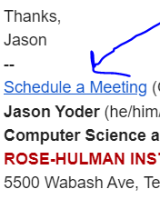
Instructor Info
Meetings with me 1 on 1
Calendly: a service to schedule
appointments (in my email signature)
Helps me plan my time effectively
Email me if you can’t find a time and we can discuss options:
Mondays: Skype/Google hangout
Tue-Fri: After 5pm, before 8am

Slide 7
Instructor Info
More about me
I am in Bloomington Sat-Monday
I like to “work hard and play hard”
I am rejuvenated by sports/physical challenges:
Ultimate Frisbee, rock climbing, hockey,+
I think its important to have a hobby or activity that helps keep you “sane” ☺
Interested in working with students on research
Feel free to stop by or email if you have interest in research

Slide 8
Introductions
TA
Students
What should we call you?
What you do for fun/rejuvenation?
Anything else you want us to know?
Notes:
Introduce TA find something each student does for rejuvenation…

Slide 9
Instructor Info
Amanda Stouder
Assistant Professor for the Practice of Computer Science and Software Engineering
You can call me:
Amanda
Professor Stouder
Don’t call me:
Mrs. Stouder (please not this)
Dr. Stouder (not this either, I’ll explain)

Slide 10
Instructor Info
Education
Rose-Hulman Institute of Technology 2008
B.S. in Computer Science and Software Engineering
Experience:
Amadeus Consulting, 2008-2010
Software Engineering Professionals (SEP), 2010-2014
Stouder Software Consulting, LLC (2014-present)
RHIT: Visiting Professor CSSE (2013-2016)

Slide 11
Instructor Info
Office Hours:
MWF 7:30am – 8:30am, 1:30pm – 4:30pm
OFF CAMPUS: Tuesdays and Thursdays
Always by my email!
If you need a different time, email me and we’ll work something out
Notes:
My reviews are consistent:
Not around as often as I’d like, but responds very quickly to email.

Slide 12
Instructor Info
Laptop Policy
I’m trying something new this quarter
Why?
I will ask you to close/open laptops as we move through the class
When closed, I need you to pay attention
This also means no phones/other devices
Closing far enough so you can’t see the screen is fine
What if I take notes on my laptop?
Notes:
Why am I doing this?
I don’t like repeating myself, and laptops are distracting. When I allow them to be open throughout class, I end up repeating myself and have students who have no idea what’s going on. For example, one year, I had a student who, three weeks into the class said he didn’t know what the schedule page was… There was more going on, but he was never forced to watch what was going on. Also, I know how tempting it is to turn on a game in the middle of class… don’t, 1) you won’t get the most out of this class… 2) You’re not as fast as you think you are at switching out of that game!
We will do a lot of live-coding, so you will need your laptops, and for those portions of the class, no problem! But during lecture, when we’re not live-coding, I’ll ask you to close / lower your laptop lids so I know I have your attention
Phones / other devices: I’m not blind, I can see you’re texting someone… You’re looking down, not up, easy to spot.
Since we will open and close our laptops a lot, I’m okay if you only close it so you can’t see the screen, rather than all the way, but barely tilted doesn’t cut it.
I know some people take notes on their laptops… If that’s you, I would ask that you come to my office after class and show me an example of the notes that you typically take on your laptop and I’ll make an exception. However, a lot of the notes taken in here should be on the daily quizzes, which we’ll get to shortly.
With all that said… please close (or at least lower) your laptop screens for the moment.

Slide 13
Instructor Info
Mike Hewner
Call me Buffalo
I love object oriented programming & weird programming languages
I’ve worked at Amazon, GroupOn, Progressive Insurance, and many other places
Contact info on the course polcies document

Slide 14
Should I really call my Professor Buffalo?
Consult this handy chart…
Situation Type | Informal | Semi-Formal/Kissing up | Highly Formal
Example Situation | asking questions in class, saying hi in the hallway | requesting things like re-grades or recommendation letters | funerals, addressing heads of state
Correct form of address | Buffalo | Dr. Buffalo | Dr. Hewner
Example | “Yo Buffalo, when is that assignment due?” | “So I think you’ll agree, Dr. Buffalo, that I deserve an extension…” | “In accepting this Turing Award, I’d like to first and foremost thank Dr. Hewner…”

Slide 15
Instructor Info
Chandan Rupakheti - Call me Chandan
I enjoy learning and teaching Software Engineering courses
My particular favorites are Object-Oriented Programming, Software Design, and Software Architecture
I’ve worked at ESRI, DASS, and on many software engineer research projects at graduate school
Contact info on the syllabus

Slide 16
Instructor Info
Aaron Wilkin

Slide 17
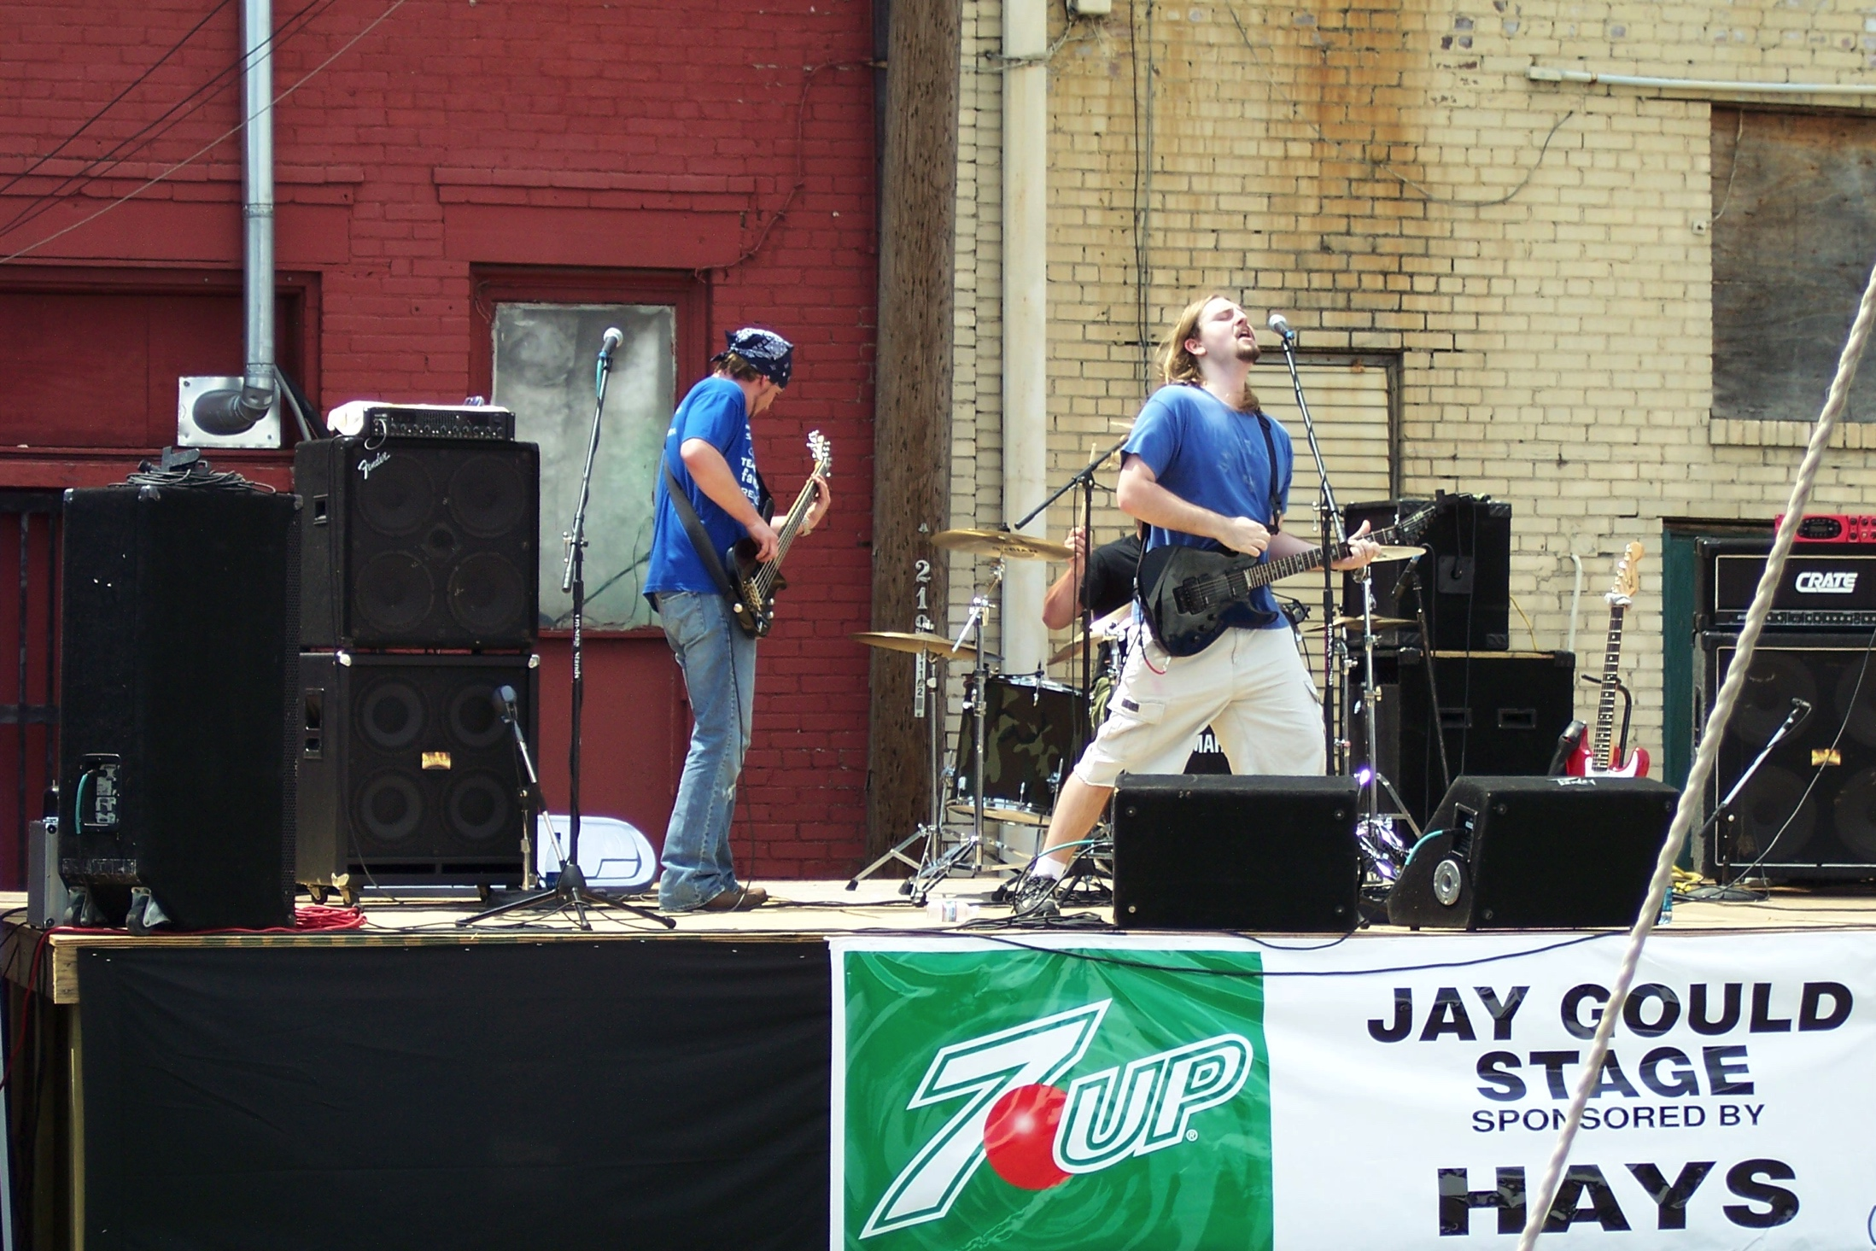

Slide 18
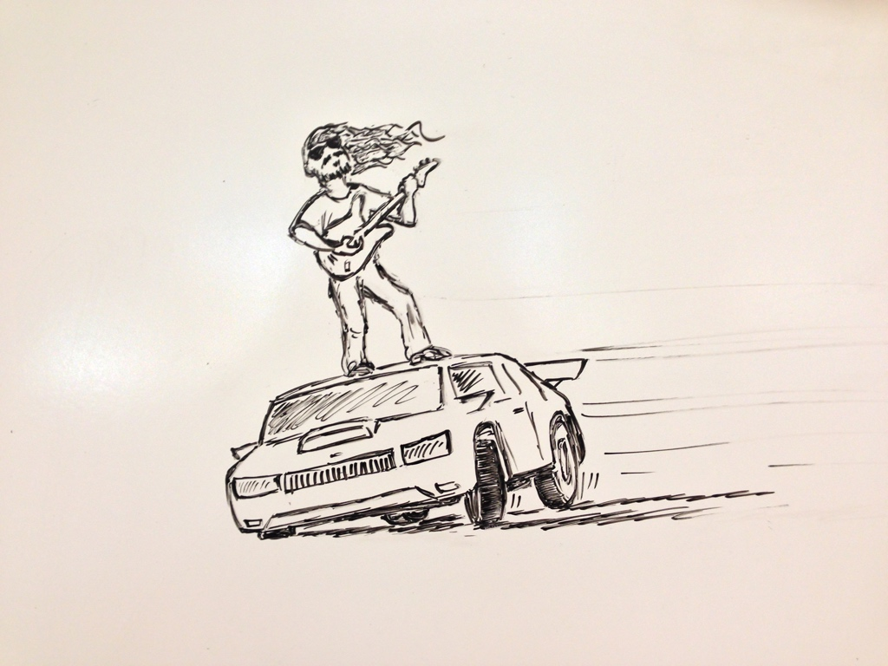

Slide 19
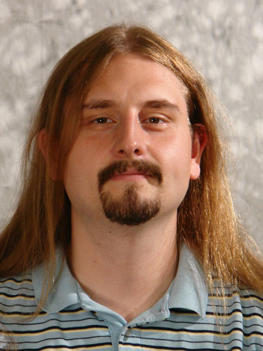

Slide 20
Instructor Info (continued)
On Campus every day
Office Hours (F203)
…
Email – wilkin@rose-hulman.edu
If you need another time, let me know and I’ll do my best

Slide 21
Instructor Info
Delvin Defoe
PhD, Washington University in St Louis 2007
Computer Science and Engineering
Tenured Associate Professor
Fall 2013
SEP
June 2014 – July 2015
Christian
Knightsville Church of Christ

Slide 22
Instructor Info (continued)
On Campus Mon., Tues., Wednes., Fri.
Office Hours (M240D)
See my schedule page
http://www.rose-hulman.edu/~defoe/schedule.html
Email – Always by my phone/computer
If you need another time, let me know and I’ll do my best

Slide 23
Instructor Info
Jason Yoder
Visiting Professor CSSE 2017-2018
You can call me:
Jason
Professor Yoder
Don’t call me:
Dr. Yoder (more info at end of class)
Notes:
Introduce TA

Slide 24
Critical Logistics
You have 2 homework assignments in the very near future
To see all assignment due dates, follow the "Course Schedule" link on Moodle
Please Bookmark Schedule page
We will only go over the course policies if we have time, but they are covered in the "Course Policies" page link on Moodle
Notes:
Open up schedule page and show students:
https://rhit-csse.github.io/csse220/schedule.html

Slide 25
Agenda
Instructor intro
Critical links
We write some java code
Conditionals
Strings
Loops

Slide 26
Let’s write hello world together

Slide 27
HelloPrinter.java
To run a Java program:
Right-click the .java file in Package Explorer view
Choose Run As → Java Application
Introduce yourself to your neighbor and change the program to say hello to them
Introduce an error in the program
See if you can come up with a different error than your neighbor
Fix the error that your neighbor introduced
Notes:
Discuss errors and error messages

Slide 28
A First Java Program
In Java, all variable and function definitions are inside class definitions
main is where we start
public class HelloPrinter {
public static void main(String[] args) {
System.out.println("Hello, World!");
}
}
System.out is Java's standard output stream. This is the variable called out in the System class.
System.out is an object from the PrintStream class. PrintStream has a method called println( ).
Q6
Notes:
Argument for main is not optional. Must be there.

Slide 29
In Class Coding
You can do this in pairs or on your own
There are 3 files:
ConditionalExamples.java
StringProbs.java
LoopProbs.java
Each file contains several solved functions and several unsolved functions. Understand the code in the solved functions, and then use that code to help you write the unsolved functions.
If you have a problem you can’t quickly debug, or you need a hint – call myself or the TA over
Test your code to ensure you’re right
In ConditionalExamples.java, modify “main” to call your new functions with test values
In the String/Loop probs, run the corresponding Test file to test your code

Slide 30
What are Types?
All variables in Java have a “type”
Describes the data that can be stored in a variable
String – text only
short/int/long – whole numbers only
float/double – numbers with decimals
boolean – true or false
char – a single text character
Classes – Class names are also types, let you define your own, more complex, types

Slide 31
Strings
String myString = “hello”;
String otherString = new String(“hello2”);
Java’s way of storing text data
Has many handy functions like substring, charAt, etc. that you will slowly learn
But how do you find out about these cool functions?

Slide 32
Quick Rule for Comparisons
Fast rules for now:
Use .equals() for comparing Strings
String alpha = “aaa”;
if (alpha.equals(“bbb”) {
System.out.println(“Yes!”)
} // end if
Use == comparing numbers or char (primitives)
boolean a = (5 == 6);
boolean b = (‘T’ == ‘F’ );
Notes:
Can decide to say this for next class or mention it now at least…

Slide 33
Java API Documentation
What’s an API?
Application Programming Interface
The Java API on-line
Google for: java api documentation 7
Or go to: http://download.oracle.com/javase/8/docs/api/
Also hopefully on your computer at
C:\Program Files\Java\jdk1.8.0_9\docs\api\index.html
You need the 7 (or 8) to get the current version of Java
Note: Your version may be something other than 8.0_9.
We recommend that you bookmark this page in your browser, so you can refer to it quickly, with or without an internet connection.
Notes:
Find the documentation for the String class from one of the above links, as follows:
Click java.lang in the top-left pane
Then click String in the bottom-left pane
Describe the parts of the String API documentation:
- description of the class
- summaries of all the fields, constructors, and method
detailed descriptions of everything

Slide 34
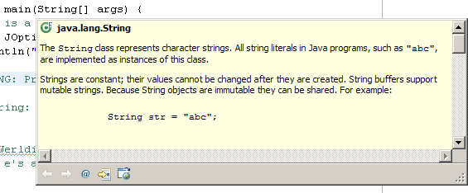
Java Documentation in Eclipse
Setting up Java API documentation in Eclipse
Should be done already,
Using the API documentation in Eclipse
Hover text
Open external documentation (Shift-F2)
Notes:
Point students to the link in the homework if everyone does not have the docs setup.
Demo hover text, F2 to focus on hover text, icon to open in web browser.
Shift-F2 to open external browser immediately.

Slide 35
Review Loops: while & for Loops
While loop syntax: Similar to Python
while (condition) { statements
}
For loop syntax: Different from Python
for (initialization ; condition ; update) { statements
}
In both cases, curly braces optional if only one statement in body; but be careful!
Notes:
Point students to Python vs Java features linked from session 1 of course schedule.

Slide 36
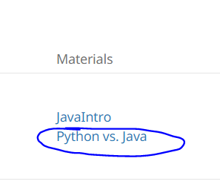
How to submit homework assignments
You'll submit your .java files via moodle assignments
There's instructions in the Homework section of the course moodle
Helpful:
Python vs Java features linked
on session 1 of course schedule:

Slide 37

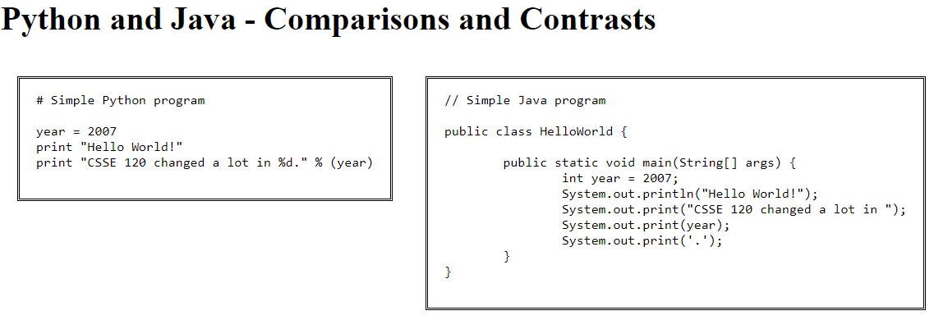
Java vs. Python

Slide 38
HW1 Due Before Next Session It’s on the schedule page: https://rhit-csse.github.io/csse220/schedule.html (It is your responsibility to keep up with the schedule page) As always, email me if you have any questions

