Slide 1
CSSE 220: Object Design
Part 1 of Many
Also Class Diagrams

Slide 2
Designing Classes
Programs typically begin as abstract ideas
These ideas form a set of requirements (i.e. what the user wants)
We must take these requirements, and figure out an approach for our coding
Usually the approach is not obvious
So we propose designs, then iteratively refine them into something that might work (continued…)

Slide 3
So we propose designs, then iteratively refine them into something that might work
Many bad ideas in the process
We don’t want to go through the effort of implementing bad ideas in code
But we need a way to communicate/think concretely about these half-baked program approaches
We need a diagram language!

Slide 4
Tools of the Trade
Class Diagrams (UML)
UML – Unified Modeling Language
Language unspecific
Has a lot of different diagrams it provides specifications for – but the class diagram language is the most widely used

Slide 5
A little class diagram will get you a long way
3 sections
Not the final version of UML we will teach, but covers the main points
ClassName
Field names
Method names
Example
Team
teamAverage name students
addGrade(grade) getTeamAverage()
Student
grades name
addGrade(grade)

Slide 6
Lines
A has a B (field)
ClassName
Field names
Method names
ClassName
Field names
Method names
Example
Note the star means several… usually a list or collection.
Team
teamAverage name students
addGrade(grade) getTeamAverage()
Student
grades name
addGrade(grade)
*
1-2

Slide 7
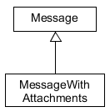
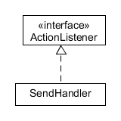
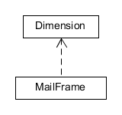
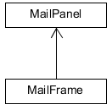



Summary of UML Class Diagram Arrows
Interface
Implementation
(is-a)
Association
(has-a-field)
Inheritance
(is-a)
Dependency
(depends-on)
Two-way Association
Two-Way Dependency
Cardinality
(one-to-one, one-to-many)
One-to-many is shown on left
Notes:
For a future class

Slide 8

Let’s try to code a simple UML diagram!
Try to make the classes and fields first!
You can create empty methods and leave TODOs
Implement the methods as the last thing you do.
Notes:
@startuml
skinparam style strictuml
class Main {
Main()
setAllBValuesTo3()
}
class A{
name
A( name )
setBValue( value)
}
class B{
count
B()
setValue( value )
}
Main -> "*" A
A-> B
@enduml

Slide 9
Principles of Design (for CSSE220)
Make sure your design allows proper functionality
Must be able to store required information (one/many to one/many relationships)
Must be able to access the required information to accomplish tasks
Data should not be duplicated (id/identifiers are OK!)
Structure design around the data to be stored
Nouns should become classes
Classes should have intelligent behaviors (methods) that may operate on their data
Functionality should be distributed efficiently
No class/part should get too large
Each class should have a single responsibility it accomplishes
Minimize dependencies between objects when it does not disrupt usability or extendability
Tell don't ask
Don't have message chains
Don't duplicate code
Similar "chunks" of code should be unified into functions
Classes with similar features should be given common interfaces
Classes with similar internals should be simplified using inheritance

Slide 10
The principles go from most important to least important. Today’s focus:
Make sure your design allows proper functionality
Must be able to store required information (one/many to one/many relationships)
Must be able to access the required information to accomplish tasks
Data should not be duplicated (id/identifiers are OK!)
Structure design around the data to be stored
Nouns should become classes
Classes should have intelligent behaviors (methods) that may operate on their data

Slide 11
An object oriented design must work!
Make sure all the data that you need is stored somewhere
And that you can access it from the classes that need it
The solution is not to keep 2 copies of the same data.
Notes:
Maybe mention in passing there are other design approaches that divide things differently, but we’ll be focusing on OO in this course

Slide 12
A good object oriented design is structured around the data
Look for the nouns in your problem, consider making them classes
…if they are complex enough
Put the data you need to store as fields in your classes
Add operations to the classes to accomplish what your need
Avoid Plural Nouns
Notes:
Maybe mention in passing there are other design approaches that divide things differently, but we’ll be focusing on OO in this course

Slide 13
An Example Problem
A website tracks books and the kids that read them. For each book the system stores the name and author. For each kid the system stores name and grade level. The teacher enters when a kid reads a particular book. It should be possible to print a report on a book that includes all kids who have read a particular book. It should be possible to print a report on a kid that includes the books a particular kid has read.
Make a UML diagram of your proposed design for this system.
Notes:
Don’t spend too long here

Slide 14
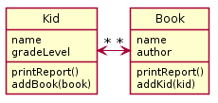
Basic solution
Note that List<Book> isn’t listed by name as an instance variable of Kid, but the line from Kid to Book with the * implies that. Ditto for List<Kid> in book, since the arrow is double-ended with * on each end

Slide 15
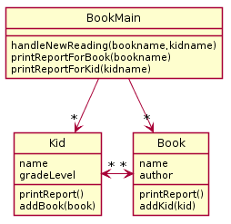
Main class
In really small programs, you could just have them as local variables in a static main
But for larger programs, it’s more usual for the class with main to be a real class with fields (also aids testing)
In our very simple designs, this class also deals with user input
Also be sure your design shows where things start and how user commands are handled
Notes:
@startuml
skinparam style strictuml
class Book {
name
author
printReport()
addKid(kid)
}
class Kid {
name
gradeLevel
printReport()
addBook(book)
}
class BookMain {
handleNewReading(bookname,kidname)
printReportForBook(bookname)
printReportForKid(kidname)
}
Kid "*" <-> "*" Book
BookMain -> "*" Book
BookMain -> "*" Kid
@enduml

Slide 16
Today’s Focus
Structure your program around the data that needs storing
Nouns become your classes, operations become their methods
Your structure needs to function correctly
Every class must have access (directly or indirectly) to the data it needs to complete its operations
Usually this means the problem must be modeled correctly
Data should also not be duplicated

Slide 17
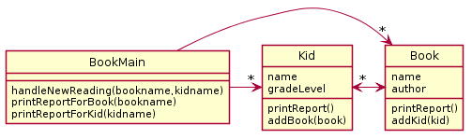
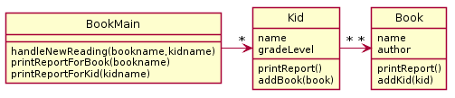
Consider
Bad Solution A
Bad Solution B
Notes:
Each kid now only has 1 book
There is no (sane) way to lookup a book to either lookup a book to add to a kid or print a report

Slide 18
In most cases non-workable design is caused by…
Not reading the problem carefully or not mapping it to design carefully (e.g. not noticing that each kid reads several books, not just one)
Not thinking about how specific required features might be implemented (e.g. how can we print a book report if we don’t have access to the book objects?)
Duplicating data (e.g. what does it matter if we store a copy of the author and title for every kid that reads the book)

Slide 19
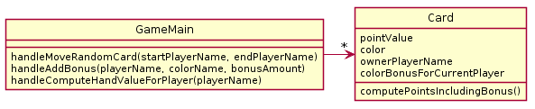
In a particular card game, players have hands of cards. Each card is worth some points and also has a color (red, blue, green). During play, players accrue bonuses that mean cards of a particular color are worth bonus points. During play, sometimes a random card is selected from one player's hand and moved to another player's hand. At the end of game, it is necessary to compute the total points for each player's hand.
What is wrong with this design? (Hint: look at and refer to your design principles by number). I see at least 2 separate categories violated.
3

Slide 20
My answer (in order of importance)
1a. The design does not function correctly
The player’s color bonus cannot be preserved if he/she loses all their cards of a particular color
It requires iterating over all objects to get the full set of cards in the players hands to move cards or compute final total
1c. Playername & player color bonus are duplicated across cards
2a. Player (common noun from problem) not represented
Notes:
Note for 1a – obviously you try to use nouns from the description. But its not required

Slide 21
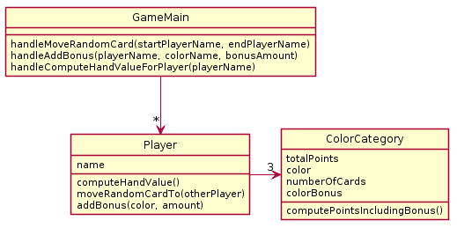
In a particular card game, players have hands of cards. Each card is worth some points and also has a color (red, blue, green). During play, players accrue bonuses that mean cards of a particular color are worth bonus points. During play, sometimes a random card is selected from one player's hand and moved to another player's hand. At the end of game, it is necessary to compute the total points for each player's hand.
What is wrong with this design? (Hint: look at and refer to your design guidelines). I see at least 2 separate categories violated.
4

Slide 22
My answer (in order of importance)
1a. The design does not function correctly
Once a card is added to a players hand, its specific point value is lost so the card cannot be randomly moved to another players hand
2a. Card (common noun from problem) not represented

Slide 23
In a particular card game, players have hands of cards. Each card is worth some points and also has a color (red, blue, green). During play, players accrue bonuses that mean cards of a particular color are worth bonus points. During play, sometimes a random card is selected from one player's hand and moved to another player's hand. At the end of game, it is necessary to compute the total points for each player's hand.
Now design your solution that solves all problems.
5

Slide 24
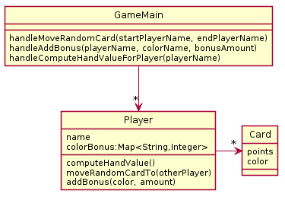
My Solution
getPoints(), getColor() too
Notes:
Since UML is meant to be a simple way to communicate, we often omit simple methods like getters and setters.
If we want you to show all methods, we will tell you to do so

Slide 25
For Next Class
Solve the 2 Design Problems in the handout
Bring your solution to be collected at the start of next class
We will go over the solution at the beginning of next class
Anything turned in late will be worth zero points
Problem 1 is also associated with ImplementingDesign1 homework
Due Thursday night. (We will go over a solution Wednesday)
You will have the option to implement your own design or out solution
ImplementingDesign1 description
We’ll discuss more design principles next class
Notes:
Briefly show the website description and how points are awarded, especially making note of the reflection questions and sample output.

Slide 26
A problem (if we have time)
A factory sells a small number of unique products. Each product has an id code, a description, price and quantity (the amount currently available at the factory). When a customer places an order, they buy a specific number of each product. The order needs to be stored in the system for future reference, with the customer’s name and address.
At some point, the order should ship to the customer, and that date should also be recorded.
The main operation of the system is to add a new order and mark an order as shipped.
In a group of 2-3, make with an object design for this system and document it in UML (on paper).
Notes:
I am leaving this slide in in case there is time but I doubt there will be.

Slide 27
A problem –revised
Now orders can be partially shipped – i.e. a single order might take several shipments to complete.
The main operation of the system is to add a new order and enter shipments for orders.
In a group of 2-3, revise your design to accommodate this new issue.

Slide 28
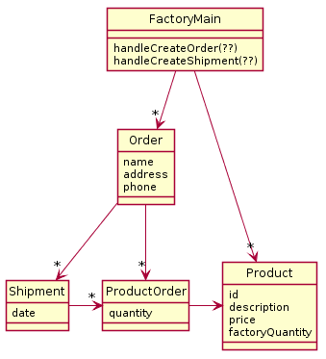
Notes:
@startuml
skinparam style strictuml
class FactoryMain {
handleCreateOrder(??)
handleCreateShipment(??)
}
class Product {
id
description
price
factoryQuantity
}
class Order {
name
address
phone
}
class ProductOrder {
quantity
}
class Shipment {
date
}
FactoryMain --> "*" Product
FactoryMain --> "*" Order
Order -> "*" ProductOrder
Order --> "*" Shipment
ProductOrder -> Product
Shipment -> "*" ProductOrder
@enduml

