Slide 1
GLOBAL TECH
LAYOFFS ANALYSIS
A data-driven review of workforce reductions across companies, industries, countries and company stages
PRESENTED BY
ABHINAV M
01

Slide 2
Executive Summary
Main patterns visible in the Power BI dashboard
EMPLOYEES LAID OFF
COMPANIES AFFECTED
INDUSTRIES AFFECTED
COUNTRIES AFFECTED
LARGEST EVENT
751,683
1,898
30
54
22K
What stands out
• Layoffs peaked in 2023 in the period shown.
• Hardware was the largest industry by recorded layoffs in the dashboard.
• The United States had the highest country-level total.
• Post-IPO companies accounted for the largest recorded layoffs by company stage.
• Funding-versus-layoff correlation cannot be assessed because funding amounts are missing.
02

Slide 3
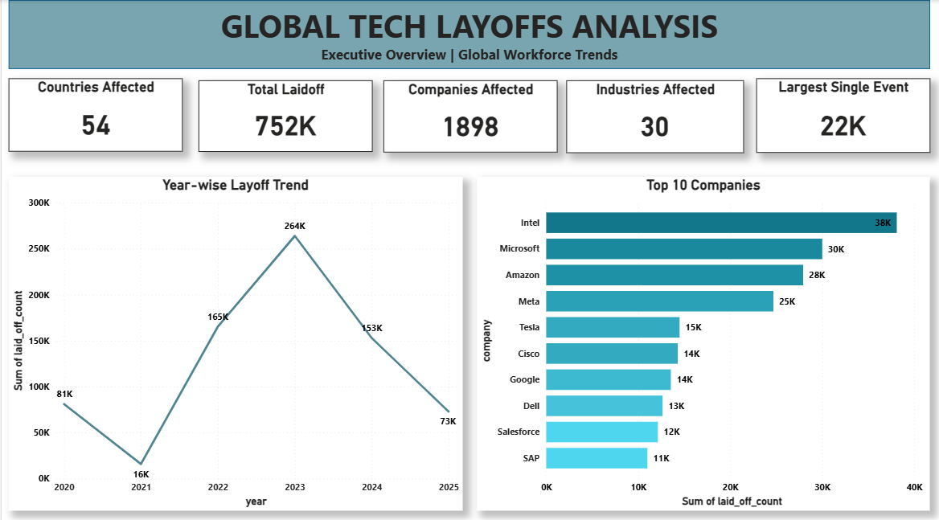
Power BI Dashboard: Executive Overview
Executive overview | global workforce trends
03

Slide 4
Project Scope & Methodology
How the analysis was organized
PROJECT OBJECTIVES
METHOD
• Measure total layoffs and affected companies.
• Compare layoffs over time.
• Identify the most affected companies and industries.
• Compare country-level and company-stage patterns.
• Build an interactive Power BI dashboard.
• Aggregated laid_off_count by year, company, industry, country and funding stage.
• Used bar, line, donut and map visuals to compare categories.
• Used slicers for interactive exploration.
• Reported limitations where the source did not contain required fields.
04

Slide 5
Layoffs Over Time
Year-wise pattern from 2020 to 2025
KEY OBSERVATIONS
• 2023 recorded the highest yearly total.
• Layoffs rose sharply from 2021 to 2022.
• Totals declined in 2024 and again in 2025.
• These patterns show timing, not the causes of layoffs.
05

Slide 6
Industry Analysis
Industries with the highest recorded layoff totals
KEY FINDING
Hardware ranks first in the dashboard, with 81,428 recorded layoffs.
Other and Consumer follow closely, showing that layoffs were spread across multiple industry groups.
06

Slide 7
Company Analysis
Top companies shown in the dashboard
WHAT THIS SHOWS
• Intel leads the displayed Top 10 list.
• Microsoft and Amazon follow.
• These are absolute layoff counts, not workforce-reduction percentages.
• Rankings can change with filters or source updates.
07

Slide 8
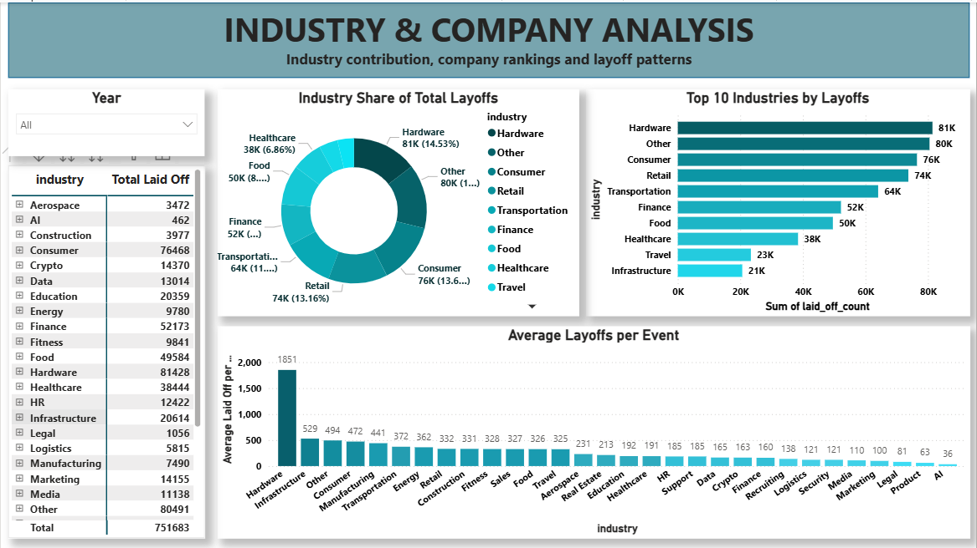
Power BI Dashboard: Industry & Company
Industry contribution, company rankings and layoff patterns
08

Slide 9
Geographic Analysis
Country-level distribution of recorded layoffs
KEY FINDING
The United States accounts for the largest recorded country total by a substantial margin.
India is second in the displayed ranking. The map visual communicates the broad geographic distribution of recorded events.
09

Slide 10
Company Stage Analysis
Layoffs by recorded funding/company stage
INTERPRETATION
Post-IPO companies account for the largest absolute layoff total in the dashboard.
This does not prove the highest workforce-reduction percentage. Total workforce sizes are not available.
10

Slide 11
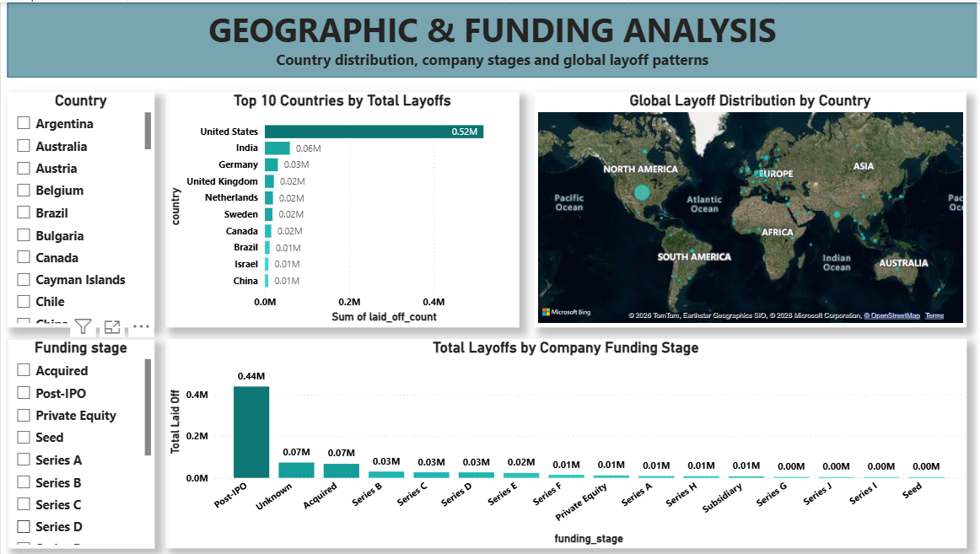
Power BI Dashboard: Geographic & Funding
Country distribution, company stages and global layoff patterns
11

Slide 12
Data Limitations & Interpretation
Important boundaries for accurate reporting
Funding amounts
Funding values are missing, so funding-versus-layoff relationships cannot be assessed.
Workforce-reduction percentage
Company workforce totals are unavailable, so workforce-reduction percentages cannot be reliably calculated.
Largest single event
Use the maximum event-level laid_off_count; confirm company and date in the source table.
12

Slide 13
CONCLUSIONS & RECOMMENDATIONS
Use the dashboard to monitor trends, compare segments and guide follow-up investigation.
1. Companies should monitor workforce changes over time and review staffing plans during periods of rising layoffs.
2. Industries and companies with high recorded layoffs should investigate their business conditions and workforce-planning practices before making further staffing decisions.
3. Management should use country-level trends to identify where layoffs are concentrated and investigate the underlying local factors.
4. Future analysis should incorporate verified funding amounts and company workforce totals to evaluate funding relationships and actual workforce-reduction percentages.
THANK YOU

