Slide 1
CAP5510 – Bioinformatics
Sequence Comparison
Tamer Kahveci

Slide 2
Goals
Understand major sequence comparison algorithms.
Gain hands on experience

Slide 3
Why Compare Sequences ?
Prediction of function
Construction of phylogeny
Shotgun sequence assembly
Predicting protein structure
Drug design

Slide 4
Question
Q = AATTCGA
X = ACATCGG
Y = CATTCGCC
Z = ATTCCGC
Form groups of 2-3. Sort X, Y, and Z in decreasing similarity to Q. (5 min)

Slide 5
Dot Plot
A A T T C G A
A
C
A
T
C
G
G
How can we compute similarity?
O(m+n) time
Is it a good scheme ?
Use longer subsequences (k-gram)

Slide 6
Dot Plot
A A T T C G A
A
C
A
T
C
G
G
Use longer subsequences (k-gram)

Slide 7
CAP5510 – Bioinformatics
Sequence Comparison
Tamer Kahveci

Slide 8
Alignment types 1/2
Global alignment: align entire sequences
Local alignment: align subsequences

Slide 9
Alignment types 2/2
Dovetail alignment: align opposite ends
Pattern search: align entire sequence to
a subsequence

Slide 10

Global Alignment
Q = AATTCGA
|rr|||r
X = ACATCGG
4 match
3 mismatch
Q = A-ATTCGA
|i|d|||r
X = ACA-TCGG
5 match
1 insert
1 delete
1 mismatch
How can we evaluate the quality of an alignment?

Slide 11
Edit Distance
Definition: Minimum number of insert / delete / replace operators to transform one sequence into the other.
Q = A-ATTCGA
|i|d|||r
X = ACA-TCGG
How do we find the minimum edit distance ?
AATTCGA
ACATTCGA
ACATCGA
ACATCGG

Slide 12
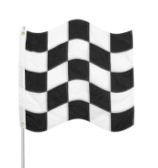
Each Alignment Maps to a Path
A A T T C G
A – A T T C G A
| i | d | | | r
A C A – T C G G
A
C
A
T
C
G

Slide 13
Global sequence alignment
(Needleman-Wunsch)
Compute distance recursively : dynamic programming.
Case 0 : one string is empty (n)
Case 1 : match (0) or mismatch (1)
Case 2 : delete (1)
Case 3 : insert (1)

Slide 14
Global sequence alignment
(Needleman-Wunsch)
D(i,j) = edit distance between A(1:i) and B(1:j)
d(a,b) = 0 if a = b, 1 otherwise.
Recurrence relation
  D(i,0) = Σ d(A(k),-), 0 <= k <= i
  D(0,j) = Σ d(-,B(k)), 0 <= k <= j
  D(i,j) = Min {
    D(i-1,j) + d(A(i),-),
    D(i,j-1) + d(-,B(j)),
    D(i-1,j-1) + d(A(i),B(j))}
d | A | C | G | T | -
A | 0 | 1 | 1 | 1 | 1
C | 1 | 0 | 1 | 1 | 1
G | 1 | 1 | 0 | 1 | 1
T | 1 | 1 | 1 | 0 | 1
- | 1 | 1 | 1 | 1 | 0

Slide 15
DP Example
A A T T C G A
A
C
A
T
C
G
G
D(i,0) = Σ d(A(k),-), 0 <= k <= i
D(0,j) = Σ d(-,B(k)), 0 <= k <= j
D(i,j) = Min {
  D(i-1,j) + d(A(i),-),
  D(i,j-1) + d(-,B(j)),
  D(i-1,j-1) + d(A(i),B(j))}
Notes:
Let the students fill most of the matrix.

Slide 16
DP Example
A A T T C G A
0 | 1 | 2 | 3 | 4 | 5 | 6 | 7
1 | 0 | 1 | 2 | 3 | 4 | 5 | 6
2 | 1 | 1 | 2 | 3 | 3 | 4 | 5
3 | 2 | 1 | 2 | 3 | 4 | 4 | 4
4 | 3 | 2 | 1 | 2 | 3 | 4 | 5
5 | 4 | 3 | 2 | 2 | 2 | 3 | 4
6 | 5 | 4 | 3 | 3 | 3 | 2 | 3
7 | 6 | 5 | 4 | 4 | 4 | 3 | 3
A
C
A
T
C
G
G
Notes:
Let the students fill most of the matrix.

Slide 17
DP Example: Backtracking
A A T T C G A
0 | 1 | 2 | 3 | 4 | 5 | 6 | 7
1 | 0 | 1 | 2 | 3 | 4 | 5 | 6
2 | 1 | 1 | 2 | 3 | 3 | 4 | 5
3 | 2 | 1 | 2 | 3 | 4 | 4 | 4
4 | 3 | 2 | 1 | 2 | 3 | 4 | 5
5 | 4 | 3 | 2 | 2 | 2 | 3 | 4
6 | 5 | 4 | 3 | 3 | 3 | 2 | 3
7 | 6 | 5 | 4 | 4 | 4 | 3 | 3
A
C
A
T
C
G
G
O(mn) time and space
Reconstruct alignment
O(min{m,n}) space if alignment not needed. How?

Slide 18
CAP5510 – Bioinformatics
Sequence Comparison
Tamer Kahveci

Slide 19
DP in Linear Space ?

Slide 20
Linear Space DP
A A T T C G
Keep two vectors at a time:
  Two columns or two rows
O(min{m,n}) space
O(mn) time
No backtracking
A
C
A
T
C
G

Slide 21
Linear Space DP with Backtracking
Find midpoint of the alignment
  Align the first half
  Align the second half
  Choose the point with best sum of score/distance
Search the upper left and lower right of mid point

Slide 22
Linear Space DP with Backtracking: Time Complexity
2(n/2 x m) = nm
2(n/4 x k) + 2(n/4 x (m-k)) = nm/2
…
nm/2^{i}
Adds up to 2nm

Slide 23
Number of Alignments
N(n, m) = number of alignments of sequences of n and m letters (not necessarily optimal alignment).
N(0, i) = N(i, 0) = 1
N(n, m) = N(n-1, m) + N(n, m-1) + N(n-1,m-1)
N(n, n) ~ (1 + 2^{1/2})^{2n+1}n^{-1/2}.
N(1000, 1000) > 10⁷⁶⁷
10⁸⁰ atoms in the universe !

Slide 24
Edit Distance: a Good Measure?
Compare these two alignments. Which one is better ?
Q = AATTCGA
| |||
X = ACATCGG
Q = A-ATTCGA
| | |||
X = ACA-TCGG
Scoring scheme:
+1 for each match
-1 for each mismatch/indel
Can be computed the same as edit distance by including +1 for each match
Notes:
Both alignments have the same number of edit operations. The second one however has more matches.

Slide 25
DP Example – try again
A A T T C G A
D(i,0) = Σ d(A(k),-), 0 <= k <= i
D(0,j) = Σ d(-,B(k)), 0 <= k <= j
D(i,j) = Min {
  D(i-1,j) + d(A(i),-),
  D(i,j-1) + d(-,B(j)),
  D(i-1,j-1) + d(A(i),B(j))}
old
A
C
A
T
C
G
G
Scoring scheme:
+1 for each match
-1 for each mismatch/indel
D(i,0) = -i, 0 <= k <= i
D(0,j) = -j, 0 <= k <= j
D(i,j) = Max {
  D(i-1,j) - 1,
  D(i,j-1) - 1,
  D(i-1,j-1) + d(A(i),B(j))}
new
Notes:
Let the students fill most of the matrix.

Slide 26
More Trouble: Scoring Matrices
Different mutations may occur at different rates in nature. Why ?
E.g., each amino acid = three nucleotides. Transformation of one amino acid to other due to single nucleotide modification may be biased
  E = GAA, GAG
  D = GAU, GAC
  F = UUU, UUC
  E similar to D, not similar to F
Mutation probability of different pairs of nucleotides may differ.
PAM, BLOSUM matrices

Slide 27
The BLOSUM45 Matrix
A R N D C Q E G H I L K M F P S T W Y V
A 5 -2 -1 -2 -1 -1 -1 0 -2 -1 -1 -1 -1 -2 -1 1 0 -2 -2 0
R -2 7 0 -1 -3 1 0 -2 0 -3 -2 3 -1 -2 -2 -1 -1 -2 -1 -2
N -1 0 6 2 -2 0 0 0 1 -2 -3 0 -2 -2 -2 1 0 -4 -2 -3
D -2 -1 2 7 -3 0 2 -1 0 -4 -3 0 -3 -4 -1 0 -1 -4 -2 -3
C -1 -3 -2 -3 12 -3 -3 -3 -3 -3 -2 -3 -2 -2 -4 -1 -1 -5 -3 -1
Q -1 1 0 0 -3 6 2 -2 1 -2 -2 1 0 -4 -1 0 -1 -2 -1 -3
E -1 0 0 2 -3 2 6 -2 0 -3 -2 1 -2 -3 0 0 -1 -3 -2 -3
G 0 -2 0 -1 -3 -2 -2 7 -2 -4 -3 -2 -2 -3 -2 0 -2 -2 -3 -3
H -2 0 1 0 -3 1 0 -2 10 -3 -2 -1 0 -2 -2 -1 -2 -3 2 -3
I -1 -3 -2 -4 -3 -2 -3 -4 -3 5 2 -3 2 0 -2 -2 -1 -2 0 3
L -1 -2 -3 -3 -2 -2 -2 -3 -2 2 5 -3 2 1 -3 -3 -1 -2 0 1
K -1 3 0 0 -3 1 1 -2 -1 -3 -3 5 -1 -3 -1 -1 -1 -2 -1 -2
M -1 -1 -2 -3 -2 0 -2 -2 0 2 2 -1 6 0 -2 -2 -1 -2 0 1
F -2 -2 -2 -4 -2 -4 -3 -3 -2 0 1 -3 0 8 -3 -2 -1 1 3 0
P -1 -2 -2 -1 -4 -1 0 -2 -2 -2 -3 -1 -2 -3 9 -1 -1 -3 -3 -3
S 1 -1 1 0 -1 0 0 0 -1 -2 -3 -1 -2 -2 -1 4 2 -4 -2 -1
T 0 -1 0 -1 -1 -1 -1 -2 -2 -1 -1 -1 -1 -1 -1 2 5 -3 -1 0
W -2 -2 -4 -4 -5 -2 -3 -2 -3 -2 -2 -2 -2 1 -3 -4 -3 15 3 -3
Y -2 -1 -2 -2 -3 -1 -2 -3 2 0 0 -1 0 3 -3 -2 -1 3 8 -1
V 0 -2 -3 -3 -1 -3 -3 -3 -3 3 1 -2 1 0 -3 -1 0 -3 -1 5

Slide 28
A R N D C Q E G H I L K M F P S T W Y V
A 5 -2 -1 -2 -1 -1 -1 0 -2 -1 -1 -1 -1 -2 -1 1 0 -2 -2 0
R -2 7 0 -1 -3 1 0 -2 0 -3 -2 3 -1 -2 -2 -1 -1 -2 -1 -2
N -1 0 6 2 -2 0 0 0 1 -2 -3 0 -2 -2 -2 1 0 -4 -2 -3
D -2 -1 2 7 -3 0 2 -1 0 -4 -3 0 -3 -4 -1 0 -1 -4 -2 -3
C -1 -3 -2 -3 12 -3 -3 -3 -3 -3 -2 -3 -2 -2 -4 -1 -1 -5 -3 -1
Q -1 1 0 0 -3 6 2 -2 1 -2 -2 1 0 -4 -1 0 -1 -2 -1 -3
E -1 0 0 2 -3 2 6 -2 0 -3 -2 1 -2 -3 0 0 -1 -3 -2 -3
G 0 -2 0 -1 -3 -2 -2 7 -2 -4 -3 -2 -2 -3 -2 0 -2 -2 -3 -3
H -2 0 1 0 -3 1 0 -2 10 -3 -2 -1 0 -2 -2 -1 -2 -3 2 -3
I -1 -3 -2 -4 -3 -2 -3 -4 -3 5 2 -3 2 0 -2 -2 -1 -2 0 3
L -1 -2 -3 -3 -2 -2 -2 -3 -2 2 5 -3 2 1 -3 -3 -1 -2 0 1
K -1 3 0 0 -3 1 1 -2 -1 -3 -3 5 -1 -3 -1 -1 -1 -2 -1 -2
M -1 -1 -2 -3 -2 0 -2 -2 0 2 2 -1 6 0 -2 -2 -1 -2 0 1
F -2 -2 -2 -4 -2 -4 -3 -3 -2 0 1 -3 0 8 -3 -2 -1 1 3 0
P -1 -2 -2 -1 -4 -1 0 -2 -2 -2 -3 -1 -2 -3 9 -1 -1 -3 -3 -3
S 1 -1 1 0 -1 0 0 0 -1 -2 -3 -1 -2 -2 -1 4 2 -4 -2 -1
T 0 -1 0 -1 -1 -1 -1 -2 -2 -1 -1 -1 -1 -1 -1 2 5 -3 -1 0
W -2 -2 -4 -4 -5 -2 -3 -2 -3 -2 -2 -2 -2 1 -3 -4 -3 15 3 -3
Y -2 -1 -2 -2 -3 -1 -2 -3 2 0 0 -1 0 3 -3 -2 -1 3 8 -1
V 0 -2 -3 -3 -1 -3 -3 -3 -3 3 1 -2 1 0 -3 -1 0 -3 -1 5
score(H,P) = -2, gap Penalty = –8
 |  | H | E | A | G | A | W | G | H | E | E
 | 0 | -8 | -16 | -24 | -32 | -40 | -48 | -56 | -64 | -72 | -80
P | -8 | -2
A | -16
W | -24
H | -32
E | -40
A | -48
E | -56

Slide 29
Score(E,P) = 0, score(E,A) = -1, score(H,A) = -2
 |  | H | E | A | G | A | W | G | H | E | E
 | 0 | -8 | -16 | -24 | -32 | -40 | -48 | -56 | -64 | -72 | -80
P | -8 | -2 | -8
A | -16 | -10 | -3
W | -24
H | -32
E | -40
A | -48
E | -56

Slide 30
H E A G A W G H E - E
- P - - A W - H E A E
Optimal alignment:
 |  | H | E | A | G | A | W | G | H | E | E
 | 0 | -8 | -16 | -24 | -32 | -40 | -48 | -56 | -64 | -72 | -80
P | -8 | -2 | -8 | -16 | -24 | -33 | -42 | -49 | -57 | -65 | -73
A | -16 | -10 | -3 | -4 | -12 | -19 | -28 | -36 | -44 | -52 | -60
W | -24 | -18 | -11 | -6 | -7 | -15 | -4 | -12 | -21 | -29 | -37
H | -32 | -14 | -18 | -13 | -8 | -9 | -12 | -6 | -2 | -11 | -19
E | -40 | -22 | -8 | -16 | -16 | -9 | -12 | -14 | -6 | 4 | -5
A | -48 | -30 | -16 | -3 | -11 | -11 | -12 | -12 | -14 | -4 | 2
E | -56 | -38 | -24 | -11 | -6 | -12 | -14 | -15 | -12 | -8 | 2

Slide 31
Distance v.s. Similarity
Similarity model: s(a,b), g’(k)
Distance model: d(a,b), g(k)
If there is a constant c, such that
  s(a,b) = c – d(a,b)
  g’(k) = g(k) – kc/2
Then
  Similarity optimal alignment = distance optimal alignment

Slide 32
Banded Global Alignment
A A T T C G A
Two sequences differ by at most w edit operations (w<<n).
How can we align ?
A
C
A
T
C
G
G

Slide 33
Global Alignment ?
Q = A-ATTCGA
| | |||
X = ACA-TCGG
Q = AATTCGA-
|||||
Y = CATTCGCC
Which one is more similar to Q ?
Notes:
Both examples have the same number of matches and edit distance. The second one however has a better local match.

Slide 34
Local alignment
G C T G G A A G - G C A T T A
| r | | d | | |
T A C A A G C A G A G C A C G
Local alignment: highest scoring subsequence alignment. How can we find it ?
Brute force: O(n³m³)
Gotoh (Smith-Waterman): O(nm)

Slide 35
Local Suffix Alignment
X[1: i]
Y[1: j]
old
D(i,0) = -i, 0 <= k <= i
D(0,j) = -j, 0 <= k <= j
D(i,j) = Max {
  D(i-1,j) - 1,
  D(i,j-1) - 1,
  D(i-1,j-1) + d(A(i),B(j))}
new
V(i, 0) = v(0, j) = 0
V(i,j) = max{0,
v(i-1, j-1) + s(x(i), y(j)),
v(i-1, j) + s(x(i), -)
v(i, j-1) + s(-, y(j))}

Slide 36
Local Alignment
The prefixes with highest local suffix alignment

Slide 37
Local Alignment Example
P’s subsequence: G C A G A G C A
Q’s subsequence: G A A G – G C A
Match = +5
Mismatch = -4
Q
 | -- | G | C | T | G | G | A | A | G | G | C | A | T
-- |  | 0 | 0 | 0 | 0 | 0 | 0 | 0 | 0 | 0 | 0 | 0 | 0
G | 0 | 5 | 1 | 0 | 5 | 5 | 1 | 0 | 5 | 5 | 1 | 0 | 0
C | 0 | 1 | 10 | 6 | 2 | 1 | 1 | 0 | 1 | 1 | 10 | 6 | 2
A | 0 | 0 | 6 | 6 | 2 | 0 | 6 | 6 | 2 | 0 | 6 | 15 | 11
G | 0 | 5 | 2 | 2 | 11 | 7 | 3 | 2 | 11 | 7 | 3 | 11 | 11
A | 0 | 1 | 1 | 0 | 7 | 7 | 11 | 8 | 7 | 7 | 3 | 8 | 7
G | 0 | 5 | 1 | 0 | 5 | 11 | 7 | 7 | 13 | 12 | 8 | 4 | 4
C | 0 | 0 | 10 | 6 | 2 | 7 | 7 | 3 | 9 | 8 | 17 | 13 | 9
A | 0 | 0 | 6 | 6 | 2 | 3 | 11 | 12 | 8 | 5 | 13 | 22 | 18
C | 0 | 0 | 5 | 2 | 2 | 0 | 7 | 8 | 8 | 4 | 18 | 18 | 18
G | 0 | 5 | 1 | 1 | 7 | 7 | 5 | 4 | 13 | 13 | 14 | 14 | 14
P

Slide 38
What is next?
Other important sequence comparison problems
  end free search
  pattern search
  non-overlapping alignments
  gaps

Slide 39
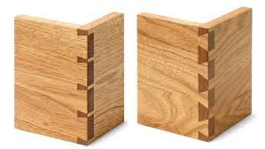
Dovetail alignment
C C A – T G A C
T T C C A G T G
AKA End space free alignment
How can we find it ?

Slide 40
End space free alignment
CCA-TGAC
TTCCAGTG
OR

Slide 41
Pattern search
AAGCAGCCA-TGACGGAAAT
CCAGTG
How can we find it ?

Slide 42
Pattern search
AAGCAGCCATGACGGAAAT
CCAGTG

Slide 43
Non-overlapping Local Alignments
GCTCTGCGAATA
GCTCTGCGAATA
CGTTGAGATACT
CGTTGAGATACT
Find all non-overlapping local alignments with score > threshold.
Two alignments overlap if they share same letter pair.
How do we find ?

Slide 44
Non-overlapping Local Alignments
Compute DP matrix
Find the largest scoring alignment > threshold
Report the alignment
Remove the effects of the alignment from the matrix
Go to step 2

Slide 45
Next: Closer look into gaps

Slide 46
Gaps
Q = AATTCGAG
|||||
Y = -ATTCGC-
Q = AATTCGAG
|||||
Z = AATTCC--
Which one is more similar to Q ?
Starting an indel is less likely than continuing an indel.
Affine gap model: Large gap open and smaller gap extend penalty.
How can we compute it ?
Notes:
Same number of gaps, mismatches, and consecutive matches. However, Z has two gaps side by side => Z is closer to Q than Y.

Slide 47
Computing affine gaps
3 cases
i
E
j
i
F
j
i
G
j

Slide 48
Recursions
i
E
j
E(i, 0) = gap_open + i x gap_extend
E(i,j) = max{E(i, j-1) + gap_extend,
V(i, j-1) + gap_open + gap_extend}

Slide 49
Recursions
i
j
F
F(0, j) = gap_open + j x gap_extend
F(i,j) = max{F(i-1, j) + gap_extend,
V(i-1, j) + gap_open + gap_extend}

Slide 50
Recursions
i
G
j
G(i,j) = G(i-1, j-1) + s(x(i), y(j))

Slide 51
Recursions
V(i, 0) = gap_open + i x gap_extend
V(0, j) = gap_open + j x gap_extend
V(i, j) = max{E(i, j), F(i, j), G(i, j)}

Slide 52
Other Gap Models
Constant: fixed gap penalty per gap regardless of length
Non-linear: Gap cost increase is non-linear.
  E.g., g(n) = -(1 + ½ + 1/3 + … + 1/n)
Arbitrary

Slide 53
Next: inversions

Slide 54
Alignment with Inversions
A’ = T and G’ = C
ACTCTCTCGCTGTACTG
AATCT-ACTACTGCTTG
Each letter is inverted only once.
An inversion cost (inv) for each inverted block.
How to find the alignment ?

Slide 55
Alignment with Inversions
For i=1:m
  For j=1:n
    For g=1:I
      For h=1:j
        Compute Z(g,h; I,j)
      V(I,j) = max{
        Max{v(i-1,j-1) + z(g,h; I,j)} + inv
        V(i-1,j-1) + s(x_{i}, y_{j})
        V(i-1, j) + ins
        V(I, j-1) + del}
O(n⁶) time

Slide 56
Alignment with Inversions: Faster Method
Find all local alignments of x and y’ (Z)
V(I,j) = max{
  max{V(g-1, h-1) + Z(g, h; I, j)} + inv,
  V(i-1, j-1) + s(x_{i}, y_{j}),
  V(i-1, j) + ins
  V(I, j-1) + del }
O(nmL) time, where L is the average number of inverse alignments ending at (i,j)

Slide 57
What is Similarity Anyway ?
Similar: have similar letters
Homolog: have common ancestor
Not exactly the same !
Three types of homology
  Paralog
  Ortholog
  Xenolog
Parent Organism
Organism A
Organism B

Slide 58
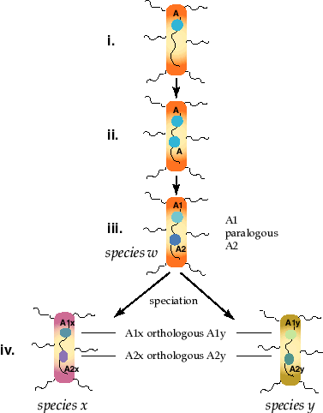
Paralog & Ortholog (1)
"Two genes are said to be paralogous if they are derived from a duplication event, but orthologous if they are derived from a speciation event.“
W-H Li
A gene called A in species w
is duplicated producing initially two copies of A.
With time the two copies diverge by evolution forming related genes A1 and A2. These two genes are said to be paralogous to one another. Paralogy typically involves comparisons within a species.

Slide 59
Paralog & Ortholog (2)
Two species, x and y evolve from species w, their common ancestor. The descendants of the A1 and A2 genes are now called A1x, A1y, and A2x, A2y to reflect which species they now occupy. A1x is orthologous to A1y and A2x is orthologous to A2y. The comparison is between two species.

Slide 60
Xenolog
Xenology is defined as that condition (horizontal transfer) where the history of the gene involves an interspecies transfer of genetic material. It does not include transfer between organelles and the nucleus. It is the only form of homology in which the history has an episode where the descent is not from parent to offspring but, rather, from one organism to another.

Slide 61
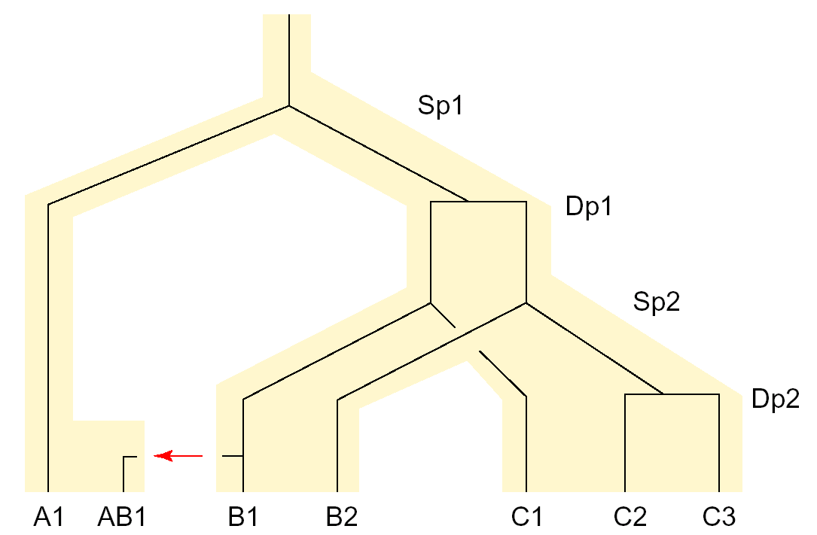
Paralog, Ortholog, Xenolog
Paralog
Xenolog
Ortholog

Slide 62
Overview
Dot plots
Dynamic programming solutions
  Local, global alignments and their extensions
Distance and similarity models
Gap models
Improvements and different on computation of sequence similarity
Similarity versus homology

Slide 63
Next: Substitution Patterns
Predict substitutions
What are scoring matrices and how are they derived?

