Slide 1
LOAD BALANCING ON HETEROGENOUS SYSTEMS USING
EVOLUTIONARY TECHNIQUES
SUBMITTED BY :-
AASTHA MEDIRATTA (0709110001)
ABHINAV BHATNAGAR (0709110002)
ABHISHEK KANAUJIA (0709110004)
KHUSHBU SRIVASTAVA (0709110050)

Slide 2
INTRODUCTION
Load Balancing is a technique to distribute workload evenly across two or more computers, network links, CPUs, hard drives, or other resources and does the following :-
Enhances the performance of the servers
Leads to their optimal utilization
Ensures no single server is overwhelmed

Slide 3
MOTIVATION
Load Balancing mediates internal communications in computer clusters
Need to improve server capacity.
Critical to improve the performance of the system to make it reliable.
Problem faced by the web servers working in heterogeneous environment, of managing the load optimally without leading to web failure -- Prime motivation for the project

Slide 4
PROJECT OBJECTIVES
The objectives of this project are ; using Particle Swarm Optimization and Hybrid Particle Swarm Optimization Algorithms :
To equally distribute the load on servers and minimize the total response time.
To reduce the communication cost.
To provide scheduling of requests that arrives dynamically.
To schedule the requests on to heterogeneous servers to minimize the response time.
To compare the two different approaches i.e. PSO and HPSO – to find the best solution.

Slide 5
Scope contd..
Implementation of Hybrid Particle Swarm Algorithm by the hybridization of the features of PSO and other Optimization algorithm like hill climbing algorithm or simulated annealing algorithm.
Generation of initial swarm.
Evaluation of Initial swarm using Fitness Function.
Re-evaluation of the swarm to achieve the best solution using the hybridized fitness function, repeating the above process for different number of iterations.
Comparison of the results of the PSO and Hybridized PSO algorithms.

Slide 6
SCOPE OF THE PROJECT
Study of load balancing problem in a heterogeneous environment.
Study and Survey of various evolutionary optimization algorithms.
Implementation of Particle Swarm Optimization algorithm .
Generation of initial swarm.
Evaluation of Initial swarm using Fitness Function.
Re-evaluation of the swarm to achieve the best solution using the fitness function, repeating the above process for different number of iterations.

Slide 7
LITERATURE SURVEY
Comprised of the study of various research papers published in the field of :-
Load balancing Problem
Concept of Optimization
Particle swarm Optimization algorithm
Hybrid Particle Swarm Optimization
Study of the various features of MATLAB which may be relevant while implementing

Slide 8
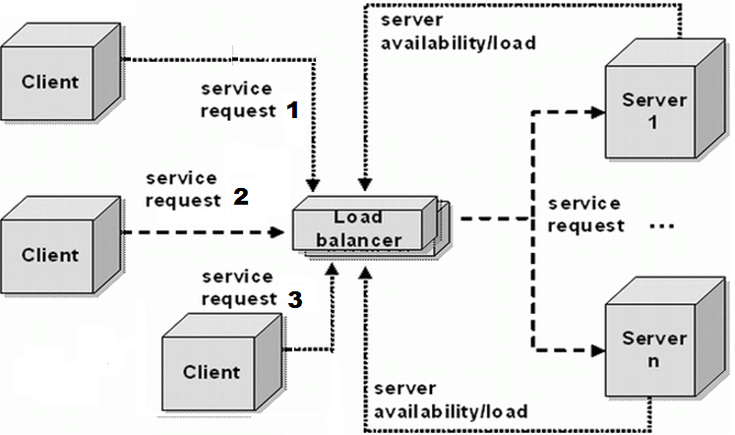
SYSTEM DESIGN AND METHODOLOGIES
SYSTEM ARCHITECTURE
Figure 1 – System Architecture

Slide 9
Find out pbest values and correspondin to it, the gbest values
FLOWCHART
Update the velocity according to social and cognitive component
Enter the number of machines and servers required
no
If
xk+1 > xmax
Create an initial swarm with the help of given number of machines and requests
yes
xmax is assigned
Create an initial swarm for the position and velocity using random function
Xk+1 is taken
Compute average completion time x for each machine with the help of the formula
Total request completion time/max time span
Update the swarm’s position and velocity
Repeat the process upto few iterations and then finally find out the gbest and pbest
Compute average utilization time for each machine by the formula
average completion time/max time span
Draw a graph for gbest vs iterations
And similarly, for gbest vs population

Slide 10
Algorithm
Generate initial swarm of the particles using the number of machines and requests entered by the user.
Generate an initial swarm for the position and velocity of the generated population using random function.
Compute average completion time x for each machine with the help of the formula : Total request completion time/max time span.
Compute Fitness Function that is the average utilization time for each machine by the formula: average completion time/max time span.
Evaluate pbest values and corresponding to it, the gbest values.
Update the velocity according to social and cognitive component.

Slide 11
Algorithm contd..
v[k+1] = v[k] + c1 * rand() * (pbest[] - present[])
+ c2 * rand() * (gbest[] - present[]) (a)
present[] = present[] + v[] (b)
7. Check If x > x if yes then assign x if no then x is taken.
8. Update the swarm with the new updated position and velocity.
9. Repeat the process for a fixed number of iterations in each iteration re-evaluate the original swarm and find the new personal best and global best to find the final values of pbest and gbest.
10. If any new request arrives during this assigning of requests, the swarm will be re-generated adding the new request to population and then perform the above steps.
11. Draw a graph for gbest vs iterations and for gbest vs population.
k+1
max
max
k+1

Slide 12
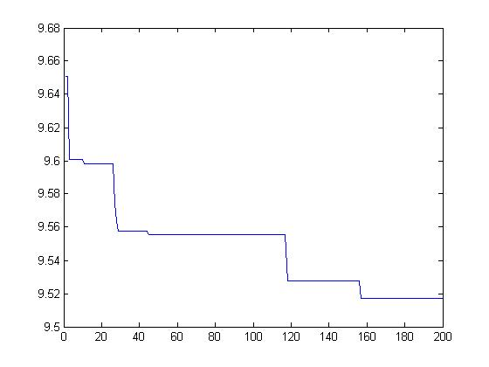
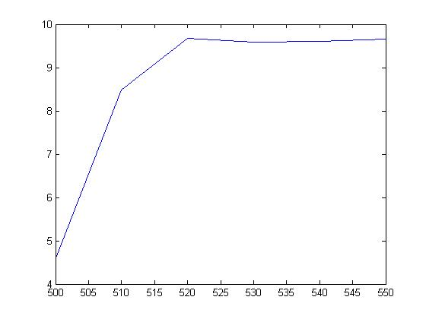
RESULTS
PARTICLE SWARM OPTIMIZATION ALGORITHM
For Static Request Scheduling
1) Completion Time VS Iterations
( 40 m/c , 2800 req)
Completion time
Iterations
Gbest
Fig .1
2) Gbest VS Population
( 50 m/c , 500 req)
Fig. 2
Population

Slide 13
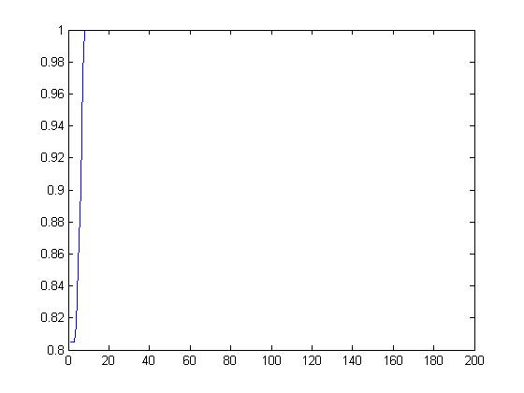
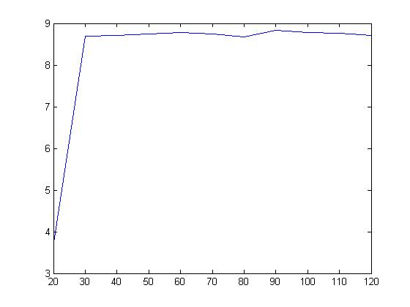
3) Gbest VS Iterations
( 40 m/c , 800 req)
Gbest
Fig. 3
Iterations
4) Computation Time VS Population
( 30 m/c , 600 req)
Computation time
Fig .4
Population

Slide 14
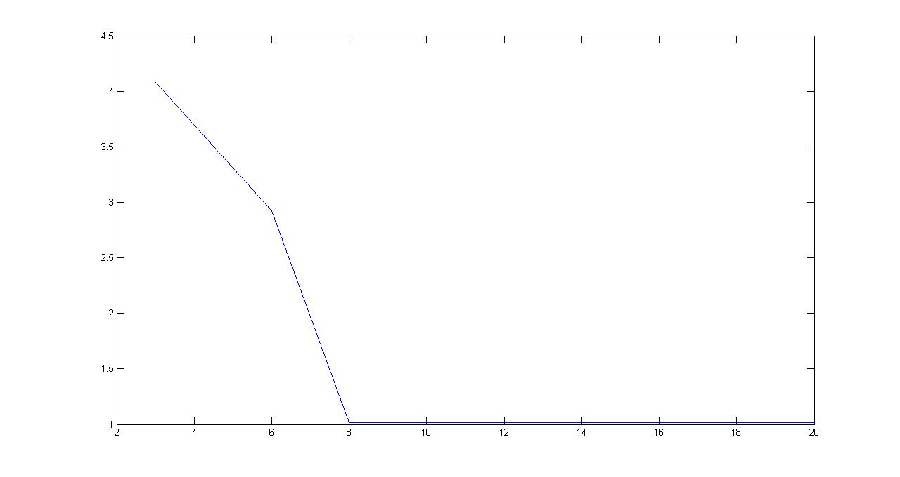
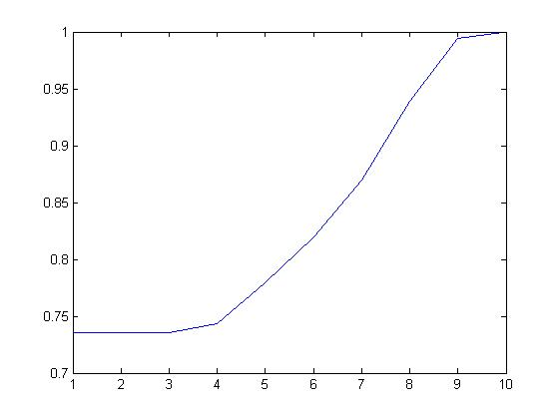
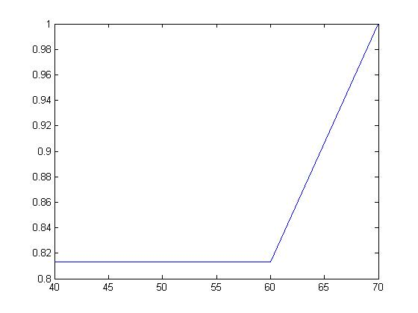
b. For Dynamic Request Scheduling
1) Completion Time VS Dynamic Requests graph
( 3 m/c , 20 req)
Completion time
Dynamic Requests
Fig .1
Gbest
2) Gbest VS Iterations ( 50 m/c , 300 req)
Fig .2
Iterations
3) Gbest VS Dynamic Requests graph
( 4 m/c , 40 req)
Gbest
Fig. 3
Dynamic Requests

Slide 15
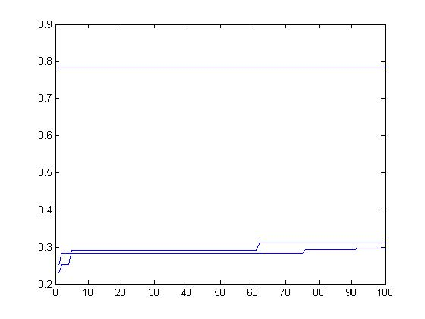
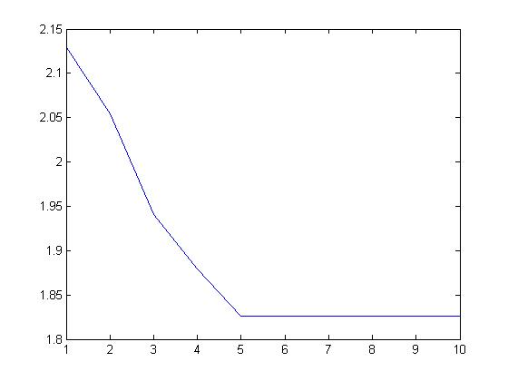
II. HYBRID PARTICLE SWARM OPTIMIZATION ALGORITHM
For Static Request Scheduling
1) Gbest VS Iterations
( 12 m/c , 450 req)
Gbest
Iterations
Fig .1
Completion time
2) Completion Time VS Iterations
( 12 m/c , 450 req)
Iterations
Fig .2

Slide 16
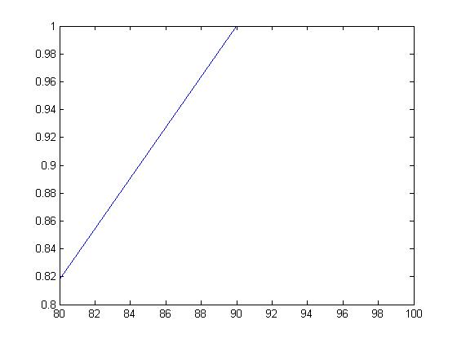
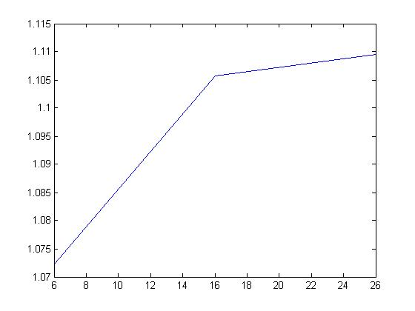
3) Gbest VS Population
( 3 m/c , 6 req)
Gbest
Population
Fig. 3
4) Completion Time VS Population
( 3 m/c , 6 req)
Completion time
Population
Fig .4

Slide 17
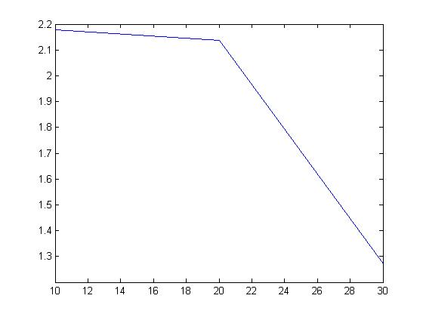
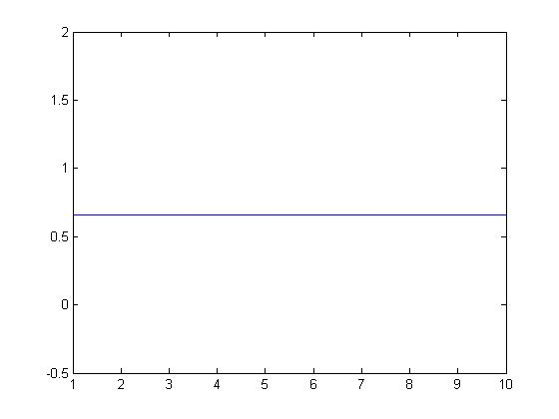
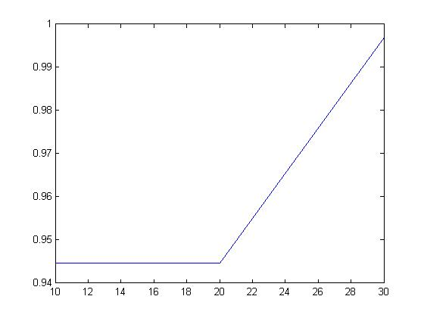
b. For Dynamic Requests Scheduling
1) Completion Time VS Dynamic Requests graph
( 4 m/c , 10 req)
Completion time
Dynamic Requests
Fig. 1
Gbest
2) Gbest VS Iterations ( 5 m/c , 200 req)
Iterations
Fig .2
3) Gbest VS Dynamic Requests graph
( 4 m/c , 10 req)
Gbest
Fig .3
Dynamic Requests

Slide 18
PERFORMANCE EVALUATION
Comparison of Static Particle swarm optimization and
Static Hybrid particle swarm optimization
(The following graphs are for 6 machines , 80 requests)
1) Gbest versus population
(a)
(b)
Figure 1 : (a) Gbest vs population graph for PSO
(b) Gbest vs population graph for HPSO

Slide 19
2) Computation time versus population
(a)
(b)
Figure 2 : (a) Completion time vs population graph for PSO
(b) Completion Time vs population graph for HPSO

Slide 20
3) Gbest versus iterations
(a)
(b)
Figure 3: (a) Gbest vs iterations graph for PSO
(b) Gbest vs iterations graph for HPSO

Slide 21
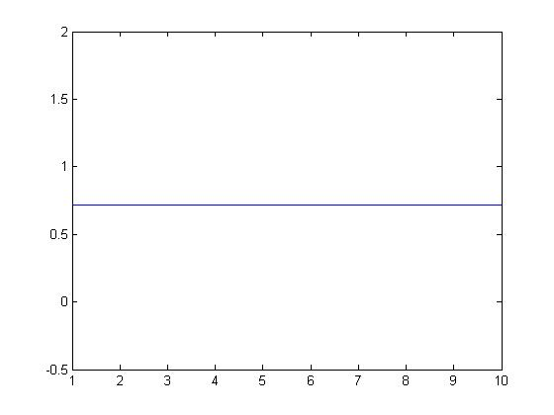
II. Comparison of Dynamic particle swarm optimization and Dynamic hybrid particle swarm optimization
1) Gbest versus iterations
(a)
(b)
Figure 5 : (a) Gbest vs iterations graph for PSO
(b) Gbest vs iterations graph for HPSO

Slide 22
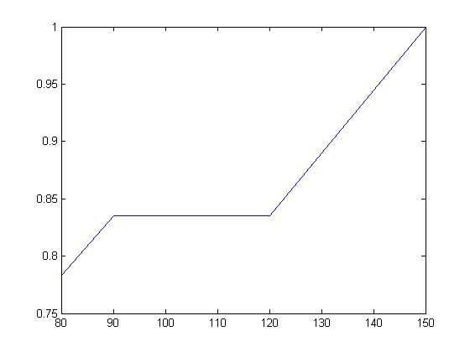
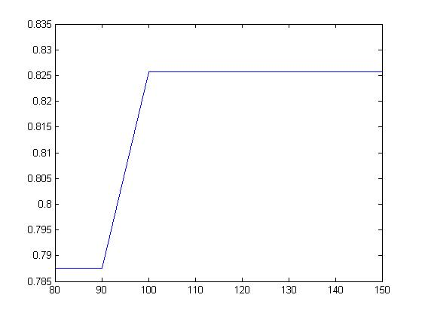
2) Gbest versus dynamic requests
(a)
(b)
Figure 6 : (a) Gbest vs dynamic requests graph for PSO
(b) Gbest vs dynamic requests graph for HPSO

Slide 23
3) Completion Time versus dynamic requests
(a)
(b)
Figure 7 : (a) Completion Time versus dynamic requsts for PSO
(b) Completion Time versus dynamic requests for HPSO

Slide 24
REFERENCES
[1] P Visalakshi , S N Sivanandam, “Dynamic Task Scheduling with Load Balancing using Hybrid Particle Swarm Optimization”, Int. J. Open Problems Compt. Math., Vol. 2, No. 3, September 2009,ISSN 1998-6262.
[2] Aly E. El-Abd, Mohamed I. El-Bendary, “A Neural Network Approach for Dynamic
Load Balancing In Homogeneous Distributed Systems”, IEEE Trans. Parallel and distributed systems, Vol 9, No.6, June 1997.
[3] Albert Y. Zomaya, Senior Member, IEEE, and Yee-Hwei The, “Observations on Using Genetic Algorithms for Dynamic Load-Balancing”, IEEE Transactions On Parallel And Distributed Systems, Vol. 12, No. 9, September 2001.
[4] Swagatam Das, Ajith Abraham, and Amit Konar, “Particle Swarm Optimization and Differential Evolution Algorithms: Technical Analysis, Applications and Hybridization Perspectives”.
[5] Chunming Yang, Simon D, “A new particle swarm optimization technique”,
Proceedings of the International Conference on Systems Engineering , pp.164-169,(2005).
[6] Parsopoulos K.E, and Vrahatis M.N, “Recent approaches to global optimization problems through particle swarm optimization”, Natural Computing , pp. 235 – 306 ,Vol.1(2002)

Slide 25
THANK YOU !!

Slide 26
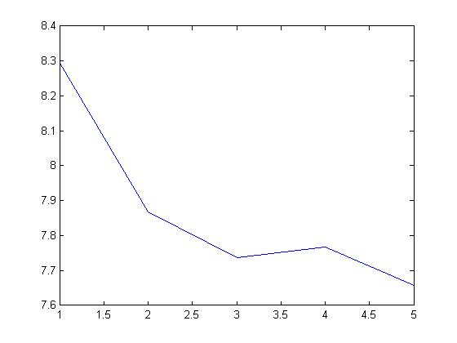
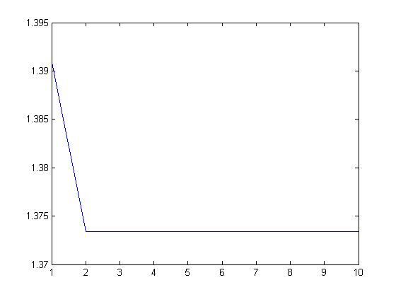
4) Completion Time versus iterations
(a)
(b)
Figure 4 : (a) Completion time vs iterations graph for PSO
(b) Completion vs iterations graph for HPSO

Slide 27
Load Balancing algorithms are designed essentially to equally spread the load on processors and maximize their utilization while minimizing the total task execution time.[1][2]
The Objective are :-
To minimize the total execution
To reduce the communication cost encountered by the task assignment subject to the resource constraints.
In this problem :
A particle is evaluated by calculating its fitness function.
The objective function calculates the total execution time of the set of tasks allocated to each processor.
The fitness function calculates the average of the total execution time of the set of tasks allocated to the processors. ^{[1][3]}

Slide 28
Hybrid Partile Swarm Optimization Algorithm
The HPSO is an optimization algorithm combining the PSO with other evolutionary algorithms . Hybridiziing PSO leads to good global search algorithm and the good local search algorithm, which yields a promising result.
Improve solution quality using simulated annealing
PSO APPROACH
Has maximum iteration reached?
Get the best individual from the last
HYBRID PSO FLOWCHART

