Slide 1
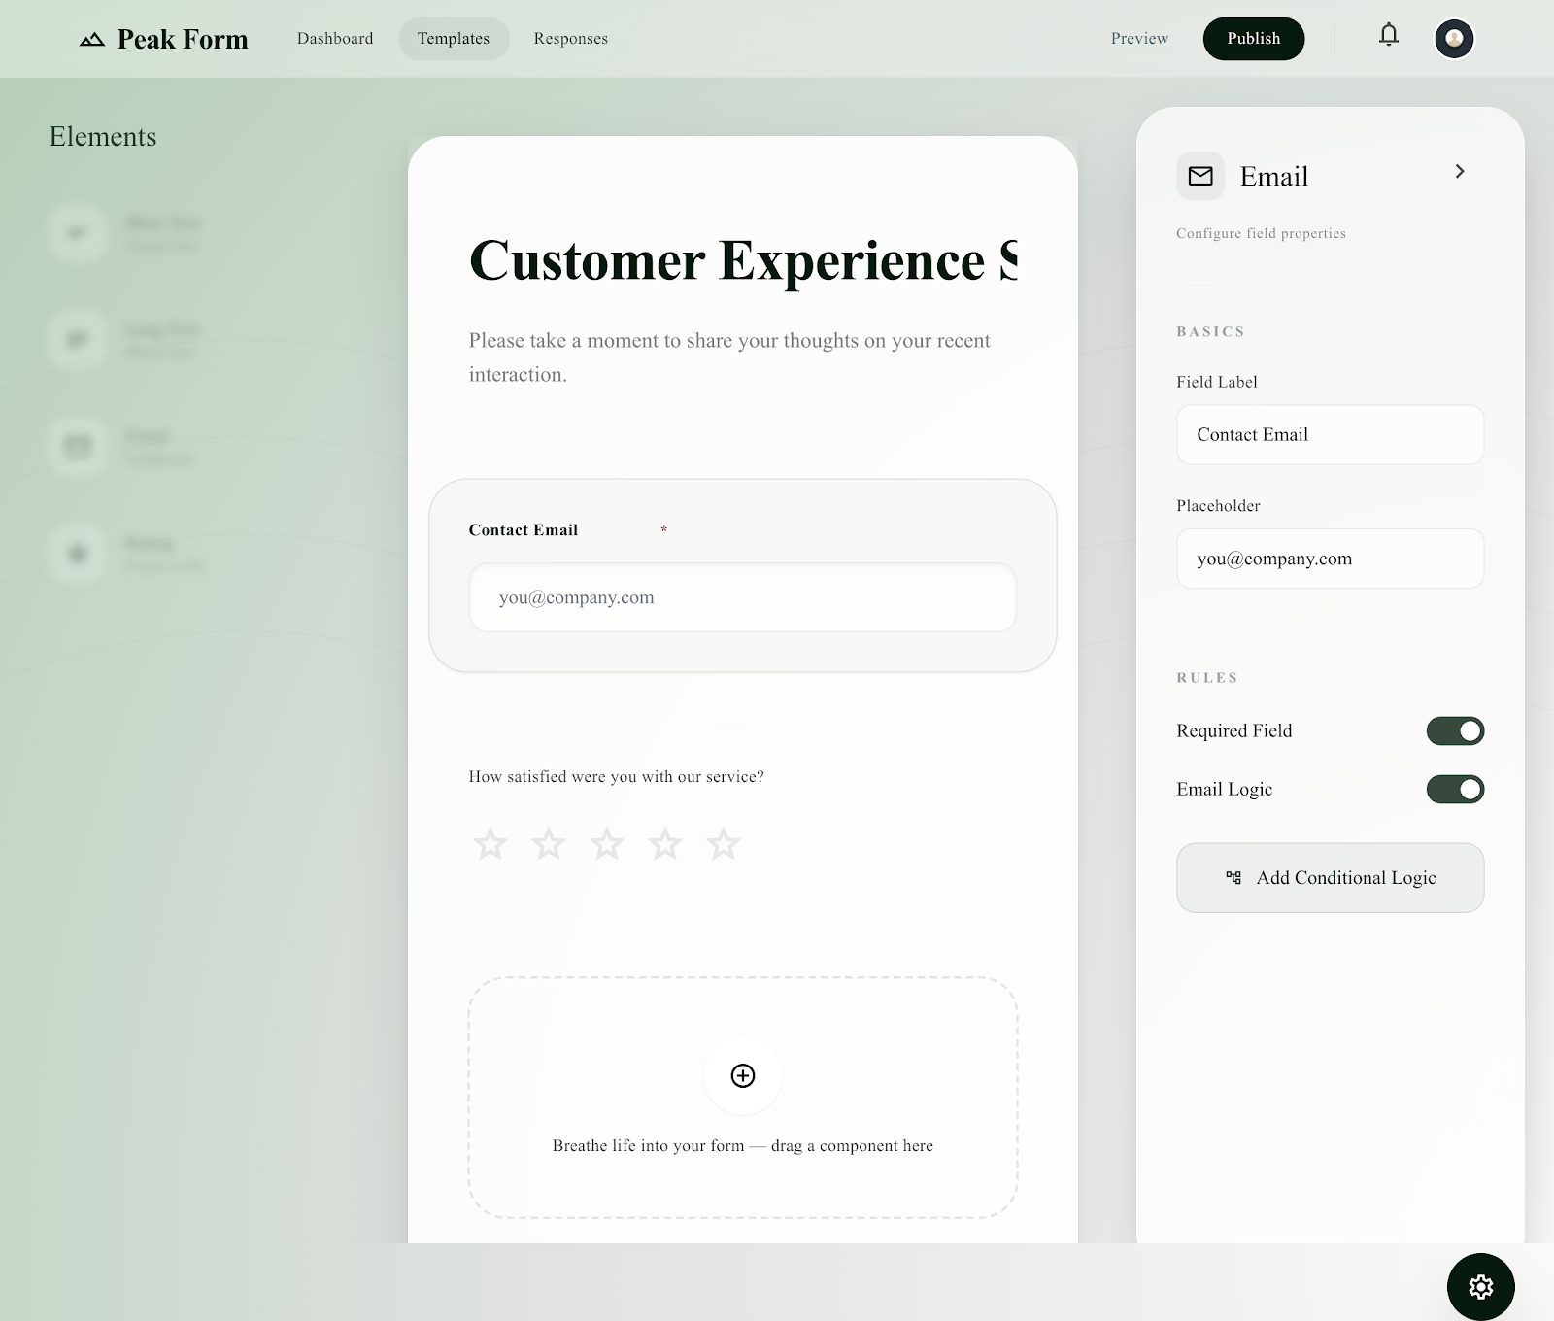
PEAKFORM CODE REVIEW
PeakForm is a complete form workflow,
not only a UI builder.
A pnpm/Turborepo app that covers creator setup, public response capture, owner review, API docs, and database-backed form lifecycle.
NEXT.JS WEB
EXPRESS API
TRPC CONTRACTS
DRIZZLE POSTGRES
11
2
4
10/min
1
SUPPORTED FIELD TYPES
API SURFACES
CORE DB MODELS
PUBLIC SUBMIT LIMIT
SHARED ROUTER
Sources: README.md, packages/trpc/server/index.ts, packages/database/models, form-submission route

Slide 2
PROBLEM
Form work breaks when each step lives in a different tool.
PeakForm targets the everyday mess behind forms: building questions, sharing links, enforcing validation, collecting responses, and turning raw answers into usable owner views.
Create
Share
Validate
Analyze
Manual form setup,
no reusable field model
Links, slugs, QR,
visibility and passwords
Required fields,
conditions, types, limits
Review table,
filters, charts, CSV export
Usually handled elsewhere
Usually handled elsewhere
Usually handled elsewhere
Usually handled elsewhere
Product requirement: keep these stages connected to the same form definition and owner permissions.
Source: README.md and current PeakForm repo
02

Slide 3
SOLUTION LOOP
The code closes the loop from builder to respondent to owner insight.
The important design choice is not one feature; it is one continuous lifecycle backed by routes, services, validation, and persisted form data.
Editor
Submission
Fields, settings,
publish, share
Validate and
store answers
Dashboard
Public page
Create/list forms
Render form by
slug or id
same form id / slug
same owner scope
same schema contract
Admin view
Owner review
Platform totals
for seeded admin
Table, analytics,
CSV export
apps/web + packages/trpc + services + database
Source: README.md and current PeakForm repo
03

Slide 4
STACK
The monorepo keeps UI, API contracts, services, and schema moving together.
README and package files show a single pnpm/Turbo workspace with separate apps and shared packages, which is exactly what a form platform needs as features cross layers.
apps/web
Next.js 16, React 19, Tailwind, shadcn/Radix-style UI, TanStack Query, tRPC React Query
packages/trpc
serverRouter, public/authenticated procedures, context, shared client types, OpenAPI metadata
apps/api
Express 5 mounts /trpc, /api, /openapi.json, /docs with CORS and auth cookies
packages/services
Business logic for auth, forms, fields, submissions, analytics, CSV, email notifications
packages/database
PostgreSQL models, Drizzle ORM, Drizzle Kit migrations, seed data
pnpm dev -> dotenv -- turbo dev
pnpm db:migrate -> Drizzle
pnpm check-types -> Turbo
Source: README.md and current PeakForm repo
04

Slide 5
API ARCHITECTURE
One router feeds both typed tRPC calls and documented REST-style endpoints.
`apps/api/src/server.ts` mounts the same `serverRouter` at `/trpc` and `/api`, then exposes `/openapi.json` and Scalar docs from route metadata.
Express /trpc
createExpressMiddleware
serverRouter
health | auth | form | formSubmission
Next.js web
React Query hooks
tRPC client
credentials included
Express /api
OpenAPI REST middleware
packages/trpc/server/index.ts
GET /openapi.json + /docs
Result: frontend keeps end-to-end types while external consumers can inspect OpenAPI/Scalar docs from the same procedure definitions.
Source: README.md and current PeakForm repo
05

Slide 6
DATA MODEL
The schema stores lifecycle, field rules, and responses without losing type meaning.
Drizzle models encode the product concepts directly: status, visibility, custom slugs, theme settings, field validation, conditional logic, and submission values.
form_fields
11 field types,
options, min/max,
validationRules JSONB,
conditionalLogic
forms
status, visibility, slug,
pageSize, passwordHash,
themeConfig
users
id, email, role
creatorId
formId
formId
form_submissions
formId + values[] JSON
Product impact: the public page can render exactly what the owner configured, and submissions can be rejoined to field labels for readable review/export.
Source: README.md and current PeakForm repo
06

Slide 7
BUILDER IMPLEMENTATION
The dashboard is wired as a real owner workflow, not a static form editor.
The editor route combines settings, field CRUD, publish controls, public sharing, QR generation, preview, clone, archive, and submissions navigation.
User action
Route
Client hook
tRPC procedure
Create/list/delete
/dashboard/forms
useCreateForm, useListForms, useDeleteForm
form.createForm, form.listForms, form.deleteForm
Configure form
/dashboard/forms/[id]
useUpdateFormSettings
form.updateFormSettings
Build fields
/dashboard/forms/[id]
useCreateField, useUpdateField, useDeleteField
form.createField/updateField/deleteField
Publish/share
/dashboard/forms/[id]
usePublishForm, useUnpublishForm
form.publishForm, form.unpublishForm
Clone/archive
/dashboard/forms/[id]
useCloneForm, useArchiveForm
form.cloneForm, form.archiveForm
apps/web/hooks/api/form/index.ts bridges UI to shared router types
Source: README.md and current PeakForm repo
07

Slide 8
PUBLIC SUBMISSION
Respondent input is checked against the live form definition before it is stored.
The public endpoint is intentionally public, but it still enforces rate limits, form status, expiry, password protection, field ownership, conditional visibility, required fields, types, ranges, and options.
Public page
Render `/form/[form_id]`
from slug or id
Form gate
published, unexpired,
password verified
Value gate
required, type,
options, min/max, regex
Rate limit
10 requests / IP /
60-second window
Field gate
belongs to form,
visible condition passes
Persist
insert JSON values
and send email
This solves the hardest form-builder risk: public submissions cannot invent fields, skip visible required fields, or write to a draft/expired/protected form.
packages/services/form-submission/index.ts
Source: README.md and current PeakForm repo
08

Slide 9
OWNER INSIGHT
Responses are shaped back into owner-readable review and export surfaces.
The submission service joins through forms for owner scope, paginates/filter-searches rows, computes analytics, returns single submissions, deletes owner-owned rows, and emits CSV.
owner outputs
owner scope
forms.creatorId = userId
review table
pagination + search
analytics trend/distribution
CSV export
delete response
form_submissions
raw JSON values
field labels
map values to columns
The solution is not just collection: it turns response data into operational views while keeping access tied to the form owner.
Source: README.md and current PeakForm repo
09

Slide 10
CLOSE
PeakForm already has the right full-stack backbone; the next work is hardening.
The repository shows an end-to-end feature slice across frontend, contracts, API, service validation, database, docs, and local operations.
Built in code
Best next steps
Email/password auth with cookie-based dashboard access
Persist rate limits beyond in-memory storage for production scale
Form lifecycle: draft, publish, unpublish, archive, clone
Add stronger audit/history for destructive owner actions
11 field types with options, constraints, and conditional logic
Expand private/team access beyond public and unlisted visibility
Public links by id/slug with password and expiry checks
Add automated integration tests for public submission validation
Submission review, analytics, CSV export, delete, admin overview
Move email delivery to a queue/retry path for reliability
OpenAPI JSON and Scalar docs from tRPC metadata
Add deployment observability around API, DB, and form errors
Demo story: one typed product loop, implemented across the actual monorepo layers.
Source: README.md and current code scan
10

