Slide 1
OAI321- Complex Gate using Domino
Group Number: 17
Group Members :
Abhinav Choudhary (MT24167)
Mayank Pokhriyal (MT24183)
Devansh Pathak (MT24163)
Nikhil Garg (MT24188)

Slide 2
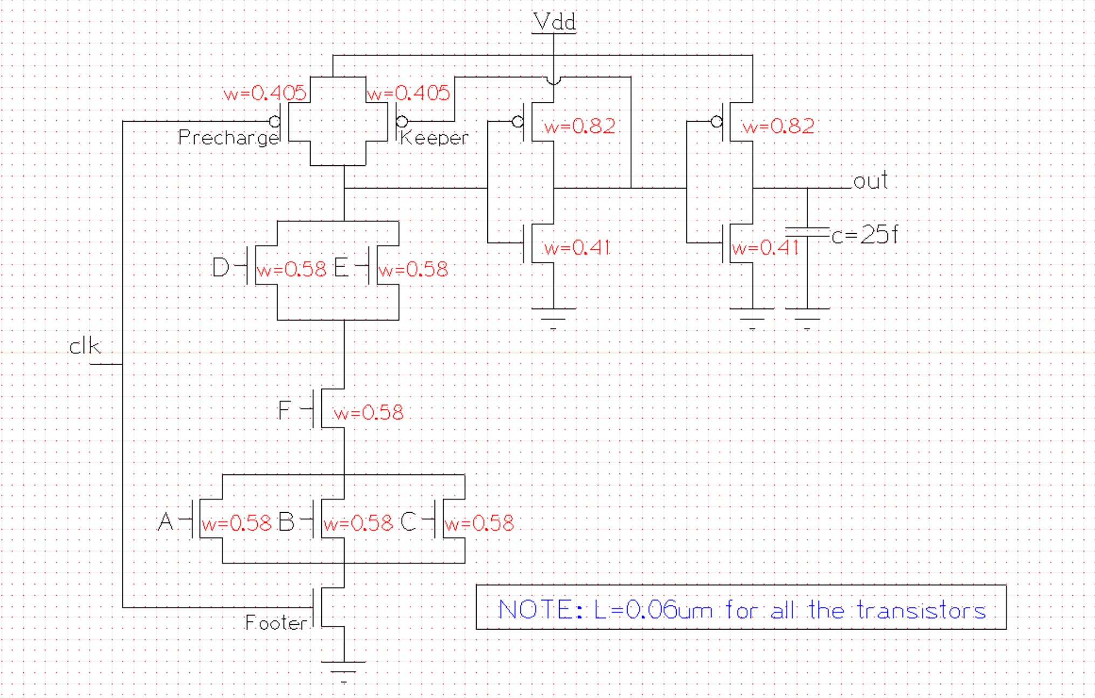
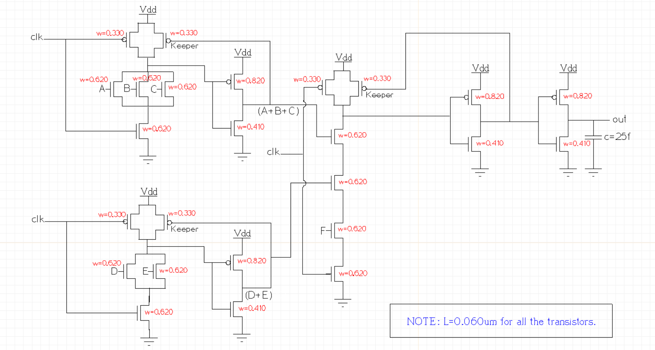
Schematic + Sizing ( Complex & Non-Complex Gate(s) )

Slide 3
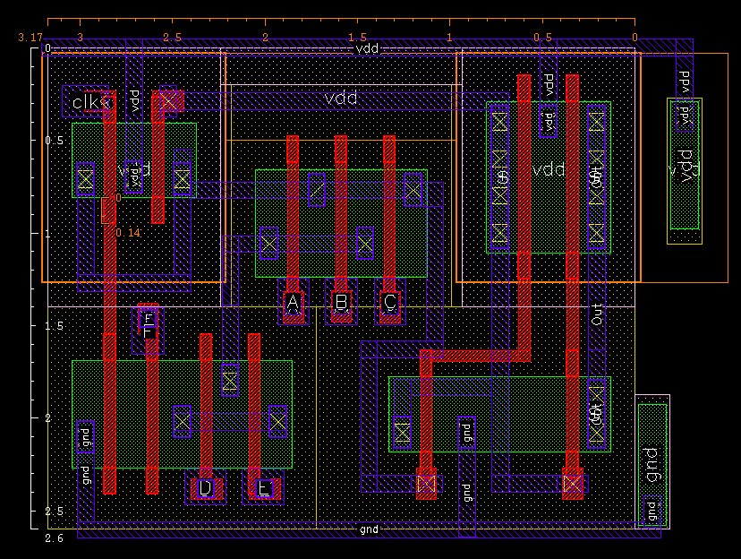
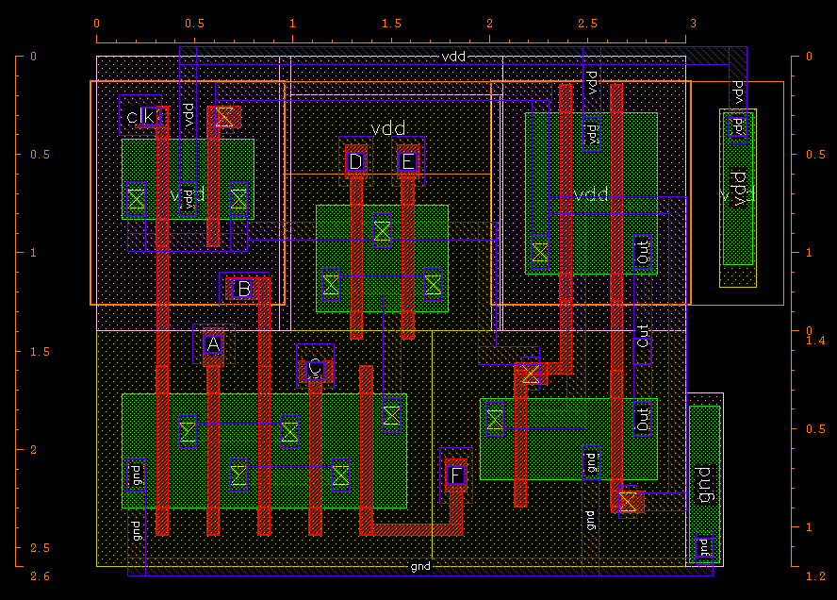
Layout (Complex Gate)
LAYOUT 1 AREA = (3.17*2.6) µm² = 8.242 µm² CHARACTERISTICS : More Area , Less Hammerheads, Shared Contacts .
LAYOUT 2 AREA = (2.6*3) µm² = 7.8 µm² CHARACTERISTICS : Less Area , More Hammerheads, Shared Contacts , Dense Layout .

Slide 4
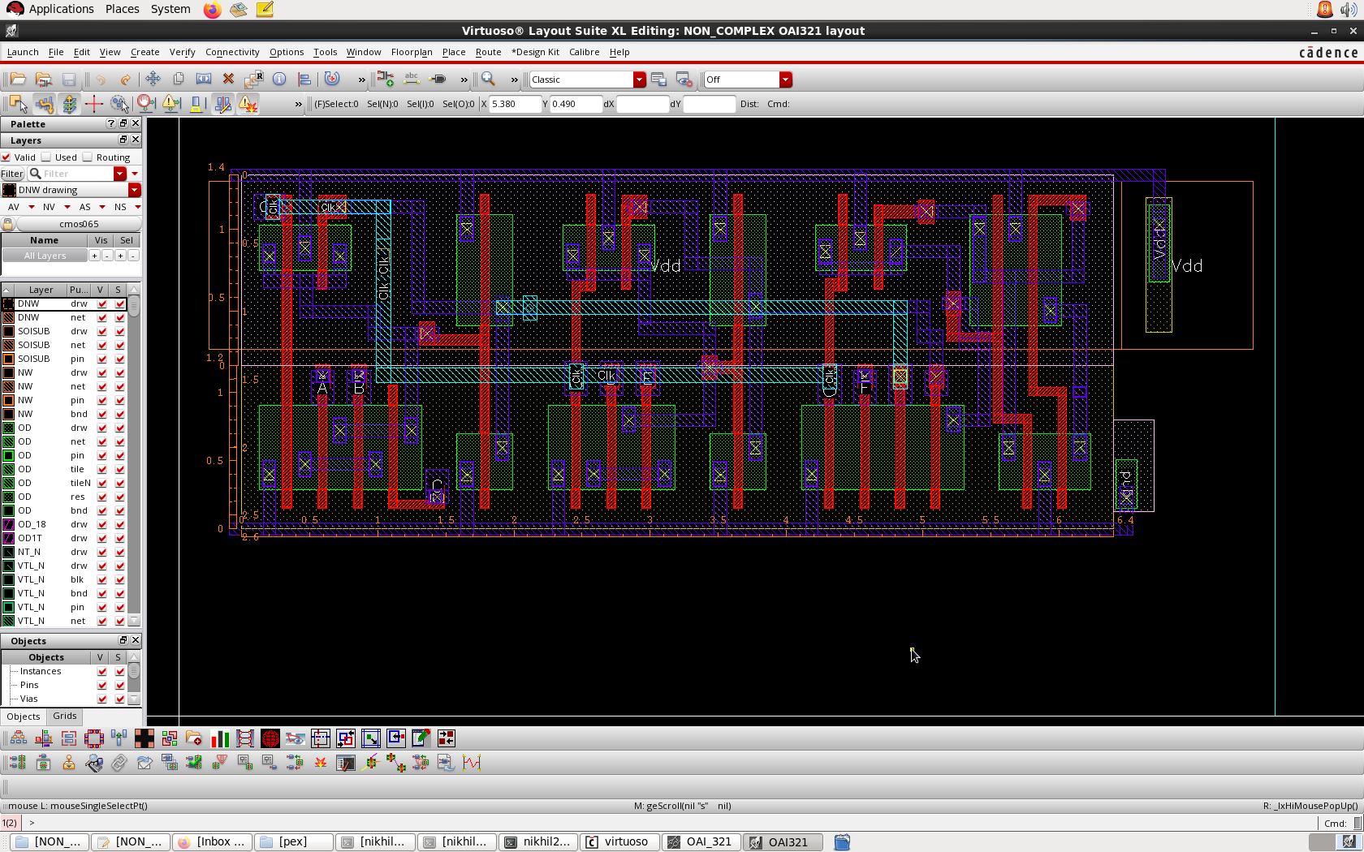
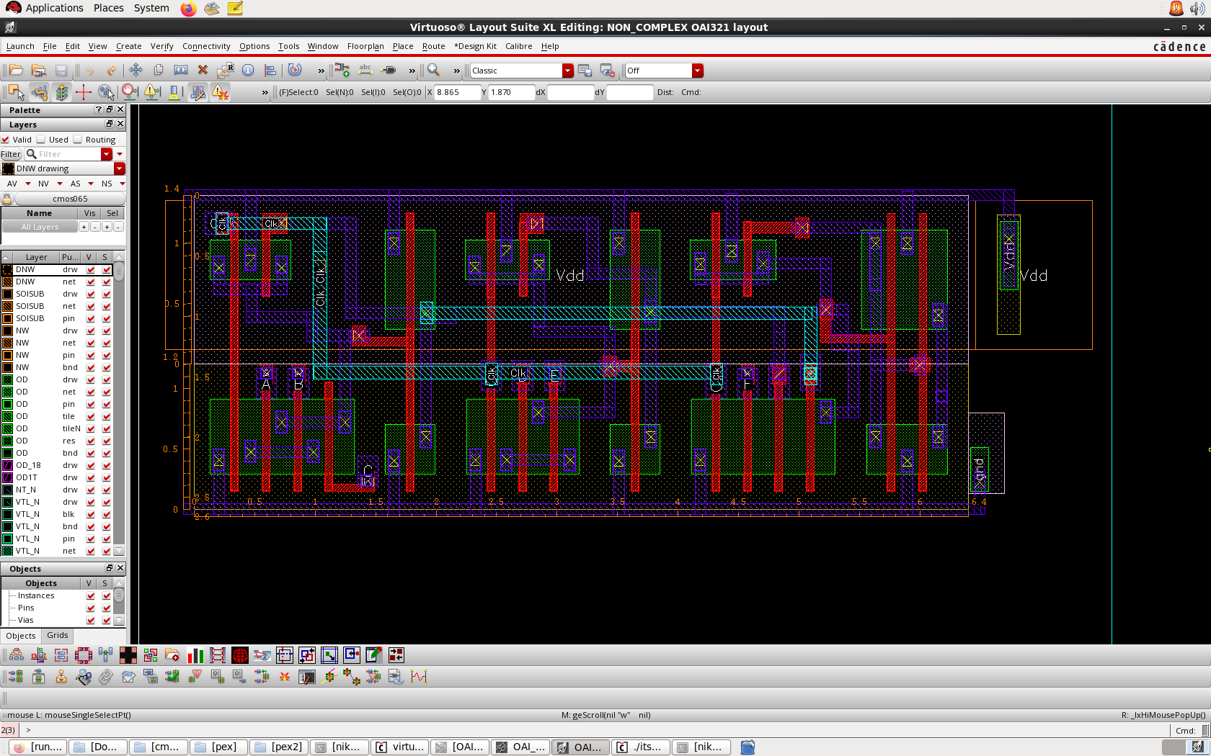
Layout (Non-Complex Gate)
LAYOUT 1
AREA = (2.6*6.4) µm² = 16.64 µm²
CHARACTERISTICS: More Poly-bending, Higher Poly Resistance, More Hammerheads.
LAYOUT 2
AREA = (2.6*6.4) µm² = 16.64 µm²
CHARACTERISTICS: Less Poly-bending, Less Poly Resistance, Less Hammerheads.

Slide 5
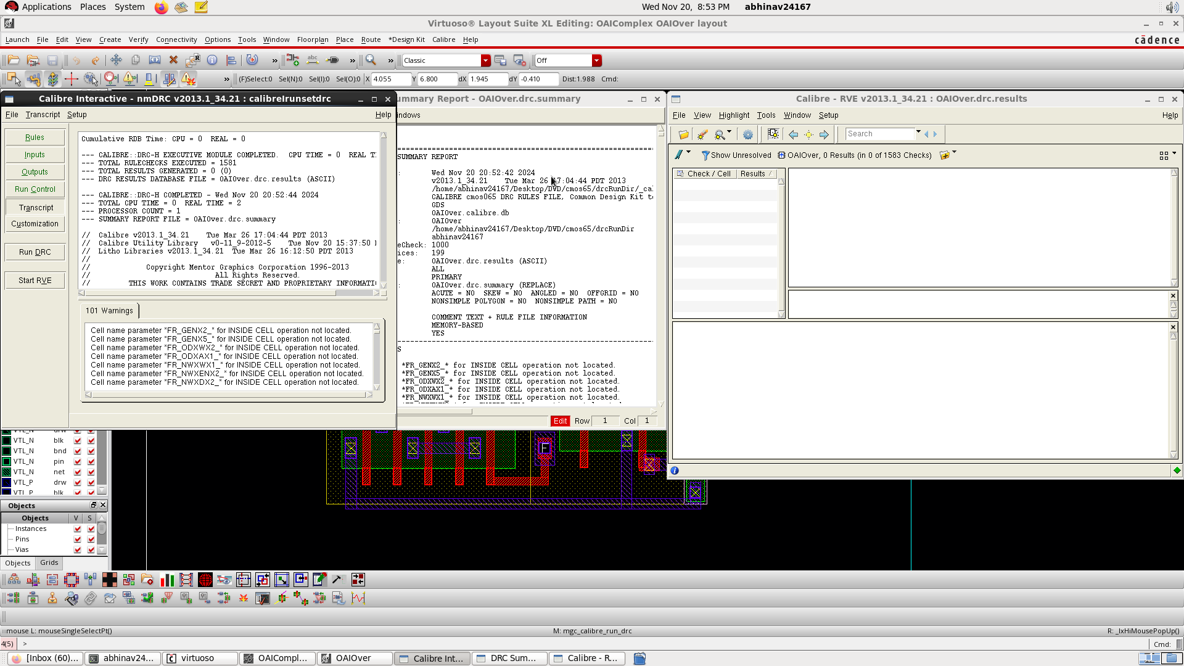
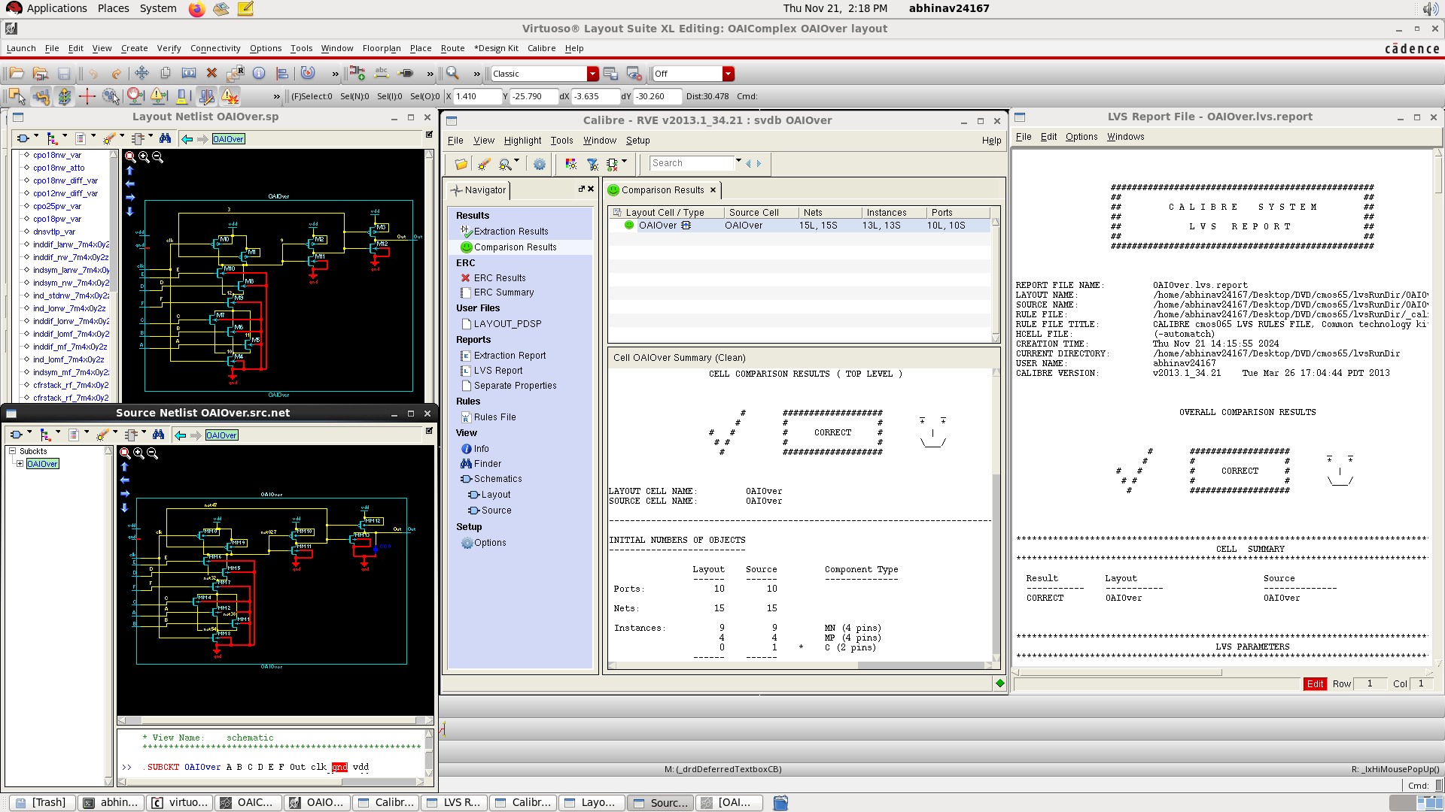
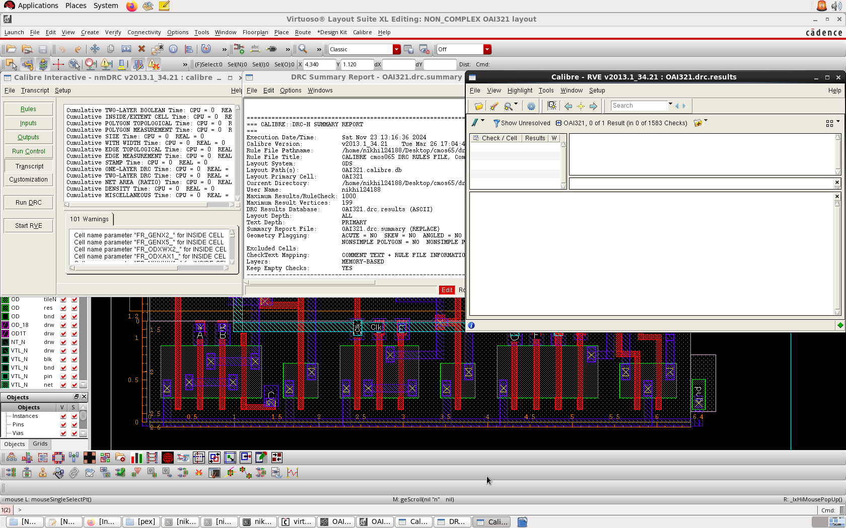
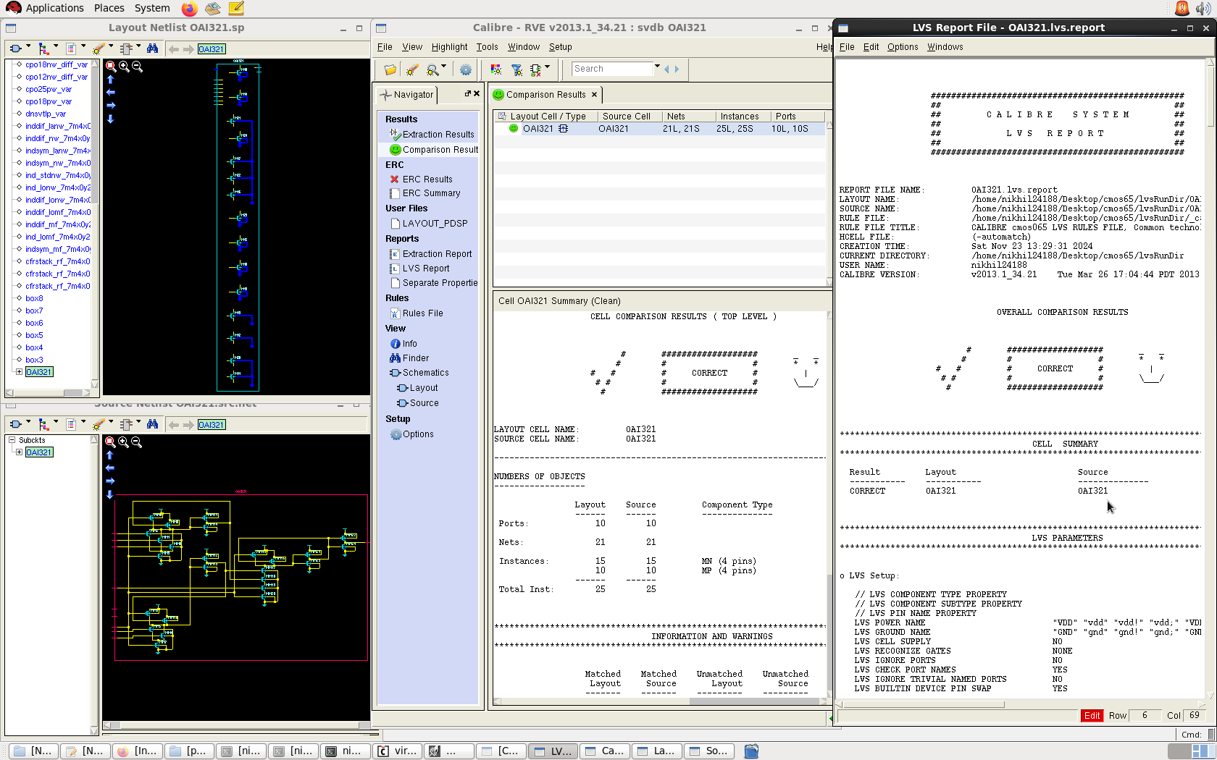
DRC, LVS Report(s) for Complex and Non-Complex Gate(s)
COMPLEX
NON
-COMPLEX

Slide 6
Analytical Simulation(s)
COMPLEX
NON-COMPLEX
Contamination Delay | Trise:- Clk 1→0 A,B,C,D,E,F = 0
 | Tfall:- Clk 0→1 D,E 0→1 A,B,C,F = 1
Propagation Delay | Trise:- Clk 1 → 0 A,B,C,D,E,F = 1
 | Tfall:- Clk 0→1 C 0→1 E,F =1 A,B,D =0
Contamination Delay | Trise:- Clk 1→0 A,B,C,D,E,F = 0
 | Tfall:- Clk 0→1 A,B,C 0→1 D,E,F = 1
Propagation Delay | Trise:- Clk 1 → 0 A,B,C,D,E,F = 1
 | Tfall:- Clk 0→1 F 0→1 E,C =1 A,B,D =0

Slide 7
Contamination delay for Complex and Non-Complex Gate(s)
 | COMPLEX |  | NON-COMPLEX
PVT corner | TCD (Pre-Layout) | TCD (Post-Layout) | TCD (Pre-Layout) | TCD (Post-Layout)
SS,1.08V,125C | 0.24433 ns | 0.24081 ns | 0.43612 ns | 0.38908 ns
SS,1.08V,25C | 0.22038 ns | 0.2192 ns | 0.40302 ns | 0.36295 ns
SS,1.08V,-40C | 0.20198 ns | 0.20194 ns | 0.37091 ns | 0.34094 ns
TT,1.2V,25C | 0.16035 ns | 0.15954 ns | 0.21933 ns | 0.21901 ns
FF,1.32V,125C | 0.14379 ns | 0.14063 ns | 0.16514 ns | 0.16978 ns
FF,1.32V,-40C | 0.10979 ns | 0.11079 ns | 0.12747 ns | 0.13484 ns

Slide 8
Propagation delay for Complex and Non-Complex Gate
 | COMPLEX |  | NON-COMPLEX
PVT corner | TPD (Pre-Layout) | TPD (Post-Layout) | TPD (Pre-Layout) | TPD (Post-Layout)
SS,1.08V,125C | 0.4421 ns | 0.37046 ns | 0.44884 ns | 0.40075 ns
SS,1.08V,25C | 0.37977 ns | 0.33217 ns | 0.41451 ns | 0.37335 ns
SS,1.08V,-40C | 0.33835 ns | 0.30604 ns | 0.38141 ns | 0.35037 ns
TT,1.2V,25C | 0.1883 ns | 0.1592 ns | 0.22830 ns | 0.22717 ns
FF,1.32V,125C | 0.1335 ns | 0.1062 ns | 0.1739 ns | 0.17687 ns
FF,1.32V,-40C | 0.09344 ns | 0.06218 ns | 0.13344 ns | 0.14029 ns

Slide 9
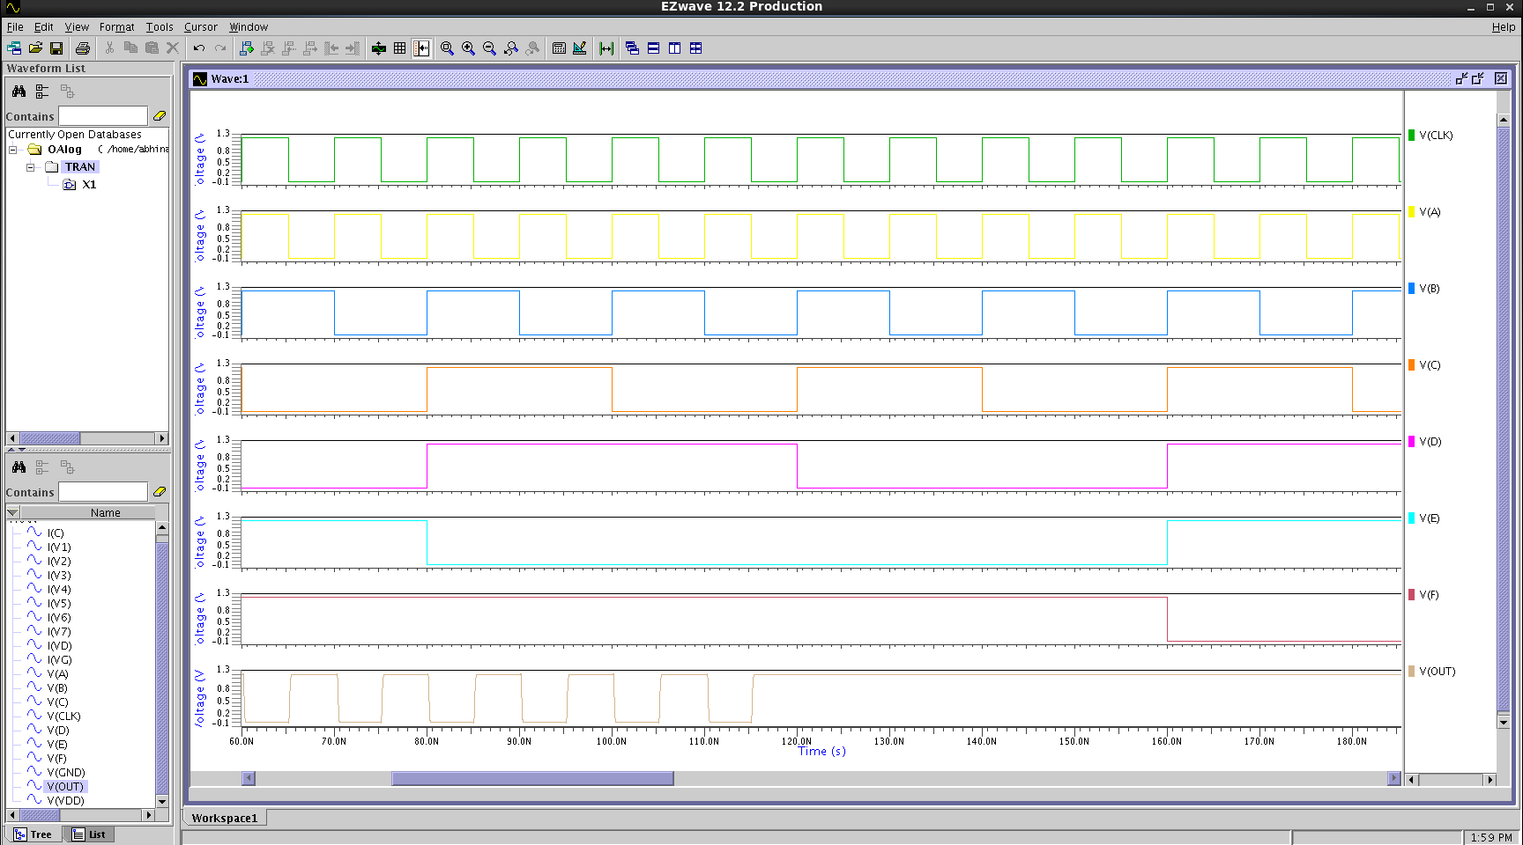
Waveforms of Complex Gate

Slide 10
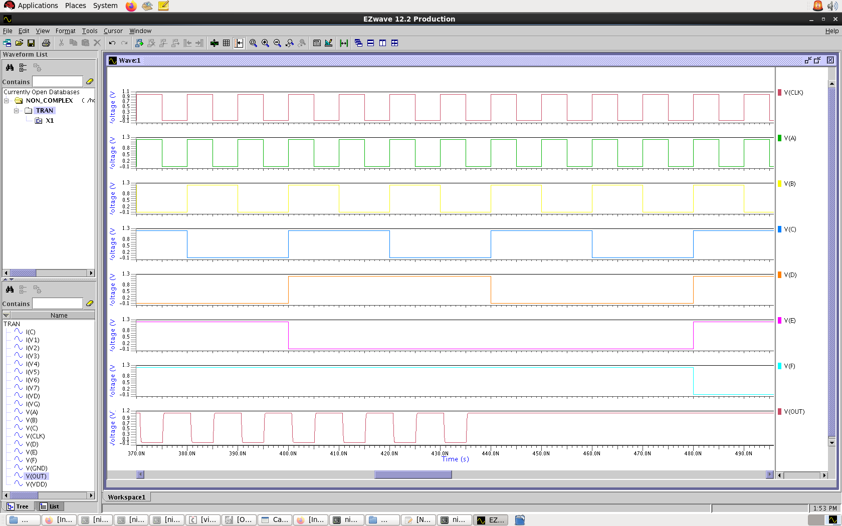
Waveforms of Non-Complex Gate

Slide 11
LEAKAGE CURRENT , STATIC AND DYNAMIC POWER
STATIC POWER IN DIFFERENT STIMULI IN nW
POWER AND CURRENT IN COMPLEX GATE
STIMULI (ABCDEF) | COMPLEX | NON- COMPLEX
000000 | 64.612 | 317.09
000001 | 79.796 | 318.24
000010 | 76.310 | 315.40
000011 | 140.052 | 371.14
000101 | 140.052 | 371.14
000110 | 76.495 | 316.66
000111 | 141.174 | 364.39
001000 | 63.767 | 285.08
001010 | 104.017 | 298.46
001011 | 136.488 | 328.39
001111 | 138.283 | 327.88
010000 | 63.767 | 285.08
010001 | 148.579 | 299.41
010100 | 104.017 | 298.46
010101 | 137.662 | 323.60
010110 | 105.630 | 301.14
010111 | 134.600 | 326.22
011000 | 63.419 | 283.81
011001 | 150.031 | 299.48
011010 | 104.115 | 298.55
011011 | 138.903 | 328.20
011101 | 141.306 | 328.20
011110 | 105.879 | 298.95
011111 | 140.659 | 327.72
111001 | 150.559 | 285.64
110001 | 150.031 | 301.56
PARAMETER | PVT CONDITION | STIMULI | PRE – LAYOUT | POST – LAYOUT
DYNAMIC POWER (WORST CASE) | TT , 1.2V, 25C | 101101 | 6.8136 µW | 6.625 µW
STATIC POWER (WORST CASE) | FF, 1.32V, 125C | 111001 | 150.559 nW | 160.762 nW
LEAKAGE CURRENT (WORST CASE) | FF, 1.32V , 125C | 111001 | 114.06 nA | 121.79 nA
POWER AND CURRENT IN NON-COMPLEX GATE
PARAMETER | PVT CONDITION | STIMULI | PRE – LAYOUT | POST – LAYOUT
DYNAMIC POWER (WORST CASE) | TT , 1.2V, 25C | 001011 | 9.0709 µW | 9.0495 µW
STATIC POWER (WORST CASE) | FF, 1.32V, 125C | 000101 | 371.14 nW | 391.81 nW
LEAKAGE CURRENT (WORST CASE) | FF, 1.32V , 125C | 000101 | 264.25 nA | 296.83 nA

Slide 12
Work Distribution
Schematic – Abhinav, Mayank
Complex Layout - Abhinav
Non complex layout – Mayank, Nikhil
Eldo simulation – Nikhil , Abhinav, Devansh
Xcircuit – Devansh
Tables and presentation- Devansh, Nikhil, Mayank

Slide 13


