Slide 1
WATER LEVEL MONITORING
ESW TEAM 8

Slide 2
AIM
The aim is to create a water level monitoring system that controls the motor's working, sends alerts to the phone based on water levels, and displays the current state of the motor (ON/OFF) and estimated time based on water levels on a dashboard.

Slide 3
WHY DO WE NEED WATER LEVEL MONITORING SYSTEM?
It reduces the possibility of human error.
These are better than traditional gauges and wired instruments in terms of safety.
They work in remote locations.
Helps keep track of water usage hence reduce wastage of water.
It Saves money and easy installation.
Alarm alerts to user helps in monitoring usage.

Slide 4
FEATURES
Basic dashboard showing water level and water usage
data processing/alerts - message to phone
Automatic switch on/off motor and the user can also control motor.
Based on water levels increase/decrease the checking time
Predicting the time when the tank will become empty.

Slide 5
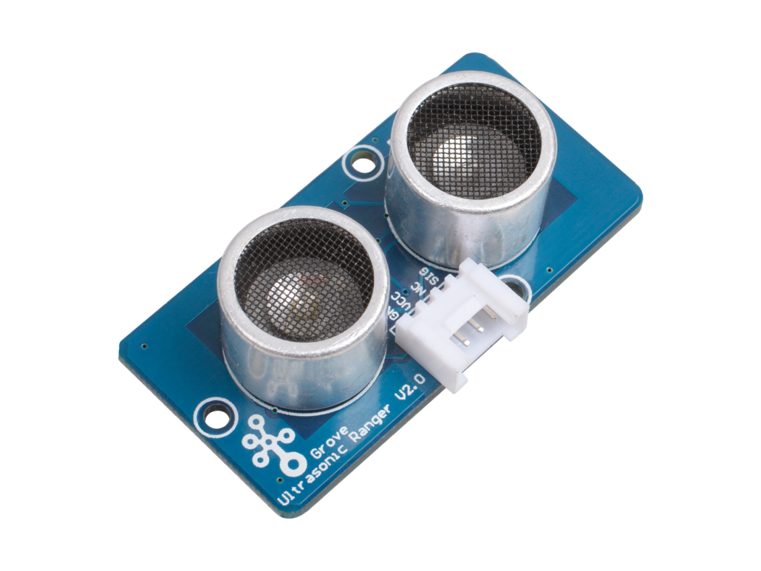
Ultrasonic sensor
Pros:
Works well in dim places
Consume lower current/power
Cons:
Limited detection range
Low resolution and slow refresh rate
Recommended Ultrasonic Sensor: Ultrasonic Sensor: Improved version of the HC-SR04

Slide 6
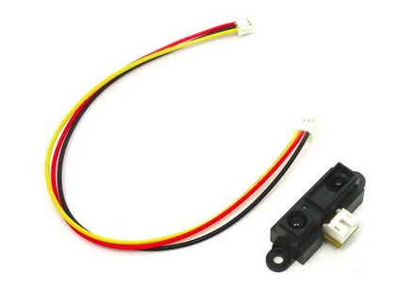
Infrared Sensor
Pros:
Small form factor
Works well in dim places
Measures distances from complex surfaces, unlike ultrasonic sensors
Cons:
Limited measurement range
Affected by environmental conditions and complex objects
Recommended IR Sensors: 80cm Infrared Proximity Sensor

Slide 7
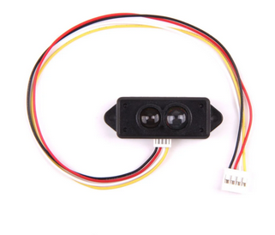
LiDAR
Pros:
High measurement range and accuracy
Fast update rate
Applicable for usage in the day and night
Cons:
Higher cost as compared to ultrasonic and IR
Harmful to the naked eye;
Recommended LiDAR Sensors: Mini LiDAR proximity sensor

Slide 8
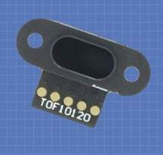
ToF Sensor
Pros:
High measurement range with accuracy
Waterproof
Quick response, small form
Cons:
Higher cost
Sensitive to external environments
Recommended Time-of-Flight Sensor: Time of Flight Distance Sensor (TOF10120)

Slide 9
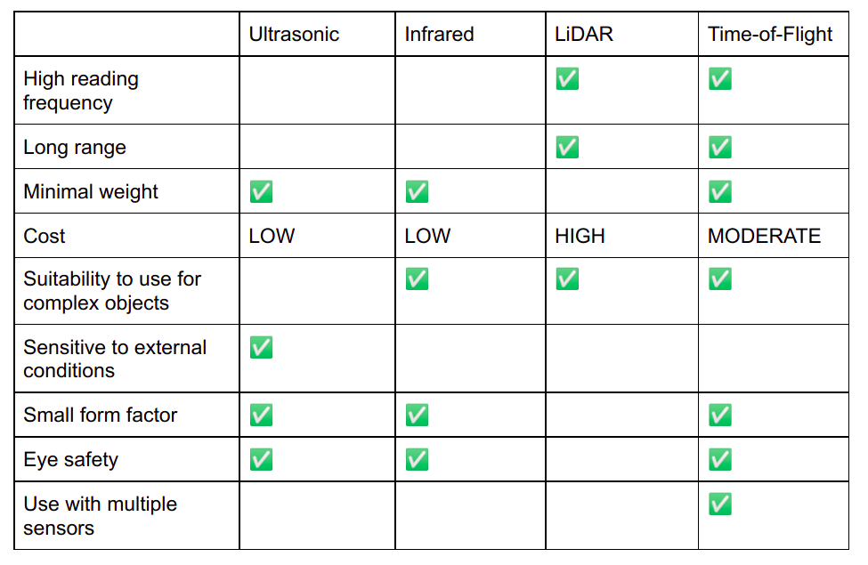

Slide 10
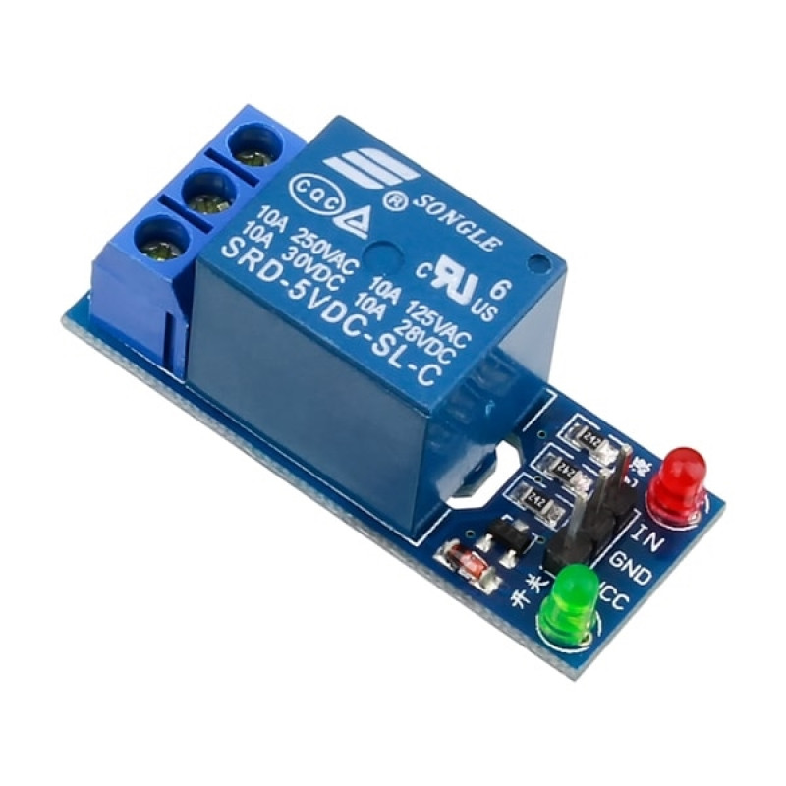
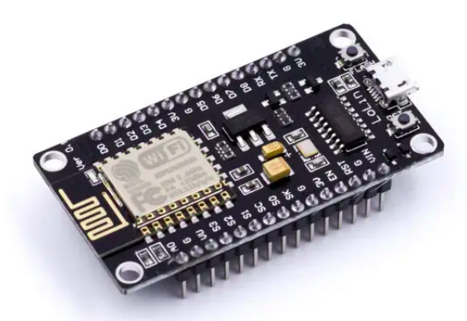
HARDWARE
1. Relay : It is used to switch on/off the motor using microcontroller..
2. Nodemcu ESP8266
3. Water pump/Motor
4. Tof sensor.
5. Ultrasonic Sensor

Slide 11
TIMELINE
Hardware Side | Time | Software Side
- | Aug 29th - Sep 5th | Things Speak Integration
3D model and circuit Design | Sep 9th - Sep 15th | Requirements and design phase
Connecting sensors to microcontrollers and testing the data sent to thingspeak, with physical values we measured | Sep 16th - Sep 22nd | Basic User Interface to monitor water level
Soldering into PCB | Sep 23rd - Sep 29th | Adding additional features

Slide 12
TIMELINE
Hardware Side | Time | Software Side
Taking opinions on the 3D model design | Sep 23rd - Sep 29th | Additional features
Implementation Of the 3D model | Oct 7th - Oct 13th | Testing and taking opinions from people about the interface
Nodes deployment | Oct 15th - Oct 27th | Changes can be done in the app and other features also can be added
Collecting sample data and final testing of the submission | Oct 28th - ending | Writing Reports

Slide 13
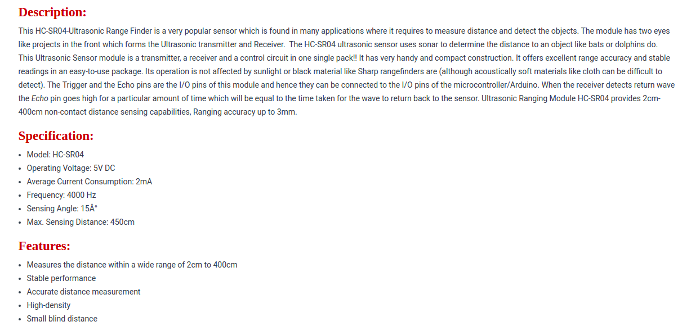
Ultrasonic HC-SR04 - rees52.com - ₹ 55.00

Slide 14
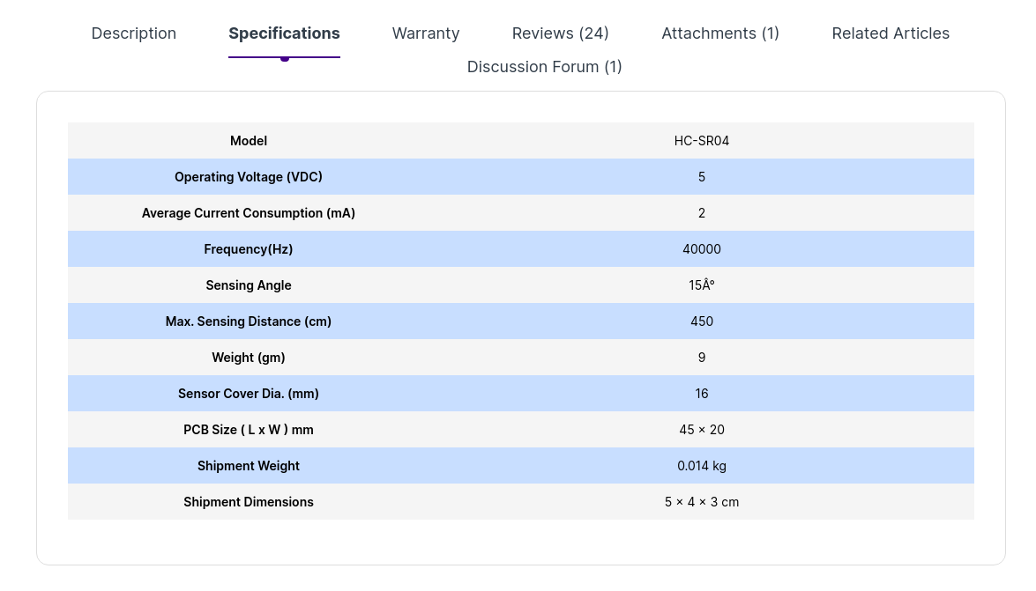
Ultrasonic HC-SR04 - robu.in - ₹ 75.00

Slide 15
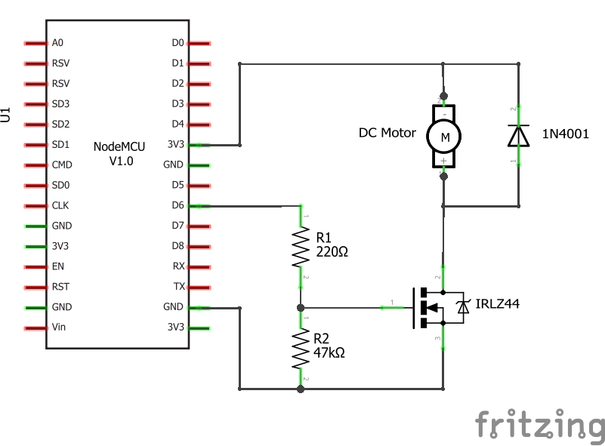
Circuit Diagram

Slide 16
Components Used
General Component | Used component
Micro Controller | ESP8266 or ESP32
Motor | Water Pump (6-12V)
Transistor | IRLZ44 NPN
Diode | 1N4001
Step-up module | 5V Step-Up Power Module Lithium Battery Charging Protection Board USB For DIY Charger 134N3P
Resistors | 470Ω, 1KΩ, 47kΩ

