Slide 1

Smart Dustbin
ABhinav dutta (1901cs02)

Slide 2
INTRODUCTION
in the recent decades, urbanization has increased tremendously. At the same phase there is an increase in waste production. Waste management has been a crucial issue to be considered. In this project smart dustbin is built on a microcontroller based platform Arduino Uno board which is interfaced with the Servo motor and ultrasonic sensor to automatically open and close the dustbin as when required.

Slide 3
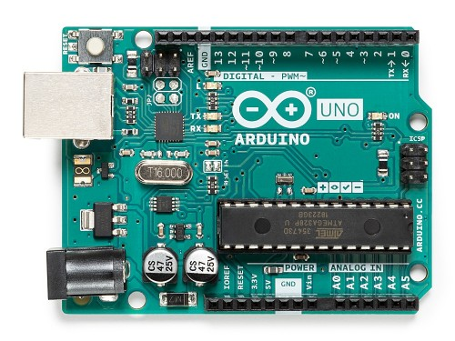
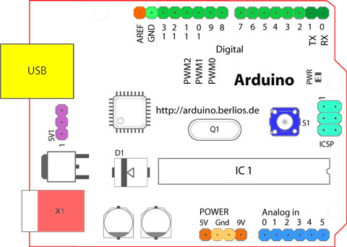
Arduino Uno
Arduino is an open-source electronics platform based on easy-to-use hardware and software. We can tell your board what to do by sending a set of instructions to the microcontroller on the board. To do so you use the Arduino Programming Language and the Arduino Software (IDE).
Arduino Uno is a microcontroller board based on the ATmega328P. It has 14 digital input/output pins (of which 6 can be used as PWM outputs), 6 analog inputs, a 16 MHz ceramic resonator (CSTCE16M0V53-R0), a USB connection, a power jack, an ICSP header and a reset button. It contains everything needed to support the microcontroller. We can simply connect it to a computer with a USB cable or power it with a AC-to-DC adapter or battery to get started.

Slide 4
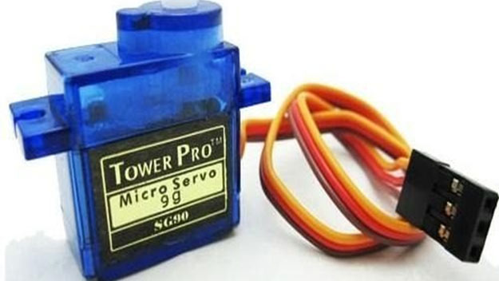
Servo Motor
A servo motor is a type of motor that can rotate with great precision. Normally this type of motor consists of a control circuit that provides feedback on the current position of the motor shaft, this feedback allows the servo motors to rotate with great precision. If you want to rotate an object at some specific angles or distance, then you use a servo motor.
Specifications of the SG 90 servo motor :
Torque: 2.5kg/cm.
Operating speed is 0.1s/60°
Gear Type: Plastic.
Rotation : 0°-180°
Weight of motor : 9gm.

Slide 5
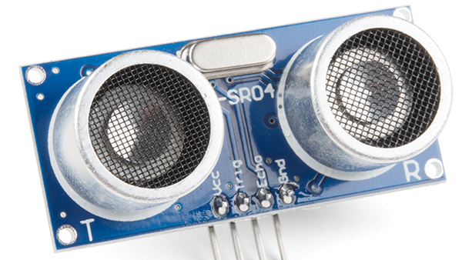
Ultrasonic Sensor
An ultrasonic sensor is an electronic device that measures the distance of a target object by emitting ultrasonic sound waves, and converts the reflected sound into an electrical signal. Ultrasonic waves travel faster than the speed of audible sound (i.e. the sound that humans can hear). Ultrasonic sensors have two main components: the transmitter (which emits the sound using piezoelectric crystals) and the receiver (which encounters the sound after it has travelled to and from the target).
Specs of the HC SR04 ultrasonic sensor:
Theoretical Measuring Distance: 2cm to 450cm
Practical Measuring Distance: 2cm to 80cm
Accuracy: 3mm
Measuring angle covered: <15°
Operating Frequency: 40Hz

Slide 6
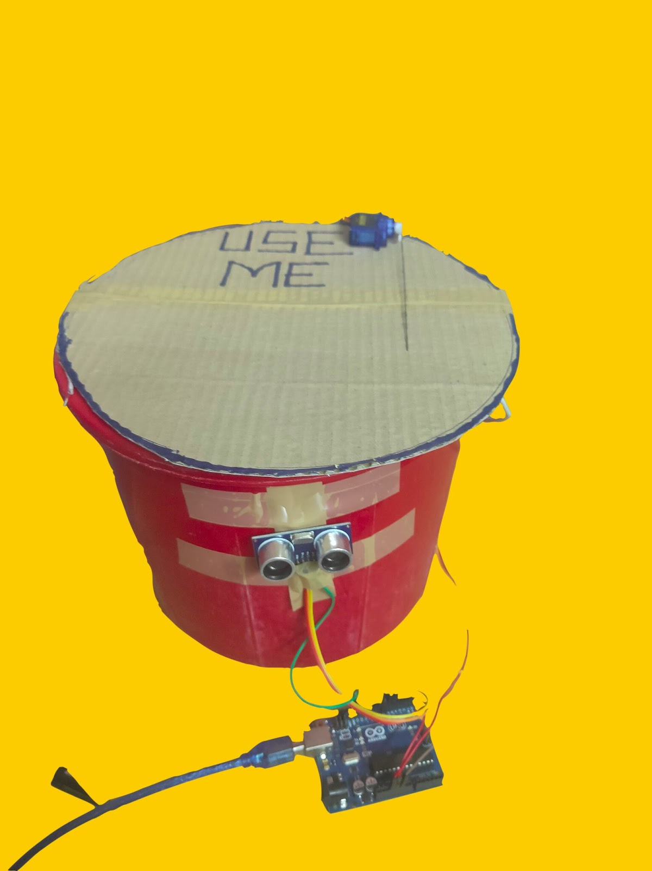
Actual Prototype

Slide 7
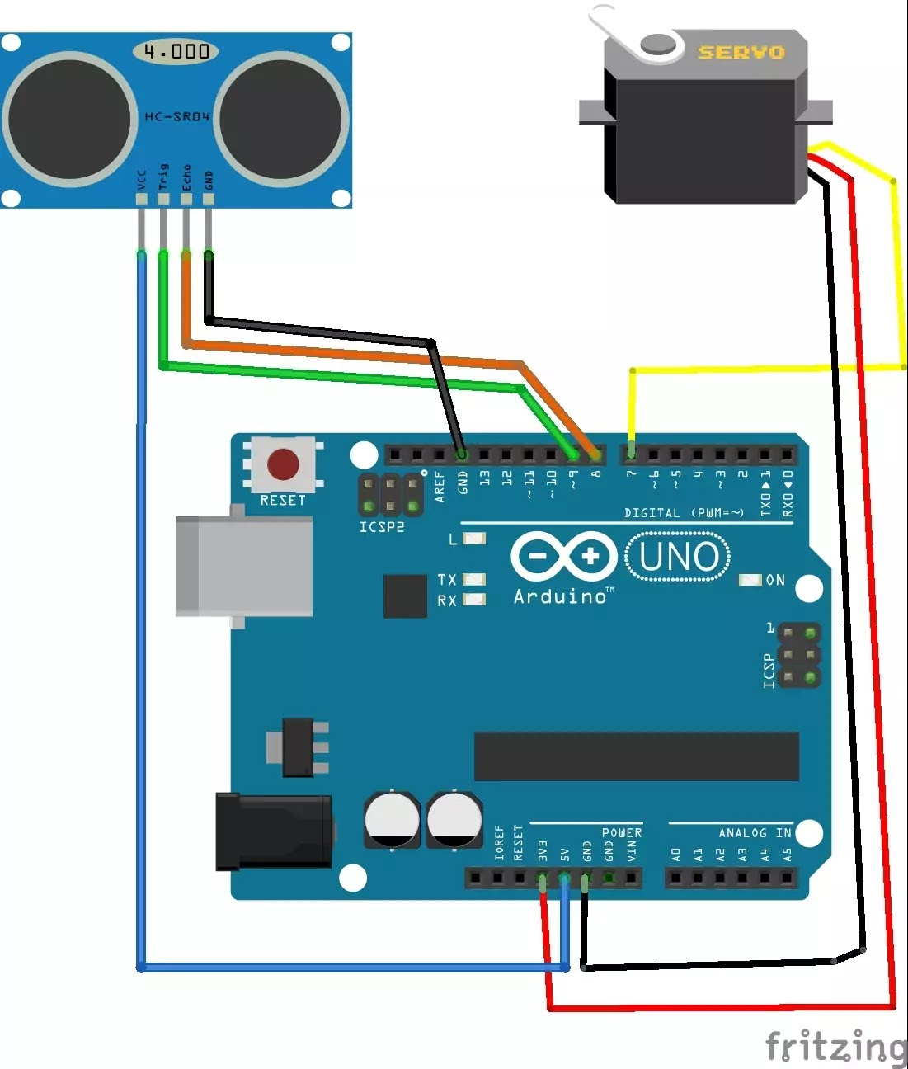
Circuit Diagram

Slide 8
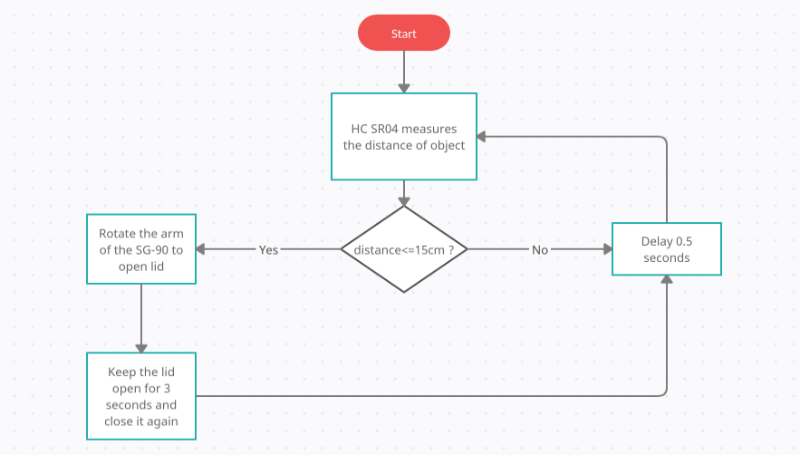
Flow Chart
The above diagram represents the overall functioning of the prototype

Slide 9
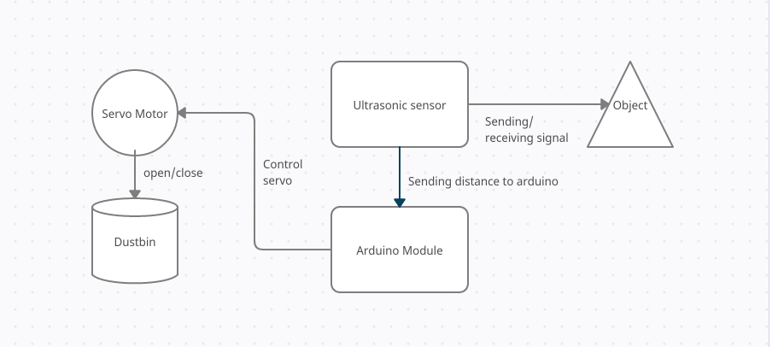
Block Diagram
The above diagram shows the overall interaction between different parts of the setup and its environment.

Slide 10

References
https://www.sparkfun.com/products/15569
https://store.arduino.cc/usa/arduino-uno-rev3
https://components101.com/motors/servo-motor-basics-pinout-datasheet
https://create.arduino.cc/projecthub/mohd-shahid/smart-dustbin-using-arduino-c0bb7a

