Slide 1
UNDERSTANDING LLM’S SYMBOLIC REASONING THROUGH COMPARATIVE ANALYSIS OF DSR METHODOLOGY
GROUP - 23
Abhinav Gupta, Akshita Kapur, Dhruvam Zaveri, Hrishikesh Thakur, Shreyas Shrawage

Slide 2
PROBLEM DESCRIPTION
LLM Drawbacks
Complex Tasks
Add Symbolic Reasoning to LMs
Excellent at solving dynamic user problems in real time. But, show inaccuracy when asked to perform complex tasks.
Employing logical connectives, navigating lengthy reasoning chains, harnessing domain specific knowledge to derive logical conclusions, etc.
A framework to efficiently learn weighted rules and apply semantic loss through the use of a Neuro Symbolic Reasoning. Complimenting an existing model architecture.

Slide 3
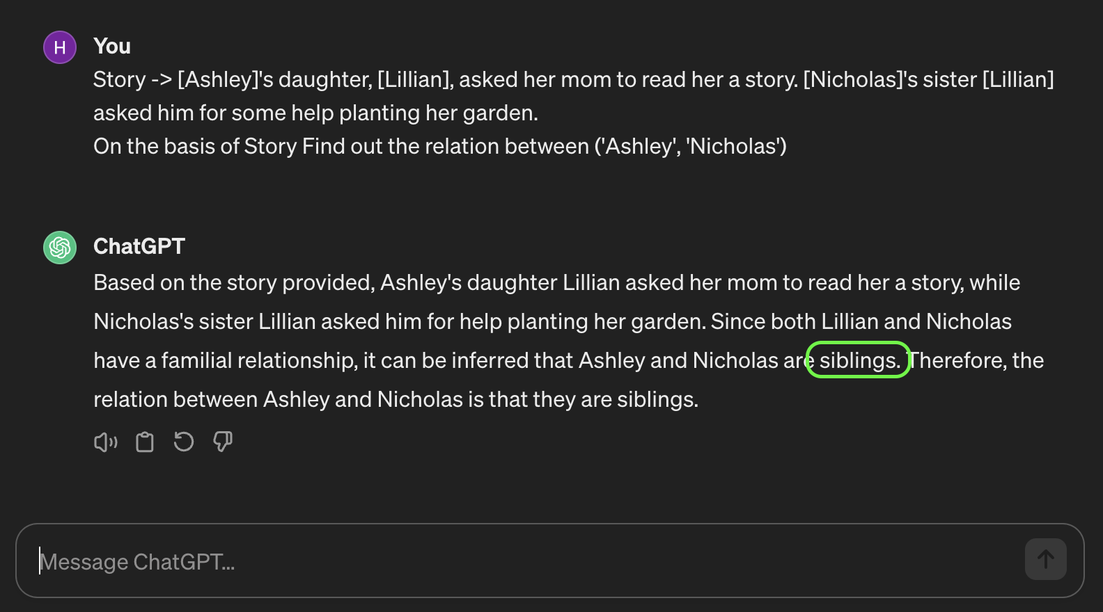

Slide 4
EXISTING RESEARCH
Combines pre-trained LMs
RoBERTa
Differentiable Symbolic Reasoning (DSR)
Symbolic Reasoning

Slide 5
NOVELTY
Various state-of-the-art models work well on different tasks
In this project, we designed 4 models implementing the DSR framework using different text classifiers
RoBERTa
XLNet
ELECTRA
ALBERT
For a fair comparison, we developed baseline models of the classifiers that perform the same task without neuro-symbolic reasoning.

Slide 6
DATASET
Semi-synthetic Stories
92 manually crafted composition rules
CLUTRR
Complex relationships
Queries for each data point

Slide 7

EXPERIMENTATION METHODOLOGY - ARCHITECTURE

Slide 8
EXPERIMENTATION METHODOLOGY - MODEL
Pre-process Dataset
Cleaning the provided Context (Input text) by picking the statements having either of the names in the query
Creating a dictionary for all the name pairs using this cleaned text
Extract
Relations
Acquiring the word embeddings of the Input text (context) using a pre-trained LLM
Feeding these embeddings into the classifier (MLP) to get the relationship of the provided name-pair.
Extract Facts
Acquiring the word embeddings of the Input text (context) using a pre-trained LLM
Feeding these embeddings into the classifier (MLP) to get the relationship of the provided name-pair.

Slide 9
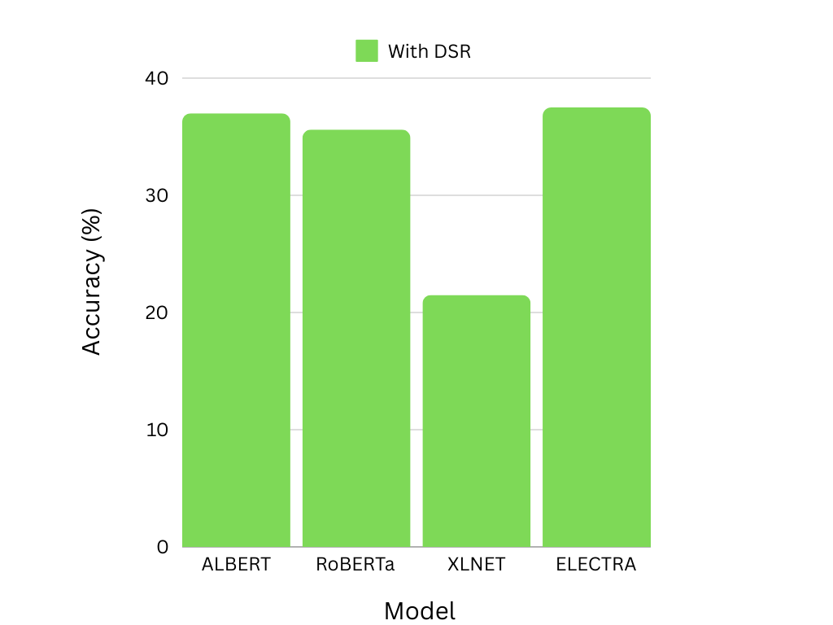
OBSERVATION - PERFORMANCE OF NEURO-SYMBOLIC REASONING
State-of-the-art LLMs:
Perform well for text and sequence classification
Not effective in logical reasoning tasks (Learning via examples)
Utilizing Neuro-symbolic reasoning:
Promotes learning via rules
Represents kinship in the form of operations
composite(brother, daughter) = niece,
Comprehensible to the model

Slide 10
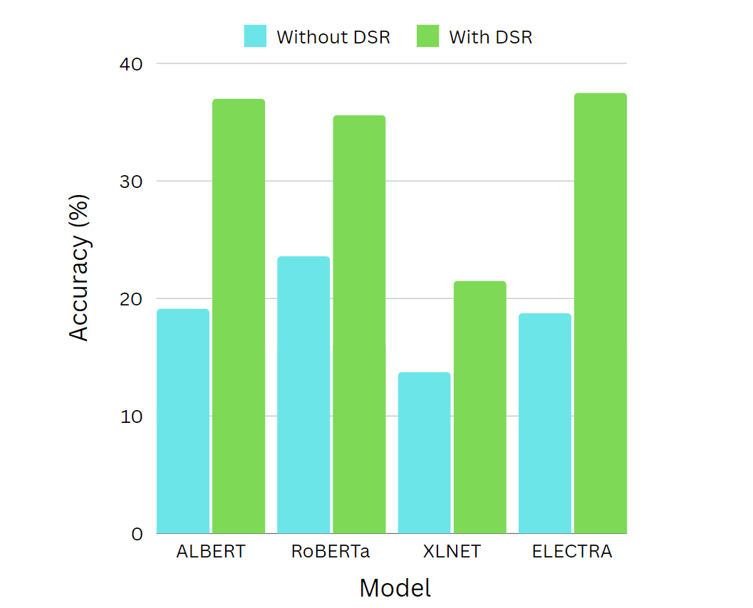
OBSERVATIONS - COMPARISON OF DSR MODELS
Since each model has a unique architecture or is trained on different set of parameters pairing it with DSR results in varied performance.
It is clearly observable that ALBERT, RoBERTa and ELECTRA are best suited to be paired with DSR.
XLNet, when augmented with the DSR layer, does not achieve results on par with those of other models enhanced by DSR.

Slide 11
RESULTS
Performance without DSR
Performance with DSR
1
ALBERT
19.125%
37%
2
RoBERTa
23.6%
35.6%
3
XLNET
13.75%
21.5%
4
ELECTRA
18.75%
37.5%
Accuracies obtained after training on 2000 data points

Slide 12
CONCLUSION
XLNet is designed to handle longer sequences effectively, thanks to the Transformer-XL architecture. However, this advantage might not translate into better performance for complex tasks where the input sequences are relatively short (evident from our observations from kinship reasoning), and the ability to model long-range dependencies is less critical.
The queries in the CLUTRR dataset involve name pairs and require the model to understand specific relationships within the story. Models that are better at capturing local context and relationships between entities might perform better on this task. XLNet's focus on capturing global context and long-range dependencies might not align as well with the requirements of the query structure in this dataset.
After incorporating the DSR layer into each model, the improvement in performance is directly proportional to the baseline performance of the models without DSR. This suggests that while DSR contributes to enhanced performance, choosing a right base model still plays a crucial role.

Slide 13
THANK YOU!

