Slide 1

Frequency Agnostic Tissue Characterization in Ultrasound Imaging using Backscattered Signal Statistics
Presented By
Gadge Abhinav Narayan
21MM62R03
(Biomedical Engineering 2nd year)
Under the supervision of
Dr. Debdoot Sheet
(Department of Electrical Engineering)
SCHOOL OF MEDICAL SCIENCE AND TECHNOLOGY
INDIAN INSTITUTE OF TECHNOLOGY, KHARAGPUR
APRIL 2023

Slide 2

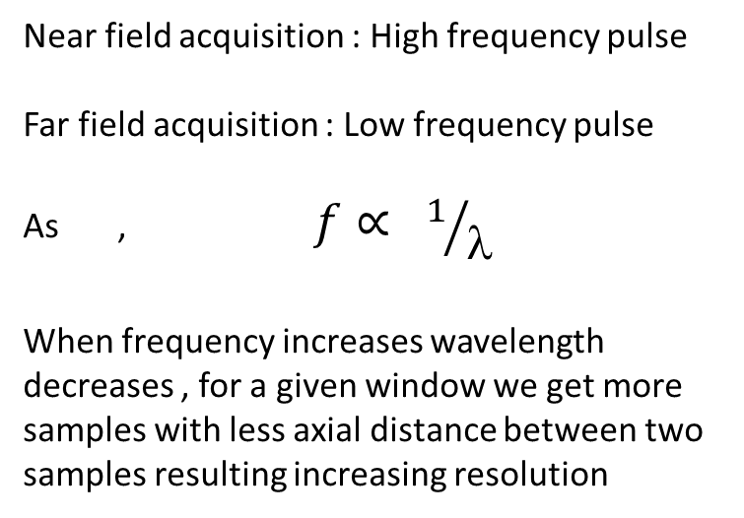
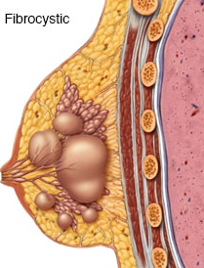
Indian Institute of Technology, Kharagpur
School of Medical Science and Technology
INTRODUCTION
Constant window
Dense Tissues
Cyst region
Trade off between resolution and depth of acquisition
Transducer
Near field
Far field
SOLUTION : FRQUENCY AGNOSTIC METHOD

Slide 3
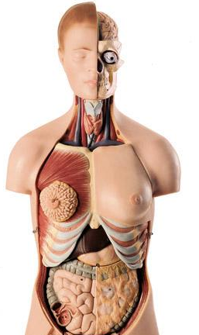
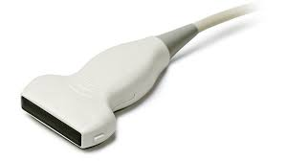
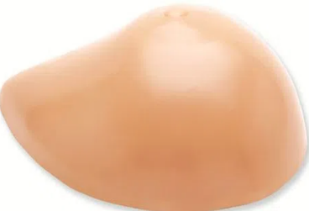
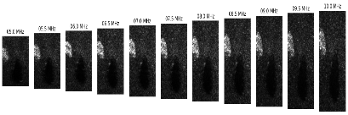


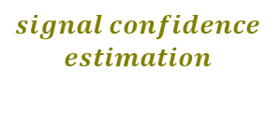
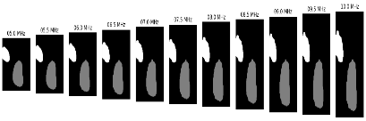



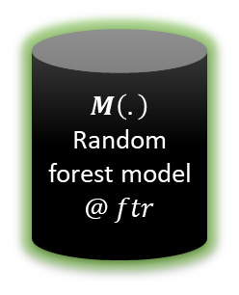



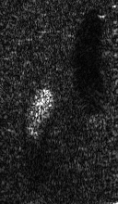



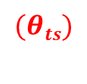

Graphical Abstract
Artificial Breast Tissue Phantom
Multi-Freq Data acquisition (RF Data)
B-mode
x
Training RF data
Envelope Detection
Log Transformation
Preprocessing
B- Mode Image
Annotations
Ground Truth Masks
Training
Variational
Patch
Resampling
Testing RF data
Predicted labels
Inference

Slide 4
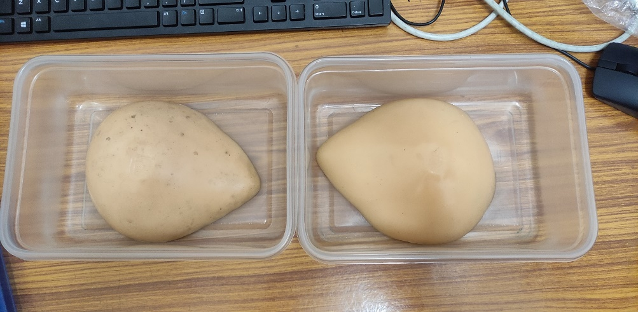
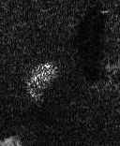
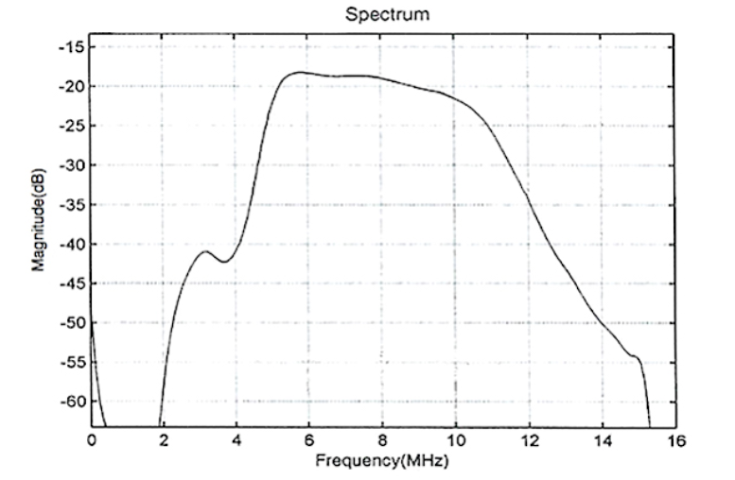
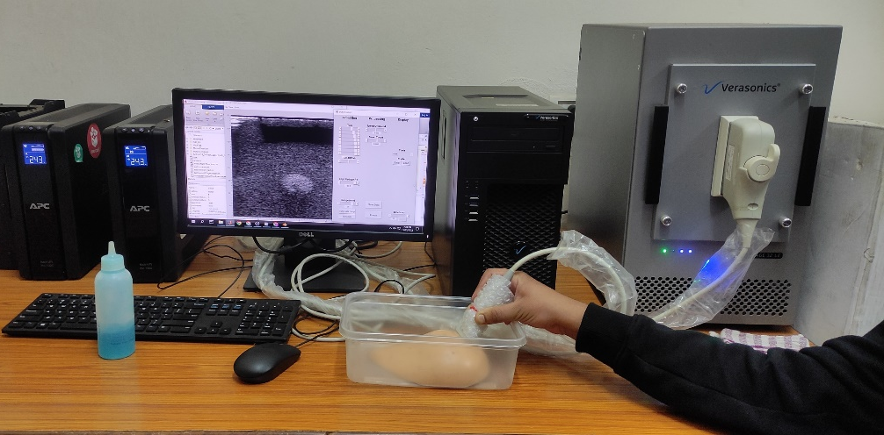
Indian Institute of Technology, Kharagpur
School of Medical Science and Technology
Isoechoic region
Research grade machine and devices
Hypoechoic region
L-11 5V Transducer(128 linear array)
CAE Blue Artificial Breast Phantoms
Hyperechoic region
US raw data generation(Reseach Machine)
f_{min} = 4.68 MHz , f₀ = 7.6 MHz , f_{max} = 15.52 MHz

Slide 5

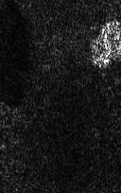



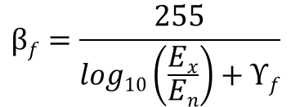

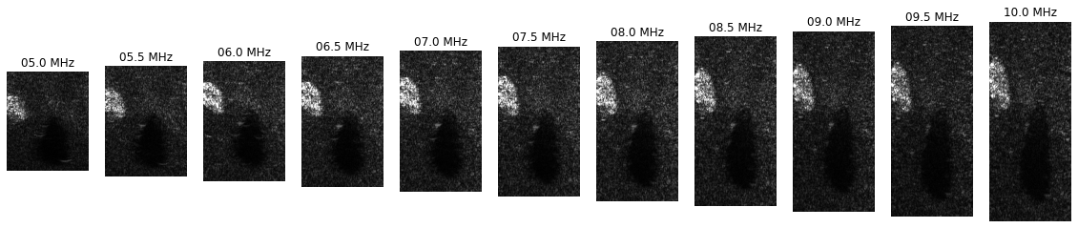
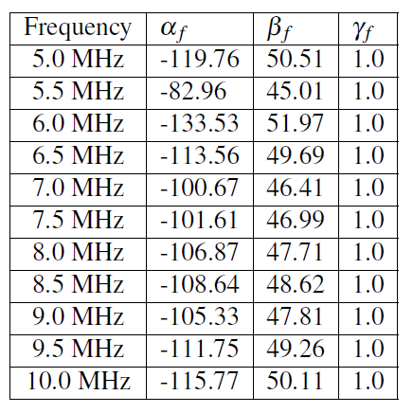
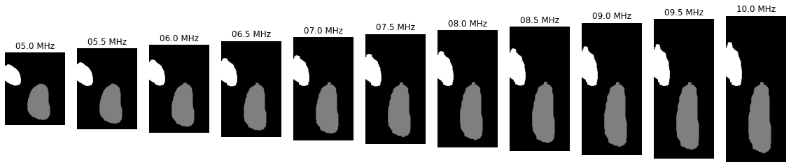
Indian Institute of Technology, Kharagpur
School of Medical Science and Technology
Indian Institute of Technology, Kharagpur
School of Medical Science and Technology
RF data to Ground Truth mask
Envelope Detection
Envelope data
Log Transformation
Annotations
RF data
B-Mode Image
Ground truth

Slide 6
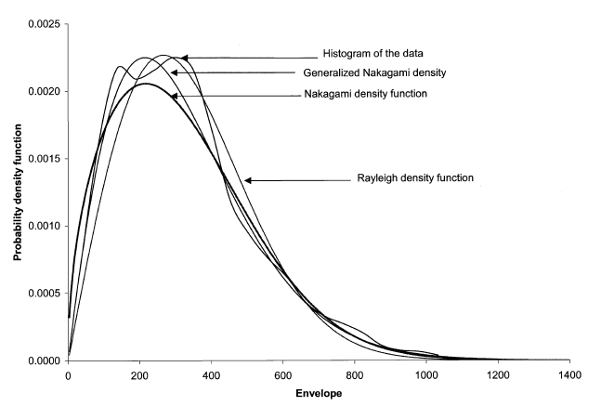
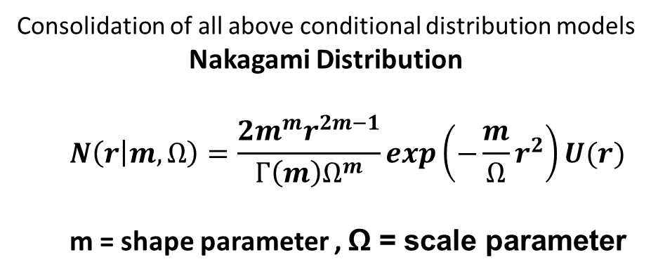
Indian Institute of Technology, Kharagpur
School of Medical Science and Technology
Indian Institute of Technology, Kharagpur
School of Medical Science and Technology
Envelope Distribution
Envelope R follows following Distributions
Rayleigh Distribution
Attenuation, Absorption, Reflection, Refraction
Pre-Rayleigh Distribution
Post-Rayleigh Distribution

Slide 7
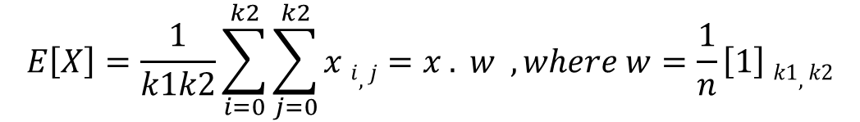


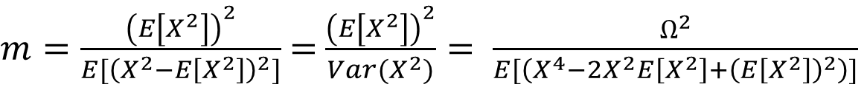
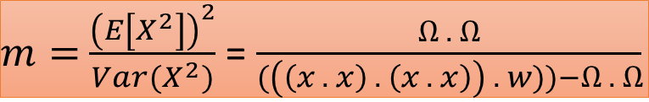
Indian Institute of Technology, Kharagpur
School of Medical Science and Technology
Indian Institute of Technology, Kharagpur
School of Medical Science and Technology
m and Ω (Shape and Scale) Formulations

Slide 8
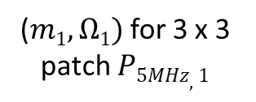
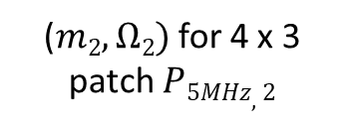
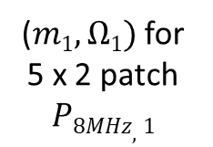
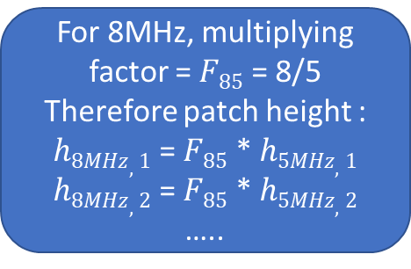
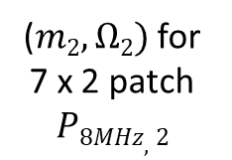
Indian Institute of Technology, Kharagpur
School of Medical Science and Technology
Indian Institute of Technology, Kharagpur
School of Medical Science and Technology
Parameter estimation for multi frequency data
Approach 1: variable patch size for each frequency
Scanlines 5MHz (Training)
Scanlines 8MHz (Testing)
Current sample r
Current sample r

Slide 9
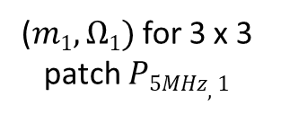
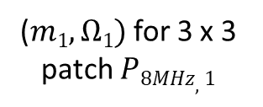
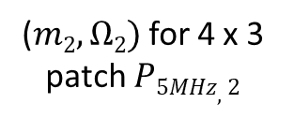
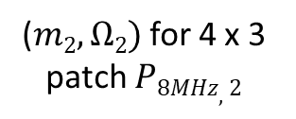
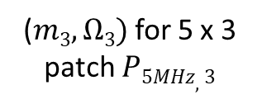
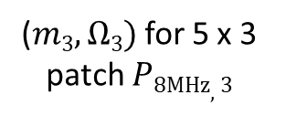
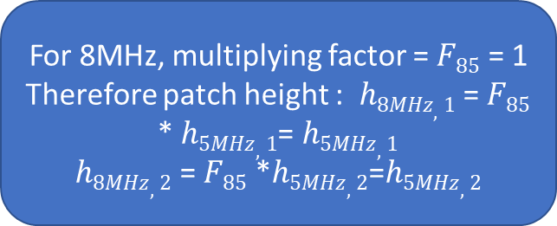
Indian Institute of Technology, Kharagpur
School of Medical Science and Technology
Indian Institute of Technology, Kharagpur
School of Medical Science and Technology
Approach 2: Resampling and estimating parameter
Estimation for 5 MHz (Training)
Estimation for 8 MHz (Testing)
Current sample r
Current sample r

Slide 10

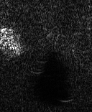
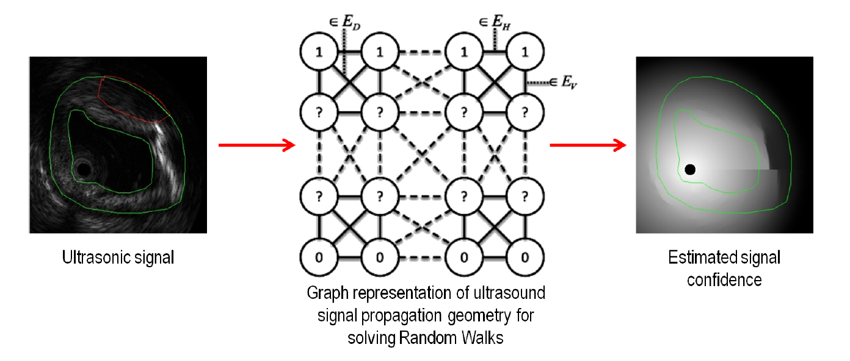
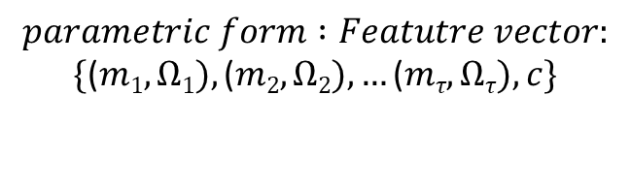
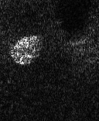

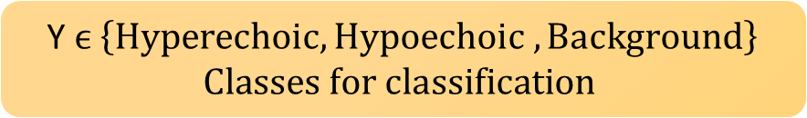
Indian Institute of Technology, Kharagpur
School of Medical Science and Technology
Indian Institute of Technology, Kharagpur
School of Medical Science and Technology
Signal Confidence Estimation
c
Total 57 parameters
Graph representation of US signal propagation for solving random walks
US signal
Generated signal confidence

Slide 11


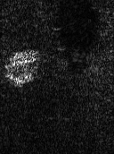
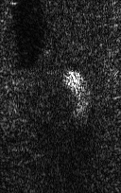
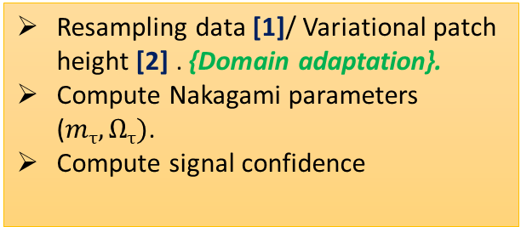

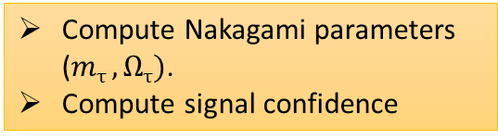

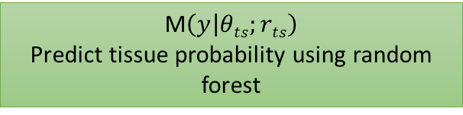



Indian Institute of Technology, Kharagpur
School of Medical Science and Technology
Transfer learning framework
Ultrasound RF test data
Ultrasound RF data
Tissue labels
result

Slide 12
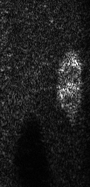
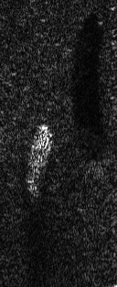
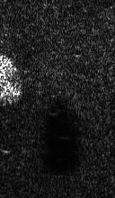









Indian Institute of Technology, Kharagpur
School of Medical Science and Technology
Indian Institute of Technology, Kharagpur
School of Medical Science and Technology
Output : Training at 5MHZ
TRAINING
TESTING
Training RF data at 5MHz visualizing B-mode images
Data at 7MHz
Data at 8.5MHz
Data at 10 MHz
Training Ground Truth
Predicted

Slide 13



Indian Institute of Technology, Kharagpur
School of Medical Science and Technology
Indian Institute of Technology, Kharagpur
School of Medical Science and Technology
Dice Matrix

Slide 14





Indian Institute of Technology, Kharagpur
School of Medical Science and Technology
Indian Institute of Technology, Kharagpur
School of Medical Science and Technology
Semantic Segmentation (Tissue Characterization)
GT PRED
Segmentation of Hypoechoic Region (Train on 7.5MHz)
Under Seg
Perfect Seg
Over Seg
Segmentation of Hyperechoic Region (Train on 7.5MHz)

Slide 15
Indian Institute of Technology, Kharagpur
School of Medical Science and Technology
Indian Institute of Technology, Kharagpur
School of Medical Science and Technology
THANK YOU !

