Slide 1

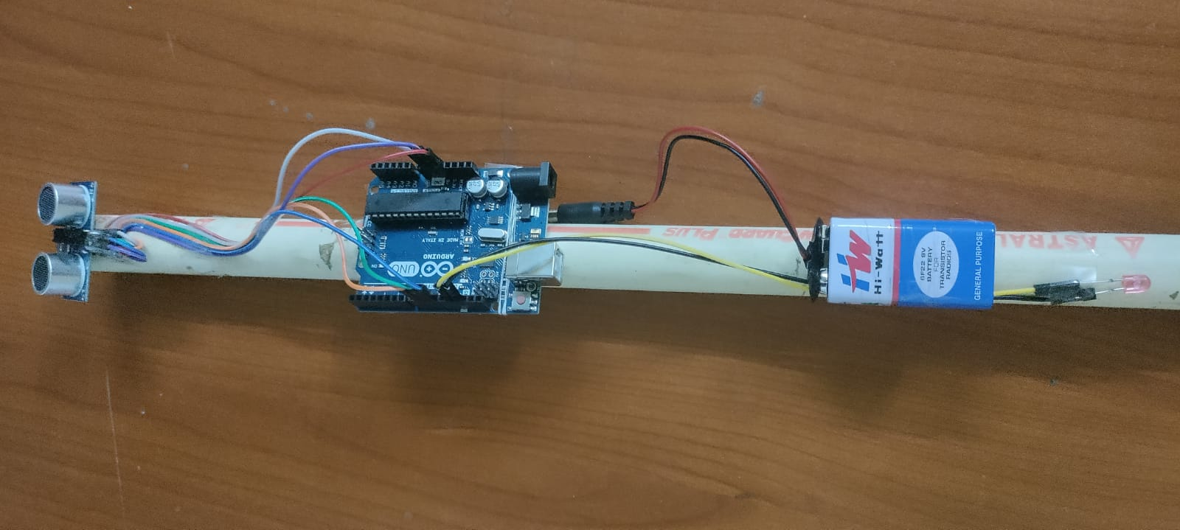
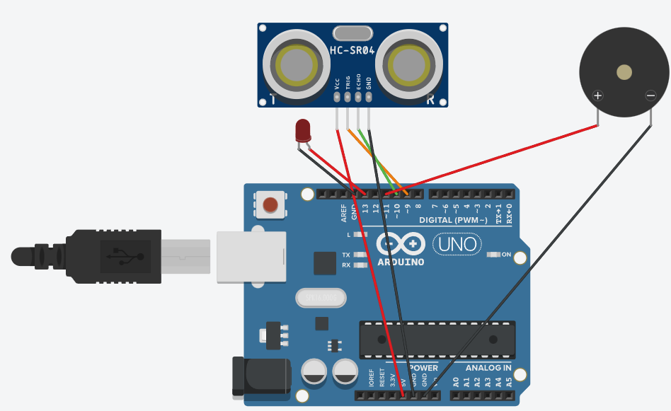





iWalk
iWalk is a smart blind walking stick which detects obstacles in front to assist visually impaired people. The device beeps when an object comes in the vicinity of the user (pre-set to 30cm). The device is made slightly forward heavy for easy usage. This device can be replaced with a regular walking stick as it increases the safety of the user by detecting objects before hand which the user might miss whilst using a regular walking stick.
Components Used:
Arduino Uno R3
Ultrasonic sensor HC-SR04
3V DC Buzzer
LED diode
9V battery
Jumper wires
Battery clip
Battery connector
Outcome of the system:
iWalk is a cost effective device which costs $14.99 (Rs 1150) which can be paired with any existing walking stick as well. The additional fee is a fair trade for the increased safety provided by this device. The device accurately beeps when it encounters an object when at a distance of 30cm.
Circuit Diagram
Model Developed
Block Diagram or Circuit Diagram
Abhinav Gunti
PES1UG20CS008
Adithya R Narayan
PES1UG20CS014
Aneesh Ravishankar
PES1UG20CS051
Ayush Praveen
PES1UG20CS900
Mahesh H B

