Slide 1

INFM 603: Information Technology and Organizational Context
Session 7: PHP
Jimmy Lin
The iSchool University of Maryland
Thursday, October 18, 2012

Slide 2
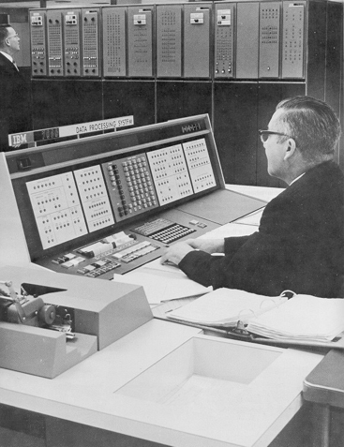
Databases Yesterday…

Slide 3










Databases today…
Wait, but these are websites?

Slide 4
Websites that are really databases
Most of the content is in a database
Web pages are dynamically constructed from results of database queries

Slide 5
Multi-Tiered Architectures
Browser
Browser
Client
Server
Web Server
Web Server
“Middleware”
Database
Database

Slide 6
Putting the Pieces Together…
Browser
Web Server
Database (MySQL)
HTML
SQL query
CGI
PHP
HTML
Results

Slide 7
What is PHP?
PHP is a server-side scripting language
Must run on a server (not in the browser)
More specifically, runs inside the web server
Typical PHP script:
Fetches input from user forms
Executes SQL queries
Constructs an HTML page containing results
Part of the “LAMP” stack
Linux, Apache, MySQL, PHP

Slide 8
PHP Scripts
Are just like normal HTML pages
With the exception of code between <?php … ?>
Variables begin with dollar signs
E.g., $a, $b
Use “echo” to output HTML
Just like document.writeln(…) in JavaScript
Use “.” to concatenate string
E.g., “here is” . “ some text”
Just like “here is” + “ some text” in JavaScript

Slide 9
Sample PHP Script
Get input from user from
Connect to the database
Execute SQL query
Process results to generate HTML

Slide 10
RideShare Exercise
Design a database to match drivers with passengers for ride sharing on long car trips:
Drivers post available seats; they want to know about interested passengers
Passengers come looking for rides: they want to know about available rides and can make reservations
These things happen in no particular order
To simplify, passengers don’t get to post “rides wanted” ads
Build a web application to accomplish the above

Slide 11
RideShare Exercise: Tasks
Design the tables you will need
First decide what information you need to keep track of
Then design tables to capture this information
Design SQL queries
What happens when a passenger comes looking for a ride?
What happens when a driver comes to find out who the passengers are?
Role play!

