Slide 1

Introduction
LBSC 888: Doctoral Seminar ― Session #1
Jimmy Lin
The iSchool, College of Information Studies
University of Maryland
Wednesday, September 2, 2009
This work is licensed under a Creative Commons Attribution-Noncommercial-Share Alike 3.0 United States See http://creativecommons.org/licenses/by-nc-sa/3.0/us/ for details.

Slide 2
Who am I?

Slide 3




NLP
IR

Slide 4
Your turn
Past. Present. Future. Bonus.

Slide 5
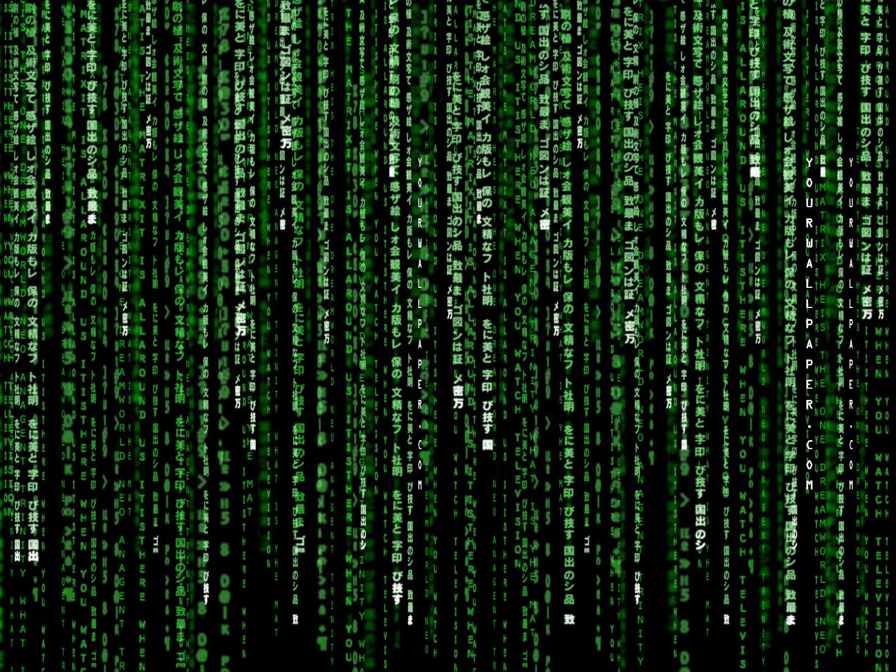
What is information studies?

Slide 6
What is information studies not?

Slide 7
Computer Science “lite”

Slide 8
MIS

Slide 9
Social Science

Slide 10
What is information studies?

Slide 11


Slide 12
M³
Allison Druin, Paul T. Jaeger, Kenneth R. Fleischmann, Jennifer Golbeck, Jimmy Lin, Yan Qu, Ping Wang, and Bo Xie. The Maryland Modular Method: An Approach to Doctoral Education in Information Studies. Journal of Education for Library and Information Science, 2009, in press.

Slide 13
Lenses
Information
People
Environments
Systems

Slide 14
Lenses
Information
People
Environments
Systems

Slide 15
Lenses
Information
People
Environments
Systems

Slide 16
Lenses
Information
People
Environments
Systems

Slide 17
Lenses
Information
People
Environments
Systems

Slide 18
Modules
Video Games and Learning
Cloud Computing
Values and Ethics
Interactive Search
Lifelong Users

Slide 19
Module Organization
Session #1, block #1 | You | Sticky notes, paper discussions
Session #1, block #2 | Me | Understanding the topic
Session #2, block #1 | Me | Research directions
Session #2, block #2 | Me | “Academic Life”

Slide 20
Administrivia

