Slide 1
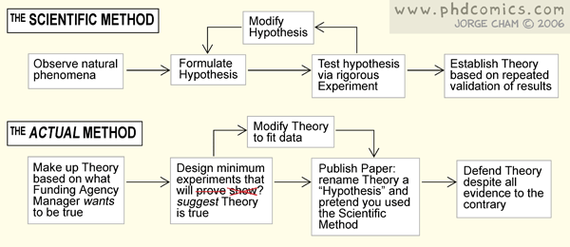

LBSC 888 Doctoral Seminar
Fall, 2009: September 16, 2009
Jimmy Lin

Slide 2
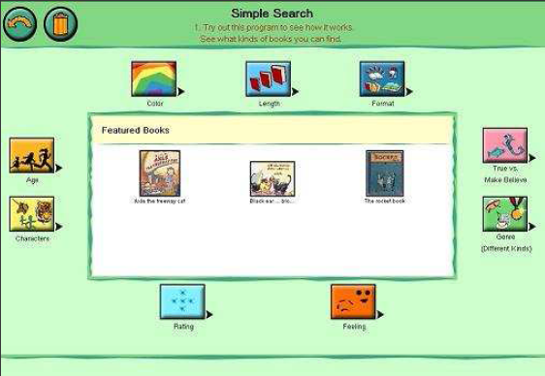
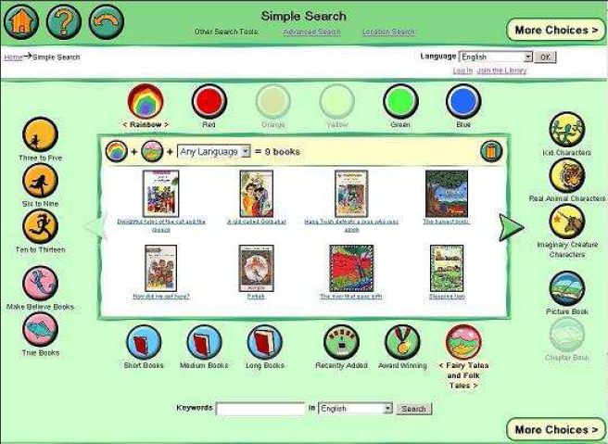
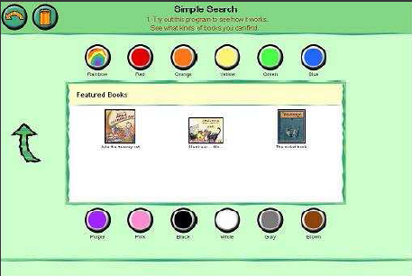
Which interface is better?
LBSC 888 Doctoral Seminar
Fall, 2009: September 16, 2009
Jimmy Lin
Hutchinson et al., IDC 2006

Slide 3
testing
hypothesis
generation
quantitative
research
qualitative
program
research
project
study
LBSC 888 Doctoral Seminar
Fall, 2009: September 16, 2009
Jimmy Lin

Slide 4
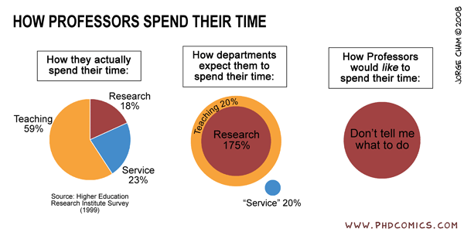
LBSC 888 Doctoral Seminar
Fall, 2009: September 16, 2009
Jimmy Lin

Slide 5
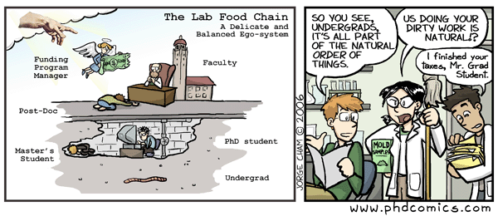
LBSC 888 Doctoral Seminar
Fall, 2009: September 16, 2009
Jimmy Lin

