Slide 1

Bigtable, Hive, and Pig
Data-Intensive Information Processing Applications ― Session #12
Jimmy Lin
University of Maryland
Tuesday, April 27, 2010
This work is licensed under a Creative Commons Attribution-Noncommercial-Share Alike 3.0 United States See http://creativecommons.org/licenses/by-nc-sa/3.0/us/ for details

Slide 2

Source: Wikipedia (Japanese rock garden)

Slide 3
Today’s Agenda
Bigtable
Hive
Pig

Slide 4
Bigtable

Slide 5
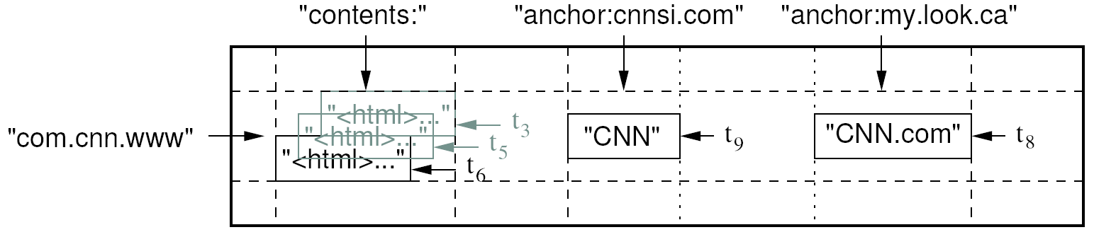
Data Model
A table in Bigtable is a sparse, distributed, persistent multidimensional sorted map
Map indexed by a row key, column key, and a timestamp
(row:string, column:string, time:int64) → uninterpreted byte array
Supports lookups, inserts, deletes
Single row transactions only
Image Source: Chang et al., OSDI 2006

Slide 6
Rows and Columns
Rows maintained in sorted lexicographic order
Applications can exploit this property for efficient row scans
Row ranges dynamically partitioned into tablets
Columns grouped into column families
Column key = family:qualifier
Column families provide locality hints
Unbounded number of columns

Slide 7
Bigtable Building Blocks
GFS
Chubby
SSTable

Slide 8
SSTable
Basic building block of Bigtable
Persistent, ordered immutable map from keys to values
Stored in GFS
Sequence of blocks on disk plus an index for block lookup
Can be completely mapped into memory
Supported operations:
Look up value associated with key
Iterate key/value pairs within a key range
64K block
64K block
64K block
SSTable
Index
Source: Graphic from slides by Erik Paulson

Slide 9
Tablet
Dynamically partitioned range of rows
Built from multiple SSTables
Tablet
Start:aardvark
End:apple
64K block
64K block
64K block
SSTable
64K block
64K block
64K block
SSTable
Index
Index
Source: Graphic from slides by Erik Paulson

Slide 10
Table
Multiple tablets make up the table
SSTables can be shared
Tablet
Tablet
aardvark
apple
apple_two_E
boat
SSTable
SSTable
SSTable
SSTable
Source: Graphic from slides by Erik Paulson

Slide 11
Architecture
Client library
Single master server
Tablet servers

Slide 12
Bigtable Master
Assigns tablets to tablet servers
Detects addition and expiration of tablet servers
Balances tablet server load
Handles garbage collection
Handles schema changes

Slide 13
Bigtable Tablet Servers
Each tablet server manages a set of tablets
Typically between ten to a thousand tablets
Each 100-200 MB by default
Handles read and write requests to the tablets
Splits tablets that have grown too large

Slide 14
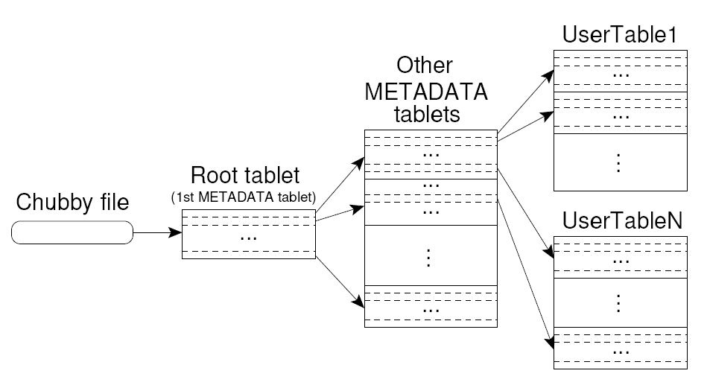
Tablet Location
Upon discovery, clients cache tablet locations
Image Source: Chang et al., OSDI 2006

Slide 15
Tablet Assignment
Master keeps track of:
Set of live tablet servers
Assignment of tablets to tablet servers
Unassigned tablets
Each tablet is assigned to one tablet server at a time
Tablet server maintains an exclusive lock on a file in Chubby
Master monitors tablet servers and handles assignment
Changes to tablet structure
Table creation/deletion (master initiated)
Tablet merging (master initiated)
Tablet splitting (tablet server initiated)

Slide 16
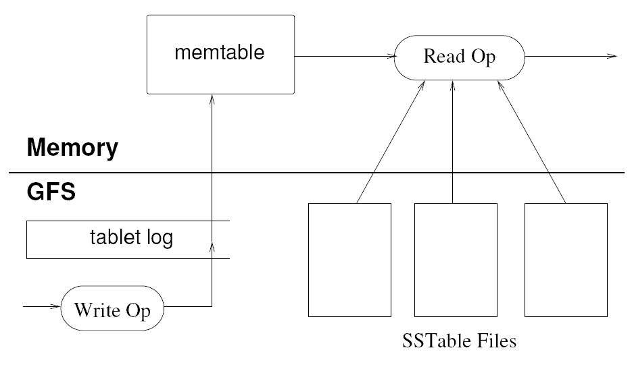
Tablet Serving
“Log Structured Merge Trees”
Image Source: Chang et al., OSDI 2006

Slide 17
Compactions
Minor compaction
Converts the memtable into an SSTable
Reduces memory usage and log traffic on restart
Merging compaction
Reads the contents of a few SSTables and the memtable, and writes out a new SSTable
Reduces number of SSTables
Major compaction
Merging compaction that results in only one SSTable
No deletion records, only live data

Slide 18
Bigtable Applications
Data source and data sink for MapReduce
Google’s web crawl
Google Earth
Google Analytics

Slide 19
Lessons Learned
Fault tolerance is hard
Don’t add functionality before understanding its use
Single-row transactions appear to be sufficient
Keep it simple!

Slide 20
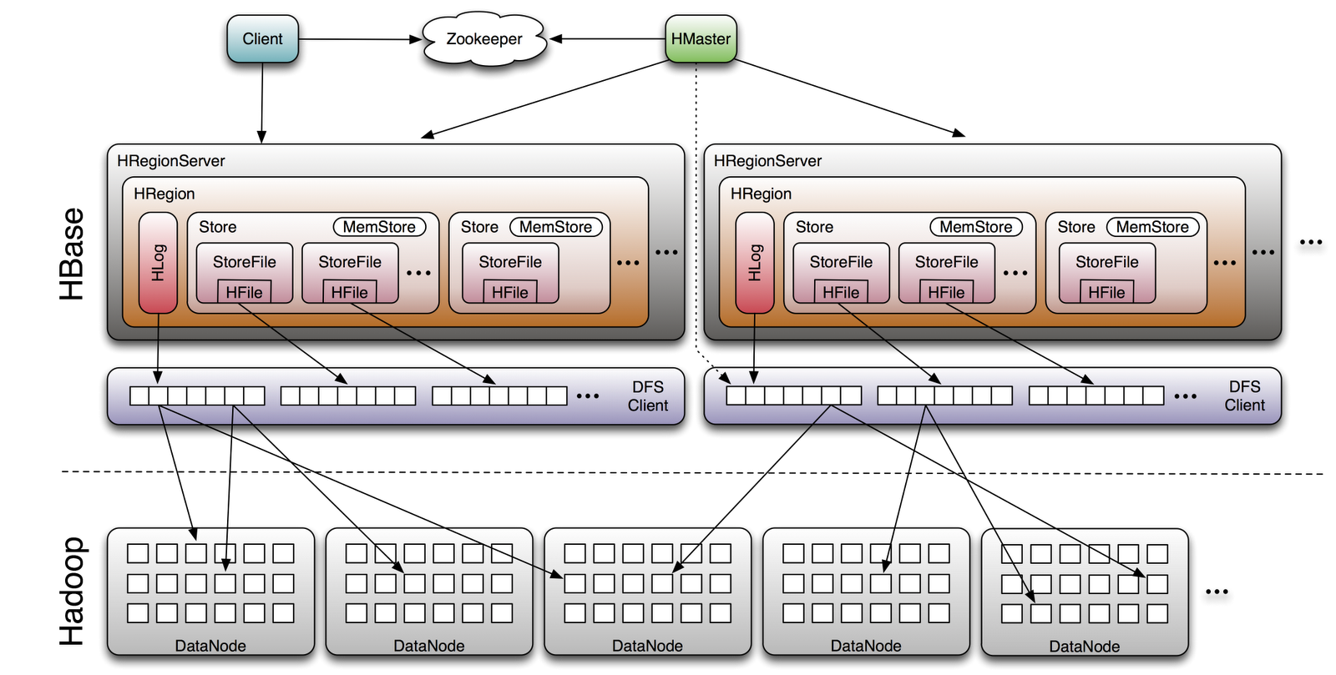
HBase
Open-source clone of Bigtable
Implementation hampered by lack of file append in HDFS
Image Source: http://www.larsgeorge.com/2009/10/hbase-architecture-101-storage.html

Slide 21
Hive and Pig

Slide 22
Need for High-Level Languages
Hadoop is great for large-data processing!
But writing Java programs for everything is verbose and slow
Not everyone wants to (or can) write Java code
Solution: develop higher-level data processing languages
Hive: HQL is like SQL
Pig: Pig Latin is a bit like Perl

Slide 23


Hive and Pig
Hive: data warehousing application in Hadoop
Query language is HQL, variant of SQL
Tables stored on HDFS as flat files
Developed by Facebook, now open source
Pig: large-scale data processing system
Scripts are written in Pig Latin, a dataflow language
Developed by Yahoo!, now open source
Roughly 1/3 of all Yahoo! internal jobs
Common idea:
Provide higher-level language to facilitate large-data processing
Higher-level language “compiles down” to Hadoop jobs

Slide 24
Hive: Background
Started at Facebook
Data was collected by nightly cron jobs into Oracle DB
“ETL” via hand-coded python
Grew from 10s of GBs (2006) to 1 TB/day new data (2007), now 10x that
Source: cc-licensed slide by Cloudera

Slide 25
Hive Components
Shell: allows interactive queries
Driver: session handles, fetch, execute
Compiler: parse, plan, optimize
Execution engine: DAG of stages (MR, HDFS, metadata)
Metastore: schema, location in HDFS, SerDe
Source: cc-licensed slide by Cloudera

Slide 26
Data Model
Tables
Typed columns (int, float, string, boolean)
Also, list: map (for JSON-like data)
Partitions
For example, range-partition tables by date
Buckets
Hash partitions within ranges (useful for sampling, join optimization)
Source: cc-licensed slide by Cloudera

Slide 27
Metastore
Database: namespace containing a set of tables
Holds table definitions (column types, physical layout)
Holds partitioning information
Can be stored in Derby, MySQL, and many other relational databases
Source: cc-licensed slide by Cloudera

Slide 28
Physical Layout
Warehouse directory in HDFS
E.g., /user/hive/warehouse
Tables stored in subdirectories of warehouse
Partitions form subdirectories of tables
Actual data stored in flat files
Control char-delimited text, or SequenceFiles
With custom SerDe, can use arbitrary format
Source: cc-licensed slide by Cloudera

Slide 29
Hive: Example
Hive looks similar to an SQL database
Relational join on two tables:
Table of word counts from Shakespeare collection
Table of word counts from the bible
SELECT s.word, s.freq, k.freq FROM shakespeare s
JOIN bible k ON (s.word = k.word) WHERE s.freq >= 1 AND k.freq >= 1 ORDER BY s.freq DESC LIMIT 10;
the 25848 62394
I 23031 8854
and 19671 38985
to 18038 13526
of 16700 34654
a 14170 8057
you 12702 2720
my 11297 4135
in 10797 12445
is 8882 6884
Source: Material drawn from Cloudera training VM

Slide 30
Hive: Behind the Scenes
SELECT s.word, s.freq, k.freq FROM shakespeare s
JOIN bible k ON (s.word = k.word) WHERE s.freq >= 1 AND k.freq >= 1 ORDER BY s.freq DESC LIMIT 10;
(Abstract Syntax Tree)
(TOK_QUERY (TOK_FROM (TOK_JOIN (TOK_TABREF shakespeare s) (TOK_TABREF bible k) (= (. (TOK_TABLE_OR_COL s) word) (. (TOK_TABLE_OR_COL k) word)))) (TOK_INSERT (TOK_DESTINATION (TOK_DIR TOK_TMP_FILE)) (TOK_SELECT (TOK_SELEXPR (. (TOK_TABLE_OR_COL s) word)) (TOK_SELEXPR (. (TOK_TABLE_OR_COL s) freq)) (TOK_SELEXPR (. (TOK_TABLE_OR_COL k) freq))) (TOK_WHERE (AND (>= (. (TOK_TABLE_OR_COL s) freq) 1) (>= (. (TOK_TABLE_OR_COL k) freq) 1))) (TOK_ORDERBY (TOK_TABSORTCOLNAMEDESC (. (TOK_TABLE_OR_COL s) freq))) (TOK_LIMIT 10)))
(one or more of MapReduce jobs)

Slide 31
Hive: Behind the Scenes
STAGE DEPENDENCIES:
Stage-1 is a root stage
Stage-2 depends on stages: Stage-1
Stage-0 is a root stage
STAGE PLANS:
Stage: Stage-1
Map Reduce
Alias -> Map Operator Tree:
s
TableScan
alias: s
Filter Operator
predicate:
expr: (freq >= 1)
type: boolean
Reduce Output Operator
key expressions:
expr: word
type: string
sort order: +
Map-reduce partition columns:
expr: word
type: string
tag: 0
value expressions:
expr: freq
type: int
expr: word
type: string
k
TableScan
alias: k
Filter Operator
predicate:
expr: (freq >= 1)
type: boolean
Reduce Output Operator
key expressions:
expr: word
type: string
sort order: +
Map-reduce partition columns:
expr: word
type: string
tag: 1
value expressions:
expr: freq
type: int
Stage: Stage-2
Map Reduce
Alias -> Map Operator Tree:
hdfs://localhost:8022/tmp/hive-training/364214370/10002
Reduce Output Operator
key expressions:
expr: _col1
type: int
sort order: -
tag: -1
value expressions:
expr: _col0
type: string
expr: _col1
type: int
expr: _col2
type: int
Reduce Operator Tree:
Extract
Limit
File Output Operator
compressed: false
GlobalTableId: 0
table:
input format: org.apache.hadoop.mapred.TextInputFormat
output format: org.apache.hadoop.hive.ql.io.HiveIgnoreKeyTextOutputFormat
Stage: Stage-0
Fetch Operator
limit: 10
Reduce Operator Tree:
Join Operator
condition map:
Inner Join 0 to 1
condition expressions:
0 {VALUE._col0} {VALUE._col1}
1 {VALUE._col0}
outputColumnNames: _col0, _col1, _col2
Filter Operator
predicate:
expr: ((_col0 >= 1) and (_col2 >= 1))
type: boolean
Select Operator
expressions:
expr: _col1
type: string
expr: _col0
type: int
expr: _col2
type: int
outputColumnNames: _col0, _col1, _col2
File Output Operator
compressed: false
GlobalTableId: 0
table:
input format: org.apache.hadoop.mapred.SequenceFileInputFormat
output format: org.apache.hadoop.hive.ql.io.HiveSequenceFileOutputFormat

Slide 32
Hive Demo

Slide 33
Example Data Analysis Task
Find users who tend to visit “good” pages.
Visits
Pages
user | url | time
Amy | www.cnn.com | 8:00
Amy | www.crap.com | 8:05
Amy | www.myblog.com | 10:00
Amy | www.flickr.com | 10:05
Fred | cnn.com/index.htm | 12:00
url | pagerank
www.cnn.com | 0.9
www.flickr.com | 0.9
www.myblog.com | 0.7
www.crap.com | 0.2
. . .
. . .
Pig Slides adapted from Olston et al.

Slide 34
Conceptual Dataflow
Load
Visits(user, url, time)
Load
Pages(url, pagerank)
Canonicalize URLs
Join
url = url
Group by user
Compute Average Pagerank
Filter
avgPR > 0.5
Pig Slides adapted from Olston et al.

Slide 35
System-Level Dataflow
Visits
Pages
. . .
. . .
load
load
canonicalize
join by url
. . .
group by user
. . .
compute average pagerank
filter
the answer
Pig Slides adapted from Olston et al.

Slide 36
MapReduce Code
Pig Slides adapted from Olston et al.

Slide 37
Pig Latin Script
Visits = load ‘/data/visits’ as (user, url, time);
Visits = foreach Visits generate user, Canonicalize(url), time;
Pages = load ‘/data/pages’ as (url, pagerank);
VP = join Visits by url, Pages by url;
UserVisits = group VP by user;
UserPageranks = foreach UserVisits generate user, AVG(VP.pagerank) as avgpr;
GoodUsers = filter UserPageranks by avgpr > ‘0.5’;
store GoodUsers into '/data/good_users';
Pig Slides adapted from Olston et al.

Slide 38
Java vs. Pig Latin
1/20 the lines of code
1/16 the development time
Performance on par with raw Hadoop!
Pig Slides adapted from Olston et al.

Slide 39
Pig takes care of…
Schema and type checking
Translating into efficient physical dataflow
(i.e., sequence of one or more MapReduce jobs)
Exploiting data reduction opportunities
(e.g., early partial aggregation via a combiner)
Executing the system-level dataflow
(i.e., running the MapReduce jobs)
Tracking progress, errors, etc.

Slide 40
Pig Demo

Slide 41
Questions?
Source: Wikipedia (Japanese rock garden)

