Slide 1

Text Retrieval Algorithms
Data-Intensive Information Processing Applications ― Session #4
Jimmy Lin
University of Maryland
Tuesday, February 23, 2010
This work is licensed under a Creative Commons Attribution-Noncommercial-Share Alike 3.0 United States See http://creativecommons.org/licenses/by-nc-sa/3.0/us/ for details

Slide 2

Source: Wikipedia (Japanese rock garden)

Slide 3
Today’s Agenda
Introduction to information retrieval
Basics of indexing and retrieval
Inverted indexing in MapReduce
Retrieval at scale

Slide 4
First, nomenclature…
Information retrieval (IR)
Focus on textual information (= text/document retrieval)
Other possibilities include image, video, music, …
What do we search?
Generically, “collections”
Less-frequently used, “corpora”
What do we find?
Generically, “documents”
Even though we may be referring to web pages, PDFs, PowerPoint slides, paragraphs, etc.

Slide 5
Information Retrieval Cycle
Source
Selection
Resource
Query
Formulation
Query
Search
Results
Selection
Documents
System discovery
Vocabulary discovery
Concept discovery
Document discovery
Examination
Information
source reselection
Delivery

Slide 6
The Central Problem in Search
Author
Searcher
Concepts
Concepts
Query Terms
Document Terms
“tragic love story”
“fateful star-crossed romance”
Do these represent the same concepts?
Notes:
Why is IR hard? Because language is hard!

Slide 7
Abstract IR Architecture
Documents
Query
document acquisition (e.g., web crawling)
online
offline
Representation
Function
Representation
Function
Query Representation
Document Representation
Index
Comparison
Function
Hits

Slide 8
How do we represent text?
Remember: computers don’t “understand” anything!
“Bag of words”
Treat all the words in a document as index terms
Assign a “weight” to each term based on “importance” (or, in simplest case, presence/absence of word)
Disregard order, structure, meaning, etc. of the words
Simple, yet effective!
Assumptions
Term occurrence is independent
Document relevance is independent
“Words” are well-defined

Slide 9
What’s a word?
天主教教宗若望保祿二世因感冒再度住進醫院。這是他今年第二度因同樣的病因住院。
وقال مارك ريجيف - الناطق باسم
الخارجية الإسرائيلية - إن شارون قبل
الدعوة وسيقوم للمرة الأولى بزيارة
تونس، التي كانت لفترة طويلة المقر
الرسمي لمنظمة التحرير الفلسطينية بعد خروجها من لبنان عام 1982.
Выступая в Мещанском суде Москвы экс-глава ЮКОСа заявил не совершал ничего противозаконного, в чем обвиняет его генпрокуратура России.
भारत सरकार ने आर्थिक सर्वेक्षण में वित्तीय वर्ष 2005-06 में सात फ़ीसदी विकास दर हासिल करने का आकलन किया है और कर सुधार पर ज़ोर दिया है
日米連合で台頭中国に対処…アーミテージ前副長官提言
조재영 기자= 서울시는 25일 이명박 시장이 `행정중심복합도시'' 건설안에 대해 `군대라도 동원해 막고싶은 심정''이라고 말했다는 일부 언론의 보도를 부인했다.

Slide 10
Sample Document
McDonald's slims down spuds
Fast-food chain to reduce certain types of fat in its french fries with new cooking oil.
NEW YORK (CNN/Money) - McDonald's Corp. is cutting the amount of "bad" fat in its french fries nearly in half, the fast-food chain said Tuesday as it moves to make all its fried menu items healthier.
But does that mean the popular shoestring fries won't taste the same? The company says no. "It's a win-win for our customers because they are getting the same great french-fry taste along with an even healthier nutrition profile," said Mike Roberts, president of McDonald's USA.
But others are not so sure. McDonald's will not specifically discuss the kind of oil it plans to use, but at least one nutrition expert says playing with the formula could mean a different taste.
Shares of Oak Brook, Ill.-based McDonald's (MCD: down $0.54 to $23.22, Research, Estimates) were lower Tuesday afternoon. It was unclear Tuesday whether competitors Burger King and Wendy's International (WEN: down $0.80 to $34.91, Research, Estimates) would follow suit. Neither company could immediately be reached for comment.
…
“Bag of Words”
14 × McDonalds
12 × fat
11 × fries
8 × new
7 × french
6 × company, said, nutrition
5 × food, oil, percent, reduce, taste, Tuesday
…

Slide 11
Counting Words…
Documents
case folding, tokenization, stopword removal, stemming
Bag of Words
syntax, semantics, word knowledge, etc.
Inverted
Index

Slide 12
Boolean Retrieval
Users express queries as a Boolean expression
AND, OR, NOT
Can be arbitrarily nested
Retrieval is based on the notion of sets
Any given query divides the collection into two sets: retrieved, not-retrieved
Pure Boolean systems do not define an ordering of the results

Slide 13
Inverted Index: Boolean Retrieval
Doc 1
Doc 2
Doc 3
Doc 4
one fish, two fish
red fish, blue fish
cat in the hat
green eggs and ham
1
2
3
4
blue
1
blue
2
cat
1
cat
3
egg
1
egg
4
fish
1
1
fish
1
2
green
1
green
4
ham
1
ham
4
hat
1
hat
3
one
1
one
1
red
1
red
2
two
1
two
1

Slide 14
Boolean Retrieval
To execute a Boolean query:
Build query syntax tree
For each clause, look up postings
Traverse postings and apply Boolean operator
Efficiency analysis
Postings traversal is linear (assuming sorted postings)
Start with shortest posting first
OR
( blue AND fish ) OR ham
ham
AND
blue
fish
blue
2
fish
1
2

Slide 15
Strengths and Weaknesses
Strengths
Precise, if you know the right strategies
Precise, if you have an idea of what you’re looking for
Implementations are fast and efficient
Weaknesses
Users must learn Boolean logic
Boolean logic insufficient to capture the richness of language
No control over size of result set: either too many hits or none
When do you stop reading? All documents in the result set are considered “equally good”
What about partial matches? Documents that “don’t quite match” the query may be useful also

Slide 16
Ranked Retrieval
Order documents by how likely they are to be relevant to the information need
Estimate relevance(q, d_{i})
Sort documents by relevance
Display sorted results
User model
Present hits one screen at a time, best results first
At any point, users can decide to stop looking
How do we estimate relevance?
Assume document is relevant if it has a lot of query terms
Replace relevance(q, d_{i}) with sim(q, d_{i})
Compute similarity of vector representations

Slide 17
Vector Space Model
t₃
d₂
d₃
d₁
θ
φ
t₁
d₅
t₂
d₄
Assumption: Documents that are “close together” in vector space “talk about” the same things
Therefore, retrieve documents based on how close the document is to the query (i.e., similarity ~ “closeness”)

Slide 18
Similarity Metric
Use “angle” between the vectors:
Or, more generally, inner products:

Slide 19
Term Weighting
Term weights consist of two components
Local: how important is the term in this document?
Global: how important is the term in the collection?
Here’s the intuition:
Terms that appear often in a document should get high weights
Terms that appear in many documents should get low weights
How do we capture this mathematically?
Term frequency (local)
Inverse document frequency (global)

Slide 20
TF.IDF Term Weighting
weight assigned to term i in document j
number of occurrence of term i in document j
number of documents in entire collection
number of documents with term i

Slide 21
Inverted Index: TF.IDF
Doc 1
Doc 2
Doc 3
Doc 4
one fish, two fish
red fish, blue fish
cat in the hat
green eggs and ham
tf
1
2
3
4
df
blue
1
1
blue
1
2
1
cat
1
1
cat
1
3
1
egg
1
1
egg
1
4
1
fish
2
2
2
fish
2
1
2
2
2
green
1
1
green
1
4
1
ham
1
1
ham
1
4
1
hat
1
1
hat
1
3
1
one
1
1
one
1
1
1
red
1
1
red
1
2
1
two
1
1
two
1
1
1

Slide 22
Positional Indexes
Store term position in postings
Supports richer queries (e.g., proximity)
Naturally, leads to larger indexes…

Slide 23
Inverted Index: Positional Information
Doc 1
Doc 2
Doc 3
Doc 4
one fish, two fish
red fish, blue fish
cat in the hat
green eggs and ham
tf
1
2
3
4
df
blue
1
1
blue
1
2
1
[3]
cat
1
1
cat
1
3
1
[1]
egg
1
1
egg
1
4
1
[2]
fish
2
2
2
fish
2
1
2
[2,4]
2
2
[2,4]
green
1
1
green
1
4
1
[1]
ham
1
1
ham
1
4
1
[3]
hat
1
1
hat
1
3
1
[2]
one
1
1
one
1
1
1
[1]
red
1
1
red
1
2
1
[1]
two
1
1
two
1
1
1
[3]

Slide 24
Retrieval in a Nutshell
Look up postings lists corresponding to query terms
Traverse postings for each query term
Store partial query-document scores in accumulators
Select top k results to return

Slide 25
Retrieval: Document-at-a-Time
Evaluate documents one at a time (score all query terms)
Tradeoffs
Small memory footprint (good)
Must read through all postings (bad), but skipping possible
More disk seeks (bad), but blocking possible
blue
9
2
21
1
35
1
…
fish
1
2
9
1
21
3
34
1
35
2
80
3
…
Accumulators
(e.g. priority queue)
Document score in top k?
Yes: Insert document score, extract-min if queue too large
No: Do nothing

Slide 26
Retrieval: Query-At-A-Time
Evaluate documents one query term at a time
Usually, starting from most rare term (often with tf-sorted postings)
Tradeoffs
Early termination heuristics (good)
Large memory footprint (bad), but filtering heuristics possible
blue
9
2
21
1
35
1
…
Accumulators (e.g., hash)
Score_{{q=x}}(doc n) = s
fish
1
2
9
1
21
3
34
1
35
2
80
3
…

Slide 27
MapReduce it?
The indexing problem
Scalability is critical
Must be relatively fast, but need not be real time
Fundamentally a batch operation
Incremental updates may or may not be important
For the web, crawling is a challenge in itself
The retrieval problem
Must have sub-second response time
For the web, only need relatively few results
Perfect for MapReduce!
Uh… not so good…

Slide 28
Indexing: Performance Analysis
Fundamentally, a large sorting problem
Terms usually fit in memory
Postings usually don’t
How is it done on a single machine?
How can it be done with MapReduce?
First, let’s characterize the problem size:
Size of vocabulary
Size of postings

Slide 29
Vocabulary Size: Heaps’ Law
Heaps’ Law: linear in log-log space
Vocabulary size grows unbounded!
M is vocabulary size
T is collection size (number of documents)
k and b are constants
Typically, k is between 30 and 100, b is between 0.4 and 0.6
Notes:
22

Slide 30
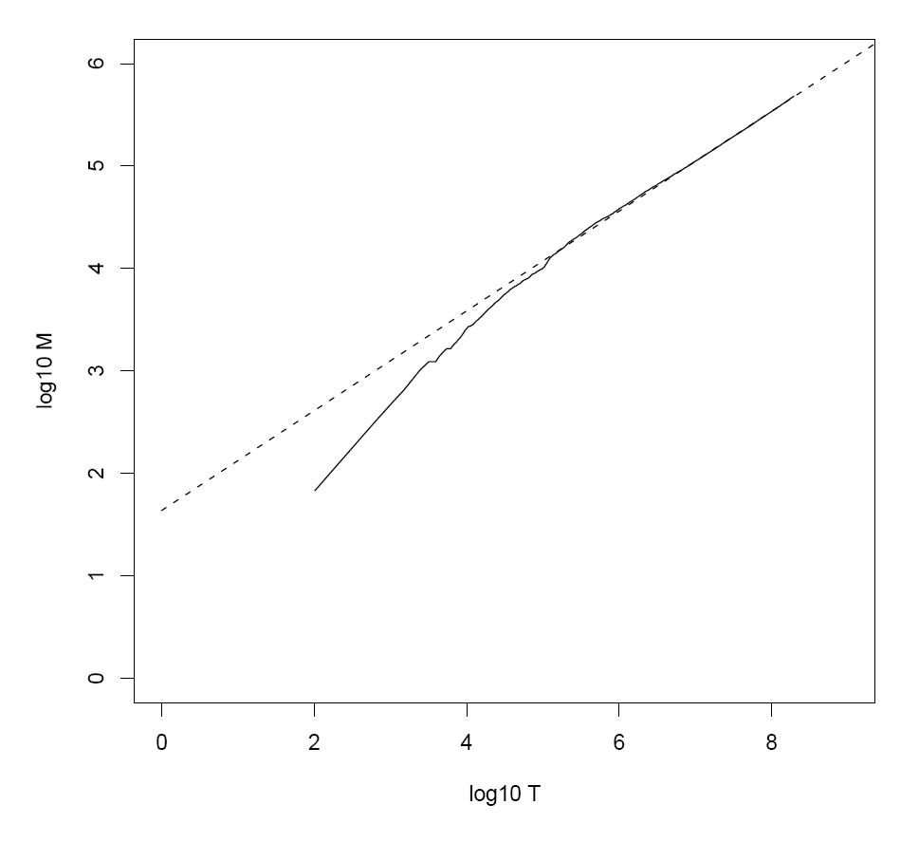
Heaps’ Law for RCV1
k = 44
b = 0.49
First 1,000,020 terms:
Predicted = 38,323
Actual = 38,365
Reuters-RCV1 collection: 806,791 newswire documents (Aug 20, 1996-August 19, 1997)
Manning, Raghavan, Schütze, Introduction to Information Retrieval (2008)

Slide 31
Postings Size: Zipf’s Law
Zipf’s Law: (also) linear in log-log space
Specific case of Power Law distributions
In other words:
A few elements occur very frequently
Many elements occur very infrequently
cf is the collection frequency of i-th common term
c is a constant
Notes:
22

Slide 32
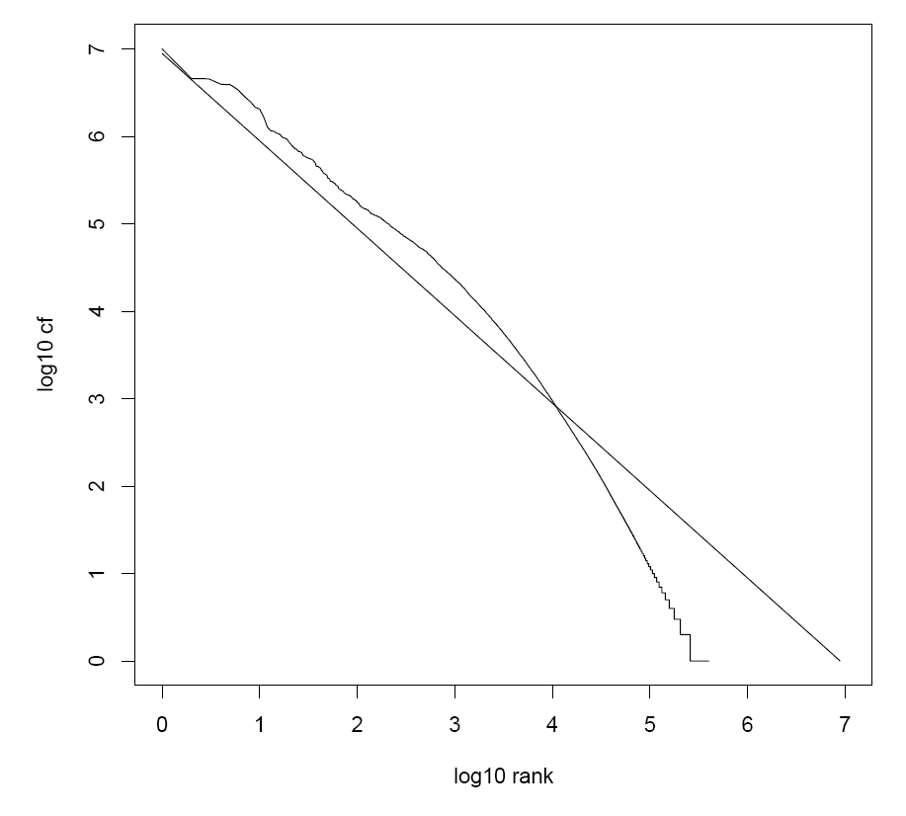
Zipf’s Law for RCV1
Fit isn’t that good… but good enough!
Reuters-RCV1 collection: 806,791 newswire documents (Aug 20, 1996-August 19, 1997)
Manning, Raghavan, Schütze, Introduction to Information Retrieval (2008)

Slide 33
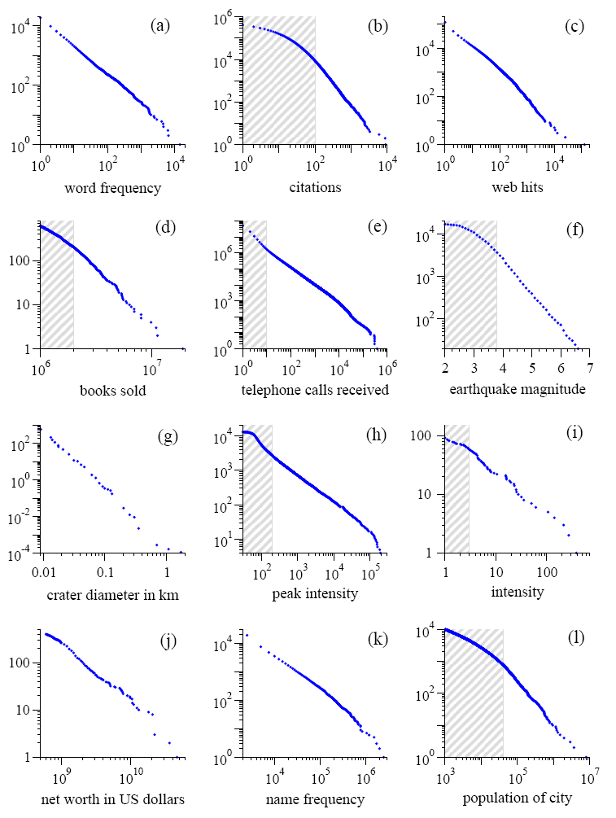
Power Laws are everywhere!
Figure from: Newman, M. E. J. (2005) “Power laws, Pareto distributions and Zipf's law.” Contemporary Physics 46:323–351.

Slide 34
MapReduce: Index Construction
Map over all documents
Emit term as key, (docno, tf) as value
Emit other information as necessary (e.g., term position)
Sort/shuffle: group postings by term
Reduce
Gather and sort the postings (e.g., by docno or tf)
Write postings to disk
MapReduce does all the heavy lifting!

Slide 35
Inverted Indexing with MapReduce
Doc 1
Doc 2
Doc 3
one fish, two fish
red fish, blue fish
cat in the hat
one
1
1
red
2
1
cat
3
1
Map
two
blue
hat
1
1
2
1
3
1
fish
1
2
fish
2
2
Shuffle and Sort: aggregate values by keys
cat
3
1
Reduce
blue
2
1
fish
1
2
2
2
hat
3
1
one
1
1
two
1
1
red
2
1

Slide 36
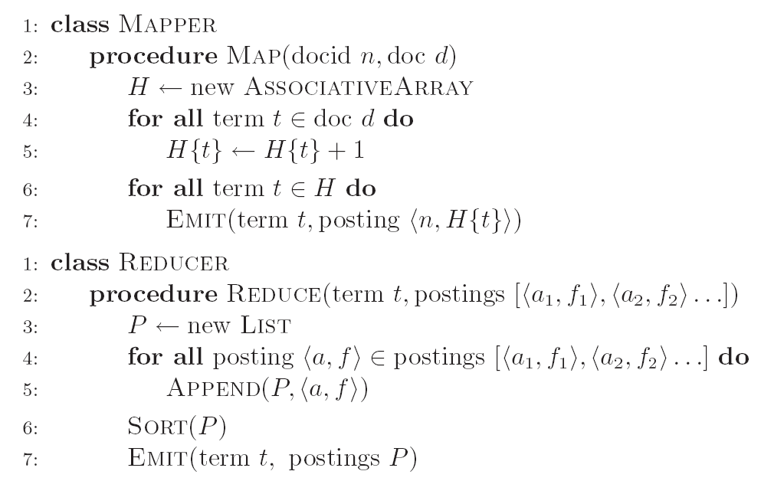
Inverted Indexing: Pseudo-Code

Slide 37
Positional Indexes
Doc 1
Doc 2
Doc 3
one fish, two fish
red fish, blue fish
cat in the hat
one
1
1
[1]
red
2
1
[1]
cat
3
1
[1]
Map
two
blue
hat
1
1
[3]
2
1
[3]
3
1
[2]
fish
1
2
[2,4]
fish
2
2
[2,4]
Shuffle and Sort: aggregate values by keys
cat
3
1
[1]
Reduce
blue
2
1
[3]
fish
1
2
[2,4]
2
2
[2,4]
hat
3
1
[2]
one
1
1
[1]
two
1
1
[3]
red
2
1
[1]

Slide 38
Inverted Indexing: Pseudo-Code
What’s the problem?

Slide 39
Scalability Bottleneck
Initial implementation: terms as keys, postings as values
Reducers must buffer all postings associated with key (to sort)
What if we run out of memory to buffer postings?
Uh oh!

Slide 40
Another Try…
(key)
(values)
(keys)
(values)
fish
1
2
[2,4]
fish
1
[2,4]
34
1
[23]
fish
9
[9]
21
3
[1,8,22]
fish
21
[1,8,22]
35
2
[8,41]
fish
34
[23]
80
3
[2,9,76]
fish
35
[8,41]
9
1
[9]
fish
80
[2,9,76]
How is this different?
Let the framework do the sorting
Term frequency implicitly stored
Directly write postings to disk!
Where have we seen this before?

Slide 41
Postings Encoding
Conceptually:
fish
1
2
9
1
21
3
34
1
35
2
80
3
…
In Practice:
Don’t encode docnos, encode gaps (or d-gaps)
But it’s not obvious that this save space…
fish
1
2
8
1
12
3
13
1
1
2
45
3
…

Slide 42
Overview of Index Compression
Byte-aligned vs. bit-aligned
Non-parameterized bit-aligned
Unary codes
γ codes
δ codes
Parameterized bit-aligned
Golomb codes (local Bernoulli model)
Want more detail? Read Managing Gigabytes by Witten, Moffat, and Bell!

Slide 43
Unary Codes
x ≥ 1 is coded as x-1 one bits, followed by 1 zero bit
3 = 110
4 = 1110
Great for small numbers… horrible for large numbers
Overly-biased for very small gaps
Watch out! Slightly different definitions in different textbooks

Slide 44
γ codes
x ≥ 1 is coded in two parts: length and offset
Start with binary encoded, remove highest-order bit = offset
Length is number of binary digits, encoded in unary code
Concatenate length + offset codes
Example: 9 in binary is 1001
Offset = 001
Length = 4, in unary code = 1110
γ code = 1110:001
Analysis
Offset = ⎣log x⎦
Length = ⎣log x⎦ +1
Total = 2 ⎣log x⎦ +1

Slide 45
δ codes
Similar to γ codes, except that length is encoded in γ code
Example: 9 in binary is 1001
Offset = 001
Length = 4, in γ code = 11000
δ code = 11000:001
γ codes = more compact for smaller numbers δ codes = more compact for larger numbers

Slide 46
Golomb Codes
x ≥ 1, parameter b:
q + 1 in unary, where q = ⎣( x - 1 ) / b⎦
r in binary, where r = x - qb - 1, in ⎣log b⎦ or ⎡log b⎤ bits
Example:
b = 3, r = 0, 1, 2 (0, 10, 11)
b = 6, r = 0, 1, 2, 3, 4, 5 (00, 01, 100, 101, 110, 111)
x = 9, b = 3: q = 2, r = 2, code = 110:11
x = 9, b = 6: q = 1, r = 2, code = 10:100
Optimal b ≈ 0.69 (N/df)
Different b for every term!

Slide 47
Comparison of Coding Schemes
 | Unary | γ | δ | Golomb
 |  |  |  | b=3 | b=6
1 | 0 | 0 | 0 | 0:0 | 0:00
2 | 10 | 10:0 | 100:0 | 0:10 | 0:01
3 | 110 | 10:1 | 100:1 | 0:11 | 0:100
4 | 1110 | 110:00 | 101:00 | 10:0 | 0:101
5 | 11110 | 110:01 | 101:01 | 10:10 | 0:110
6 | 111110 | 110:10 | 101:10 | 10:11 | 0:111
7 | 1111110 | 110:11 | 101:11 | 110:0 | 10:00
8 | 11111110 | 1110:000 | 11000:000 | 110:10 | 10:01
9 | 111111110 | 1110:001 | 11000:001 | 110:11 | 10:100
10 | 1111111110 | 1110:010 | 11000:010 | 1110:0 | 10:101
Witten, Moffat, Bell, Managing Gigabytes (1999)

Slide 48
Index Compression: Performance
Comparison of Index Size (bits per pointer)
Bible | TREC
Unary | 262 | 1918
Binary | 15 | 20
γ | 6.51 | 6.63
δ | 6.23 | 6.38
Golomb | 6.09 | 5.84
Recommend best practice
Bible: King James version of the Bible; 31,101 verses (4.3 MB)
TREC: TREC disks 1+2; 741,856 docs (2070 MB)
Witten, Moffat, Bell, Managing Gigabytes (1999)

Slide 49
Chicken and Egg?
(key)
(value)
fish
1
[2,4]
But wait! How do we set the Golomb parameter b?
fish
9
[9]
fish
21
[1,8,22]
Recall: optimal b ≈ 0.69 (N/df)
fish
34
[23]
We need the df to set b…
fish
35
[8,41]
But we don’t know the df until we’ve seen all postings!
fish
80
[2,9,76]
…
Write directly to disk
Sound familiar?

Slide 50
Getting the df
In the mapper:
Emit “special” key-value pairs to keep track of df
In the reducer:
Make sure “special” key-value pairs come first: process them to determine df
Remember: proper partitioning!

Slide 51
Getting the df: Modified Mapper
Doc 1
Input document…
one fish, two fish
(key)
(value)
fish
1
[2,4]
Emit normal key-value pairs…
one
1
[1]
two
1
[3]
fish
★
[1]
Emit “special” key-value pairs to keep track of df…
one
★
[1]
two
★
[1]

Slide 52
Getting the df: Modified Reducer
(key)
(value)
fish
★
[63]
[82]
[27]
…
First, compute the df by summing contributions from all “special” key-value pair…
Compute Golomb parameter b…
fish
1
[2,4]
fish
9
[9]
fish
21
[1,8,22]
Important: properly define sort order to make sure “special” key-value pairs come first!
fish
34
[23]
fish
35
[8,41]
fish
80
[2,9,76]
…
Write postings directly to disk
Where have we seen this before?

Slide 53
MapReduce it?
The indexing problem
Scalability is paramount
Must be relatively fast, but need not be real time
Fundamentally a batch operation
Incremental updates may or may not be important
For the web, crawling is a challenge in itself
The retrieval problem
Must have sub-second response time
For the web, only need relatively few results
Just covered
Now

Slide 54
Retrieval with MapReduce?
MapReduce is fundamentally batch-oriented
Optimized for throughput, not latency
Startup of mappers and reducers is expensive
MapReduce is not suitable for real-time queries!
Use separate infrastructure for retrieval…

Slide 55
Important Ideas
Partitioning (for scalability)
Replication (for redundancy)
Caching (for speed)
Routing (for load balancing)
The rest is just details!

Slide 56
Term vs. Document Partitioning
D
T₁
D
T₂
Term Partitioning
…
T₃
T
Document Partitioning
…
T
D₁
D₂
D₃

Slide 57
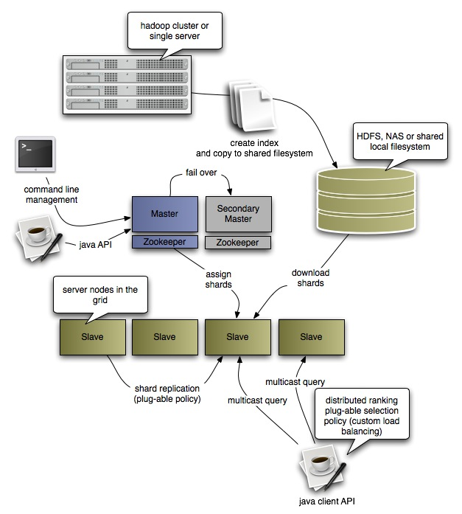
Katta Architecture (Distributed Lucene)
http://katta.sourceforge.net/

Slide 58
Questions?
Source: Wikipedia (Japanese rock garden)

