Slide 1

Graph Algorithms
Data-Intensive Information Processing Applications ― Session #5
Jimmy Lin
University of Maryland
Tuesday, March 2, 2010
This work is licensed under a Creative Commons Attribution-Noncommercial-Share Alike 3.0 United States See http://creativecommons.org/licenses/by-nc-sa/3.0/us/ for details

Slide 2

Source: Wikipedia (Japanese rock garden)

Slide 3
Today’s Agenda
Graph problems and representations
Parallel breadth-first search
PageRank

Slide 4
What’s a graph?
G = (V,E), where
V represents the set of vertices (nodes)
E represents the set of edges (links)
Both vertices and edges may contain additional information
Different types of graphs:
Directed vs. undirected edges
Presence or absence of cycles
Graphs are everywhere:
Hyperlink structure of the Web
Physical structure of computers on the Internet
Interstate highway system
Social networks

Slide 5
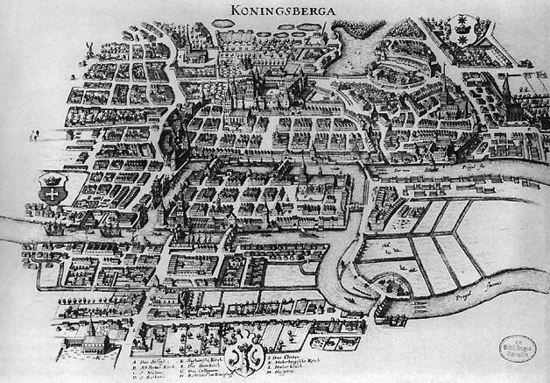
Source: Wikipedia (Königsberg)

Slide 6
Some Graph Problems
Finding shortest paths
Routing Internet traffic and UPS trucks
Finding minimum spanning trees
Telco laying down fiber
Finding Max Flow
Airline scheduling
Identify “special” nodes and communities
Breaking up terrorist cells, spread of avian flu
Bipartite matching
Monster.com, Match.com
And of course... PageRank

Slide 7
Graphs and MapReduce
Graph algorithms typically involve:
Performing computations at each node: based on node features, edge features, and local link structure
Propagating computations: “traversing” the graph
Key questions:
How do you represent graph data in MapReduce?
How do you traverse a graph in MapReduce?

Slide 8
Representing Graphs
G = (V, E)
Two common representations
Adjacency matrix
Adjacency list

Slide 9
Adjacency Matrices
Represent a graph as an n x n square matrix M
n = |V|
M_{ij} = 1 means a link from node i to j
2
 | 1 | 2 | 3 | 4
1 | 0 | 1 | 0 | 1
2 | 1 | 0 | 1 | 1
3 | 1 | 0 | 0 | 0
4 | 1 | 0 | 1 | 0
1
3
4

Slide 10
Adjacency Matrices: Critique
Advantages:
Amenable to mathematical manipulation
Iteration over rows and columns corresponds to computations on outlinks and inlinks
Disadvantages:
Lots of zeros for sparse matrices
Lots of wasted space

Slide 11
Adjacency Lists
Take adjacency matrices… and throw away all the zeros
 | 1 | 2 | 3 | 4
1 | 0 | 1 | 0 | 1
2 | 1 | 0 | 1 | 1
3 | 1 | 0 | 0 | 0
4 | 1 | 0 | 1 | 0
1: 2, 4
2: 1, 3, 4
3: 1
4: 1, 3

Slide 12
Adjacency Lists: Critique
Advantages:
Much more compact representation
Easy to compute over outlinks
Disadvantages:
Much more difficult to compute over inlinks

Slide 13
Single Source Shortest Path
Problem: find shortest path from a source node to one or more target nodes
Shortest might also mean lowest weight or cost
First, a refresher: Dijkstra’s Algorithm

Slide 14
Dijkstra’s Algorithm Example
∞
1
∞
10
0
2
3
9
4
6
5
7
∞
∞
2
Example from CLR

Slide 15
Dijkstra’s Algorithm Example
10
1
∞
10
0
2
3
9
4
6
5
7
5
∞
2
Example from CLR

Slide 16
Dijkstra’s Algorithm Example
8
1
14
10
0
2
3
9
4
6
5
7
5
7
2
Example from CLR

Slide 17
Dijkstra’s Algorithm Example
8
1
13
10
0
2
3
9
4
6
5
7
5
7
2
Example from CLR

Slide 18
Dijkstra’s Algorithm Example
8
1
9
1
10
0
2
3
9
4
6
5
7
5
7
2
Example from CLR

Slide 19
Dijkstra’s Algorithm Example
8
1
9
10
0
2
3
9
4
6
5
7
5
7
2
Example from CLR

Slide 20
Single Source Shortest Path
Problem: find shortest path from a source node to one or more target nodes
Shortest might also mean lowest weight or cost
Single processor machine: Dijkstra’s Algorithm
MapReduce: parallel Breadth-First Search (BFS)

Slide 21
Finding the Shortest Path
Consider simple case of equal edge weights
Solution to the problem can be defined inductively
Here’s the intuition:
Define: b is reachable from a if b is on adjacency list of a
DistanceTo(s) = 0
For all nodes p reachable from s, DistanceTo(p) = 1
For all nodes n reachable from some other set of nodes M, DistanceTo(n) = 1 + min(DistanceTo(m), m ∈ M)
d₁
m₁
…
d₂
s
…
n
m₂
…
d₃
m₃

Slide 22

Source: Wikipedia (Wave)

Slide 23
Visualizing Parallel BFS
n₇
n₀
n₁
n₃
n₂
n₆
n₅
n₄
n₈
n₉

Slide 24
From Intuition to Algorithm
Data representation:
Key: node n
Value: d (distance from start), adjacency list (list of nodes reachable from n)
Initialization: for all nodes except for start node, d = ∞
Mapper:
∀m ∈ adjacency list: emit (m, d + 1)
Sort/Shuffle
Groups distances by reachable nodes
Reducer:
Selects minimum distance path for each reachable node
Additional bookkeeping needed to keep track of actual path

Slide 25
Multiple Iterations Needed
Each MapReduce iteration advances the “known frontier” by one hop
Subsequent iterations include more and more reachable nodes as frontier expands
Multiple iterations are needed to explore entire graph
Preserving graph structure:
Problem: Where did the adjacency list go?
Solution: mapper emits (n, adjacency list) as well

Slide 26
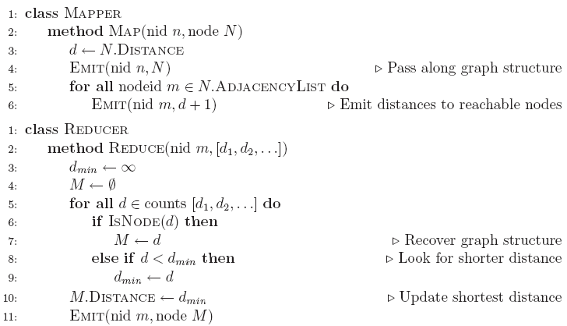
BFS Pseudo-Code

Slide 27
Stopping Criterion
How many iterations are needed in parallel BFS (equal edge weight case)?
Convince yourself: when a node is first “discovered”, we’ve found the shortest path
Now answer the question...
Six degrees of separation?
Practicalities of implementation in MapReduce

Slide 28
Comparison to Dijkstra
Dijkstra’s algorithm is more efficient
At any step it only pursues edges from the minimum-cost path inside the frontier
MapReduce explores all paths in parallel
Lots of “waste”
Useful work is only done at the “frontier”
Why can’t we do better using MapReduce?

Slide 29
Weighted Edges
Now add positive weights to the edges
Why can’t edge weights be negative?
Simple change: adjacency list now includes a weight w for each edge
In mapper, emit (m, d + w_{p}) instead of (m, d + 1) for each node m
That’s it?

Slide 30
Stopping Criterion
How many iterations are needed in parallel BFS (positive edge weight case)?
Convince yourself: when a node is first “discovered”, we’ve found the shortest path
Not true!

Slide 31
Additional Complexities
search frontier
1
n₆
1
n₇
1
n₈
r
10
1
n₅
n₉
n₁
s
1
1
p
q
n₄
1
n₂
1
n₃

Slide 32
Stopping Criterion
How many iterations are needed in parallel BFS (positive edge weight case)?
Practicalities of implementation in MapReduce

Slide 33
Graphs and MapReduce
Graph algorithms typically involve:
Performing computations at each node: based on node features, edge features, and local link structure
Propagating computations: “traversing” the graph
Generic recipe:
Represent graphs as adjacency lists
Perform local computations in mapper
Pass along partial results via outlinks, keyed by destination node
Perform aggregation in reducer on inlinks to a node
Iterate until convergence: controlled by external “driver”
Don’t forget to pass the graph structure between iterations

Slide 34
Random Walks Over the Web
Random surfer model:
User starts at a random Web page
User randomly clicks on links, surfing from page to page
PageRank
Characterizes the amount of time spent on any given page
Mathematically, a probability distribution over pages
PageRank captures notions of page importance
Correspondence to human intuition?
One of thousands of features used in web search
Note: query-independent

Slide 35
PageRank: Defined
Given page x with inlinks t₁…t_{n}, where
C(t) is the out-degree of t
α is probability of random jump
N is the total number of nodes in the graph
t₁
X
t₂
…
t_{n}

Slide 36
Computing PageRank
Properties of PageRank
Can be computed iteratively
Effects at each iteration are local
Sketch of algorithm:
Start with seed PR_{i} values
Each page distributes PR_{i} “credit” to all pages it links to
Each target page adds up “credit” from multiple in-bound links to compute PR_{i+1}
Iterate until values converge

Slide 37
Simplified PageRank
First, tackle the simple case:
No random jump factor
No dangling links
Then, factor in these complexities…
Why do we need the random jump?
Where do dangling links come from?

Slide 38
Sample PageRank Iteration (1)
Iteration 1
n₂ (0.2)
n₂ (0.166)
n₁ (0.2)
0.1
0.1
0.1
n₁ (0.066)
0.1
0.066
0.066
0.066
n₅ (0.2)
n₃ (0.2)
n₅ (0.3)
n₃ (0.166)
0.2
0.2
n₄ (0.2)
n₄ (0.3)

Slide 39
Sample PageRank Iteration (2)
Iteration 2
n₂ (0.166)
n₂ (0.133)
n₁ (0.066)
0.033
0.083
0.083
n₁ (0.1)
0.033
0.1
0.1
0.1
n₅ (0.3)
n₃ (0.166)
n₅ (0.383)
n₃ (0.183)
0.3
0.166
n₄ (0.3)
n₄ (0.2)

Slide 40
PageRank in MapReduce
n₁ [n₂, n₄]
n₂ [n₃, n₅]
n₃ [n₄]
n₄ [n₅]
n₅ [n₁, n₂, n₃]
Map
n₂
n₄
n₃
n₅
n₄
n₅
n₁
n₂
n₃
n₁
n₂
n₂
n₃
n₃
n₄
n₄
n₅
n₅
Reduce
n₁ [n₂, n₄]
n₂ [n₃, n₅]
n₃ [n₄]
n₄ [n₅]
n₅ [n₁, n₂, n₃]

Slide 41
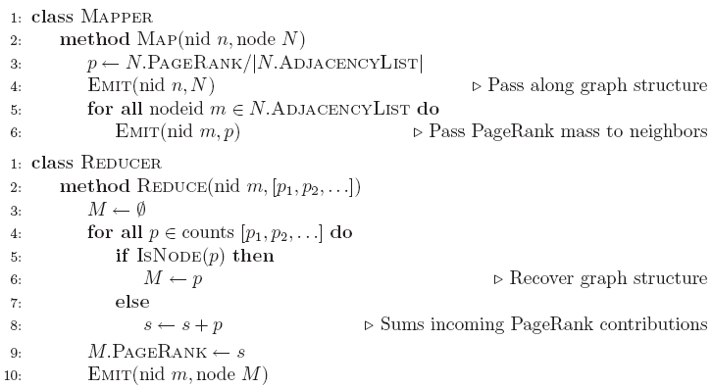
PageRank Pseudo-Code

Slide 42
Complete PageRank
Two additional complexities
What is the proper treatment of dangling nodes?
How do we factor in the random jump factor?
Solution:
Second pass to redistribute “missing PageRank mass” and account for random jumps
p is PageRank value from before, p' is updated PageRank value
|G| is the number of nodes in the graph
m is the missing PageRank mass

Slide 43
PageRank Convergence
Alternative convergence criteria
Iterate until PageRank values don’t change
Iterate until PageRank rankings don’t change
Fixed number of iterations
Convergence for web graphs?

Slide 44
Beyond PageRank
Link structure is important for web search
PageRank is one of many link-based features: HITS, SALSA, etc.
One of many thousands of features used in ranking…
Adversarial nature of web search
Link spamming
Spider traps
Keyword stuffing
…

Slide 45
Efficient Graph Algorithms
Sparse vs. dense graphs
Graph topologies

Slide 46
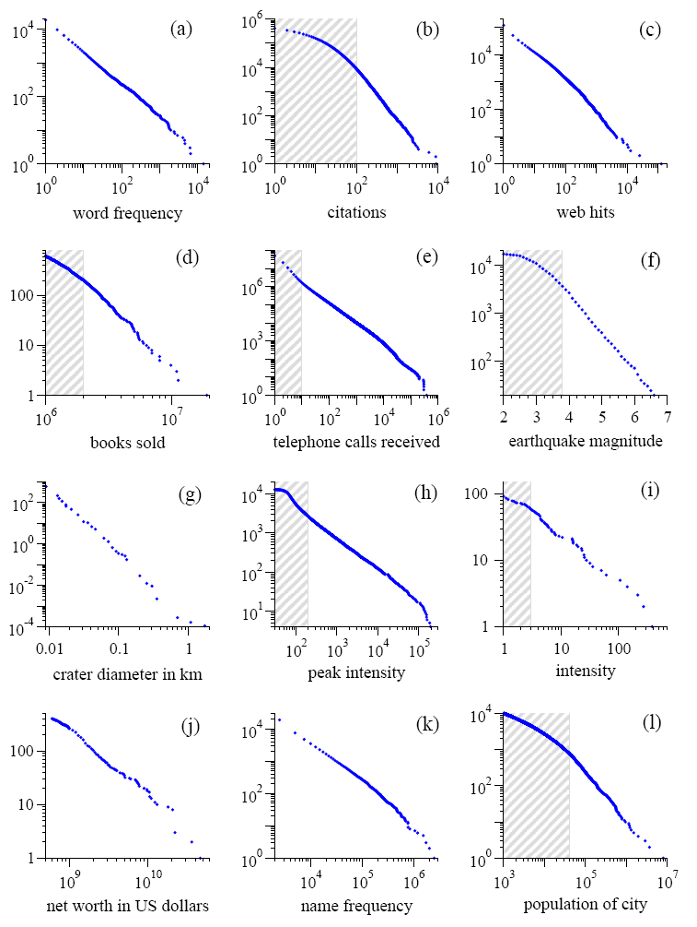
Power Laws are everywhere!
Figure from: Newman, M. E. J. (2005) “Power laws, Pareto distributions and Zipf's law.” Contemporary Physics 46:323–351.

Slide 47
Local Aggregation
Use combiners!
In-mapper combining design pattern also applicable
Maximize opportunities for local aggregation
Simple tricks: sorting the dataset in specific ways

Slide 48
Questions?
Source: Wikipedia (Japanese rock garden)

