Slide 1

Hidden Markov Models & EM
Data-Intensive Information Processing Applications ― Session #8
Nitin Madnani
University of Maryland
Tuesday, March 30, 2010
This work is licensed under a Creative Commons Attribution-Noncommercial-Share Alike 3.0 United States See http://creativecommons.org/licenses/by-nc-sa/3.0/us/ for details

Slide 2

Source: Wikipedia (Japanese rock garden)

Slide 3
Today’s Agenda
Need to cover lots of background material
Introduction to Statistical Models
Hidden Markov Models
Part of Speech Tagging
Applying HMMs to POS tagging
Expectation-Maximization (EM) Algorithm
Now on to the Map Reduce stuff
Training HMMs using MapReduce
Supervised training of HMMs
Rough conceptual sketch of unsupervised training using EM

Slide 4
Introduction to statistical models
Until the 1990s, text processing relied on rule-based systems
Advantages
More predictable
Easy to understand
Easy to identify errors and fix them
Disadvantages
Extremely labor-intensive to create
Not robust to out of domain input
No partial output or analysis when failure occurs

Slide 5
Introduction to statistical models
A better strategy is to use data-driven methods
Basic idea: learn from a large corpus of examples of what we wish to model (Training Data)
Advantages
More robust to the complexities of real-world input
Creating training data is usually cheaper than creating rules
Even easier today thanks to Amazon Mechanical Turk
Data may already exist for independent reasons
Disadvantages
Systems often behave differently compared to expectations
Hard to understand the reasons for errors or debug errors

Slide 6
Introduction to statistical models
Learning from training data usually means estimating the parameters of the statistical model
Estimation usually carried out via machine learning
Two kinds of machine learning algorithms
Supervised learning
Training data consists of the inputs and respective outputs (labels)
Labels are usually created via expert annotation (expensive)
Difficult to annotate when predicting more complex outputs
Unsupervised learning
Training data just consists of inputs. No labels.
One example of such an algorithm: Expectation Maximization

Slide 7
Hidden Markov Models (HMMs) A very useful and popular statistical model

Slide 8
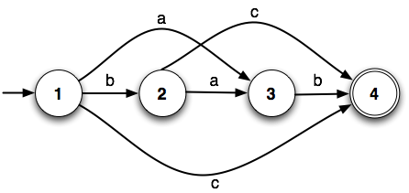
Finite State Machines
What do we need to specify an FSM formally ?
Finite number of states
Transitions
Input alphabet
Start state
Final state(s)

Slide 9
Real World Knowledge
Weighted FSMs
2
3
1
1
1
1
‘a’ is twice as likely to be seen in state 1 as ‘b’ or ‘c’
‘c’ is three times as likely to be seen in state 2 as ‘a’
What do we get out of it ?
score(‘ab’) = 2, score(‘bc’) = 3

Slide 10
Real World Knowledge
Probabilistic FSMs
0.5
0.75
0.25
0.25
1.0
0.25
‘a’ is twice as likely to be seen in state 1 as ‘b’ or ‘c’
‘c’ is three times as likely to be seen in state 2 as ‘a’
What do we get out of it ?
P(‘ab’) = 0.50 * 1.00 = 0.5, P(‘bc’) = 0.25 * 0.75 = 0.1875

Slide 11
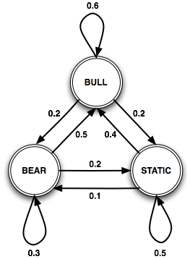
Markov Chains
This not a valid prob. FSM!
No start states
Use prior probabilities
Note that prob. of being in any state ONLY depends on previous state ,i.e., the (1st order) Markov assumption
This extension of a prob. FSM is called a Markov Chain or an Observed Markov Model
Each state corresponds to an observable physical event
0.5
0.2
0.3

Slide 12
Are states always observable?
Day:
1, 2, 3, 4, 5, 6
Bu: Bull Market
Be: Bear Market
S : Static Market
Bu, Be, S, Be, S, Bu
Here’s what you actually observe:
Day:
1, 2, 3, 4, 5, 6
↑: Market is up
↓: Market is down
↔: Market hasn’t changed
↑ ↓ ↔ ↑ ↓ ↔
↑ ↓ ↔ ↑ ↓ ↔

Slide 13
Hidden Markov Models
Markov chains are usually inadequate
Need to model problems where observed events don’t correspond to states directly
Instead observations = f_{p}(states) for some p.d.f p
Solution: A Hidden Markov Model (HMM)
Assume two probabilistic processes
Underlying process is hidden (states = hidden events)
Second process produces sequence of observed events

Slide 14


Formalizing HMMs
An HMM λ = (A, B, ∏) is characterized by:
Set of N states {q₁, q₂, ..., q_{N}}
N x N Transition probability matrix A = [a_{ij}]
Sequence of observations o₁, o₂, ... o_{T}, each drawn from a given set of symbols (vocabulary V)
N x |V| Emission probability matrix, B = [b_{it}]
N x 1 Prior probabilities vector ∏ = { ∏₁, ∏₂, ..., ∏_{N} }

Slide 15
Things to know about HMMs
The (first-order) Markov assumption holds
The probability of an output symbol depends only on the state generating it
The number of states (N) does not have to equal the number of observations (T)

Slide 16
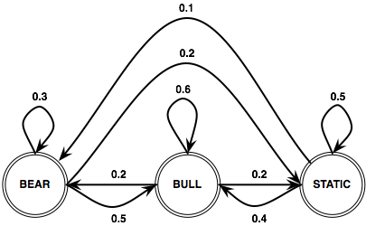

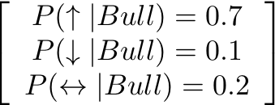
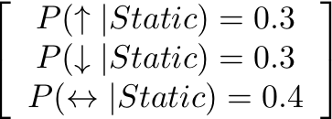
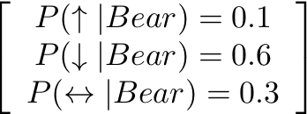
Stock Market HMM
States ✓
Transitions ✓
Valid ✓
Vocabulary ✓
∏1=0.5
∏3=0.3
Emissions ✓
∏2=0.2
Valid ✓
Priors ✓
Valid ✓

Slide 17
Applying HMMs
3 problems to solve before HMMs can be useful
Given an HMM λ = (A, B, ∏), and a sequence of observed events O, find P(O| λ) [ Likelihood ]
Given an HMM λ = (A, B, ∏), and an observation sequence O, find the most likely (hidden) state sequence [ Decoding ]
Given a set of observation sequences and the set of states Q in λ, compute the parameters A and B. [ Training ]

Slide 18
Computing Likelihood
t:
1 2 3 4 5 6
∏1=0.5
∏2=0.2
∏3=0.3
O:
↑ ↓ ↔ ↑ ↓ ↔
λstock
Assuming λstock models the stock market, how likely is it
that on day 1, the market is up, on day 2, it’s down etc. ?
Markov Chain?

Slide 19


Computing Likelihood
Sounds easy!
Sum over all possible ways in which we could generate O from λ
Takes exponential (∝ N^{T}) time to compute !
Right idea, wrong algorithm !

Slide 20
Computing Likelihood
What are we doing wrong ?
State sequences may have a lot of overlap
We are recomputing the shared bits every time
Need to store intermediate computation results somehow so that they can be used
Requires a Dynamic Programming algorithm

Slide 21

Forward Algorithm
Use an N x T trellis or chart [α_{tj}]
α_{tj} or α_{t}(j) = P(being in state j after seeing t observations) = p(o₁, o₂, ... o_{t}, q_{t}=j)
Each cell = ∑ extensions of all paths from other cells
α_{t-1}(i): forward path probability until (t-1)
a_{ij} : transition probability of going from state i to j
b_{j}(o_{t}) : probability of emitting symbol ot in state j
P(O|λ) = ∑_{i} α_{T}(i)
Polynomial time (∝ N²T)

Slide 22
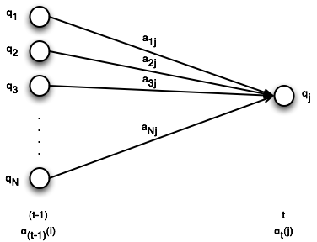
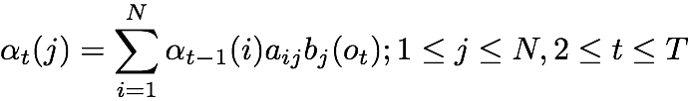
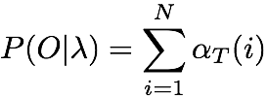
Forward Algorithm
Formal Definition
Initialization
Recursion
Termination

Slide 23
Forward Algorithm
Static
Bear
O =
↑ ↓ ↑
states
find P(O|λstock)
Bull
↑
↓
↑
t=1
t=2
t=3
time

Slide 24
Forward Algorithm (Initialization)
0.3*0.3
=0.09
Static
0.5*0.1
=0.05
Bear
states
α1(Bu)0.2*0.7=0.14
Bull
↑
↓
↑
t=1
t=2
t=3
time

Slide 25
Forward Algorithm (Recursion)
0.3*0.3
=0.09
Static
0.5*0.1
=0.05
0.09 * 0.4 * 0.1 =0.0036
Bear
states
.... and so on
0.05 * 0.5 * 0.1 =0.0025
∑
0.0145
α1(Bu)0.2*0.7=0.14
Bull
α1(Bu) * aBuBu * bBu(↓)
0.14 * 0.6 * 0.1=0.0084
↑
↓
↑
t=1
t=2
t=3
time

Slide 26
Forward Algorithm (Recursion)
0.3*0.3
=0.09
0.0249
0.006477
Static
0.5*0.1
=0.05
0.0312
0.001475
Bear
states
α1(Bu)0.2*0.7=0.14
0.0145
0.024
Bull
↑
↓
↑
t=1
t=2
t=3
time

Slide 27
Forward Algorithm (Recursion)
0.3*0.3
=0.09
0.0249
0.006477
Static
0.5*0.1
=0.05
0.0312
0.001475
Bear
∑
states
P(O) = 0.03195
α1(Bu)0.2*0.7=0.14
0.0145
0.024
Bull
↑
↓
↑
t=1
t=2
t=3
time

Slide 28
Decoding
t:
1 2 3 4 5 6
∏1=0.5
∏2=0.2
∏3=0.3
O:
↑ ↓ ↔ ↑ ↓ ↔
λstock
Given λstock as our model and O as our observations, what are the most likely states the market went through to produce O ?

Slide 29
Decoding
“Decoding” because states are hidden
There’s a simple way to do it
For each possible hidden state sequence, compute P(O) using “forward algorithm”
Pick the one that gives the highest P(O)
Will this give the right answer ?
Is it practical ?
Notes:
Why do I have forward algorithm in quotes?
Write equation on board.

Slide 30
Viterbi Algorithm
Another dynamic programming algorithm
Same idea as the forward algorithm
Store intermediate computation results in a trellis
Build new cells from existing cells
Efficient (polynomial vs. exponential)

Slide 31

Viterbi Algorithm
Use an N x T trellis [v_{tj}]
v_{tj} or v_{t}(j) = P(in state j after seeing t observations & passing through the most likely state sequence so far) = p(q₁, q₂, ..., q_{t-1}, q_{t}=j, o₁, o₂, ... o_{t})
Each cell = extension of most likely path from other cells
v_{t-1}(i): viterbi probability until time (t-1)
a_{ij} : transition probability of going from state i to j
b_{j}(o_{t}) : probability of emitting symbol ot in state j
P = max_{i} v_{T}(i)

Slide 32
Viterbi Algorithm
Maximization instead of summation over previous paths
This algorithm is still missing something !
Unlike forward alg., we need something else in addition to the probability !
Need to keep track which previous cell we chose
At the end, follow the chain of backpointers and we have the most likely state sequence too !
q_{T}* = argmax_{i} v_{T}(i); q_{t}* = the state q_{t+1}* points to

Slide 33


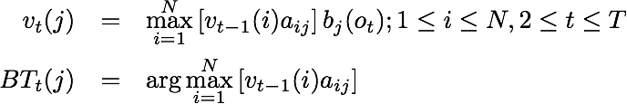
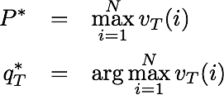
Viterbi Algorithm
Formal Definition
Initialization
Recursion
Termination
Why no b() ?

Slide 34
Viterbi Algorithm
Static
Bear
O =
↑ ↓ ↑
states
find most likely given state sequence
Bull
↑
↓
↑
t=1
t=2
t=3
time

Slide 35
Viterbi Algorithm (Initialization)
0.3*0.3
=0.09
Static
0.5*0.1
=0.05
Bear
states
v1(Bu)0.2*0.7=0.14
Bull
↑
↓
↑
t=1
t=2
t=3
time

Slide 36
Viterbi Algorithm (Recursion)
0.3*0.3
=0.09
Static
0.5*0.1
=0.05
0.09 * 0.4 * 0.1 =0.0036
Bear
states
0.05 * 0.5 * 0.1 =0.0025
max
0.0084
v1(Bu)0.2*0.7=0.14
Bull
v1(Bu) * aBuBu * bBu(↓)
0.14 * 0.6 * 0.1=0.0084
↑
↓
↑
t=1
t=2
t=3
time

Slide 37
Viterbi Algorithm (Recursion)
0.3*0.3
=0.09
Static
0.5*0.1
=0.05
Bear
states
.... and so on
v1(Bu)0.2*0.7=0.14
0.0084
Bull
↑
↓
↑
t=1
t=2
t=3
time

Slide 38
Viterbi Algorithm (Recursion)
0.3*0.3
=0.09
0.0135
0.00202
Static
0.5*0.1
=0.05
0.0168
0.000504
Bear
states
α1(Bu)0.2*0.7=0.14
0.0084
0.00588
Bull
↑
↓
↑
t=1
t=2
t=3
time

Slide 39
Viterbi Algorithm (Termination)
0.3*0.3
=0.09
0.0135
0.00202
Static
0.5*0.1
=0.05
0.0168
0.000504
Bear
states
v1(Bu)0.2*0.7=0.14
0.0084
0.00588
Bull
↑
↓
↑
t=1
t=2
t=3
time

Slide 40
Viterbi Algorithm (Termination)
0.3*0.3
=0.09
0.0135
0.00202
Static
Most likely state sequence
[ Bull, Bear, Bull ], P = 0.00588
0.5*0.1
=0.05
0.0168
0.000504
Bear
states
v1(Bu)0.2*0.7=0.14
0.0084
0.00588
Bull
↑
↓
↑
t=1
t=2
t=3
time

Slide 41
Why are HMMs useful?
Models of data that is ordered sequentially
Recall sequence of market up/down/static observations
Other more useful sequences
Words in a sentence
Base pairs in a gene
Letters in a word
Have been used for almost everything
Automatic speech recognition
Stock market forecasting (you thought I was joking?!)
Aligning words in a bilingual parallel text
Tagging words with parts of speech
Md. Rafiul Hassan and Baikunth Nath. Stock Market Forecasting Using Hidden Markov Models: A New Approach.
Proceedings of the International Conference on Intelligent Systems Design and Applications.

Slide 42
Part of Speech Tagging

Slide 43
Part of Speech (POS) Tagging
Parts of speech are well recognized linguistic entities
The Art of Grammar circa 100 B.C.
Written to allow post-Classical Greek speakers to understand Odyssey and other classical poets
8 classes of words [Noun, Verb, Pronoun, Article, Adverb, Conjunction, Participle, Preposition]
Remarkably enduring list
Occur in almost every language
Defined primarily in terms of syntactic and morphological criteria (affixes)

Slide 44
Part of Speech (POS) Tagging
Two broad categories of POS tags
Closed Class:
Relatively fixed membership
Conjunctions, Prepositions, Auxiliaries, Determiners, Pronouns …
Function words: short and used primarily for structuring
Open Class:
Nouns, Verbs, Adjectives, Adverbs
Frequent neologisms (borrowed/coined)

Slide 45
Part of Speech (POS) Tagging
Several English tagsets have been developed
Vary in number of tags
Brown Tagset (87)
Penn Treebank (45) [More common]
Language specific
Simple morphology = more ambiguity = smaller tagset
Size depends on language and purpose
Notes:
RICH MORPHOLOGY => MORE YOU NEED TO IDENTIFY THINGS => MORE TAGS

Slide 46
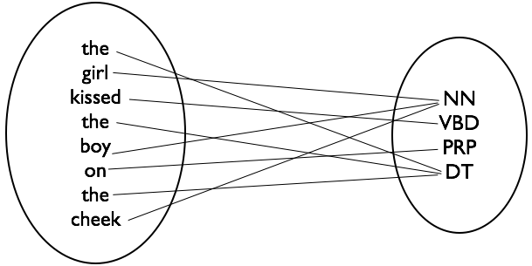
Part of Speech (POS) Tagging
POS Tagging: The process of assigning “one” POS or other lexical
class marker to each word in a corpus
Notes:
RICH MORPHOLOGY => MORE YOU NEED TO IDENTIFY THINGS => MORE TAGS

Slide 47
Why do POS tagging?
Corpus-based Linguistic Analysis & Lexicography
Information Retrieval & Question Answering
Automatic Speech Synthesis
Word Sense Disambiguation
Shallow Syntactic Parsing
Machine Translation

Slide 48
Why is POS tagging hard?
Not really a lexical problem
Sequence labeling problem
Treating it as lexical problem runs us smack into the wall of ambiguity
I thought that you ... (that: conjunction) That day was nice (that: determiner) You can go that far (that: adverb)

Slide 49
HMMs & POS Tagging

Slide 50
Modeling the problem
What should the HMM look like?
States: Part-of-Speech Tags (t₁, t₂, … t_{N})
Output symbols: Words (w₁, w₂, …, w_{M})
Can an HMM find the best tagging for a given sentence ?
Yes ! Viterbi Decoding (best = most likely)
Once we have an HMM model, tagging lots of data is embarrassingly parallel: a tagger in each mapper
The HMM machinery gives us (almost) everything we need to solve the problem

Slide 51
HMM Training
Almost everything ?
Before HMMs can decode, they must be trained, i.e., (A, B, ∏) must be computed
Recall the two types of training?
Supervised training: Use a large corpus of already tagged words as training data; count stuff; estimate model parameters
Unsupervised training: Use a corpus of untagged words; bootstrap parameter estimates; improve estimates iteratively

Slide 52
Supervised Training
We have training data, i.e., thousands of sentences with their words already tagged
Given this data, we already have the set of states and symbols
Next, compute Maximum Likelihood Estimates (MLEs) for the various parameters
Those estimates of the parameters that maximize the likelihood that the training data was actually generated by our model

Slide 53
Supervised Training
Transition Probabilities
Any P(t_{i} | t_{i-1}) = C(t_{i-1}t_{i})/Σ_{t’}C(t_{i-1}t’) from the training data
For P(NN|VB), count how many times a noun follows a verb and divide by the the number of times anything else follows a verb
Emission Probabilities
Any P(w_{i} | t_{i}) = C(w_{i},t_{i})/Σ_{w’}C(w’, t_{i}) from the training data
For P(bank|NN), count how many times the word bank was seen tagged as a noun and divide by the number of times anything was seen tagged as a noun
Priors
The prior probability of any state (tag)
For ∏_{noun}, count the number of times a noun occurs and divide by the total number of words in the corpus

Slide 54




Supervised Training in MapReduce
Recall that we computed relative frequencies of words in MapReduce using the Stripes design
Estimating HMM parameters via supervised training is identical
(Eqn 3.1, p. 51)
Transition
probabilities
Emission
probabilities
Priors is like counting words

Slide 55
Unsupervised Training
No labeled/tagged training data
No way to compute MLEs directly
Make an initial guess for parameter values
Use this guess to get a better estimate
Iteratively improve the estimate until some convergence criterion is met
EXPECTATION MAXIMIZATION (EM)

Slide 56
Expectation Maximization
A fundamental tool for unsupervised machine learning techniques
Forms basis of state-of-the-art systems in MT, Parsing, WSD, Speech Recognition and more
Seminal paper (with a very instructive title) Maximum Likelihood from Incomplete Data via the EM algorithm, JRSS, Dempster et al., 1977

Slide 57
Motivating Example
Let observed events be the grades given out in, say, this class
Assume grades are generated by a probabilistic model described by single parameter μ
P(A) = 1/2, P(B) = μ, P(C) = 2μ, P(D) = 1/2 - 3μ
Number of ‘A’s observed = ‘a’, ‘b’ number of ‘B’s etc.
Compute MLE of μ given ‘a’, ‘b’, ‘c’ and ‘d’
Adapted from Andrew Moore’s Slides
http://www.autonlab.org/tutorials/gmm.html

Slide 58
Motivating Example
Recall the definition of MLE “.... maximizes likelihood of data given the model.”
P(data|model)= P(a,b,c,d|μ) = K(1/2)ª(μ)^{b}(2μ)^{c}(1/2-3μ)^{d} [independent and identically distributed]
L = log-likelihood = log P(a,b,c,d|μ) = a log(1/2) + b log μ + c log 2μ + d log(1/2-3μ)
How to maximize L w.r.t μ ? [ Think Calculus ]
δL/δμ = 0; (b/μ) + (2c/2μ) - (3d/(1/2 - 3μ)) = 0
μ = (b+c)/6(b+c+d) [Note missing ‘a’ ]
We got our answer without EM. Boring !
Notes:
Independent Bernoulli trials -> Multinomial Process. Each grade is independent of the other grade.

Slide 59
Motivating Example
P(A) = 1/2, P(B) = μ, P(C) = 2μ, P(D) = 1/2 - 3μ
Number of ‘A’s and ‘B’s = h, c ‘C’s and d ‘D’s
Part of the observable information is hidden
Can we compute the MLE for μ now?
If we knew ‘b’ (and hence ‘a’), we could compute the MLE for μ. But we need to know μ to know how the model generates ‘a’ and ‘b’.
Circular enough for you?

Slide 60
The EM Algorithm
Start with an initial guess for μ (μ0)
t = 1; Repeat
b_{t} = μ_{(t-1)}h/(1/2 + μ_{(t-1))} [E-step: Compute expected value of b given μ ]
μ_{t} = (b_{t} + c)/6(b_{t} + c + d) [M-step: Compute MLE of μ given b ]
t = t + 1
Until some convergence criterion is met

Slide 61
The EM Algorithm
Algorithm to compute MLEs for model parameters when information is hidden
Iterate between Expectation (E-step) and Maximization (M-step)
Each iteration is guaranteed to increase the log-likelihood of the data (improve the estimate)
Good news: It will always converge to a maximum
Bad news: It will always converge to a maximum

Slide 62
Applying EM to HMMs
Just the intuition; No gory details
Hidden information (the state sequence)
Model Parameters: A, B & ∏
Introduce two new observation statistics:
Number of transitions from q_{i} to q_{j} (ξ)
Number of times in state q_{i} (γ)
The EM algorithm should now apply perfectly

Slide 63
Applying EM to HMMs
Start with initial guesses for A, B and ∏
t = 1; Repeat
E-step: Compute expected values of ξ, γ using A_{t}, B_{t}, ∏_{t}
M-step: Compute MLE of A, B and ∏ using ξ_{t}, γ_{t}
t = t + 1
Until some specified convergence criterion is met
Optional: Read Section 6.2 in Lin & Dyer for gory details
Baum-Welch Algorithm

Slide 64
EM in MapReduce
Each iteration of EM is one MapReduce job
A driver program spawns MR jobs, keeps track of the number of iterations and convergence criteria
Model parameters static for the duration of each job are loaded by each mapper from HDFS
Mappers map over independent instances from training data to do computations from E-step
Reducers sum together stuff from mappers to solve equations from M-step
Combiners are important to sum together the training instances in memory and reduce disk I/O

Slide 65
Questions?
Source: Wikipedia (Japanese rock garden)

