Slide 1

Language Models
Data-Intensive Information Processing Applications ― Session #9
Nitin Madnani
University of Maryland
Tuesday, April 6, 2010
This work is licensed under a Creative Commons Attribution-Noncommercial-Share Alike 3.0 United States See http://creativecommons.org/licenses/by-nc-sa/3.0/us/ for details

Slide 2

Source: Wikipedia (Japanese rock garden)

Slide 3
Today’s Agenda
What are Language Models?
Mathematical background and motivation
Dealing with data sparsity (smoothing)
Evaluating language models
Large Scale Language Models using MapReduce

Slide 4
N-Gram Language Models
What?
LMs assign probabilities to sequences of tokens
How?
Based on previous word histories
n-gram = consecutive sequences of tokens
Why?
Speech recognition
Handwriting recognition
Predictive text input
Statistical machine translation
Notes:
What does modeling a language, say, English actually mean ?
Explain Noisy Channel Model for SMT to show the language model utility

Slide 5
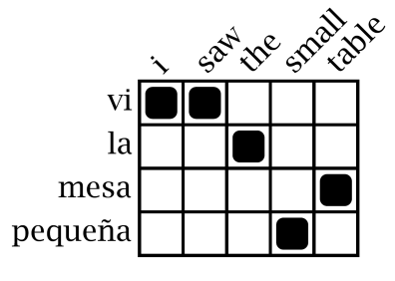
Statistical Machine Translation
Training Data
Word Alignment
Phrase Extraction
i saw the small table
(vi, i saw)
(la mesa pequeña, the small table)
…
vi la mesa pequeña
Parallel Sentences
he sat at the table
the service was good
Language Model
Translation Model
Target-Language Text
Decoder
maria no daba una bofetada a la bruja verde
mary did not slap the green witch
Foreign Input Sentence
English Output Sentence

Slide 6
SMT: The role of the LM
Maria
no
dio
una
bofetada
a
la
bruja
verde
Mary
not
give
a
slap
to
the
witch
green
did not
a slap
by
green witch
no
slap
to the
did not give
to
the
slap
the witch

Slide 7
N-Gram Language Models
N=1 (unigrams)
This is a sentence
Unigrams:
This,
is,
a,
sentence
Sentence of length s, how many unigrams?
Notes:
What are n-grams ? We already saw what they are sort of when we looked at NgramTaggers.

Slide 8
N-Gram Language Models
N=2 (bigrams)
This is a sentence
Bigrams:
This is,
is a,
a sentence
Sentence of length s, how many bigrams?
Notes:
What are n-grams ? We already saw what they are sort of when we looked at NgramTaggers.

Slide 9
N-Gram Language Models
N=3 (trigrams)
This is a sentence
Trigrams:
This is a,
is a sentence
Sentence of length s, how many trigrams?
Notes:
What are n-grams ? We already saw what they are sort of when we looked at NgramTaggers.

Slide 10

Computing Probabilities
[chain rule]
Is this practical?
No! Can’t keep track of all possible histories of all words!
Notes:
Sentence with T words - assign a probability to it

Slide 11
Approximating Probabilities
Basic idea: limit history to fixed number of words N
(Markov Assumption)
N=1: Unigram Language Model
Relation to HMMs?

Slide 12
Approximating Probabilities
Basic idea: limit history to fixed number of words N
(Markov Assumption)
N=2: Bigram Language Model
Relation to HMMs?
Notes:
Since we also want to include the first word in the bigram model, we need a dummy beginning of sentence marker <s>. We usually also have an end of sentence marker but for the sake of brevity, I don’t show that here.

Slide 13
Approximating Probabilities
Basic idea: limit history to fixed number of words N
(Markov Assumption)
N=3: Trigram Language Model
Relation to HMMs?

Slide 14
Building N-Gram Language Models
Use existing sentences to compute n-gram probability estimates (training)
Terminology:
N = total number of words in training data (tokens)
V = vocabulary size or number of unique words (types)
C(w₁,...,w_{k}) = frequency of n-gram w₁, ..., w_{k} in training data
P(w₁, ..., w_{k}) = probability estimate for n-gram w₁ ... w_{k}
P(w_{k}|w₁, ..., w_{k-1}) = conditional probability of producing w_{k} given the history w₁, ... w_{k-1}
What’s the vocabulary size?

Slide 15



Building N-Gram Models
Start with what’s easiest!
Compute maximum likelihood estimates for individual n-gram probabilities
Unigram:
Bigram:
Uses relative frequencies as estimates
Maximizes the likelihood of the data given the model P(D|M)
Why not just substitute P(wi) ?
Notes:
N-gram probability estimates. Derive the conditional probability expression on board ! Given that the occurrence of an n-gram is a random variable with a binomial distribution i.e. each n-gram is independent of the next. Untrue: (a) n-grams are overlapping (b) content words tend to clump (used once, likely to get used again)

Slide 16
Example: Bigram Language Model
<s>
I am Sam Sam I am
I do not like green eggs and ham
</s>
<s>
</s>
<s>
</s>
Training Corpus
P( I | <s> ) = 2/3 = 0.67 P( Sam | <s> ) = 1/3 = 0.33
P( am | I ) = 2/3 = 0.67 P( do | I ) = 1/3 = 0.33
P( </s> | Sam )= 1/2 = 0.50 P( Sam | am) = 1/2 = 0.50
...
Bigram Probability Estimates
Note: We don’t ever cross sentence boundaries

Slide 17
Building N-Gram Models
Start with what’s easiest!
Compute maximum likelihood estimates for individual n-gram probabilities
Unigram:
Bigram:
Uses relative frequencies as estimates
Maximizes the likelihood of the data given the model P(D|M)
Let’s revisit this issue…
Why not just substitute P(wi)?
Notes:
N-gram probability estimates. Derive the conditional probability expression on board ! Given that the occurrence of an n-gram is a random variable with a binomial distribution i.e. each n-gram is independent of the next. Untrue: (a) n-grams are overlapping (b) content words tend to clump (used once, likely to get used again)

Slide 18
More Context, More Work
Larger N = more context
Lexical co-occurrences
Local syntactic relations
More context is better?
Larger N = more complex model
For example, assume a vocabulary of 100,000
How many parameters for unigram LM? Bigram? Trigram?
Larger N has another more serious problem!

Slide 19
Data Sparsity
P( I | <s> ) = 2/3 = 0.67 P( Sam | <s> ) = 1/3 = 0.33
P( am | I ) = 2/3 = 0.67 P( do | I ) = 1/3 = 0.33
P( </s> | Sam )= 1/2 = 0.50 P( Sam | am) = 1/2 = 0.50
...
Bigram Probability Estimates
P(I like ham)
= P( I | <s> ) P( like | I ) P( ham | like ) P( </s> | ham )
= 0
Why?
Why is this bad?
Notes:
Why is the 0 bad ?

Slide 20
Data Sparsity
Serious problem in language modeling!
Becomes more severe as N increases
What’s the tradeoff?
Solution 1: Use larger training corpora
Can’t always work... Blame Zipf’s Law (Looong tail)
Solution 2: Assign non-zero probability to unseen n-grams
Known as smoothing
Notes:
Explain what Zipf’s law is and ask the students if they understand how it bears on this discussion.

Slide 21
Smoothing
Zeros are bad for any statistical estimator
Need better estimators because MLEs give us a lot of zeros
A distribution without zeros is “smoother”
The Robin Hood Philosophy: Take from the rich (seen n-grams) and give to the poor (unseen n-grams)
And thus also called discounting
Critical: make sure you still have a valid probability distribution!
Language modeling: theory vs. practice

Slide 22
Laplace’s Law
Simplest and oldest smoothing technique
Just add 1 to all n-gram counts including the unseen ones
So, what do the revised estimates look like?

Slide 23







Laplace’s Law: Probabilities
Unigrams
Bigrams
Careful, don’t confuse the N’s!
What if we don’t know V?
Notes:
You have to make sure that the joint is well-formed and understand how the conditional probability formula is derived.

Slide 24

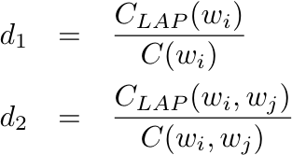
Laplace’s Law: Frequencies
Expected Frequency Estimates
Relative Discount

Slide 25
Laplace’s Law
Bayesian estimator with uniform priors
Moves too much mass over to unseen n-grams
What if we added a fraction of 1 instead?

Slide 26
Lidstone’s Law of Succession
Add 0 < γ < 1 to each count instead
The smaller γ is, the lower the mass moved to the unseen n-grams (0=no smoothing)
The case of γ = 0.5 is known as Jeffery-Perks Law or Expected Likelihood Estimation
How to find the right value of γ?

Slide 27

Good-Turing Estimator
Intuition: Use n-grams seen once to estimate n-grams never seen and so on
Compute N_{r} (frequency of frequency r)
N₀ is the number of items with count 0
N₁ is the number of items with count 1
…
Notes:
The conditional probability just uses the discounted bigram count as the numerator but the MLE count for the unigram.

Slide 28



Good-Turing Estimator
For each r, compute an expected frequency estimate (smoothed count)
Replace MLE counts of seen bigrams with the expected frequency estimates and use those for probabilities
Notes:
The conditional probability just uses the discounted bigram count as the numerator but the MLE count for the unigram.

Slide 29


Good-Turing Estimator
What about an unseen bigram?
Do we know N₀? Can we compute it for bigrams?
Notes:
Make sure it’s clear that PGT is the probability for each unseen bigram (not the total probability mass)

Slide 30
Good-Turing Estimator: Example
r | Nr
1 | 138741
2 | 25413
3 | 10531
4 | 5997
5 | 3565
6 | ...
N₀ =
(14585)² - 199252
C_{unseen} =
N₁ / N₀ = 0.00065
P_{unseen} =
N₁ /( N₀ N ) = 1.06 x 10⁻⁹
Note: Assumes mass is uniformly distributed
V = 14585
Seen bigrams =199252
C(person she) = 2
CGT(person she) = (2+1)(10531/25413) = 1.243
C(person) = 223
P(she|person) =CGT(person she)/223 = 0.0056

Slide 31
Good-Turing Estimator
For each r, compute an expected frequency estimate (smoothed count)
Replace MLE counts of seen bigrams with the expected frequency estimates and use those for probabilities
What if w_{i} isn’t observed?
Notes:
The conditional probability just uses the discounted bigram count as the numerator but the MLE count for the unigram.

Slide 32
Good-Turing Estimator
Can’t replace all MLE counts
What about r_{max}?
N_{r+1} = 0 for r = r_{max}
Solution 1: Only replace counts for r < k (~10)
Solution 2: Fit a curve S through the observed (r, N_{r}) values and use S(r) instead
For both solutions, remember to do what?
Bottom line: the Good-Turing estimator is not used by itself but in combination with other techniques

Slide 33
Combining Estimators
Better models come from:
Combining n-gram probability estimates from different models
Leveraging different sources of information for prediction
Three major combination techniques:
Simple Linear Interpolation of MLEs
Katz Backoff
Kneser-Ney Smoothing

Slide 34


Linear MLE Interpolation
Mix a trigram model with bigram and unigram models to offset sparsity
Mix = Weighted Linear Combination

Slide 35
Linear MLE Interpolation
λ_{i} are estimated on some held-out data set (not training, not test)
Estimation is usually done via an EM variant or other numerical algorithms (e.g. Powell)

Slide 36
Backoff Models
Consult different models in order depending on specificity (instead of all at the same time)
The most detailed model for current context first and, if that doesn’t work, back off to a lower model
Continue backing off until you reach a model that has some counts
Notes:
Make sure they understand why discounting is necessary !

Slide 37
Backoff Models
Important: need to incorporate discounting as an integral part of the algorithm… Why?
MLE estimates are well-formed…
But, if we back off to a lower order model without taking something from the higher order MLEs, we are adding extra mass!
Katz backoff
Starting point: GT estimator assumes uniform distribution over unseen events… can we do better?
Use lower order models!

Slide 38

Katz Backoff
Given a trigram “x y z”

Slide 39
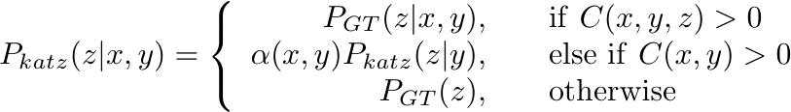
Katz Backoff (from textbook)
Given a trigram “x y z”
Typo?

Slide 40
Kneser-Ney Smoothing
Observation:
Average Good-Turing discount for r ≥ 3 is largely constant over r
So, why not simply subtract a fixed discount D (≤1) from non-zero counts?
Absolute Discounting: discounted bigram model, back off to MLE unigram model
Kneser-Ney: Interpolate discounted model with a special “continuation” unigram model
Notes:
Save the work and just subtract a fixed value rather than by multiplying with a discount factor like in Laplace’s Law and Good-Turing discounting. This gives us absolute discounting.
Kneser-Ney extends this idea further and interpolates with a cleverly constructed unigram distribution rather than an MLE one.

Slide 41
Kneser-Ney Smoothing
Intuition
Lower order model important only when higher order model is sparse
Should be optimized to perform in such situations
Example
C(Los Angeles) = C(Angeles) = M; M is very large
“Angeles” always and only occurs after “Los”
Unigram MLE for “Angeles” will be high and a normal backoff algorithm will likely pick it in any context
It shouldn’t, because “Angeles” occurs with only a single context in the entire training data

Slide 42


Kneser-Ney Smoothing
Kneser-Ney: Interpolate discounted model with a special “continuation” unigram model
Based on appearance of unigrams in different contexts
Excellent performance, state of the art
Why interpolation, not backoff?
= number of different contexts w_{i} has appeared in

Slide 43
Explicitly Modeling OOV
Fix vocabulary at some reasonable number of words
During training:
Consider any words that don’t occur in this list as unknown or out of vocabulary (OOV) words
Replace all OOVs with the special word <UNK>
Treat <UNK> as any other word and count and estimate probabilities
During testing:
Replace unknown words with <UNK> and use LM
Test set characterized by OOV rate (percentage of OOVs)

Slide 44
Evaluating Language Models
Information theoretic criteria used
Most common: Perplexity assigned by the trained LM to a test set
Perplexity: How surprised are you on average by what comes next ?
If the LM is good at knowing what comes next in a sentence ⇒ Low perplexity (lower is better)
Relation to weighted average branching factor
Notes:
If it has good probability estimates -> makes good predictions -> knows what comes next

Slide 45
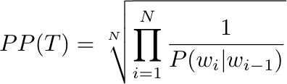
Computing Perplexity
Given test set W with words w₁, ...,w_{N}
Treat entire test set as one word sequence
Perplexity is defined as the probability of the entire test set normalized by the number of words
Using the probability chain rule and (say) a bigram LM, we can write this as
A lot easier to do with logprobs!

Slide 46
Practical Evaluation
Use <s> and </s> both in probability computation
Count </s> but not <s> in N
Typical range of perplexities on English text is 50-1000
Closed vocabulary testing yields much lower perplexities
Testing across genres yields higher perplexities
Can only compare perplexities if the LMs use the same vocabulary
Order | Unigram | Bigram | Trigram
PP | 962 | 170 | 109
Training: N=38 million, V~20000, open vocabulary, Katz backoff where applicable
Test: 1.5 million words, same genre as training

Slide 47
Typical “State of the Art” LMs
Training
N = 10 billion words, V = 300k words
4-gram model with Kneser-Ney smoothing
Testing
25 million words, OOV rate 3.8%
Perplexity ~50

Slide 48
Take-Away Messages
LMs assign probabilities to sequences of tokens
N-gram language models: consider only limited histories
Data sparsity is an issue: smoothing to the rescue
Variations on a theme: different techniques for redistributing probability mass
Important: make sure you still have a valid probability distribution!

Slide 49
Scaling Language Models with MapReduce

Slide 50
Language Modeling Recap
Interpolation: Consult all models at the same time to compute an interpolated probability estimate.
Backoff: Consult the highest order model first and backoff to lower order model only if there are no higher order counts.
Interpolated Kneser Ney (state-of-the-art)
Use absolute discounting to save some probability mass for lower order models.
Use a novel form of lower order models (count unique single word contexts instead of occurrences)
Combine models into a true probability model using interpolation

Slide 51
Questions for today
Can we efficiently train an IKN LM with terabytes of data?
Does it really matter?

Slide 52
Using MapReduce to Train IKN
Step 0: Count words [MR]
Step 0.5: Assign IDs to words [vocabulary generation] (more frequent → smaller IDs)
Step 1: Compute n-gram counts [MR]
Step 2: Compute lower order context counts [MR]
Step 3: Compute unsmoothed probabilities and interpolation weights [MR]
Step 4: Compute interpolated probabilities [MR]
[MR] = MapReduce job

Slide 53
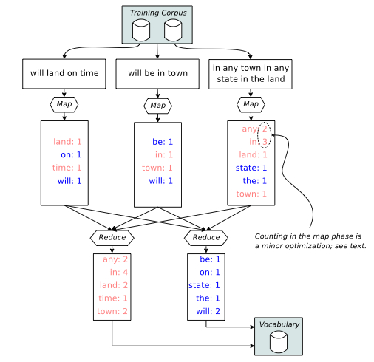
Steps 0 & 0.5
Step 0
Step 0.5

Slide 54
Steps 1-4
 | Step 1 | Step 2 | Step 3 | Step 4
Input Key | DocID | n-grams “a b c” | “a b c” | “a b”
Input Value | Document | C_{total}(“a b c”) | C_{KN}(“a b c”) | _Step 3 Output_
Intermediate Key | n-grams “a b c” | “a b c” | “a b” (history) | “c b a”
Intermediate Value | C_{doc}(“a b c”) | C’_{KN}(“a b c”) | (“c”, C_{KN}(“a b c”)) | (P’(“a b c”), λ(“a b”))
Partitioning | “a b c” | “a b c” | “a b” | “c b”
Output Value | C_{total}(“a b c”) | C_{KN}(“a b c”) | (“c”, P’(“a b c”), λ(“a b”)) | (P_{KN}(“a b c”), λ(“a b”))
Mapper Input
Mapper Output
Reducer Input
Reducer
Output
Count
n-grams
Count
contexts
Compute unsmoothed probs AND interp. weights
Compute
Interp. probs
All output keys are always the same as the intermediate keys
I only show trigrams here but the steps operate on bigrams and unigrams as well

Slide 55
Steps 1-4
 | Step 1 | Step 2 | Step 3 | Step 4
Input Key | DocID | n-grams “a b c” | “a b c” | “a b”
Input Value | Document | C_{total}(“a b c”) | C_{KN}(“a b c”) | _Step 3 Output_
Intermediate Key | n-grams “a b c” | “a b c” | “a b” (history) | “c b a”
Intermediate Value | C_{doc}(“a b c”) | C’_{KN}(“a b c”) | (“c”, C_{KN}(“a b c”)) | (P’(“a b c”), λ(“a b”))
Partitioning | “a b c” | “a b c” | “a b” | “c b”
Output Value | C_{total}(“a b c”) | C_{KN}(“a b c”) | (“c”, P’(“a b c”), λ(“a b”)) | (P_{KN}(“a b c”), λ(“a b”))
Mapper Input
Details are not important!
5 MR jobs to train IKN (expensive)!
IKN LMs are big!
(interpolation weights are context dependent)
Can we do something that has better
behavior at scale in terms of time and space?
Mapper Output
Reducer Input
Reducer
Output
Count
n-grams
Count
contexts
Compute unsmoothed probs AND interp. weights
Compute
Interp. probs
All output keys are always the same as the intermediate keys
I only show trigrams here but the steps operate on bigrams and unigrams as well

Slide 56
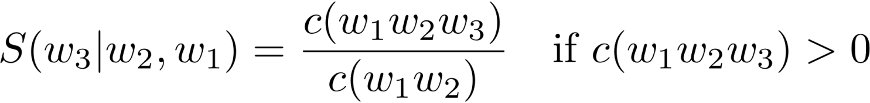
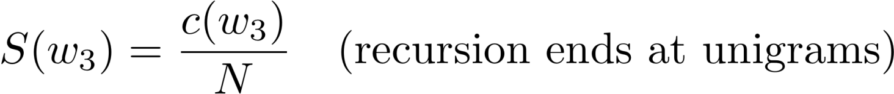
Let’s try something stupid!
Simplify backoff as much as possible!
Forget about trying to make the LM be a true probability distribution!
Don’t do any discounting of higher order models!
Have a single backoff weight independent of context! [α(•) = α]
“Stupid Backoff (SB)”

Slide 57
Using MapReduce to Train SB
Step 0: Count words [MR]
Step 0.5: Assign IDs to words [vocabulary generation] (more frequent → smaller IDs)
Step 1: Compute n-gram counts [MR]
Step 2: Generate final LM “scores” [MR]
[MR] = MapReduce job

Slide 58
Steps 0 & 0.5
Step 0
Step 0.5

Slide 59
Steps 1 & 2
 | Step 1 | Step 2
Input Key | DocID | First two words of n-grams “a b c” and “a b” (“a b”)
Input Value | Document | C_{total}(“a b c”)
Intermediate Key | n-grams “a b c” | “a b c”
Intermediate Value | C_{doc}(“a b c”) | S(“a b c”)
Partitioning | first two words (why?) “a b” | last two words “b c”
Output Value | “a b c”, C_{total}(“a b c”) | S(“a b c”) [write to disk]
Mapper Input
Mapper Output
Reducer Input
Reducer
Output
Count
n-grams
Compute
LM scores
All unigram counts are replicated in all partitions in both steps
The clever partitioning in Step 2 is the key to efficient use at runtime!
The trained LM model is composed of partitions written to disk
Notes:
recall that the reducer wrote out actual "S" scores for each n-gram and not the counts. Therefore, we don't need to do *any• computation for the trigram score; the partition will already have the score S("e f g") and all we need to do is just take that score and multiply it by \alpha. Of course, if it the partition doesn't have S("e f g"), it may have S("f g") so we can take that and multiply it by \alpha². And if it doesn't have S("f g"), we *know* it will have S("g") because unigram counts are replicated across all partitions. So, we take S("g") and multiply it by \alpha³.

Slide 60
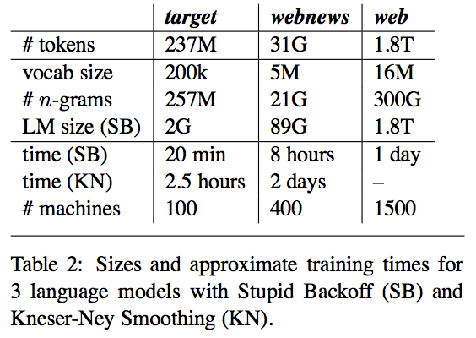
Which one wins?

Slide 61
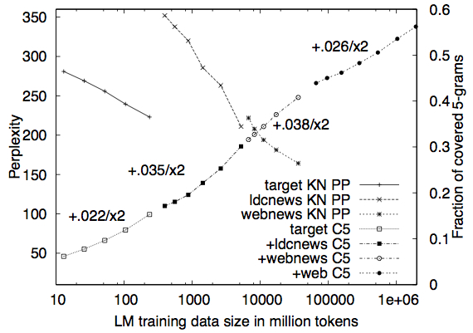
Which one wins?
Can’t compute perplexity for SB. Why?
Why do we care about 5-gram coverage for a test set?

Slide 62
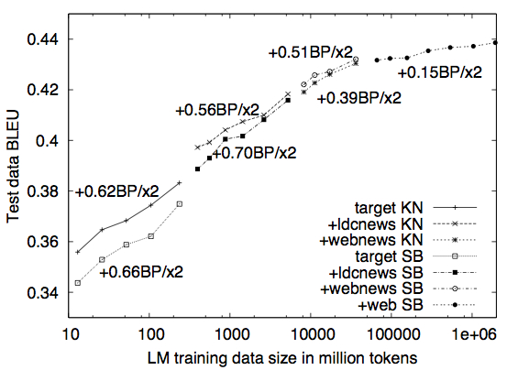
Which one wins?
SB overtakes IKN
BLEU is a measure of MT performance.
Not as stupid as you thought, huh?

Slide 63
Take away
The MapReduce paradigm and infrastructure make it simple to scale algorithms to web scale data
At Terabyte scale, efficiency becomes really important!
When you have a lot of data, a more scalable technique (in terms of speed and memory consumption) can do better than the state-of-the-art even if it’s stupider!
“The difference between genius and stupidity is that genius has its limits.”
- Oscar Wilde
“The dumb shall inherit the cluster”
- Nitin Madnani

Slide 64
Questions?
Source: Wikipedia (Japanese rock garden)

