Slide 1

INFM 603: Information Technology and Organizational Context
Session 2: HTML and CSS (And Computing Tradeoffs, Networking)
Jimmy Lin
The iSchool University of Maryland
Thursday, September 18, 2014

Slide 2
Ways to characterize computing
How big?
How fast?
How reliable?
Computing is fundamentally about tradeoffs!

Slide 3
Example 1: Multi-Core

Slide 4
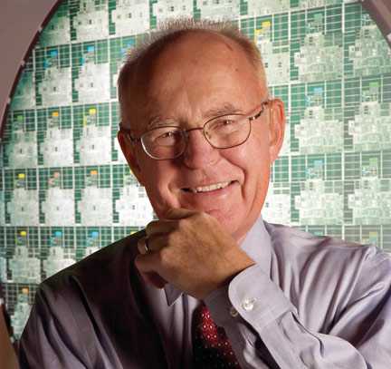

Slide 5
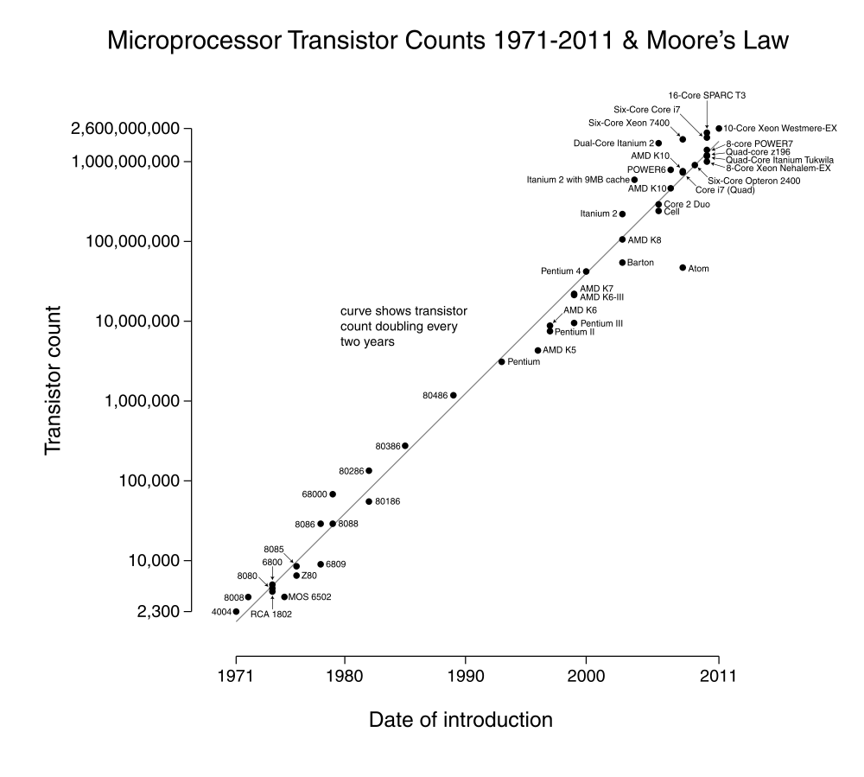
What’s this?
Source: Wikipedia (Moore’s Law)

Slide 6
Trends in Computing: #1

Slide 7
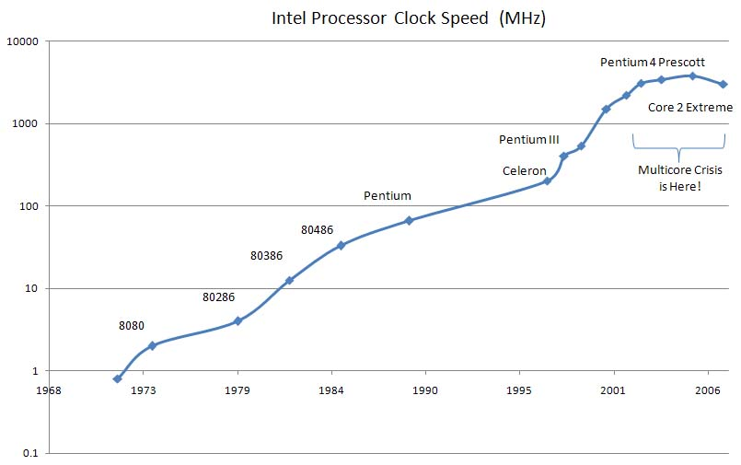
What’s this?
Source: smoothspan.wordpress.com

Slide 8
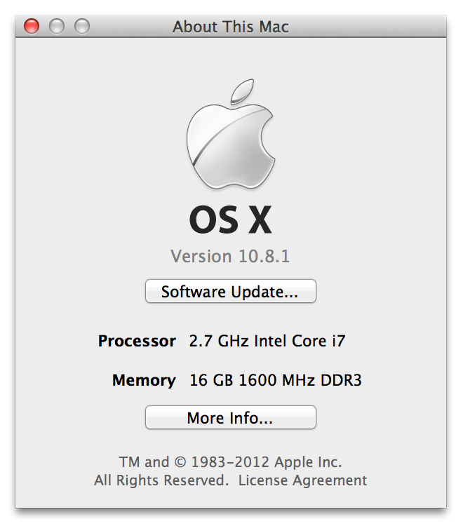

Slide 9
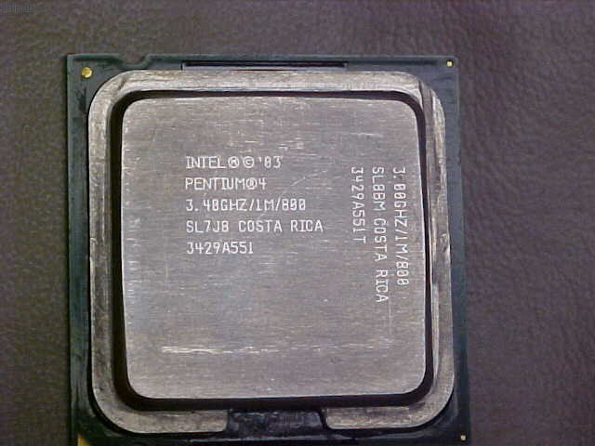

Slide 10
Trends in Computing: #1
2.7 GHz in 2012
Huh?
3.4 GHz in 2003

Slide 11
Source: smoothspan.wordpress.com

Slide 12
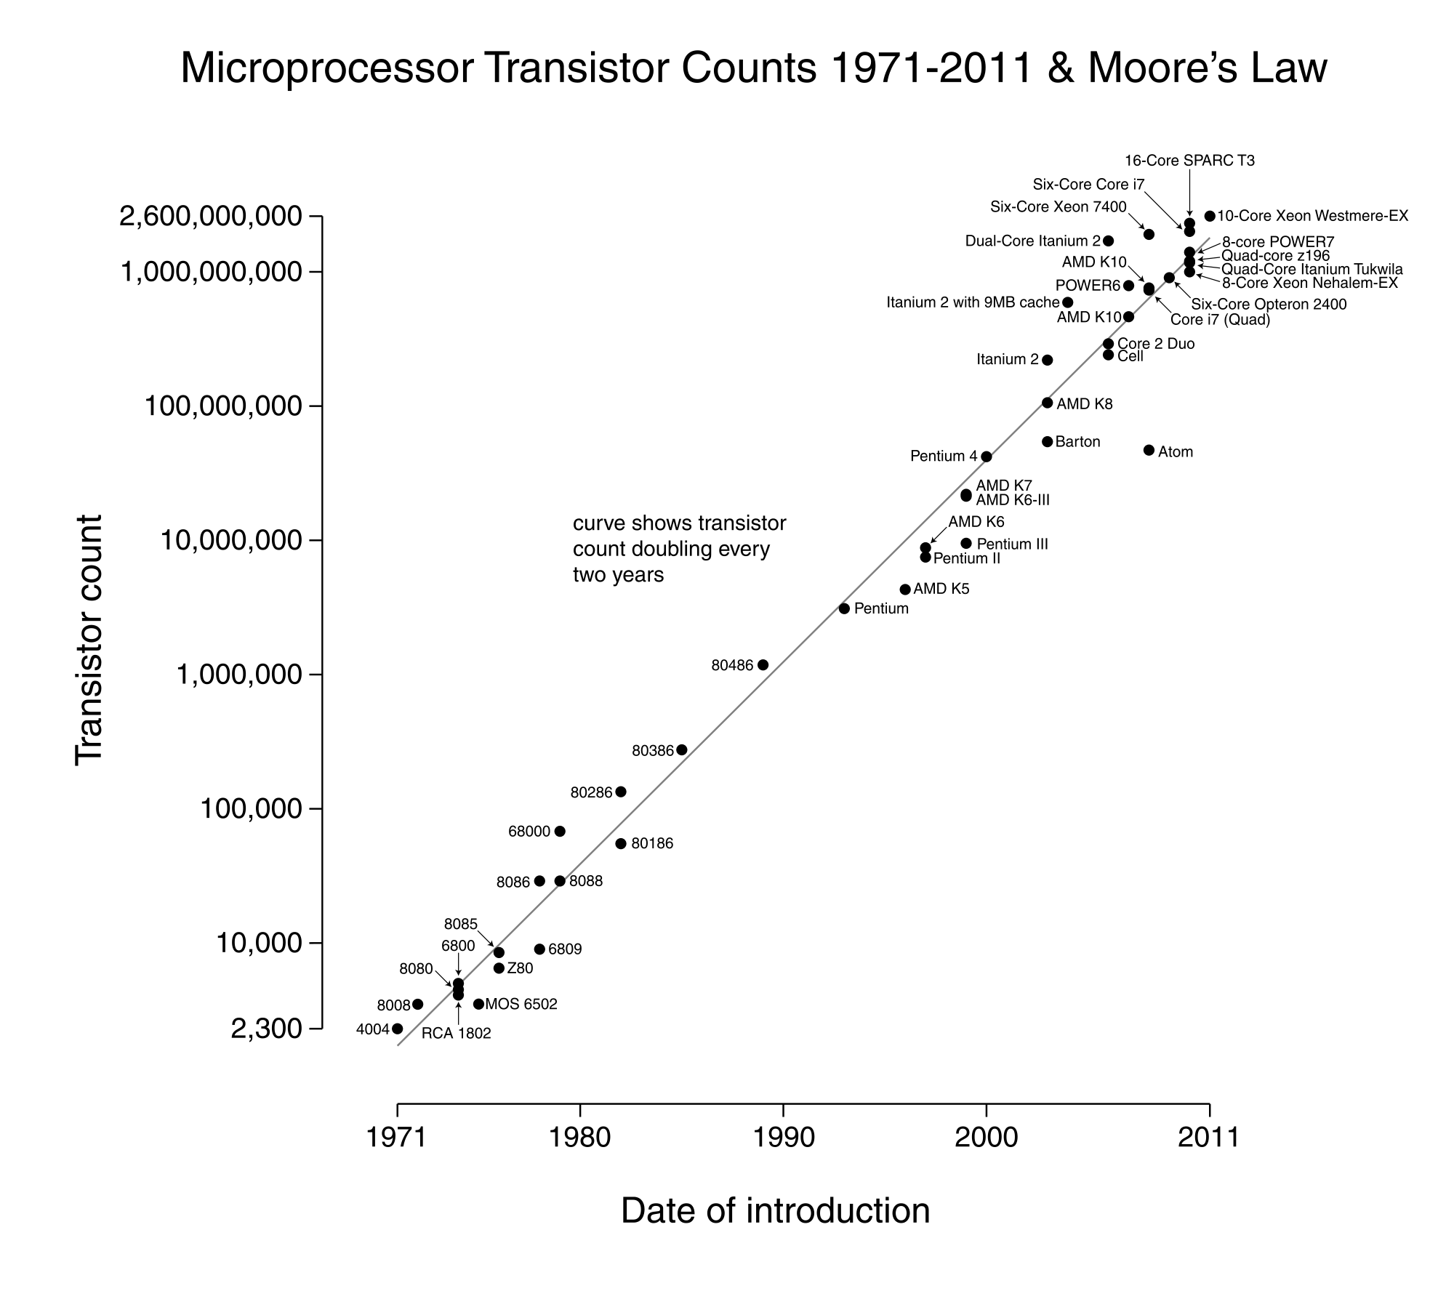
Source: Wikipedia (Moore’s Law)

Slide 13
What’s big shift?
From single to multiple cores:
Increasing speed of single processor reached point of diminishing returns
Solution: put more cores on a processor!
Important issues:
Power
Cool
Parallelism

Slide 14
Example 2: Caching

Slide 15
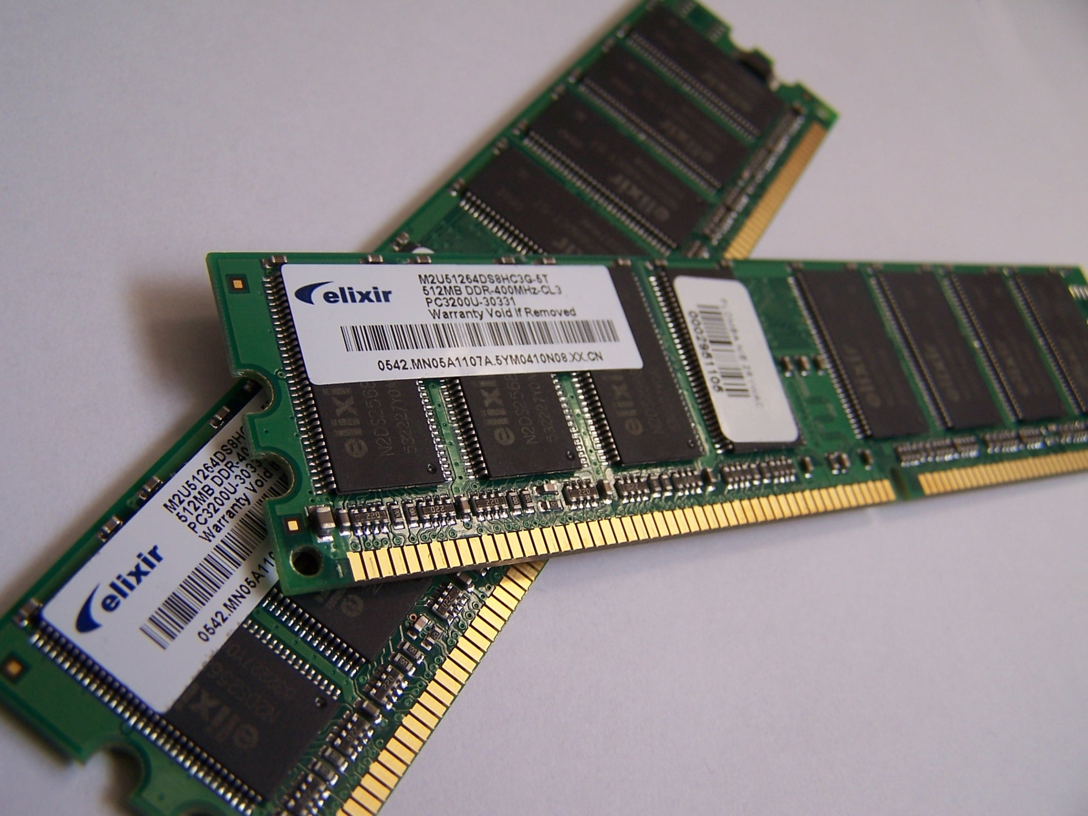
Typical Access Time: 100 ns
Source: Wikipedia

Slide 16
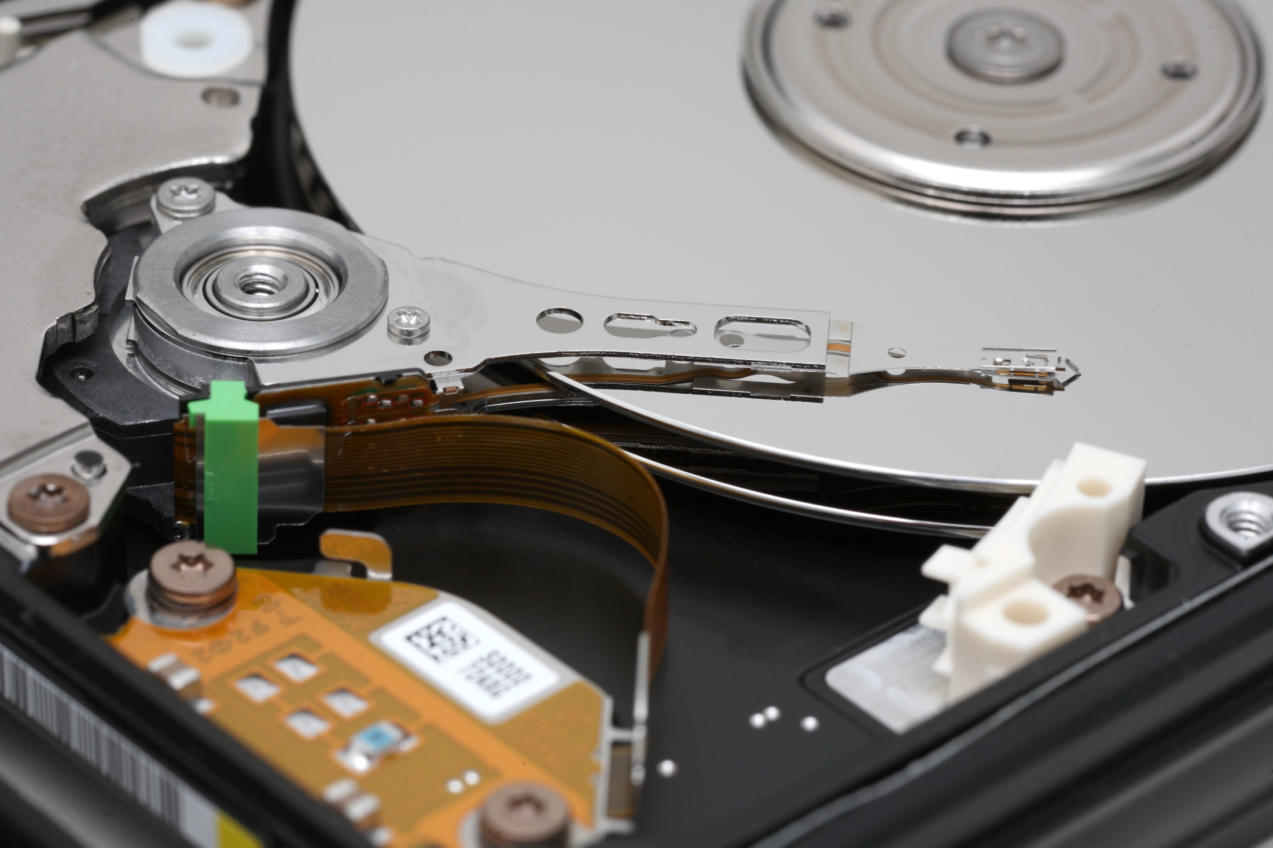
Typical Access Time: 10 ms
(10,000x slower than RAM!!!)
Source: Wikipedia

Slide 17
Pick two
Speed
Capacity
Cost

Slide 18
RAM: small, expensive, fast
Hard drives: big, cheap, slow

Slide 19
Best of both worlds? cheap, fast, and big
Think about your bookshelf and the library…

Slide 20
Caching
Idea: move data you’re going to use from slow memory into fast memory
Slow memory is cheap so you can buy lots of it
Caching gives you the illusion of having lots of fast memory
Physical analogy?
How do we know what data to cache?
Spatial locality: If the system fetched x, it is likely to fetch data located near x (Why?)
Temporal locality: If the system fetched x, it is likely to fetch x again (Why?)

Slide 21
Example 3: Replication

Slide 22
Characterizing Reliability
“Nines” | Availability | Downtime (per year)
One nine | 90% | 36.5 d
Two nines | 99% | 3.65 d
Three nines | 99.9% | 8.76 h
Four nines | 99.99% | 52.56 m
Five nines | 99.999% | 5.256 m
Six nines | 99.9999% | 31.536 s

Slide 23
How do you ensure reliability?
Keep multiple copies:
On different machines
On different machines far apart
What are the challenges with this?
Synchronous vs. Asynchronous
Active-Active vs. Active-Passive
…

Slide 24
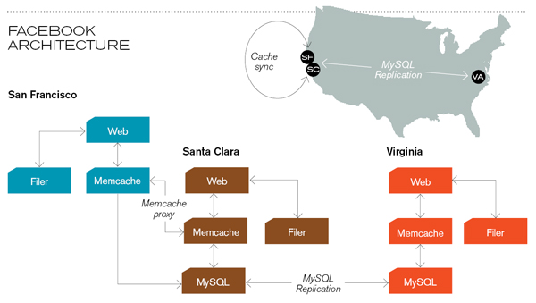
Facebook architecture (circa 2008)
Source: Technology Review

Slide 25
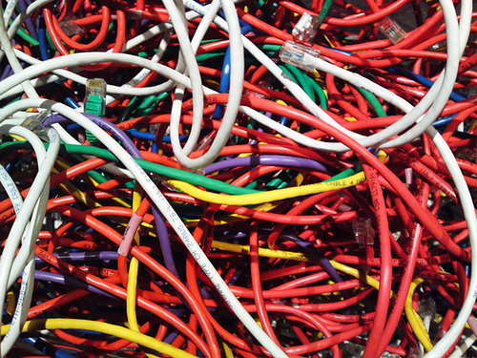
Networking
Source: http://www.flickr.com/photos/fusedforces/4324320625/

Slide 26
Internet ≠ Web
Internet = collection of global networks
Web = particular way of accessing information on the Internet
Uses the HTTP protocol
Other ways of using the Internet
Usenet
FTP
email (SMTP, POP, IMAP, etc.)
Internet Relay Chat

Slide 27
Intranets
Intranet
Gateways
What are firewalls?
Why can’t you do certain things behind firewalls?
Intranet

Slide 28
Intranets
Problem: How do you securely connect separate networks?
Public Internet
Intranet
“leased line”
Intranet
VPN = Virtual Private Network
a secure private network over the public Internet

Slide 29
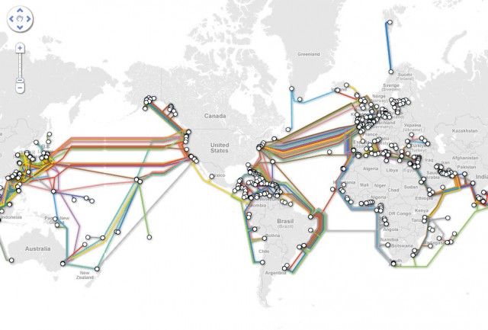
Source: http://www.extremetech.com/computing/96827-the-secret-world-of-submarine-cables

Slide 30
Foundations
Basic protocols for the Internet:
TCP/IP (Transmission Control Protocol/Internet Protocol): basis for communication
DNS (Domain Name Service): basis for naming computers on the network
Protocol for the Web:
HTTP (HyperText Transfer Protocol): protocol for transferring Web pages

Slide 31
IP Address
Every computer on the Internet is identified by a address
IP address = 32 bit number, divided into four “octets”
Example: go in your browser and type “http://74.125.131.147/”
Are there enough IP addresses to go around?
What is the difference between static and dynamic IP?

Slide 32
Packet Routing (TCP/IP)
128.0.1.5
63.6.9.12
4.8.15.2
52.55.64.2
18.1.1.4
192.28.2.5
(Much simplified) Routing table for 4.8.15.2
Destination | Next Hop
52.55.*.* | 63.6.9.12
18.1.*.* | 192.28.2.5/63.6.9.12
4.*.*.* | 225.2.55.1
…

Slide 33
Domain Name Service (DNS)
Domain names improve usability
Easier to remember than IP addresses
DNS provides a lookup service
Each name server knows one level of names
“Top level” name server knows .edu, .com, .mil, …
.edu name server knows umd, mit, stanford, …
.umd.edu name server knows ischool, wam, …

Slide 34
Demo
Play with various utilities at
http://network-tools.com/
http://www.yougetsignal.com/tools/visual-tracert/
http://en.dnstools.ch/visual-traceroute.html

Slide 35
HyperText Transfer Protocol
Send request
Server response
GET /path/file.html HTTP/1.0
From: someuser@somedomain.com
User-Agent: HTTPTool/1.0
HTTP/1.0 200 OK
Date: Fri, 31 Dec 1999 23:59:59 GMT
Content-Type: text/html
Content-Length: 1354
<html><body> <h1>Happy New Millennium!</h1> … </body> </html>

Slide 36
Tell me what happens…
From the moment you click on “check messages” to the moment you start reading your email
From the moment you click “send” to the moment the other party receives the email
From the moment you type a URL and hit “enter” to the moment you see the Web page

Slide 37
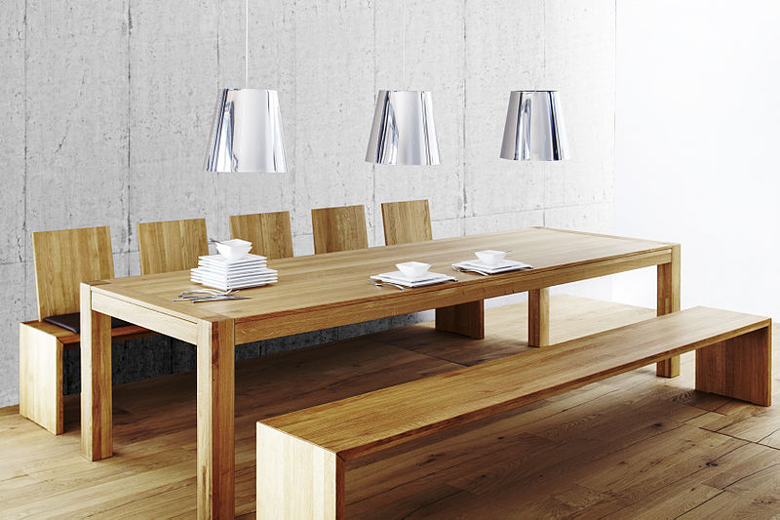
Tables
Source: Wikipedia (Table)

Slide 38
Tables
<table>
eenie | mennie | miney
mo | catch | a tiger
by | the | toe
<tr>
<td>
</td>
<td>
</td>
<td>
</td>
</tr>
<tr>
<td>
</td>
<td>
</td>
<td>
</td>
</tr>
<tr>
<td>
</td>
<td>
</td>
<td>
</td>
</tr>
</table>

Slide 39
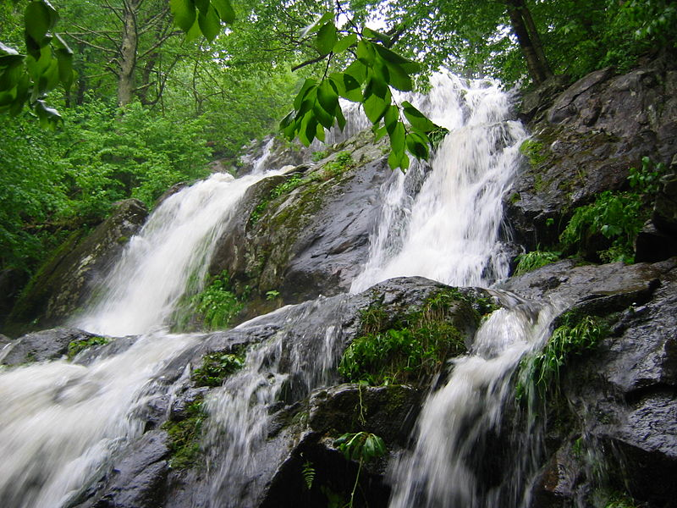
CSS
Source: Wikipedia (Waterfall)

Slide 40
What’s a Document?
Content
Structure
Appearance
Behavior

Slide 41
CSS: Cascading Style Sheets
Separating content and structure from appearance
Rules for defining styles “cascade” from broad to narrow:
Browser default
External style sheet
Internal style sheet
Inline style

Slide 42
Basics of CSS
Basic syntax:
Example:
Causes
Font to be center-aligned
Font to be Arial and black
selector {property: value}
HTML tag you want to modify…
The property you want to change…
The value you want the property to take
p { text-align: center;
color: black;
font-family: arial }

Slide 43
Different Ways for Using CSS
Inline style:
Causes only the tag to have the desired properties
Internal stylesheet:
Causes all tags to have the desired properties
<p style="font-family:arial; color:blue">…</p>
…
<head>…
<style type="text/css">
p { font-family:arial; color:blue}
</style>
</head>
<body>
<p>…</p>
…

Slide 44
Customizing Classes
Define customized styles for standard HTML tags:
…
<head>…
<style type="text/css">
p.style1 { font-family:arial; color:blue}
p.style2 { font-family:serif; color:red}
</style>
</head>
<body>
<p class="style1">…</p>
<p class="style2">…</p>
…

Slide 45
External Style Sheets
Store formatting metadata in a separate file
mystyle.css
p.style1 { font-family:arial; color:blue}
p.style2 { font-family:serif; color:red}
…
<head>…
<link rel="stylesheet" href="mystyle.css" type="text/css" />
</head>
<body>
<p class="style1">…</p>
<p class="style2">…</p>
…

Slide 46
Why Use CSS?
What are the advantages of CSS?
Why have three separate ways of using styles?

