Slide 1

INFM 603: Information Technology and Organizational Context
Session 4: JavaScript – DOM and Events
Jimmy Lin
The iSchool University of Maryland
Thursday, October 2, 2014

Slide 2
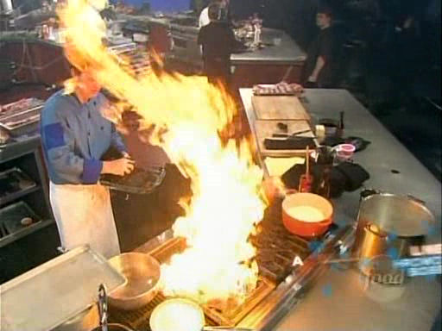
Programming… is a lot like cooking!
Source: Iron Chef America

Slide 3
Arrays
An array holds a collection of values
Each value is referenced with an index, starting from 0
Creating an array:
Or, alternatively:
Note, arrays automatically grow in size
var arr = new Array();
arr[0] = 0;
arr[1] = 3;
arr[2] = 2;
arr[3] = 4;
What happens if you don’t specify value for a particular index?
var arr = [0, 3, 2, 4];

Slide 4
Using Arrays
Referencing values in an array:
Array values can be used in other expressions and statements: var f = 5 + arr[0] + arr[2];
Find out the length of an array: arr.length
Arrays and for loops go hand in glove:
arr[0]
name of array
index (starts at 0!)
var arr = [0, 3, 2, 4];
var sum = 0;
for (var i=0; i<arr.length; i++) {
sum += arr[i];
}
console.log(sum);

Slide 5
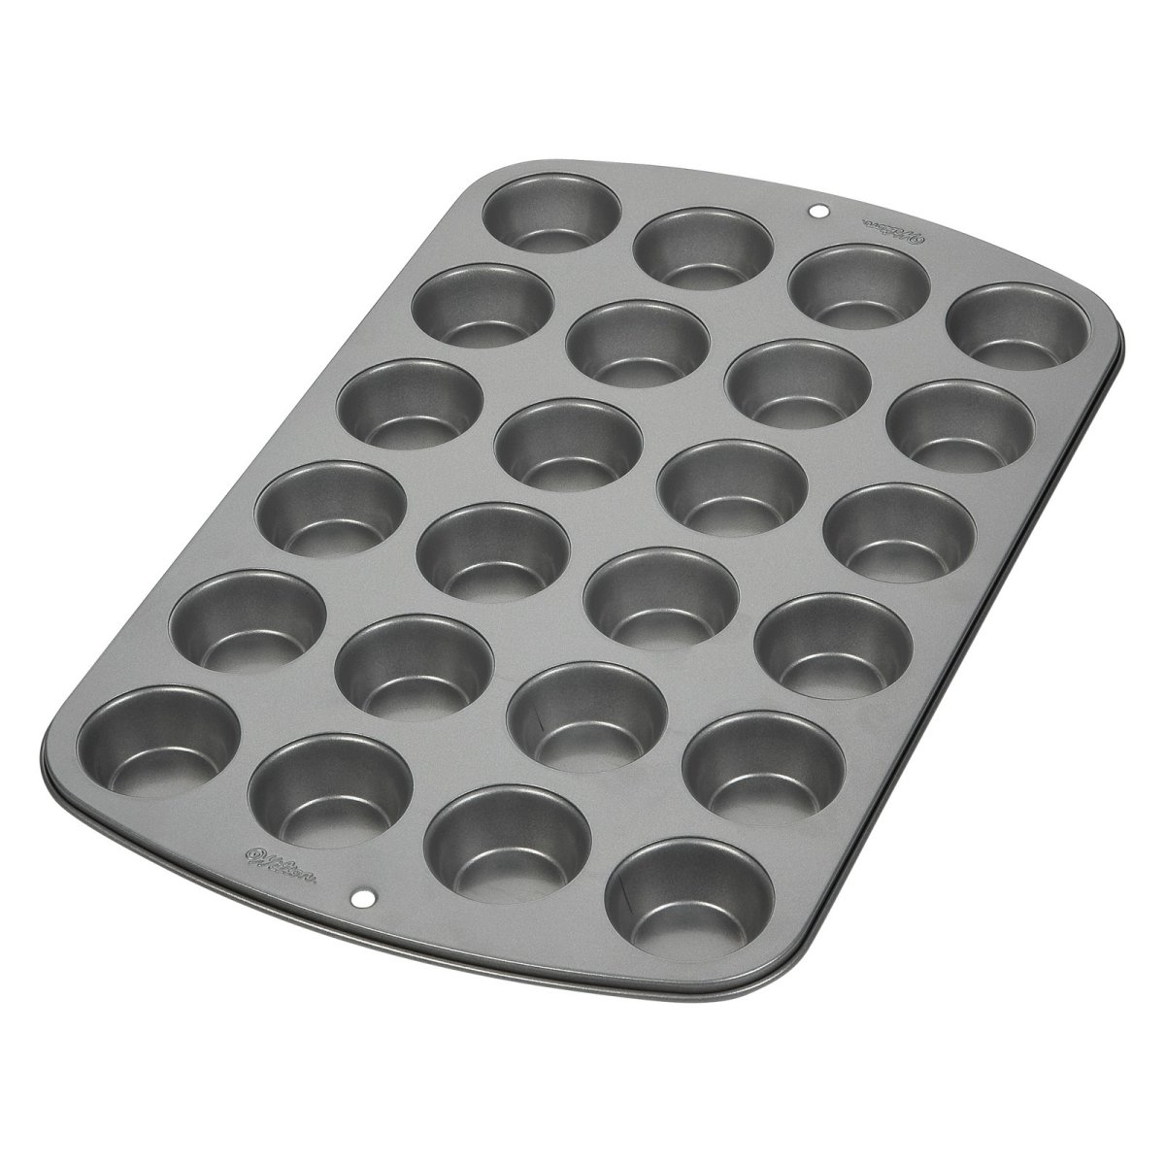
Cooking analogy?
Source: http://www.hayneedle.com/

Slide 6

The Document Object Model (DOM)
Source: http://www.flickr.com/photos/pierrehanquin/6989364994/

Slide 7
The Document Object Model (DOM)
Source: http://www.flickr.com/photos/pierrehanquin/6989364994/

Slide 8
document
head
body
h1
p
p
ul
li
li
li
Source: http://www.flickr.com/photos/pierrehanquin/6989364994/

Slide 9
Asking the DOM to “do stuff”
the method is want you want the document “to do”, usually a verb phrase
document.method(“argument”);
document represents the entire page and contains the DOM
arguments are additional details that you specify
More on the dot notation later…

Slide 10
DOM: Selecting Nodes
Selecting a DOM node by id:
document.getElementById("id");
Note, returns a DOM node
Selecting DOM nodes by tag:
document.getElementsByTagName("p");
Note, returns a collection (treat as an array)
Once you select a DOM node:
Get a node’s children: list.childNodes
Get a node’s number of children: list.childNodes.length
Natural to iterate over child nodes using for loops
BTW, <div> tags are very useful for grouping elements together.

Slide 11
DOM: Manipulating Nodes
Simplest way to manipulate DOM nodes: select the node and modifying its innerHTML property:
var p = document.getElementById("para");
p.innerHTML = "some text";
innerHTML can be any HTML!
Modify a child node using innerHTML:
document.getElementById("list").childNodes[1].innerHTML = "new item";

Slide 12
DOM: Building Nodes
Building DOM nodes programmatically:
var p = document.createElement("p");
p.innerHTML = "here is some new text.";
document.getElementById("div1").appendChild(p);
var newItem = document.createElement("li");
newItem.innerHTML = "new list item";
document.getElementById("list").appendChild(newItem);
Set setAttribute method to set attributes
document.getElementById("para").setAttribute("style", "font-family: arial");

Slide 13
DOM: Removing Nodes
Select the node to remove, then use the removeChild method in its parent:
var list = document.getElementById("list");
var listItem = list.childNodes[1];
list.removeChild(listItem);

Slide 14

Let’s build a table!
Source: Wikipedia (Table)

Slide 15
var t = document.createElement("table");
t.setAttribute("border", 1);
var row1 = document.createElement("tr");
var row1col1 = document.createElement("td");
row1col1.innerHTML = "A";
var row1col2 = document.createElement("td");
row1col2.innerHTML = "B";
row1.appendChild(row1col1);
row1.appendChild(row1col2);
t.appendChild(row1);
document.getElementById("div1").appendChild(t);

Slide 16
Events
GUI are driven by events
When an event happens, an event handler is called to “handle” the event
Easier to show in an example…
Note, what I’m showing is slightly easier than what’s in the book…

Slide 17
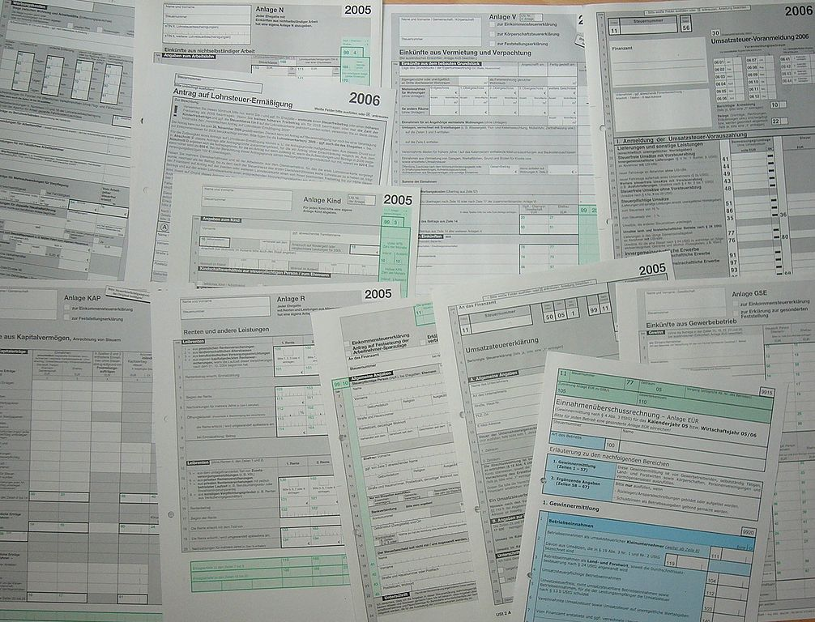
Forms
Source: Wikipedia (Form (Document))

Slide 18

Putting everything together…
Source: Wikipedia (Construction)

