Slide 1

INFM 603: Information Technology and Organizational Context
Session 5: JavaScript – Functions and Objects
Jimmy Lin
The iSchool University of Maryland
Thursday, October 9, 2014

Slide 2

It’ll all make sense today…
Source: The Matrix

Slide 3
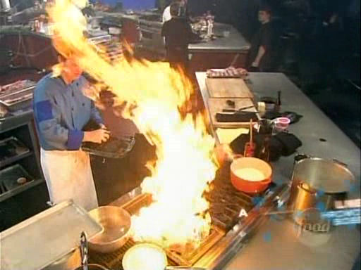
Programming… is a lot like cooking!
Source: Iron Chef America

Slide 4
Functions
Reusable code for performing a computation
A function…
Takes in one or more parameters (or arguments)
Executes some code
Optionally returns a value

Slide 5
Anatomy of Functions
name of the function
list of parameters
function convertToCelsius(f) {
var celsius = 5/9 * (f-32);
return celsius;
}
function weirdAddition(a, b) {
var result = a + b - 0.5;
return result;
}
return value

Slide 6
Using Functions
Calling functions invokes the set of instructions it represents
Parameters to the function are specified between the parens
Multiple arguments are separated by commas
argument to the function
c = convertToCelsius(60);
function convertToCelsius(f) {
var celsius = 5/9 * (f-32);
return celsius;
}

Slide 7
More Examples
var r = weirdAddition(2, 4);
var a = 2;
var b = 3;
var s = weirdAddition(a, b);
function weirdAddition(a, b) {
var result = a + b - 0.5;
return result;
}

Slide 8
You’ve already been doing it!
Built in functions:
prompt("enter some text", "default");
alert("message here");
Message handlers!

Slide 9
Cooking analogy?

Slide 10

Objects
It’s just a collection of properties!
var fido = {
name: "Fido",
weight: 40, breed: "Mixed", loves: ["walks", "fetching balls"]
};

Slide 11
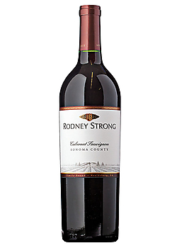
Objects and Properties
Access object properties using the “dot” notation
Where have we seen this before?
var w = fido.weight;
fido.breed = "Yellow Lab";
Wine demo (Part 1)

Slide 12
Objects: Methods
It’s just a collection of properties!
Objects can have functions also! (called methods)
var fido = {
name: "Fido",
weight: 40, breed: "Mixed", loves: ["walks", "fetching balls"],
bark: function() {
alert("Woof woof!");
}
};

Slide 13
Calling a Method
Invoke an object’s method using the dot notation:
It’s just like a function call!
Where have you seen this before?
What’s “this”?
fido.bark();

Slide 14
What’s the point?
Claim: every method can be rewritten as a ordinary function, and vice versa?
Why have methods? What’s the advantage of functions directly to objects?
Wine demo (Part 2)

Slide 15
Constructor!
So far, building objects is a tedious process… that’s where constructors come in:
function Dog(name, breed, weight) {
this.name = name; this.breed = breed;
this.weight = weight;
this.bark = function() {
if (this.weight > 25) {
alert(this.name + " says Woof!");
} else { alert(this.name + " says Yip!");
}
};
}

Slide 16
Using Constructors
Invoke constructors using “new”:
var fido = new Dog("Fido", "Mixed", 38); var tiny = new Dog("Tiny", "Chawalla", 8); var clifford = new Dog("Clifford", "Bloodhound", 65);
fido.bark();
tiny.bark();
clifford.bark();
Wine demo (Part 3)

Slide 17
It’ll all make sense today…
Source: The Matrix

Slide 18
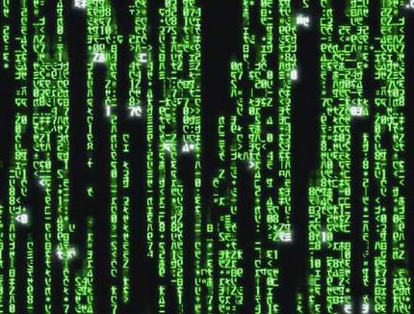
Make sense now?
Source: The Matrix

Slide 19

Okay, you can relax now…
Source: Flickr http://www.flickr.com/photos/kitchenplan/6258898113/

Slide 20
(a bit) more of this…
Source: The Matrix

Slide 21
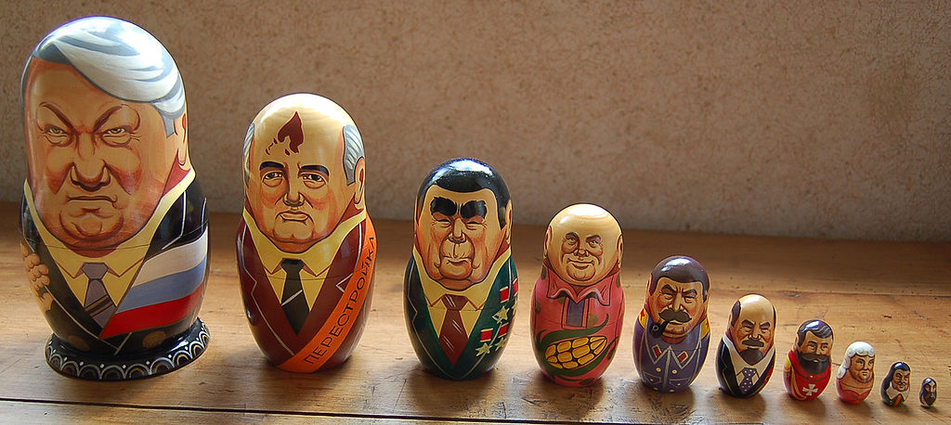
What happens if a function calls itself?
Source: Wikipedia

Slide 22
How do we find an element
in a sorted list of elements?
How do we quantify the speed of various algorithms?

Slide 23

Sequential Search
Source: Wikipedia

Slide 24
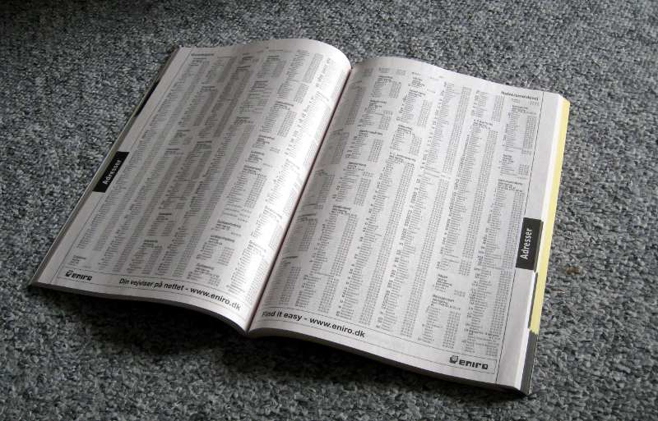
Binary Search
Source: Wikipedia

Slide 25
Algorithmic Complexity
Linear vs. logarithmic algorithms
Matters as data sizes increase!

