Slide 1

INFM 603: Information Technology and Organizational Context
Session 6: Relational Databases
Jimmy Lin
The iSchool University of Maryland
Thursday, October 10, 2013

Slide 2
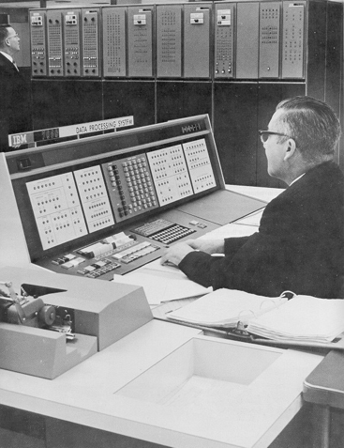
Databases Yesterday…

Slide 3










Databases Today…

Slide 4
What’s structured information?
It’s what you put in a database
What’s a database?
It’s what you store structured information in

Slide 5
So what’s a database?
An integrated collection of data organized according to some model…

Slide 6
So what’s a relational database?
An integrated collection of data organized according to a relational model

Slide 7
Database Management System (DBMS)
Software system designed to store, manage, and facilitate access to databases

Slide 8
Databases (try to) model reality…
Entities: things in the world
Example: airlines, tickets, passengers
Relationships: how different things are related
Example: the tickets each passenger bought
“Business Logic”: rules about the world
Example: fare rules

Slide 9

Relational Databases
Source: Microsoft Office Clip Art

Slide 10
Components of a Relational Database
Field: an “atomic” unit of data
Record: a collection of related fields
Sometimes called a “tuple”
Table: a collection of related records
Each record is a row in the table
Each field is a column in the table
Database: a collection of tables

Slide 11
A Simple Example
Field Name
Table
Name | DOB | SSN
John Doe | 04/15/1970 | 153-78-9082
Jane Smith | 08/31/1985 | 768-91-2376
Mary Adams | 11/05/1972 | 891-13-3057
Record
Field
Primary Key

Slide 12
Why “Relational”?
View of the world in terms of entities and relations:
Tables represent “relations”
Each row (record, tuple) is “about” an entity
Fields can be interpreted as “attributes” or “properties” of the entity
Data is manipulated by “relational algebra”:
Defines things you can do with tuples
Expressed in SQL

Slide 13
The Registrar Example
What do we need to know?
Something about the students (e.g., first name, last name, email, department)
Something about the courses (e.g., course ID, description, enrolled students, grades)
Which students are in which courses
How do we capture these things?

Slide 14
A First Try
Put everything in a big table…
Why is this a bad idea?

Slide 15
Goals of “Normalization”
Save space
Save each fact only once
More rapid updates
Every fact only needs to be updated once
More rapid search
Finding something once is good enough
Avoid inconsistency
Changing data once changes it everywhere

Slide 16
Another Try...
Student Table
Department Table
Course Table
Enrollment Table

Slide 17

Keys
“Primary Key” uniquely identifies a record
e.g., student ID in the student table
“Foreign Key” is primary key in the other table
It need not be unique in this table

Slide 18
Approaches to Normalization
For simple problems:
Start with the entities you’re trying to model
Group together fields that “belong together”
Add keys where necessary to connect entities in different tables
For more complicated problems:
Entity-relationship modeling

Slide 19
The Data Model
Student Table
Department Table
Course Table
Enrollment Table

Slide 20
Registrar ER Diagram
Student
Student ID
First name
Last name
Department
E-mail
…
Enrollment
Student
Course
Grade
…
has
has
associated with
Course
Course ID
Course Name
…
Department
Department ID
Department Name
…

Slide 21
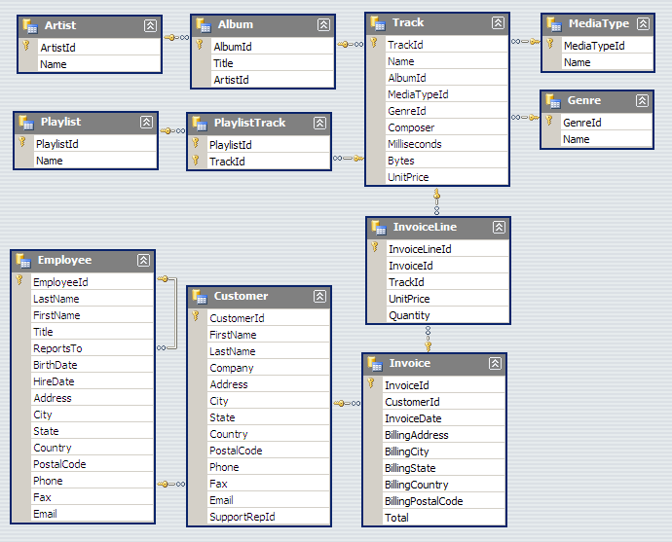
A Real Example

Slide 22
Types of Relationships
Many-to-Many
One-to-Many
One-to-One

Slide 23
Database Integrity
Registrar database must be internally consistent
All enrolled students must have an entry in the student table
All courses must have a name
…
What happens:
When a student withdraws from the university?
When a course is taken off the books?

Slide 24
Integrity Constraints
Conditions that must be true of the database at any time
Specified when the database is designed
Checked when the database is modified
RDBMS ensures that integrity constraints are always kept
So that database contents remain faithful to the real world
Helps avoid data entry errors
Where do integrity constraints come from?

Slide 25
SQL
(Don’t Panic!)

Slide 26
Select
select Student ID, Department

Slide 27
Where
where Department ID = “HIST”

Slide 28
Simple SQL Statements
Choosing columns: SELECT
Based on their labels (field names)
* is a shorthand for saying “all fields”
Choosing rows: WHERE
Based on their contents
These can be specified together
department ID = “HIST”

Slide 29
Simple SQL Template
select [columns in the table]
from [table name]
where [selection criteria]

Slide 30
SQL Tips and Tricks
Referring to fields (in SELECT statements)
Use TableName.FieldName
Can drop TableName if FieldName is unambiguous
Selection criteria
Use = instead of ==
Note, different dialects of SQL!

Slide 31
Join
Student Table
Department Table
“Joined” Table

Slide 32
SQL Template for Joins
select [columns in the table]
from [table name]
join [another tablename] on [join criterion]
join [another tablename] on [join criterion]
…
where [selection criteria]
Join criterion: usually, based on primary/foreign key relationships e.g., Table1.PrimaryKey = Table2.ForeignKey

Slide 33
Aggregations
SQL aggregation functions
Examples: count, min, max, sum, avg
Use in select statements
Tip: when trying to write SQL query with aggregation, do it first without
Group by [field]
Often used in conjunction with aggregation
Conceptually, breaks table apart based on the [field]
select count(*)…
select min(price)…
select sum(length)…

Slide 34
How do you want your results served?
Order by [field name]
Does exactly what you think it does!
Either “asc” or “desc”
Limit n
Returns only n records
Useful to retrieving the top n or bottom n

Slide 35
So how’s a database more than a spreadsheet?

Slide 36
Database in the “Real World”
Typical database applications:
Banking (e.g., saving/checking accounts)
Trading (e.g., stocks)
Traveling (e.g., airline reservations)
Social media (e.g., Facebook)
…
Characteristics:
Lots of data
Lots of concurrent operations
Must be fast
“Mission critical” (well… sometimes)

Slide 37
Operational Requirements
Must hold a lot of data
Must be reliable
Must be fast
Must support concurrent operations

Slide 38
Must hold a lot of data
Solution: Use lots of machines
(Each machine holds a small slice)
So which machine has your copy?

Slide 39
Must be reliable
Solution: Use lots of machines
(Store multiple copies)
But which copy is the right one?
How do you keep the copies in sync?

Slide 40
Must be fast
Solution: Use lots of machines
(Share the load)
How do you spread the load?

Slide 41
Must support concurrent operations
Solution: this is hard!
(But fortunately doesn’t matter for many applications)

Slide 42
Database Transactions
Transaction = sequence of database actions grouped together
e.g., transfer $500 from checking to savings
ACID properties:
Atomicity: all-or-nothing
Consistency: each transaction yield a consistent state
Isolation: concurrent transactions must appear to run in isolation
Durability: results of transactions must survive even if systems crash

Slide 43
Making Transactions
Idea: keep a log (history) of all actions carried out while executing transactions
Before a change is made to the database, the corresponding log entry is forced to a safe location
Recovering from a crash:
Effects of partially executed transactions are undone
Effects of committed transactions are redone
Trickier than it sounds!
the log

Slide 44
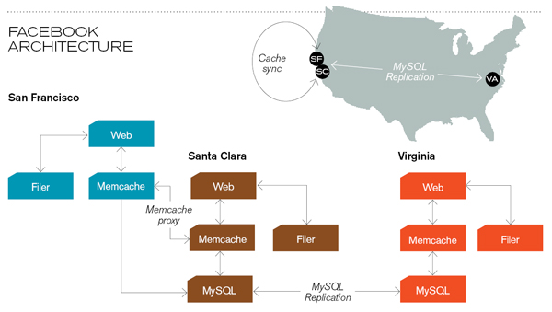
Caching servers: 15 million requests per second, 95% handled by memcache (15 TB of RAM)
Database layer: 800 eight-core Linux servers running MySQL (40 TB user data)
Source: Technology Review (July/August, 2008)

Slide 45
Now you know…
Wait, but these are websites?

