Slide 1

Introduction to NLP
CMSC 723: Computational Linguistics I ― Session #1
Jimmy Lin
The iSchool
University of Maryland
Wednesday, September 2, 2009

Slide 2




About Me
NLP
IR
CLIP
Teaching Assistant: Melissa Egan

Slide 3
About You (pre-requisites)
Must be interested in NLP
Must have strong computational background
Must be a competent programmer
Do not need to have a background in linguistics
Notes:
Polling:
Grads undergrads
Linguists CS
Programming
python

Slide 4
Administrivia
Text:
Speech and Language Processing: An Introduction to Natural Language Processing, Speech Recognition, and Computational Linguistics, second edition, Daniel Jurafsky and James H. Martin (2008)
Course webpage:
http://www.umiacs.umd.edu/~jimmylin/CMSC723-2009-Fall/
Class:
Wednesdays, 4 to 6:30pm (CSI 2107)
Two blocks, 5-10 min break in between

Slide 5

Course Grade
Exams: 50%
Class Assignments: 45%
Assignment 1 “warm up”: 5%
Assignments 2-5: 10% each
Class participation: 5%
Showing up for class, demonstrating preparedness, and contributing to class discussions
Policy for late and incomplete work, etc.
Notes:
. CS MS comp grade (AI area) will be based entirely on the average of the two exams.
These assignments will involve on-paper exercises (e.g. walking through algorithms or calculations), hands-on programming, and/or analysis of data.

Slide 6
Out-of-Class Support
Office hours: by appointment
Course mailing list: umd-cmsc723-fall-2009@googlegroups.com

Slide 7
Let’s get started!

Slide 8
What is Computational Linguistics?
Study of computer processing of natural languages
Interdisciplinary field
Roots in linguistics and computer science (specifically, AI)
Influenced by electrical engineering, cognitive science, psychology, and other fields
Dominated today by machine learning and statistics
Goes by various names
Computational linguistics
Natural language processing
Speech/language/text processing
Human language technology/technologies

Slide 9
Where does NLP fit in CS?
Computer Science
Algorithms, Theory
Programming Languages
Systems, Networks
…
Human-Computer Interaction
Artificial Intelligence
Databases
Machine Learning
NLP
Robotics
…

Slide 10
Science vs. Engineering
What is the goal of this endeavor?
Understanding the phenomenon of human language
Building a better applications
Goals (usually) in tension
Analogy: flight

Slide 11
Rationalism vs. Empiricism
Where does the source of knowledge reside?
Chomsky’s poverty of stimulus argument
It’s an endless pendulum?

Slide 12
Success Stories
“If it works, it’s not AI”
Speech recognition and synthesis
Information extraction
Automatic essay grading
Grammar checking
Machine translation

Slide 13
NLP “Layers”
Phonology
Morphology
Syntax
Semantics
Reasoning
Speech Recognition
Morphological Analysis
Parsing
Semantic Analysis
Reasoning, Planning
Speech Synthesis
Morphological Realization
Syntactic Realization
Utterance Planning
Source: Adapted from NLTK book, chapter 1

Slide 14
Speech Recognition
Conversion from raw waveforms into text
Involves lots of signal processing
“It’s hard to wreck a nice beach”

Slide 15
Optical Character Recognition
Conversion from raw pixels into text
Involves a lot of image processing
What if the image is distorted, or the original text is in poor condition?

Slide 16
What’s a word?
Break up by spaces, right?
What about these?
Ebay | Sells | Most | of | Skype | to | Private | Investors
Swine | flu | isn’t | something | to | be | feared
达赖喇嘛在高雄为灾民祈福
ليبيا تحيي ذكرى وصول القذافي إلى السلطة
百貨店、８月も不振 大手５社の売り上げ８～１１％減
टाटा ने कहा, घाटा पूरा करो

Slide 17
Morphological Analysis
Morpheme = smallest linguistic unit that has meaning
Inflectional
duck + s = [_{N} duck] + [_{plural} s]
duck + s = [_{V} duck] + [_{3rd person singular} s]
Derivational
organize, organization
happy, happiness

Slide 18
Complex Morphology
Turkish is an example of agglutinative language
From the root “uyu-” (sleep), the following can be derived…
uyuyorum I am sleeping
uyuyorsun you are sleeping
uyuyor he/she/it is sleeping
uyuyoruz we are sleeping
uyuyorsunuz you are sleeping
uyuyorlar they are sleeping
uyuduk we slept
uyudukça as long as (somebody) sleeps
uyumalıyız we must sleep
uyumadan without sleeping
uyuman your sleeping
uyurken while (somebody) is sleeping
uyuyunca when (somebody) sleeps
uyutmak to cause somebody to sleep
uyutturmak to cause (somebody) to cause (another) to sleep
uyutturtturmak to cause (somebody) to cause (some other) to cause (yet another) to sleep
. .
From Hakkani-Tür, Oflazer, Tür (2002)

Slide 19
What’s a phrase?
Coherent group of words that serve some function
Organized around a central “head”
The head specifies the type of phrase
Examples:
Noun phrase (NP): the happy camper
Verb phrase (VP): shot the bird
Prepositional phrase (PP): on the deck

Slide 20
Syntactic Analysis
Parsing: the process of assigning syntactic structure
S
NP
VP
N
N
V
NP
N
det
det
N
I
saw
the
man
I
saw
the
man
[_{S} [_{NP} I ] [_{VP} saw [_{NP} the man] ] ]

Slide 21
Semantics
Different structures, same* meaning:
I saw the man.
The man was seen by me.
The man was who I saw.
…
Semantic representations attempt to abstract “meaning”
First-order predicate logic: ∃ x, man(x) ∧ see(x, I) ∧ tense(past)
Semantic frames and roles: (predicate = see, experiencer = I, patient = man)

Slide 22
Semantics: More Complexities
Scoping issues:
Everyone on the island speaks two languages.
Two languages are spoken by everyone on the island.
Ultimately, what is meaning?
Simply pushing the problem onto different sets of symbols?

Slide 23
Lexical Semantics
Any verb can add “able” to form an adjective.
I taught the class. The class is teachable.
I loved that bear. The bear is loveable.
I rejected the idea. The idea is rejectable.
Association of words with specific semantic forms
John: noun, masculine, proper
the boys: noun, masculine, plural, human
load/smear verbs: specific restrictions on subjects and objects

Slide 24
Pragmatics and World Knowledge
Interpretation of sentences requires context, world knowledge, speaker intention/goals, etc.
Example 1:
Could you turn in your assignments now? (command)
Could you finish the assignment? (question, command)
Example 2:
I couldn’t decide how to catch the crook. Then I decided to spy on the crook with binoculars.
To my surprise, I found out he had them too. Then I knew to just follow the crook with binoculars. [ the crook [with binoculars]] vs. [the crook] [with binoculars]

Slide 25
Discourse Analysis
Discourse: how multiple sentences fit together
Pronoun reference:
The professor told the student to finish the exam. He was pretty aggravated at how long it was taking him to complete it.
Multiple reference to same entity:
George Bush, Clinton
Inference and other relations between sentences:
The bomb exploded in front of the hotel. The fountain was destroyed, but the lobby was largely intact.

Slide 26
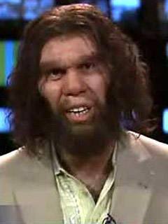
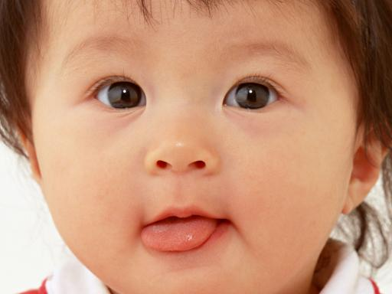
Why is NLP hard?
So easy…

Slide 27
Ambiguity

Slide 28
At the word level
Part of speech
[V Duck]!
[N Duck] is delicious for dinner.
Word sense
I went to the bank to deposit my check.
I went to the bank to look out at the river.
I went to the bank of windows and chose the one for “complaints”.

Slide 29
At the syntactic level
PP Attachment ambiguity
I saw the man on the hill with the telescope
Structural ambiguity
I cooked her duck.
Visiting relatives can be annoying.
Time flies like an arrow.

Slide 30
Difficult cases…
Requires world knowledge:
The city council denied the demonstrators the permit because they advocated violence
The city council denied the demonstrators the permit because they feared violence
Requires context:
John hit the man. He had stolen his bicycle.

Slide 31
So how do humans cope?

Slide 32
Okay, so how does NLP work?

Slide 33
Goals for Practical Applications
Accurate; minimize errors (false positives/negatives)
Maximize coverage
Robust, degrades gracefully
Fast, scalable
Notes:
DRA FT A perhaps surprising fact about these categories of linguistic knowledge is that most tasks in speech and language processing can be viewed as resolving ambiguity at one AMBIGUITY of these levels. We say some input is ambiguous if there are multiple alternative lin- AMBIGUOUS guistic structures that can be built for it. Consider the spoken sentence I made her duck. Here’s ﬁve different meanings this sentence could have (see if you can think of some more), each of which exempliﬁes an ambiguity at some level: (1.1) I cooked waterfowl for her. (1.2) I cooked waterfowl belonging to her. (1.3) I created the (plaster?) duck she owns. (1.4) I caused her to quickly lower her head or body. (1.5) I waved my magic wand and turned her into undifferentiated waterfowl. These different meanings are caused by a number of ambiguities. First, the words duck and her are morphologically or syntactically ambiguous in their part-of-speech. Duck can be a verb or a noun, while her can be a dative pronoun or a possessive pronoun. Second, the word make is semantically ambiguous; it can mean create or cook. Finally, the verb make is syntactically ambiguous in a different way. Make can be transitive, that is, taking a single direct object (1.2), or it can be ditransitive, that is, taking two objects (1.5), meaning that the ﬁrst object (her) got made into the second object (duck). Finally, make can take a direct object and a verb (1.4), meaning that the object (her) got caused to perform the verbal action (duck). Furthermore, in a spoken sentence, there is an even deeper kind of ambiguity; the ﬁrst word could have been eye or the second word maid.
We will often introduce the models and algorithms we present throughout the book as ways to resolve or disambiguate these ambiguities. For example deciding whether duck is a verb or a noun can be solved by part-of-speech tagging. Deciding whether make means “create” or “cook” can be solved by word sense disambiguation. Reso- lution of part-of-speech and word sense ambiguities are two important kinds of lexical disambiguation. A wide variety of tasks can be framed as lexical disambiguation problems. For example, a text-to-speech synthesis system reading the word lead needs to decide whether it should be pronounced as in lead pipe or as in lead me on. By contrast, deciding whether her and duck are part of the same entity (as in (1.1) or (1.4)) or are different entity (as in (1.2)) is an example of syntactic disambiguation and can be addressed by probabilistic parsing. Ambiguities that don’t arise in this particu- lar example (like whether a given sentence is a statement or a question) will also be resolved, for example by speech act interpretation.

Slide 34
Rule-Based Approaches
Prevalent through the 80’s
Rationalism as the dominant approach
Manually-encoded rules for various aspects of NLP
E.g., swallow is a verb of ingestion, taking an animate subject and a physical object that is edible, …

Slide 35
What’s the problem?
Rule engineering is time-consuming and error-prone
Natural language is full of exceptions
Rule engineering requires knowledge
Is this a bad thing?
Rule engineering is expensive
Experts cost a lot of money
Coverage is limited
Knowledge often limited to specific domains

Slide 36
More problems…
Systems became overly complex and difficult to debug
Unexpected interaction between rules
Systems were brittle
Often broke on unexpected input (e.g., “The machine swallowed my change.” or “She swallowed my story.”)
Systems were uninformed by prevalence of phenomena
Why WordNet thinks congress is a donkey…
Problem isn’t with rule-based approaches per se, it’s with manual knowledge engineering…

Slide 37
The alternative?
Empirical approach: learn by observing language as it’s used, “in the wild”
This approach goes by different names:
Statistical NLP
Data-driven NLP
Empirical NLP
Corpus linguistics
…
Central tool: statistics
Fancy way of saying “counting things”

Slide 38
Advantages
Generalize patterns as they exist in actual language use
Little need for knowledge (just count!)
Systems more robust and adaptable
Systems degrade more gracefully

Slide 39
It’s all about the corpus!
Corpus (pl. corpora): a collection of natural language text systematically gathered and organized in some manner
Brown Corpus, Wall Street journal, SwitchBoard, …
Can we learn how language works from corpora?
Look for patterns in the corpus

Slide 40
Features of a corpus
Size
Balanced or domain-specific
Written or spoken
Raw or annotated
Free or pay
Other special characteristics (e.g., bitext)
Notes:
Brown corpus is probably the most widely known corpus. It is a tagged corpus of about a million words that was put together at Brown university in the 1960s and 1970s. It is a balanced corpus. That is, an balanced corpus attempt was made to make the corpus a representative sample of Amer- ican English at the time. Genres covered are press reportage, ﬁction, scientiﬁc text, legal text, and many others. Unfortunately, one has to pay to obtain the Brown corpus, but it is relatively inexpensive for research.
The Susanne corpus is a 130,000 word subset of the Brown corpus, which has the advantage of being freely available. It is also annotated with information on the syntactic structure of sentences – the Brown cor- pus only disambiguates on a word-for-word basis. A larger corpus of syntactically annotated (or parsed) sentences is the Penn Treebank. The Penn Treebank text is from the Wall Street Journal. It is more widely used, but not avail- able for free.

Slide 41

Getting our hands dirty…
(Example of simple things that you can do with a corpus)

Slide 42

Lets pick up a book…

Slide 43
How many words are there?
Size: ~0.5 MB
Tokens: 71,370
Types: 8,018
Average frequency of a word: # tokens / # types = 8.9
But averages lie….

Slide 44
What are the most frequent words?
Word | Freq. | Use
the | 3332 | determiner (article)
and | 2972 | conjunction
a | 1775 | determiner
to | 1725 | preposition, verbal inﬁnitive marker
of | 1440 | preposition
was | 1161 | auxiliary verb
it | 1027 | (personal/expletive) pronoun
in | 906 | preposition
from Manning and Shütze
Notes:
So we have a corpus
Function words

Slide 45
And the distribution of frequencies?
Word Freq. | Freq. of Freq.
1 | 3993
2 | 1292
3 | 664
4 | 410
5 | 243
6 | 199
7 | 172
8 | 131
9 | 82
10 | 91
11-50 | 540
50-100 | 99
> 100 | 102
from Manning and Shütze
Notes:
So we have a corpus
Function words

Slide 46
Zipf’s Law
George Kingsley Zipf (1902-1950) observed the following relation between frequency and rank
Example: the 50th most common word should occur three times more often than the 150th most common word
In other words:
A few elements occur very frequently
Many elements occur very infrequently
Zipfian distributions are linear in log-log plots
f = frequency
r = rank
c = constant
or

Slide 47
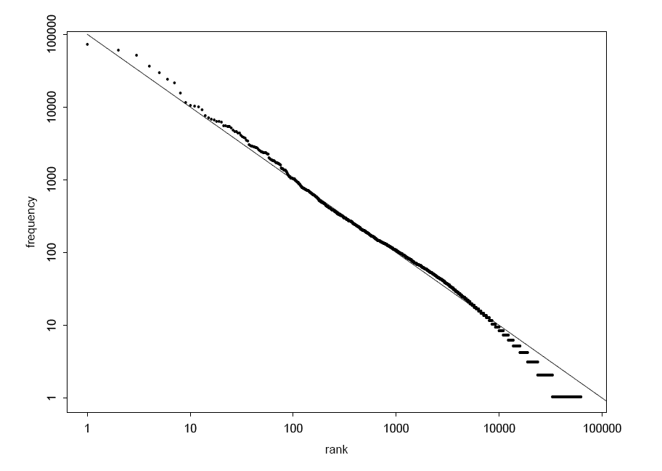
Zipf’s Law
Graph illustrating Zipf’s Law for the Brown corpus
from Manning and Shütze

Slide 48
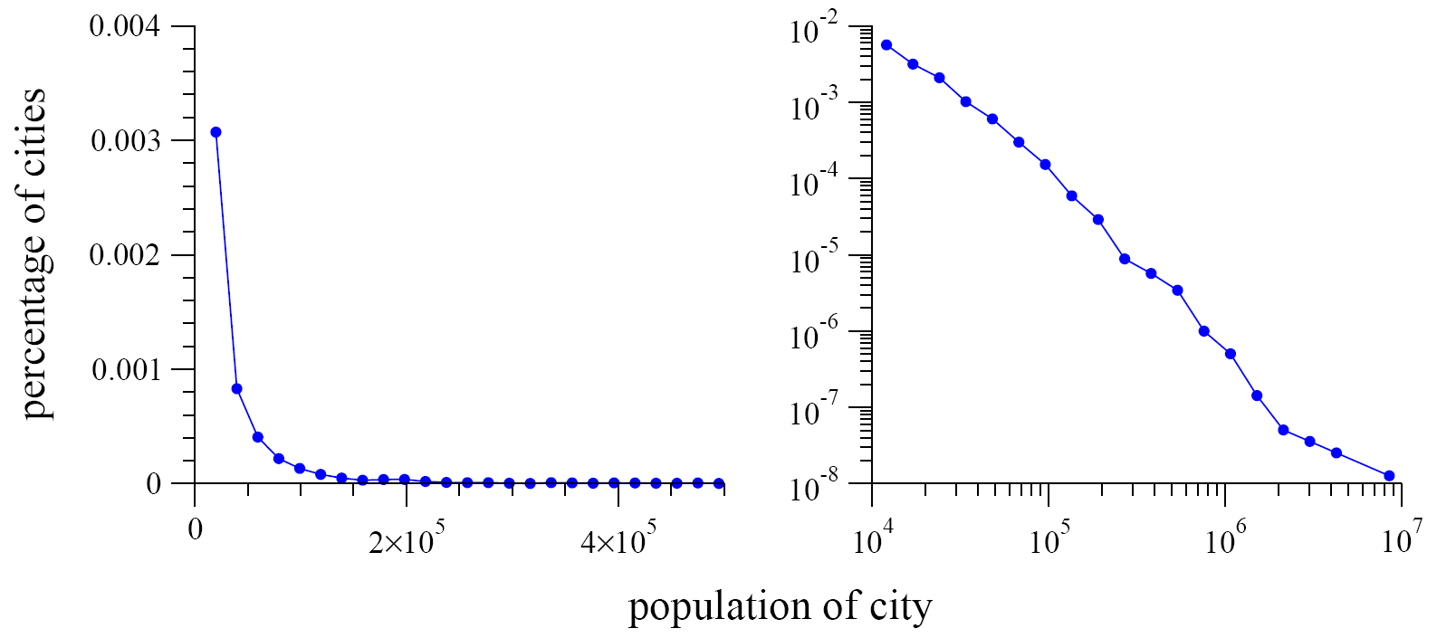
Power Law Distributions: Population
Distribution US cities with population greater than 10,000. Data from 2000 Census.
These and following figures from: Newman, M. E. J. (2005) “Power laws, Pareto distributions and Zipf's law.” Contemporary Physics 46:323–351.

Slide 49
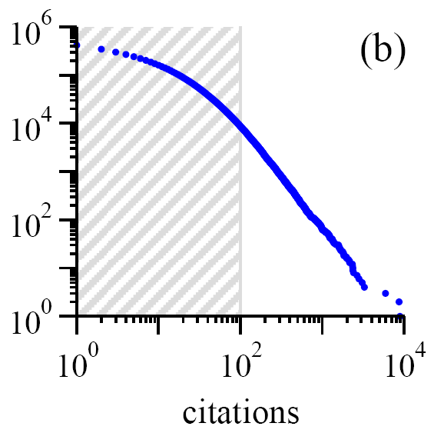
Power Law Distributions: Citations
Numbers of citations to scientific papers published in 1981, from time of publication until June 1997

Slide 50
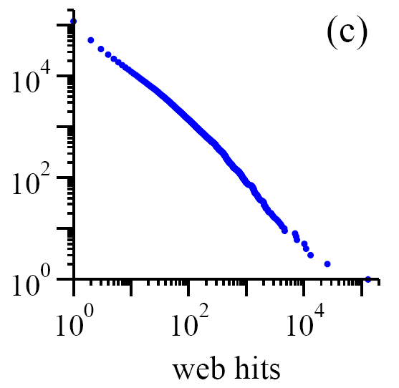
Power Law Distributions: Web Hits
Numbers of hits on web sites by 60,000 users of the AOL, 12/1/1997

Slide 51
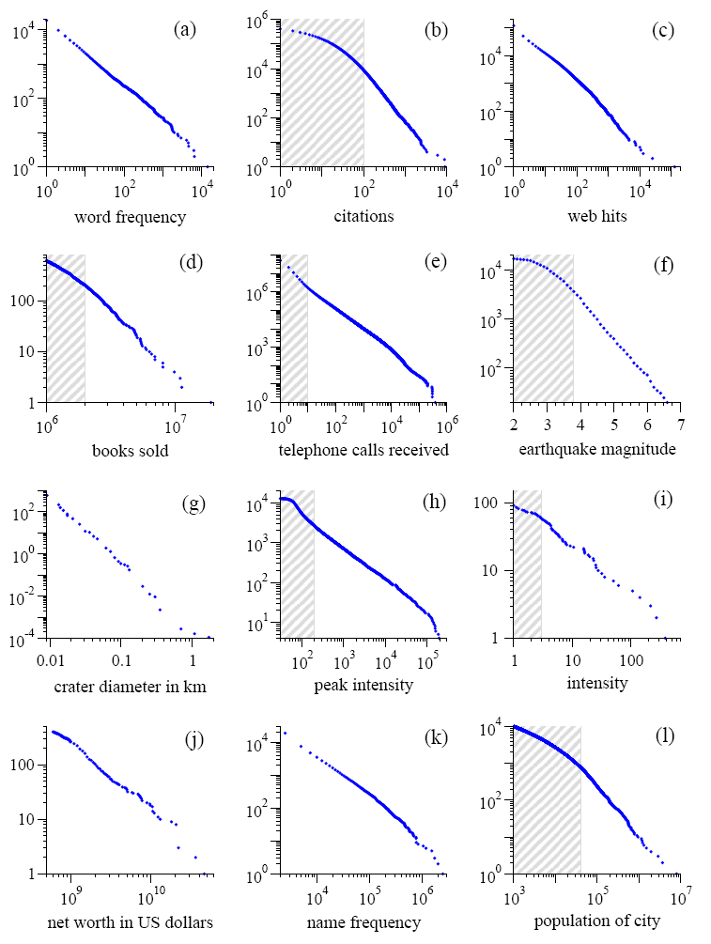
More Power Law Distributions!

Slide 52
What else can we do by counting?

Slide 53
Raw Bigram collocations
Frequency | Word 1 | Word 2
80871 | of | the
58841 | in | the
26430 | to | the
21842 | on | the
21839 | for | the
18568 | and | the
16121 | that | the
15630 | at | the
15494 | to | be
13899 | in | a
13689 | of | a
13361 | by | the
13183 | with | the
12622 | from | the
11428 | New | York
Most frequent bigrams collocations in the New York Times, from Manning and Shütze

Slide 54
Filtered Bigram Collocations
Frequency | Word 1 | Word 2 | POS
11487 | New | York | A N
7261 | United | States | A N
5412 | Los | Angeles | N N
3301 | last | year | A N
3191 | Saudi | Arabia | N N
2699 | last | week | A N
2514 | vice | president | A N
2378 | Persian | Gulf | A N
2161 | San | Francisco | N N
2106 | President | Bush | N N
2001 | Middle | East | A N
1942 | Saddam | Hussein | N N
1867 | Soviet | Union | A N
1850 | White | House | A N
1633 | United | Nations | A N
Most frequent bigrams collocations in the New York Times filtered by part of speech, from Manning and Shütze

Slide 55
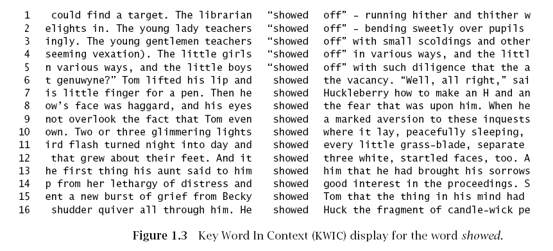
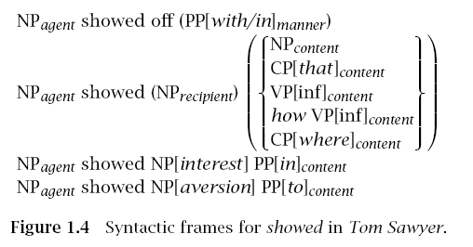
Learning verb “frames”
from Manning and Shütze

Slide 56
How is this different?
No need to think of examples, exceptions, etc.
Generalizations are guided by prevalence of phenomena
Resulting systems better capture real language use

Slide 57
Three Pillars of Statistical NLP
Corpora
Representations
Models and algorithms

Slide 58
Aye, but there’s the rub…
What if there’s no corpus available for your application?
What if the necessary annotations are not present?
What if your system is applied to text different from the text on which it’s trained?

Slide 59
Key Points
Different “layers” of NLP: morphology, syntax, semantics
Ambiguity makes NLP difficult
Rationalist vs. Empiricist approaches

