Slide 1

Word Sense Disambiguation
CMSC 723: Computational Linguistics I ― Session #11
Jimmy Lin
The iSchool
University of Maryland
Wednesday, November 11, 2009
Material drawn from slides by Saif Mohammad and Bonnie Dorr

Slide 2
Progression of the Course
Words
Finite-state morphology
Part-of-speech tagging (TBL + HMM)
Structure
CFGs + parsing (CKY, Earley)
N-gram language models
Meaning!

Slide 3
Today’s Agenda
Word sense disambiguation
Beyond lexical semantics
Semantic attachments to syntax
Shallow semantics: PropBank

Slide 4
Word Sense Disambiguation

Slide 5
Recap: Word Sense
From WordNet:
Noun
{pipe, tobacco pipe} (a tube with a small bowl at one end; used for smoking tobacco)
{pipe, pipage, piping} (a long tube made of metal or plastic that is used to carry water or oil or gas etc.)
{pipe, tube} (a hollow cylindrical shape)
{pipe} (a tubular wind instrument)
{organ pipe, pipe, pipework} (the flues and stops on a pipe organ)
Verb
{shriek, shrill, pipe up, pipe} (utter a shrill cry)
{pipe} (transport by pipeline) “pipe oil, water, and gas into the desert”
{pipe} (play on a pipe) “pipe a tune”
{pipe} (trim with piping) “pipe the skirt”

Slide 6
Word Sense Disambiguation
Task: automatically select the correct sense of a word
Lexical sample
All-words
Theoretically useful for many applications:
Semantic similarity (remember from last time?)
Information retrieval
Machine translation
…
Solution in search of a problem? Why?

Slide 7
How big is the problem?
Most words in English have only one sense
62% in Longman’s Dictionary of Contemporary English
79% in WordNet
But the others tend to have several senses
Average of 3.83 in LDOCE
Average of 2.96 in WordNet
Ambiguous words are more frequently used
In the British National Corpus, 84% of instances have more than one sense
Some senses are more frequent than others

Slide 8
Ground Truth
Which sense inventory do we use?
Issues there?
Application specificity?

Slide 9
Corpora
Lexical sample
line-hard-serve corpus (4k sense-tagged examples)
interest corpus (2,369 sense-tagged examples)
…
All-words
SemCor (234k words, subset of Brown Corpus)
Senseval-3 (2081 tagged content words from 5k total words)
…
Observations about the size?

Slide 10
Evaluation
Intrinsic
Measure accuracy of sense selection wrt ground truth
Extrinsic
Integrate WSD as part of a bigger end-to-end system, e.g., machine translation or information retrieval
Compare ±WSD

Slide 11
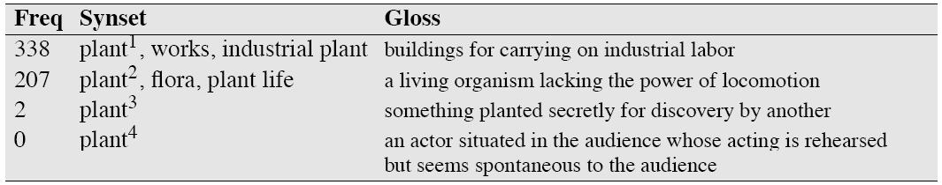
Baseline + Upper Bound
Baseline: most frequent sense
Equivalent to “take first sense” in WordNet
Does surprisingly well!
Upper bound:
Fine-grained WordNet sense: 75-80% human agreement
Coarser-grained inventories: 90% human agreement possible
What does this mean?
62% accuracy in this case!

Slide 12
WSD Approaches
Depending on use of manually created knowledge sources
Knowledge-lean
Knowledge-rich
Depending on use of labeled data
Supervised
Semi- or minimally supervised
Unsupervised

Slide 13
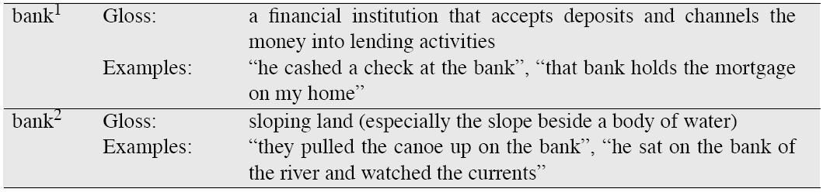
Lesk’s Algorithm
Intuition: note word overlap between context and dictionary entries
Unsupervised, but knowledge rich
The bank can guarantee deposits will eventually cover future tuition costs because it invests in adjustable-rate mortgage securities.
WordNet

Slide 14
Lesk’s Algorithm
Simplest implementation:
Count overlapping content words between glosses and context
Lots of variants:
Include the examples in dictionary definitions
Include hypernyms and hyponyms
Give more weight to larger overlaps (e.g., bigrams)
Give extra weight to infrequent words (e.g., idf weighting)
…
Works reasonably well!

Slide 15
Supervised WSD: NLP meets ML
WSD as a supervised classification task
Train a separate classifier for each word
Three components of a machine learning problem:
Training data (corpora)
Representations (features)
Learning method (algorithm, model)

Slide 16
Supervised Classification
Training
Testing
training data
unlabeled
document
?
label₁
label₂
label₃
label₄
Representation Function
label₁?
Classifier
label₂?
supervised machine
learning algorithm
label₃?
label₄?

Slide 17
Three Laws of Machine Learning
Thou shalt not mingle training data with test data
Thou shalt not mingle training data with test data
Thou shalt not mingle training data with test data
But what do you do if you need more test data?

Slide 18
Features
Possible features
POS and surface form of the word itself
Surrounding words and POS tag
Positional information of surrounding words and POS tags
Same as above, but with n-grams
Grammatical information
…
Richness of the features?
Richer features = ML algorithm does less of the work
More impoverished features = ML algorithm does more of the work

Slide 19
Classifiers
Once we cast the WSD problem as supervised classification, many learning techniques are possible:
Naïve Bayes (the thing to try first)
Decision lists
Decision trees
MaxEnt
Support vector machines
Nearest neighbor methods
…

Slide 20
Classifiers Tradeoffs
Which classifier should I use?
It depends:
Number of features
Types of features
Number of possible values for a feature
Noise
…
General advice:
Start with Naïve Bayes
Use decision trees/lists if you want to understand what the classifier is doing
SVMs often give state of the art performance
MaxEnt methods also work well

Slide 21
Naïve Bayes
Pick the sense that is most probable given the context
Context represented by feature vector
By Bayes’ Theorem:
Problem: data sparsity!
We can ignore this term… why?

Slide 22
The “Naïve” Part
Feature vectors are too sparse to estimate directly:
So… assume features are conditionally independent given the word sense
This is naïve because?
Putting everything together:

Slide 23
Naïve Bayes: Training
How do we estimate the probability distributions?
Maximum-Likelihood Estimates (MLE):
What else do we need to do?
Well, how well does it work?
(later…)

Slide 24
Decision List
Ordered list of tests (equivalent to “case” statement):
Example decision list, discriminating between bass (fish) and bass (music) :

Slide 25
Building Decision Lists
Simple algorithm:
Compute how discriminative each feature is:
Create ordered list of tests from these values
Limitation?
How do you build n-way classifiers from binary classifiers?
One vs. rest (sequential vs. parallel)
Another learning problem
Well, how well does it work?
(later…)

Slide 26
Decision Trees
Instead of a list, imagine a tree…
fish in ±k words
yes
no
FISH
striped bass
yes
no
FISH
guitar in ±k words
yes
no
MUSIC
…

Slide 27
Using Decision Trees
Given an instance (= list of feature values)
Start at the root
At each interior node, check feature value
Follow corresponding branch based on the test
When a leaf node is reached, return its category
Decision tree material drawn from slides by Ed Loper

Slide 28
Building Decision Trees
Basic idea: build tree top down, recursively partitioning the training data at each step
At each node, try to split the training data on a feature (could be binary or otherwise)
What features should we split on?
Small decision tree desired
Pick the feature that gives the most information about the category
Example: 20 questions
I’m thinking of a number from 1 to 1,000
You can ask any yes no question
What question would you ask?

Slide 29
Evaluating Splits via Entropy
Entropy of a set of events E:
Where P(c) is the probability that an event in E has category c
How much information does a feature give us about the category (sense)?
H(E) = entropy of event set E
H(E|f) = expected entropy of event set E once we know the value of feature f
Information Gain: G(E, f) = H(E) – H(E|f) = amount of new information provided by feature f
Split on feature that maximizes information gain
Well, how well does it work?
(later…)

Slide 30
WSD Accuracy
Generally:
Naïve Bayes provides a reasonable baseline: ~70%
Decision lists and decision trees slightly lower
State of the art is slightly higher
However:
Accuracy depends on actual word, sense inventory, amount of training data, number of features, etc.
Remember caveat about baseline and upper bound

Slide 31
Minimally Supervised WSD
But annotations are expensive!
“Bootstrapping” or co-training (Yarowsky 1995)
Start with (small) seed, learn decision list
Use decision list to label rest of corpus
Retain “confident” labels, treat as annotated data to learn new decision list
Repeat…
Heuristics (derived from observation):
One sense per discourse
One sense per collocation

Slide 32
One Sense per Discourse
A word tends to preserve its meaning across all its occurrences in a given discourse
Evaluation:
8 words with two-way ambiguity, e.g. plant, crane, etc.
98% of the two-word occurrences in the same discourse carry the same meaning
The grain of salt: accuracy depends on granularity
Performance of “one sense per discourse” measured on SemCor is approximately 70%
Slide by Mihalcea and Pedersen

Slide 33
One Sense per Collocation
A word tends to preserve its meaning when used in the same collocation
Strong for adjacent collocations
Weaker as the distance between words increases
Evaluation:
97% precision on words with two-way ambiguity
Again, accuracy depends on granularity:
70% precision on SemCor words
Slide by Mihalcea and Pedersen

Slide 34
Yarowsky’s Method: Example
Disambiguating plant (industrial sense) vs. plant (living thing sense)
Think of seed features for each sense
Industrial sense: co-occurring with “manufacturing”
Living thing sense: co-occurring with “life”
Use “one sense per collocation” to build initial decision list classifier
Treat results as annotated data, train new decision list classifier, iterate…

Slide 36
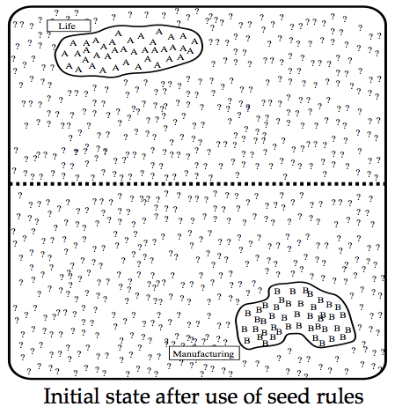

Slide 37
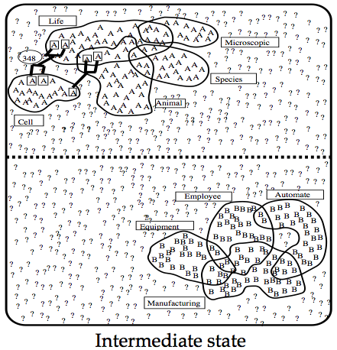

Slide 38
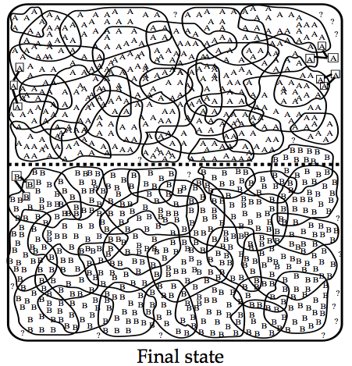

Slide 39
Yarowsky’s Method: Stopping
Stop when:
Error on training data is less than a threshold
No more training data is covered
Use final decision list for WSD

Slide 40
Yarowsky’s Method: Discussion
Advantages:
Accuracy is about as good as a supervised algorithm
Bootstrapping: far less manual effort
Disadvantages:
Seeds may be tricky to construct
Works only for coarse-grained sense distinctions
Snowballing error with co-training
Recent extension: now apply this to the web!

Slide 41
WSD with Parallel Text
But annotations are expensive!
What’s the “proper” sense inventory?
How fine or coarse grained?
Application specific?
Observation: multiple senses translate to different words in other languages!
A “bill” in English may be a “pico” (bird jaw) in or a “cuenta” (invoice) in Spanish
Use the foreign language as the sense inventory!
Added bonus: annotations for free! (Byproduct of word-alignment process in machine translation)

Slide 42
Beyond Lexical Semantics

Slide 43
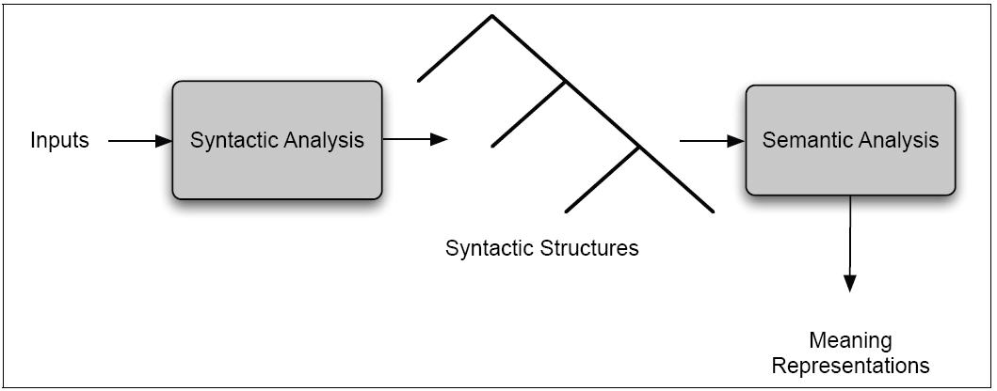
Syntax-Semantics Pipeline
Example: FOPL

Slide 44
Semantic Attachments
Basic idea:
Associate λ-expressions with lexical items
At branching node, apply semantics of one child to another (based on synctatic rule)
Refresher in λ-calculus…

Slide 45
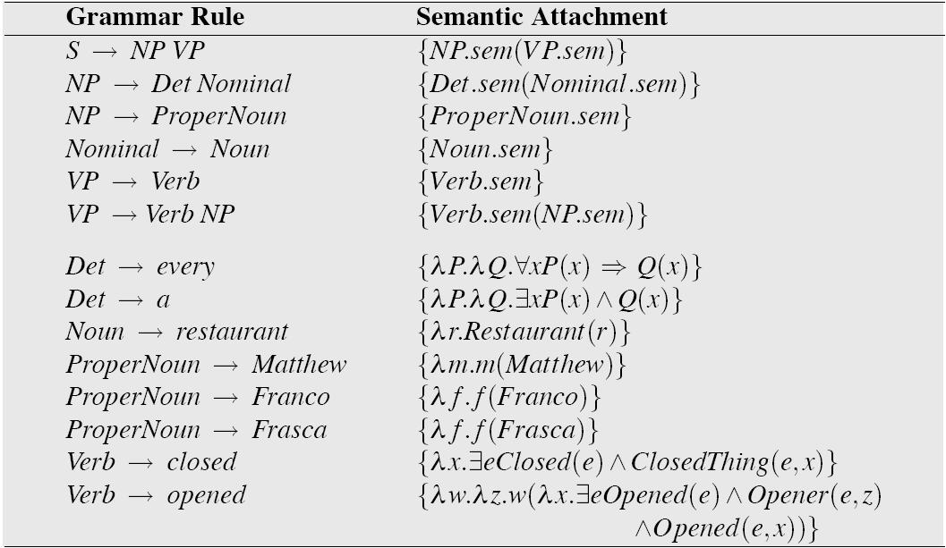
Augmenting Syntactic Rules

Slide 46
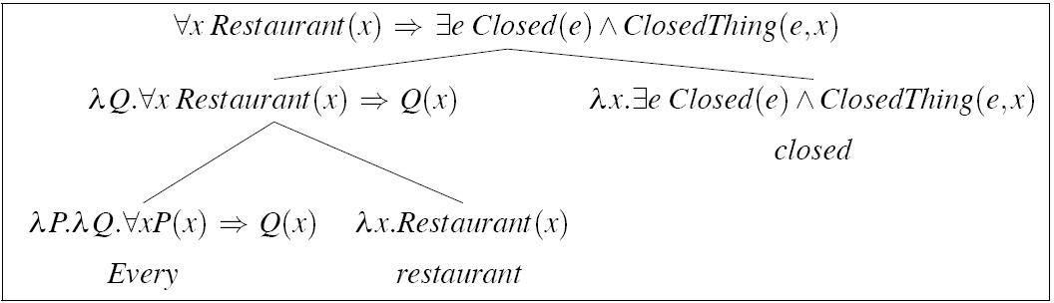
Semantic Analysis: Example

Slide 47
Complexities
Oh, there are many…
Classic problem: quantifier scoping
Every restaurant has a menu
Issues with this style of semantic analysis?

Slide 48
Semantics in NLP Today
Can be characterized as “shallow semantics”
Verbs denote events
Represent as “frames”
Nouns (in general) participate in events
Types of event participants = “slots” or “roles”
Event participants themselves = “slot fillers”
Depending on the linguistic theory, roles may have special names: agent, theme, etc.
Semantic analysis: semantic role labeling
Automatically identify the event type (i.e., frame)
Automatically identify event participants and the role that each plays (i.e., label the semantic role)

Slide 49
What works in NLP?
POS-annotated corpora
Tree-annotated corpora: Penn Treebank
Role-annotated corpora: Proposition Bank (PropBank)

Slide 50
PropBank: Two Examples
agree.01
Arg0: Agreer
Arg1: Proposition
Arg2: Other entity agreeing
Example: [_{Arg0} John] agrees [_{Arg2} with Mary] [_{Arg1} on everything]
fall.01
Arg1: Logical subject, patient, thing falling
Arg2: Extent, amount fallen
Arg3: Start point
Arg4: End point
Example: [_{Arg1} Sales] fell [_{Arg4} to $251.2 million] [_{Arg3} from $278.7 million]

Slide 51
How do we do it?
Short answer: supervised machine learning
One approach: classification of each tree constituent
Features can be words, phrase type, linear position, tree position, etc.
Apply standard machine learning algorithms

Slide 52
Recap of Today’s Topics
Word sense disambiguation
Beyond lexical semantics
Semantic attachments to syntax
Shallow semantics: PropBank

Slide 53
The Complete Picture
Phonology
Morphology
Syntax
Semantics
Reasoning
Speech Recognition
Morphological Analysis
Parsing
Semantic Analysis
Reasoning, Planning
Speech Synthesis
Morphological Realization
Syntactic Realization
Utterance Planning

Slide 54
The Home Stretch
Next week: MapReduce and large-data processing
No classes Thanksgiving week!
December: two guest lectures by Ken Church

