Slide 1

MapReduce and Data Intensive NLP
CMSC 723: Computational Linguistics I ― Session #12
Jimmy Lin and Nitin Madnani
University of Maryland
Wednesday, November 18, 2009

Slide 2
Three Pillars of Statistical NLP
Algorithms and models
Features
Data

Slide 3
Why big data?
Fundamental fact of the real world
Systems improve with more data

Slide 4

How much data?
Google processes 20 PB a day (2008)
Wayback Machine has 3 PB + 100 TB/month (3/2009)
Facebook has 2.5 PB of user data + 15 TB/day (4/2009)
eBay has 6.5 PB of user data + 50 TB/day (5/2009)
CERN’s LHC will generate 15 PB a year (??)
640K ought to be enough for anybody.

Slide 5
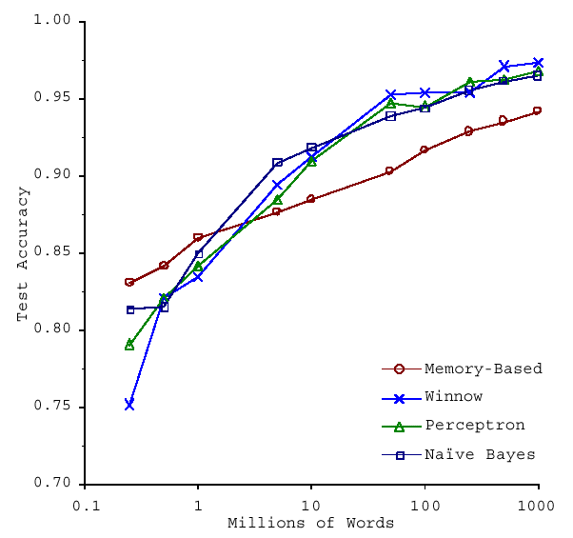
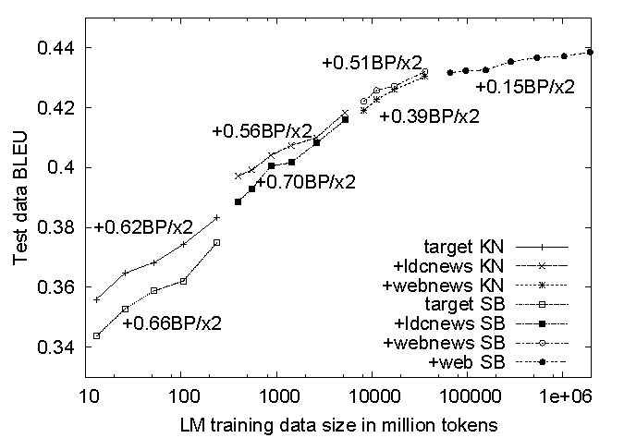
No data like more data!
s/knowledge/data/g;
How do we get here if we’re not Google?
(Banko and Brill, ACL 2001)
(Brants et al., EMNLP 2007)

Slide 6
How do we scale up?

Slide 7
Divide and Conquer
“Work”
Partition
w₁
w₂
w₃
“worker”
“worker”
“worker”
r₁
r₂
r₃
Combine
“Result”

Slide 8
It’s a bit more complex…
Fundamental issues
scheduling, data distribution, synchronization, inter-process communication, robustness, fault tolerance, …
Different programming models
Message Passing
Shared Memory
Memory
P₁
P₂
P₃
P₄
P₅
P₁
P₂
P₃
P₄
P₅
Architectural issues
Flynn’s taxonomy (SIMD, MIMD, etc.), network typology, bisection bandwidth UMA vs. NUMA, cache coherence
Different programming constructs
mutexes, conditional variables, barriers, …
masters/slaves, producers/consumers, work queues, …
Common problems
livelock, deadlock, data starvation, priority inversion…
dining philosophers, sleeping barbers, cigarette smokers, …
The reality: programmer shoulders the burden of managing concurrency…

Slide 9
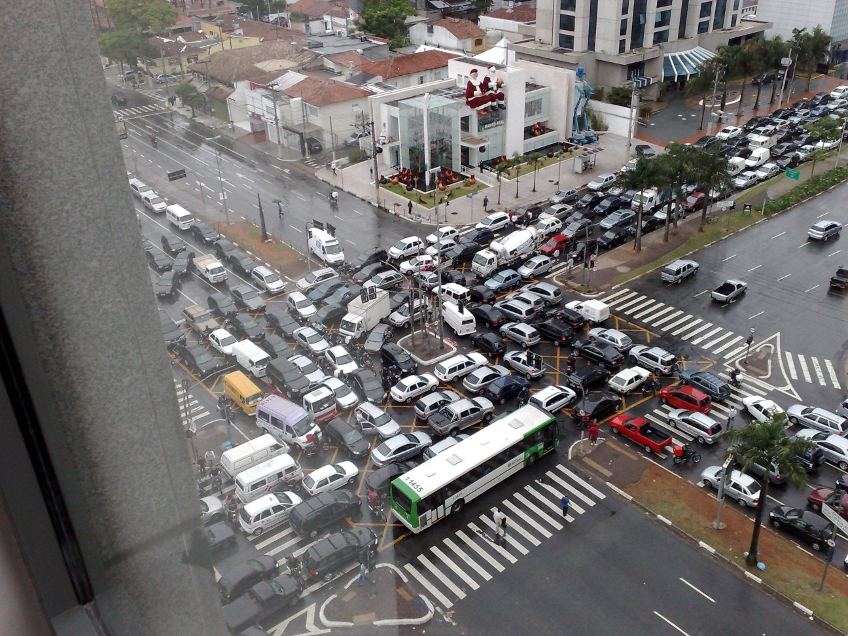
Source: Ricardo Guimarães Herrmann

Slide 10
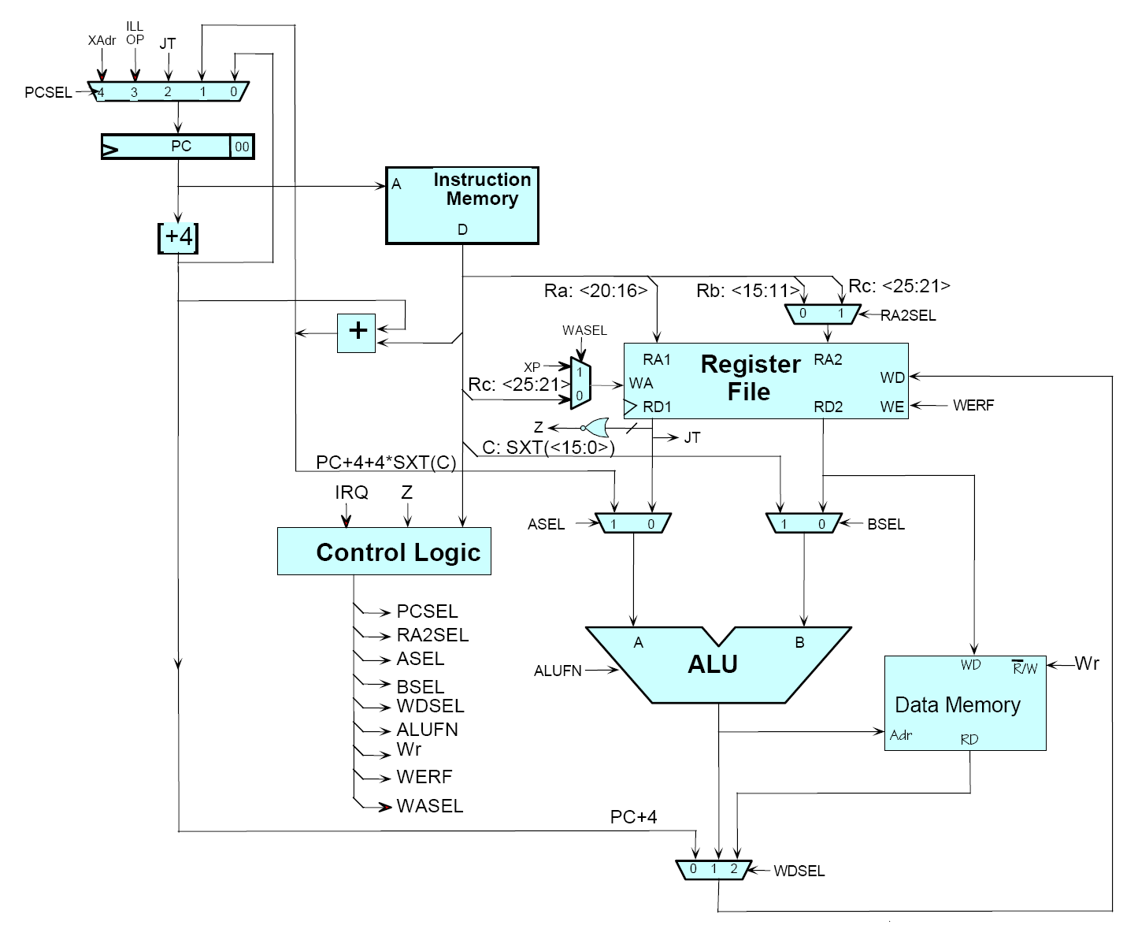
Source: MIT Open Courseware

Slide 11

Source: MIT Open Courseware

Slide 12
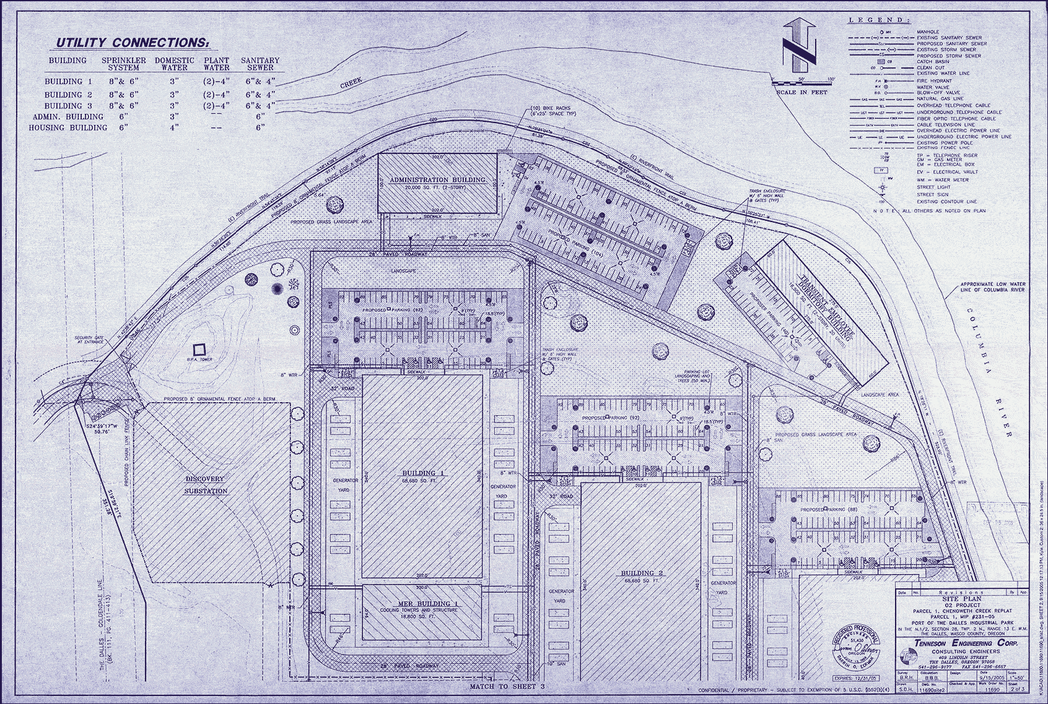
Source: Harper’s (Feb, 2008)

Slide 13
MapReduce

Slide 14
Typical Large-Data Problem
Iterate over a large number of records
Extract something of interest from each
Shuffle and sort intermediate results
Aggregate intermediate results
Generate final output
Map
Reduce
Key idea: provide a functional abstraction for these two operations
(Dean and Ghemawat, OSDI 2004)

Slide 15
Roots in Functional Programming
Map
f
f
f
f
f
Fold
g
g
g
g
g

Slide 16
MapReduce
Programmers specify two functions:
map (k, v) → <k’, v’>*
reduce (k’, v’) → <k’, v’>*
All values with the same key are reduced together
The execution framework handles everything else…

Slide 17
k₁
v₁
k₂
v₂
k₃
v₃
k₄
v₄
k₅
v₅
k₆
v₆
map
map
map
map
a
1
b
2
c
3
c
6
a
5
c
2
b
7
c
8
Shuffle and Sort: aggregate values by keys
a
1
5
b
2
7
c
2
3
6
8
reduce
reduce
reduce
r₁
s₁
r₂
s₂
r₃
s₃

Slide 18
MapReduce
Programmers specify two functions:
map (k, v) → <k’, v’>*
reduce (k’, v’) → <k’, v’>*
All values with the same key are reduced together
The execution framework handles everything else…
Not quite…usually, programmers also specify:
partition (k’, number of partitions) → partition for k’
Often a simple hash of the key, e.g., hash(k’) mod n
Divides up key space for parallel reduce operations
combine (k’, v’) → <k’, v’>*
Mini-reducers that run in memory after the map phase
Used as an optimization to reduce network traffic

Slide 19
k₁
v₁
k₂
v₂
k₃
v₃
k₄
v₄
k₅
v₅
k₆
v₆
map
map
map
map
a
1
b
2
c
3
c
6
a
5
c
2
b
7
c
8
combine
combine
combine
combine
a
1
b
2
c
9
a
5
c
2
b
7
c
8
partition
partition
partition
partition
Shuffle and Sort: aggregate values by keys
a
1
5
b
2
7
c
2
3
6
8
reduce
reduce
reduce
r₁
s₁
r₂
s₂
r₃
s₃

Slide 20
MapReduce “Runtime”
Handles scheduling
Assigns workers to map and reduce tasks
Handles “data distribution”
Moves processes to data
Handles synchronization
Gathers, sorts, and shuffles intermediate data
Handles errors and faults
Detects worker failures and restarts
Everything happens on top of a distributed FS (later)

Slide 21
“Hello World”: Word Count
Map(String docid, String text):
for each word w in text:
Emit(w, 1);
Reduce(String term, Iterator<Int> values):
int sum = 0;
for each v in values:
sum += v;
Emit(term, value);

Slide 22
MapReduce can refer to…
The programming model
The execution framework (aka “runtime”)
The specific implementation
Usage is usually clear from context!

Slide 23
MapReduce Implementations
Google has a proprietary implementation in C++
Bindings in Java, Python
Hadoop is an open-source implementation in Java
Project led by Yahoo, used in production
Rapidly expanding software ecosystem
Lots of custom research implementations
For GPUs, cell processors, etc.

Slide 24
User Program
(1) fork
(1) fork
(1) fork
Master
(2) assign map
(2) assign reduce
worker
split 0
(6) write
output
file 0
split 1
(3) read
(5) remote read
worker
split 2
(4) local write
split 3
worker
split 4
worker
output
file 1
worker
Input
files
Map
phase
Intermediate files
(on local disk)
Reduce
phase
Output
files
Redrawn from (Dean and Ghemawat, OSDI 2004)

Slide 25

How do we get data to the workers?
NAS
SAN
Compute Nodes
What’s the problem here?

Slide 26
Distributed File System
Don’t move data to workers… move workers to the data!
Store data on the local disks of nodes in the cluster
Start up the workers on the node that has the data local
Why?
Not enough RAM to hold all the data in memory
Disk access is slow, but disk throughput is reasonable
A distributed file system is the answer
GFS (Google File System)
HDFS for Hadoop (= GFS clone)

Slide 27
GFS: Assumptions
Commodity hardware over “exotic” hardware
Scale out, not up
High component failure rates
Inexpensive commodity components fail all the time
“Modest” number of huge files
Files are write-once, mostly appended to
Perhaps concurrently
Large streaming reads over random access
High sustained throughput over low latency
GFS slides adapted from material by (Ghemawat et al., SOSP 2003)

Slide 28
GFS: Design Decisions
Files stored as chunks
Fixed size (64MB)
Reliability through replication
Each chunk replicated across 3+ chunkservers
Single master to coordinate access, keep metadata
Simple centralized management
No data caching
Little benefit due to large datasets, streaming reads
Simplify the API
Push some of the issues onto the client
HDFS = GFS clone (same basic ideas)

Slide 29
HDFS Architecture
HDFS namenode
Application
/foo/bar
(file name, block id)
File namespace
HDFS Client
block 3df2
(block id, block location)
instructions to datanode
(block id, byte range)
datanode state
HDFS datanode
HDFS datanode
block data
Linux file system
Linux file system
…
…
Adapted from (Ghemawat et al., SOSP 2003)

Slide 30
Master’s Responsibilities
Metadata storage
Namespace management/locking
Periodic communication with the datanodes
Chunk creation, re-replication, rebalancing
Garbage collection

Slide 31
MapReduce Algorithm Design

Slide 32
Managing Dependencies
Remember: Mappers run in isolation
You have no idea in what order the mappers run
You have no idea on what node the mappers run
You have no idea when each mapper finishes
Tools for synchronization:
Ability to hold state in reducer across multiple key-value pairs
Sorting function for keys
Partitioner
Cleverly-constructed data structures
Slides in this section adapted from work reported in (Lin, EMNLP 2008)

Slide 33
Motivating Example
Term co-occurrence matrix for a text collection
M = N x N matrix (N = vocabulary size)
M_{ij}: number of times i and j co-occur in some context (for concreteness, let’s say context = sentence)
Why?
Distributional profiles as a way of measuring semantic distance
Semantic distance useful for many language processing tasks

Slide 34
MapReduce: Large Counting Problems
Term co-occurrence matrix for a text collection = specific instance of a large counting problem
A large event space (number of terms)
A large number of observations (the collection itself)
Goal: keep track of interesting statistics about the events
Basic approach
Mappers generate partial counts
Reducers aggregate partial counts
How do we aggregate partial counts efficiently?

Slide 35
First Try: “Pairs”
Each mapper takes a sentence:
Generate all co-occurring term pairs
For all pairs, emit (a, b) → count
Reducers sums up counts associated with these pairs
Use combiners!

Slide 36
“Pairs” Analysis
Advantages
Easy to implement, easy to understand
Disadvantages
Lots of pairs to sort and shuffle around (upper bound?)

Slide 37
Another Try: “Stripes”
Idea: group together pairs into an associative array
Each mapper takes a sentence:
Generate all co-occurring term pairs
For each term, emit a → { b: count_{b}, c: count_{c}, d: count_{d} … }
Reducers perform element-wise sum of associative arrays
(a, b) → 1
(a, c) → 2
(a, d) → 5
(a, e) → 3
(a, f) → 2
a → { b: 1, c: 2, d: 5, e: 3, f: 2 }
a → { b: 1, d: 5, e: 3 }
a → { b: 1, c: 2, d: 2, f: 2 }
a → { b: 2, c: 2, d: 7, e: 3, f: 2 }
+

Slide 38
“Stripes” Analysis
Advantages
Far less sorting and shuffling of key-value pairs
Can make better use of combiners
Disadvantages
More difficult to implement
Underlying object is more heavyweight
Fundamental limitation in terms of size of event space

Slide 39
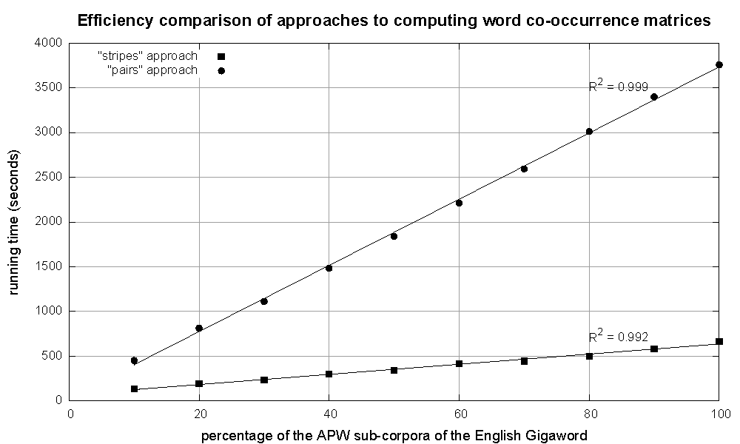
Cluster size: 38 cores
Data Source: Associated Press Worldstream (APW) of the English Gigaword Corpus (v3), which contains 2.27 million documents (1.8 GB compressed, 5.7 GB uncompressed)

Slide 40
Conditional Probabilities
How do we estimate conditional probabilities from counts?
Why do we want to do this?
How do we do this with MapReduce?

Slide 41
P(B|A): “Stripes”
Easy!
One pass to compute (a, *)
Another pass to directly compute P(B|A)
a → {b₁:3, b₂ :12, b₃ :7, b₄ :1, … }

Slide 42
P(B|A): “Pairs”
For this to work:
Must emit extra (a, *) for every b_{n} in mapper
Must make sure all a’s get sent to same reducer (use partitioner)
Must make sure (a, *) comes first (define sort order)
Must hold state in reducer across different key-value pairs
(a, *) → 32
Reducer holds this value in memory
(a, b₁) → 3
(a, b₂) → 12
(a, b₃) → 7
(a, b₄) → 1
…
(a, b₁) → 3 / 32
(a, b₂) → 12 / 32
(a, b₃) → 7 / 32
(a, b₄) → 1 / 32
…

Slide 43
Synchronization in Hadoop
Approach 1: turn synchronization into an ordering problem
Sort keys into correct order of computation
Partition key space so that each reducer gets the appropriate set of partial results
Hold state in reducer across multiple key-value pairs to perform computation
Illustrated by the “pairs” approach
Approach 2: construct data structures that “bring the pieces together”
Each reducer receives all the data it needs to complete the computation
Illustrated by the “stripes” approach

Slide 44
Issues and Tradeoffs
Number of key-value pairs
Object creation overhead
Time for sorting and shuffling pairs across the network
Size of each key-value pair
De/serialization overhead
Combiners make a big difference!
RAM vs. disk vs. network
Arrange data to maximize opportunities to aggregate partial results

Slide 45
Case Study: LMs with MR

Slide 46
Language Modeling Recap
Interpolation: Consult all models at the same time to compute an interpolated probability estimate.
Backoff: Consult the highest order model first and backoff to lower order model only if there are no higher order counts.
Interpolated Kneser Ney (state-of-the-art)
Use absolute discounting to save some probability mass for lower order models.
Use a novel form of lower order models (count unique single word contexts instead of occurrences)
Combine models into a true probability model using interpolation

Slide 47
Questions for today
Can we efficiently train an IKN LM with terabytes of data?
Does it really matter?

Slide 48
Using MapReduce to Train IKN
Step 0: Count words [MR]
Step 0.5: Assign IDs to words [vocabulary generation] (more frequent → smaller IDs)
Step 1: Compute n-gram counts [MR]
Step 2: Compute lower order context counts [MR]
Step 3: Compute unsmoothed probabilities and interpolation weights [MR]
Step 4: Compute interpolated probabilities [MR]
[MR] = MapReduce job

Slide 49
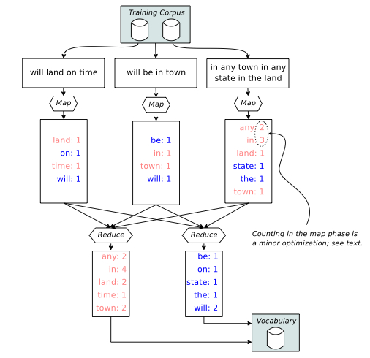
Steps 0 & 0.5
Step 0
Step 0.5

Slide 50
Steps 1-4
 | Step 1 | Step 2 | Step 3 | Step 4
Input Key | DocID | n-grams “a b c” | “a b c” | “a b”
Input Value | Document | C_{total}(“a b c”) | C_{KN}(“a b c”) | _Step 3 Output_
Intermediate Key | n-grams “a b c” | “a b c” | “a b” (history) | “c b a”
Intermediate Value | C_{doc}(“a b c”) | C’_{KN}(“a b c”) | (“c”, C_{KN}(“a b c”)) | (P’(“a b c”), λ(“a b”))
Partitioning | “a b c” | “a b c” | “a b” | “c b”
Output Value | C_{total}(“a b c”) | C_{KN}(“a b c”) | (“c”, P’(“a b c”), λ(“a b”)) | (P_{KN}(“a b c”), λ(“a b”))
Mapper Input
Mapper Output
Reducer Input
Reducer
Output
Count
n-grams
Count
contexts
Compute unsmoothed probs AND interp. weights
Compute
Interp. probs
All output keys are always the same as the intermediate keys
I only show trigrams here but the steps operate on bigrams and unigrams as well

Slide 51
Steps 1-4
 | Step 1 | Step 2 | Step 3 | Step 4
Input Key | DocID | n-grams “a b c” | “a b c” | “a b”
Input Value | Document | C_{total}(“a b c”) | C_{KN}(“a b c”) | _Step 3 Output_
Intermediate Key | n-grams “a b c” | “a b c” | “a b” (history) | “c b a”
Intermediate Value | C_{doc}(“a b c”) | C’_{KN}(“a b c”) | (“c”, C_{KN}(“a b c”)) | (P’(“a b c”), λ(“a b”))
Partitioning | “a b c” | “a b c” | “a b” | “c b”
Output Value | C_{total}(“a b c”) | C_{KN}(“a b c”) | (“c”, P’(“a b c”), λ(“a b”)) | (P_{KN}(“a b c”), λ(“a b”))
Mapper Input
Details are not important!
5 MR jobs to train IKN (expensive)!
IKN LMs are big!
(interpolation weights are context dependent)
Can we do something that has better
behavior at scale in terms of time and space?
Mapper Output
Reducer Input
Reducer
Output
Count
n-grams
Count
contexts
Compute unsmoothed probs AND interp. weights
Compute
Interp. probs
All output keys are always the same as the intermediate keys
I only show trigrams here but the steps operate on bigrams and unigrams as well

Slide 52
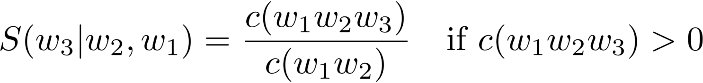
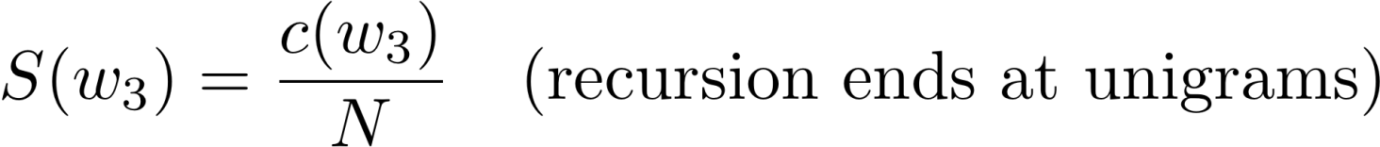
Let’s try something stupid!
Simplify backoff as much as possible!
Forget about trying to make the LM be a true probability distribution!
Don’t do any discounting of higher order models!
Have a single backoff weight independent of context! [α(•) = α]
“Stupid Backoff (SB)”

Slide 53
Using MapReduce to Train SB
Step 0: Count words [MR]
Step 0.5: Assign IDs to words [vocabulary generation] (more frequent → smaller IDs)
Step 1: Compute n-gram counts [MR]
Step 2: Generate final LM “scores” [MR]
[MR] = MapReduce job

Slide 54
Steps 0 & 0.5
Step 0
Step 0.5

Slide 55
Steps 1 & 2
 | Step 1 | Step 2
Input Key | DocID | n-grams “a b c”
Input Value | Document | C_{total}(“a b c”)
Intermediate Key | n-grams “a b c” | “a b c”
Intermediate Value | C_{doc}(“a b c”) | S(“a b c”)
Partitioning | first two words “a b” | last two words “b c”
Output Value | C_{total}(“a b c”) | S(“a b c”) [write to disk]
Mapper Input
Mapper Output
Reducer Input
Reducer
Output
Count
n-grams
Compute
LM scores
The clever partitioning in Step 2 is the key to efficient use at runtime!

Slide 56
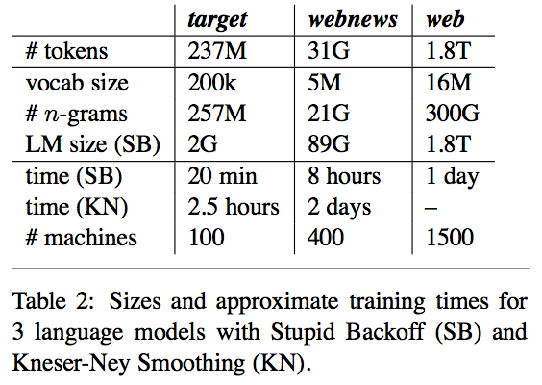
Which one wins?

Slide 57
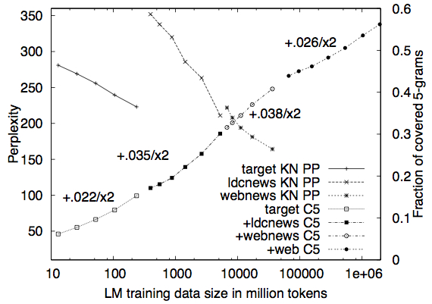
Which one wins?
Can’t compute perplexity for SB. Why?
Why do we care about 5-gram coverage for a test set?

Slide 58
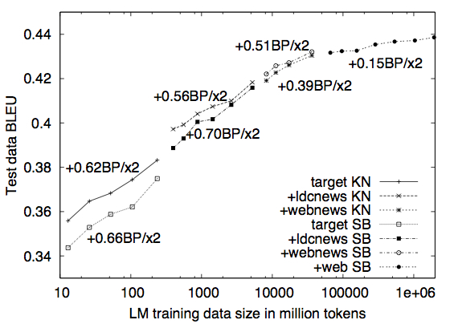
Which one wins?
SB overtakes IKN
BLEU is a measure of MT performance.
Not as stupid as you thought, huh?

Slide 59
Take away
The MapReduce paradigm and infrastructure make it simple to scale algorithms to web scale data
At Terabyte scale, efficiency becomes really important!
When you have a lot of data, a more scalable technique (in terms of speed and memory consumption) can do better than the state-of-the-art even if it’s stupider!
“The difference between genius and stupidity is that genius has its limits.”
- Oscar Wilde
“The dumb shall inherit the cluster”
- Nitin Madnani

Slide 60
Back to the Beginning…
Algorithms and models
Features
Data

