Slide 1

Finite-State Morphology
CMSC 723: Computational Linguistics I ― Session #3
Jimmy Lin
The iSchool
University of Maryland
Wednesday, September 16, 2009

Slide 2
Today’s Agenda
Computational tools
Regular expressions
Finite-state automata (deterministic vs. non-deterministic)
Finite-state transducers
Overview of morphological processes
Computational morphology with finite-state methods

Slide 3
Regular Expressions
A metalanguage for specifying simple classes of strings
Very useful in searching and matching text strings
Everyone does it!
Implementations in the shell, Perl, Java, Python, …

Slide 4
Regular Expressions
Basic regular expressions
/happy/ → happy
/[abcd]/ → a, b, c, d
/[a-d]/ → a, b, c, d
/[^a-d]/ → e, f, g, … z
/[Tt]he/ → the, The
/(dog|cat)/ → dog, cat
Special metacharacters
/colou?r/ → color, colour
/oo*h!/ → oh!, ooh!, oooh!, …
/oo+h!/ → ooh!, oooh!, ooooh!, …
/beg.n/ → began, begin, begun, begbn, …

Slide 5
NLP* with Regular Expressions
Transcript with Eliza, simulation of a Rogerian psychotherapist
(Weizenbaum, 1966)
User: Men are all alike
ELIZA: IN WHAT WAY
User: They’re always bugging us about something or other
ELIZA: CAN YOU THINK OF A SPECIFIC EXAMPLE?
User: Well, my boyfriend made me come here
ELIZA: YOUR BOYFRIEND MADE YOU COME HERE
User: He says I’m depressed much of the time
ELIZA: I AM SORRY TO HEAR THAT YOU ARE DEPRESSED

Slide 6
How did it work?
.* all .*
→ IN WHAT WAY
.* always .*
→ CAN YOU THINK OF A SPECIFIC EXAMPLE
.* I’m (depressed|sad) .*
→ I AM SORRY TO HEAR YOU ARE \1
.* I’m (depressed|sad) .*
→ WHY DO YOU THINK YOU ARE \1?

Slide 7
Aside…
What is intelligence?
What does Eliza tell us about intelligence?

Slide 8
Equivalence Relations
We can say the following
Regular expressions describe a regular language
Regular expressions can be implemented by finite-state automata
Regular languages can be generated by regular grammars
So what?
Regular Languages
Finite-State Automata
Regular Expressions
Regular Grammars

Slide 9
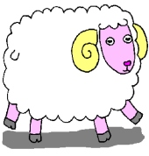
Sheeptalk!
Language:
baa!
baaa!
baaaa!
baaaaa!
...
Regular Expression:
/baa+!/
Finite-State Automaton:
b
a
a
!
q₀
q₁
q₂
q₃
q₄
a

Slide 10
Finite-State Automata
What are they?
What do they do?
How do they work?

Slide 11
FSA: What are they?
Q: a finite set of N states
Q = {q₀, q₁, q₂, q₃, q₄}
The start state: q₀
The set of final states: F = {q₄}
Σ: a finite input alphabet of symbols
Σ = {a, b, !}
δ(q,i): transition function
Given state q and input symbol i, return new state q'
δ(q₃,!) → q₄
b
a
a
!
q₀
q₁
q₂
q₃
q₄
a

Slide 12
FSA: State Transition Table
 | Input
State | b | a | !
0 | 1 | ∅ | ∅
1 | ∅ | 2 | ∅
2 | ∅ | 3 | ∅
3 | ∅ | 3 | 4
4 | ∅ | ∅ | ∅
b
a
a
!
q₀
q₁
q₂
q₃
q₄
a

Slide 13
FSA: What do they do?
Given a string, a FSA either rejects or accepts it
ba! → reject
baa! → accept
baaaz! → reject
baaaa! → accept
baaaaaa! → accept
baa → reject
moooo → reject
What does this have to do with NLP?
Think grammaticality!

Slide 14
FSA: How do they work?
q₀
q₁
q₂
q₃
q₃
q₄
ACCEPT
b
a
a
a
!
b
a
a
!
q₀
q₁
q₂
q₃
q₄
a

Slide 15
FSA: How do they work?
q₀
q₁
q₂
REJECT
b
a
!
!
!
b
a
a
!
q₀
q₁
q₂
q₃
q₄
a

Slide 16
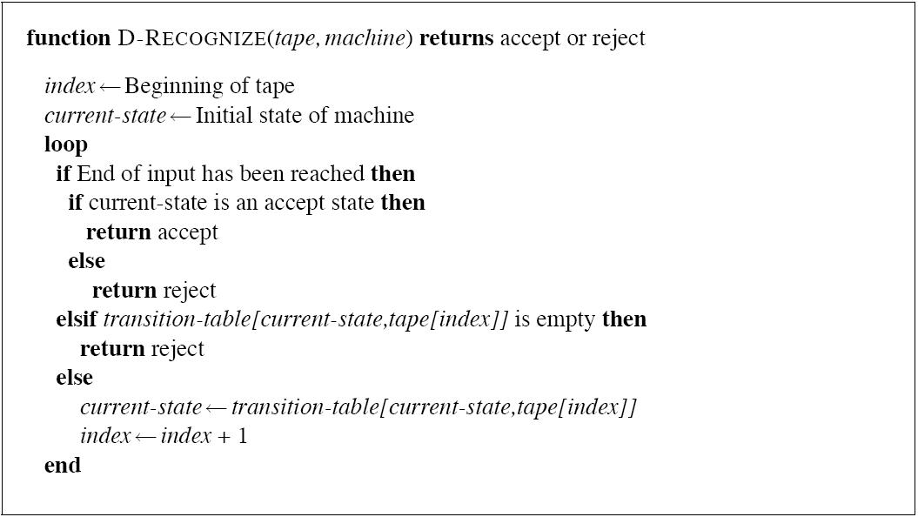
D-RECOGNIZE

Slide 17
Accept or Generate?
Formal languages are sets of strings
Strings composed of symbols drawn from a finite alphabet
Finite-state automata define formal languages
Without having to enumerate all the strings in the language
Two views of FSAs:
Acceptors that can tell you if a string is in the language
Generators to produce all and only the strings in the language

Slide 18
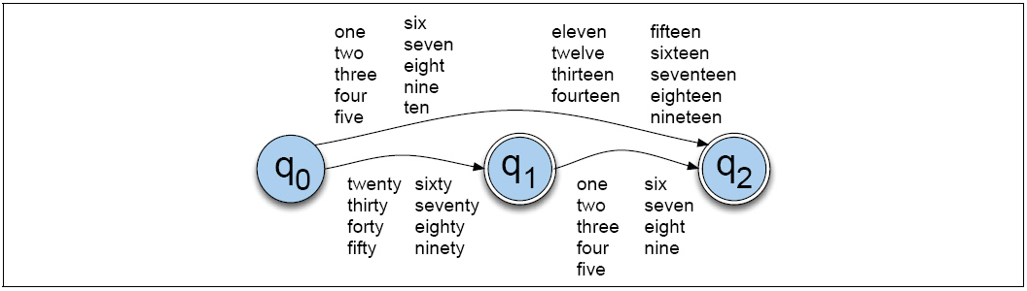
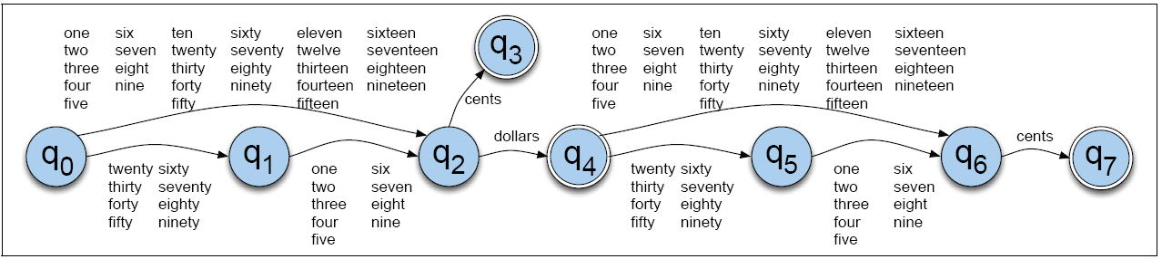
Simple NLP with FSAs

Slide 19
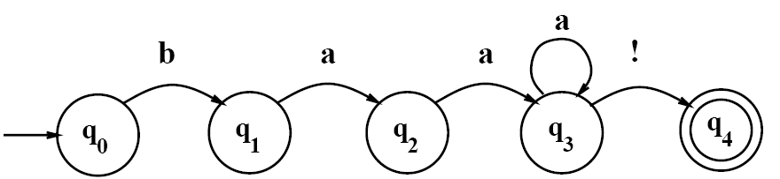
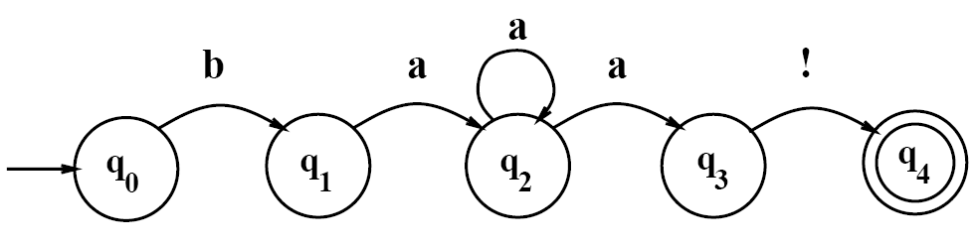
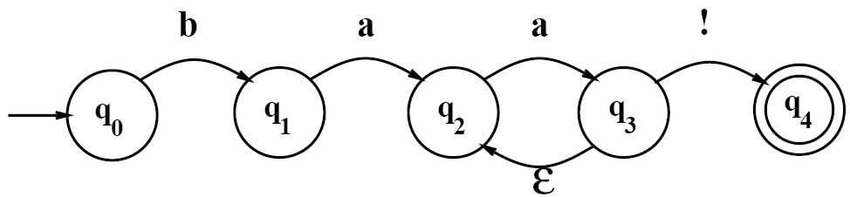
Introducing Non-Determinism
Deterministic vs. Non-deterministic FSAs
Epsilon (ε) transitions

Slide 20
Using NFSAs to Accept Strings
What does it mean?
Accept: there exist at least one path (need not be all paths)
Reject: no paths exist
General approaches:
Backup: add markers at choice points, then possibly revisit unexplored arcs at marked choice point
Look-ahead: look ahead in input to provide clues
Parallelism: look at alternatives in parallel
Recognition with NFSAs as search through state space
Agenda holds (state, tape position) pairs

Slide 21
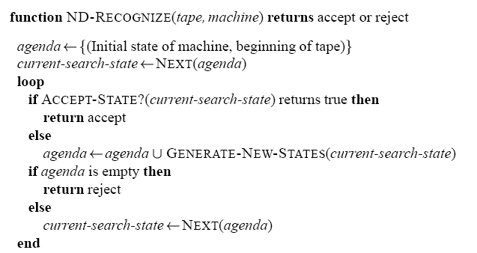
ND-Recognize

Slide 22
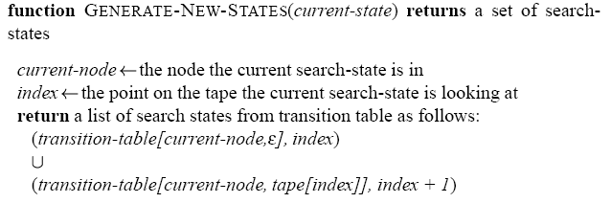
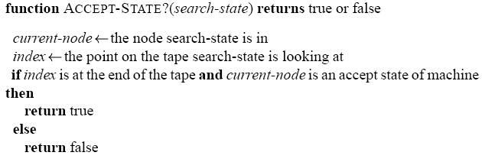
ND-Recognize

Slide 23
State Orderings
Stack (LIFO): depth-first
Queue (FIFO): breadth-first

Slide 24
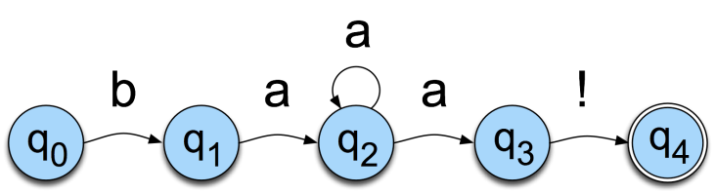
ND-Recognize: Example
ACCEPT

Slide 25
What’s the point?
NFSAs and DFSAs are equivalent
For every NFSA, there is a equivalent DFSA (and vice versa)
Equivalence between regular expressions and FSA
Easy to show with NFSAs
Why use NFSAs?

Slide 26
Regular Language: Definition
∅ is a regular language
∀a ∈ Σ ∪ ε, {a} is a regular language
If L₁ and L₂ are regular languages, then so are:
L₁ · L₂ = {x y | x ∈ L₁ , y ∈ L₂ }, the concatenation of L₁ and L₂
L₁ ∪ L₂, the union or disjunction of L₁ and L₂
L₁∗, the Kleene closure of L₁

Slide 27
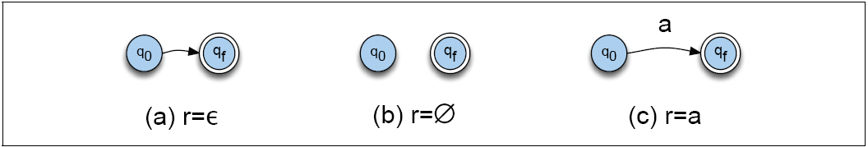
Regular Languages: Starting Points

Slide 28
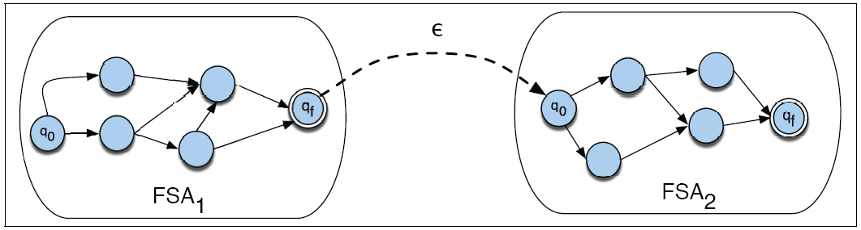
Regular Languages: Concatenation

Slide 29
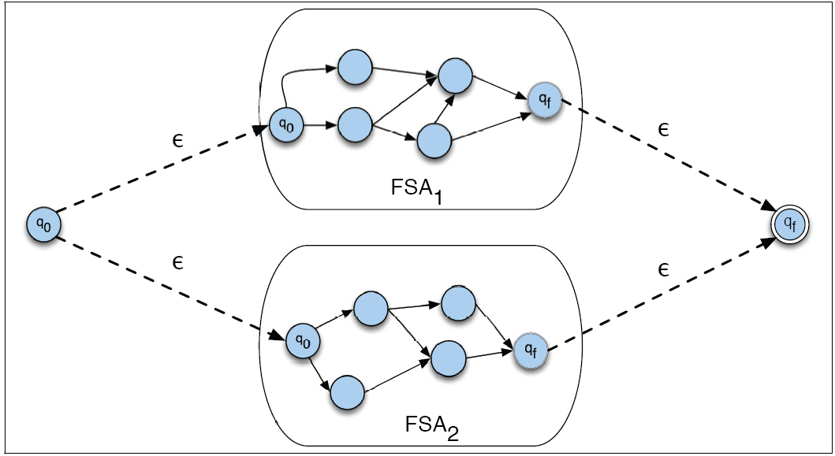
Regular Languages: Disjunction

Slide 30
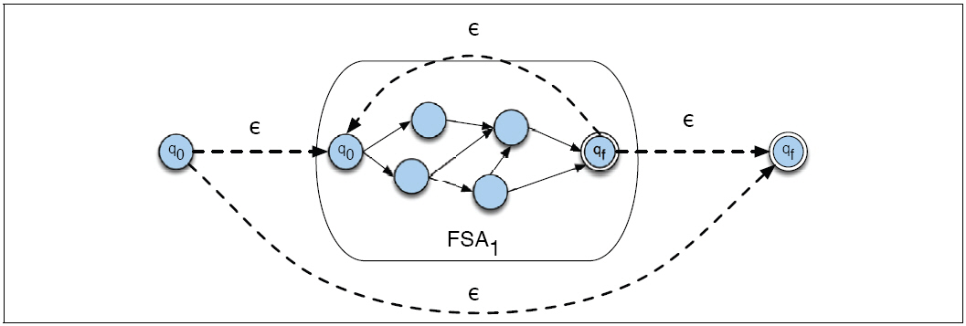
Regular Languages: Kleene Closure

Slide 31

Finite-State Transducers (FSTs)
A two-tape automaton that recognizes or generates pairs of strings
Think of an FST as an FSA with two symbol strings on each arc
One symbol string from each tape

Slide 32
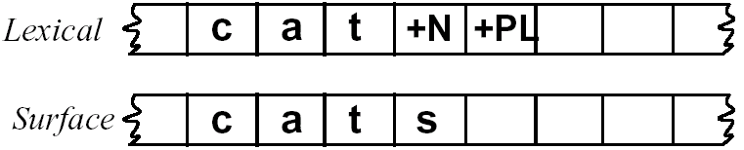
Four-fold view of FSTs
As a recognizer
As a generator
As a translator
As a set relater

Slide 33
Summary: Computational Tools
Regular expressions
Finite-state automata (deterministic vs. non-deterministic)
Finite-state transducers

Slide 34
Computational Morphology
Definitions and problems
What is morphology?
Topology of morphologies
Computational morphology
Finite-state methods

Slide 35
Morphology
Study of how words are constructed from smaller units of meaning
Smallest unit of meaning = morpheme
fox has morpheme fox
cats has two morphemes cat and –s
Note: it is useful to distinguish morphemes from orthographic rules
Two classes of morphemes:
Stems: supply the “main” meaning
Affixes: add “additional” meaning

Slide 36
Topology of Morphologies
Concatenative vs. non-concatenative
Derivational vs. inflectional
Regular vs. irregular

Slide 37
Concatenative Morphology
Morpheme+Morpheme+Morpheme+…
Stems (also called lemma, base form, root, lexeme):
hope+ing → hoping
hop+ing → hopping
Affixes:
Prefixes: Antidisestablishmentarianism
Suffixes: Antidisestablishmentarianism
Agglutinative languages (e.g., Turkish)
uygarlaştıramadıklarımızdanmışsınızcasına → uygar+laş+tır+ama+dık+lar+ımız+dan+mış+sınız+casına
Meaning: behaving as if you are among those whom we could not cause to become civilized

Slide 38
Non-Concatenative Morphology
Infixes (e.g., Tagalog)
hingi (borrow)
humingi (borrower)
Circumfixes (e.g., German)
sagen (say)
gesagt (said)
Reduplication (e.g., Motu, spoken in Papua New Guinea)
mahuta (to sleep)
mahutamahuta (to sleep constantly)
mamahuta (to sleep, plural)

Slide 39
Templatic Morphologies
Common in Semitic languages
Roots and patterns
Arabic
Hebrew
ب
ت
ك
ב
ת
כ
?
و
?
?
مَ
?
ו
?
?
مكتوب
כתוב
maktuub written
ktuuv written

Slide 40
Derivational Morphology
Stem + morpheme →
Word with different meaning or different part of speech
Exact meaning difficult to predict
Nominalization in English:
-ation: computerization, characterization
-ee: appointee, advisee
-er: killer, helper
Adjective formation in English:
-al: computational, derivational
-less: clueless, helpless
-able: teachable, computable

Slide 41
Inflectional Morphology
Stem + morpheme →
Word with same part of speech as the stem
Adds: tense, number, person,…
Plural morpheme for English noun
cat+s
dog+s
Progressive form in English verbs
walk+ing
rain+ing

Slide 42
Noun Inflections in English
Regular
cat/cats
dog/dogs
Irregular
mouse/mice
ox/oxen
goose/geese

Slide 43
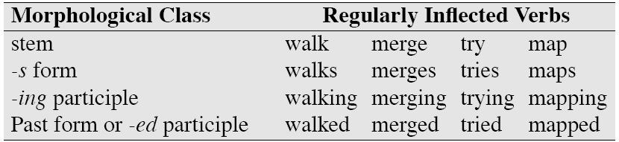
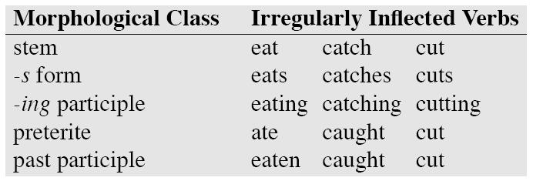
Verb Inflections in English

Slide 44
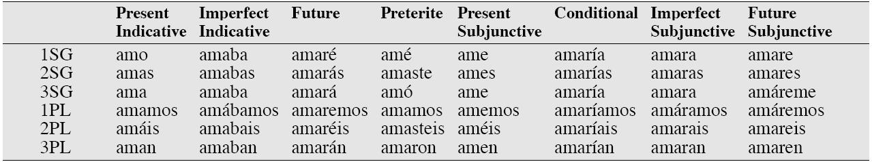
Verb Inflections in Spanish

Slide 45
Morphological Parsing
Computationally decompose input forms into component morphemes
Components needed:
A lexicon (stems and affixes)
A model of how stems and affixes combine
Orthographic rules

Slide 46
Morphological Parsing: Examples
WORD STEM (+FEATURES)*
cats cat +N +PL
cat cat +N +SG
cities city +N +PL
geese goose +N +PL
ducks (duck +N +PL) or (duck +V +3SG)
merging merge +V +PRES-PART
caught (catch +V +PAST-PART) or (catch +V +PAST)

Slide 47
Different Approaches
Lexicon only
Rules only
Lexicon and rules
finite-state automata
finite-state transducers

Slide 48
Lexicon-only
Simply enumerate all surface forms and analyses
So what’s the problem?
When might this be useful?
acclaim acclaim $N$
acclaim acclaim $V+0$
acclaimed acclaim $V+ed$
acclaimed acclaim $V+en$
acclaiming acclaim $V+ing$
acclaims acclaim $N+s$
acclaims acclaim $V+s$
acclamation acclamation $N$
acclamations acclamation $N+s$
acclimate acclimate $V+0$
acclimated acclimate $V+ed$
acclimated acclimate $V+en$
acclimates acclimate $V+s$
acclimating acclimate $V+ing$

Slide 49
Rule-only: Porter Stemmer
Cascading set of rules
ational → ate (e.g., reational → relate)
ing → ε (e.g., walking → walk)
sses → ss (e.g., grasses → grass)
…
Examples
cities → citi
city→ citi
generalizations → generalization → generalize → general → gener

Slide 50
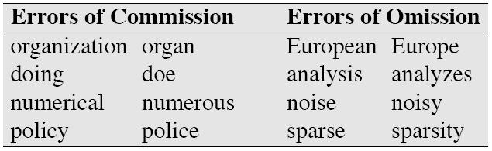
Porter Stemmer: What’s the Problem?
Errors…
Why is it still useful?

Slide 51
Lexicon + Rules
FSA: for recognition
Recognize all grammatical input and only grammatical input
FST: for analysis
If grammatical, analyze surface form into component morphemes
Otherwise, declare input ungrammatical

Slide 52
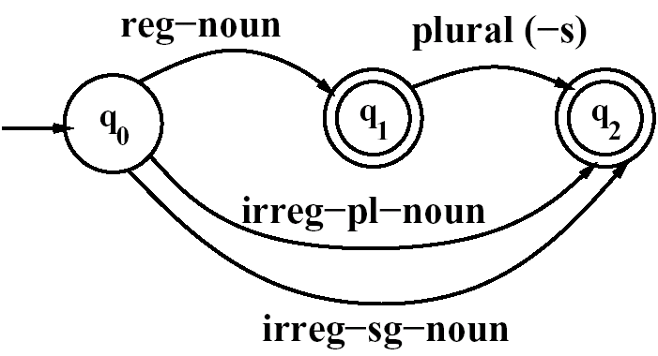
FSA: English Noun Morphology
Lexicon
reg-noun | irreg-pl-noun | irreg-sg-noun | plural
fox cat dog | geese sheep mice | goose sheep mouse | -s
Rule
Note problem with orthography!

Slide 53
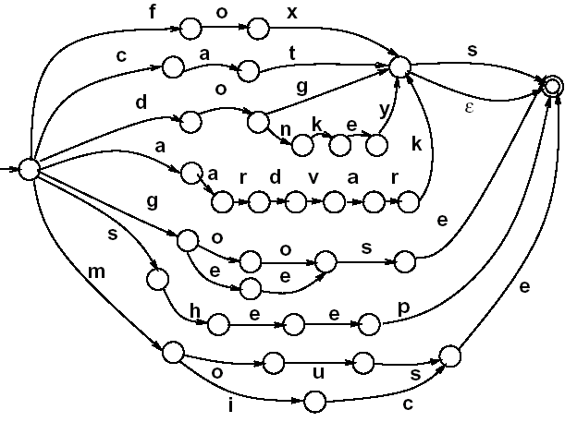
FSA: English Noun Morphology

Slide 54
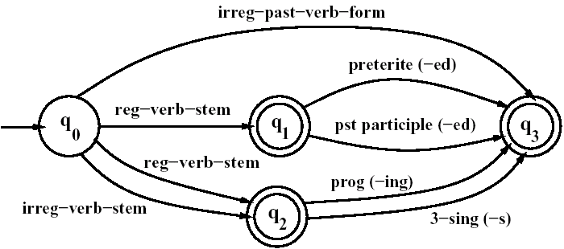
FSA: English Verb Morphology
Lexicon
reg-verb-stem | irreg-verb-stem | irreg-past-verb | past | past-part | pres-part | 3sg
walk fry talk impeach | cut speak spoken sing sang | caught ate eaten | -ed | -ed | -ing | -s
Rule

Slide 55
FSA: English Adjectival Morphology
Examples:
big, bigger, biggest
smaller, smaller, smallest
happy, happier, happiest, happily
unhappy, unhappier, unhappiest, unhappily
Morphemes:
Roots: big, small, happy, etc.
Affixes: un-, -er, -est, -ly

Slide 56
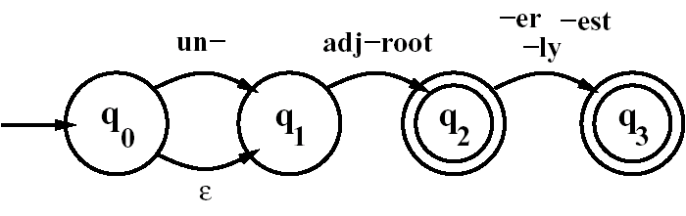
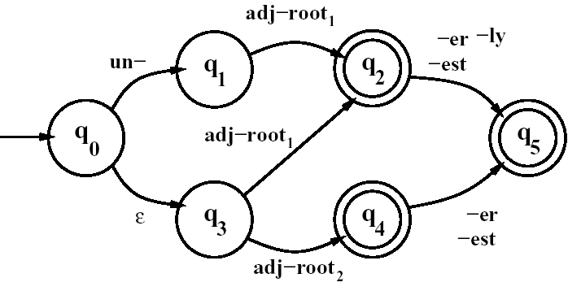
FSA: English Adjectival Morphology
adj-root₁: {happy, real, …}
adj-root₂: {big, small, …}

Slide 57
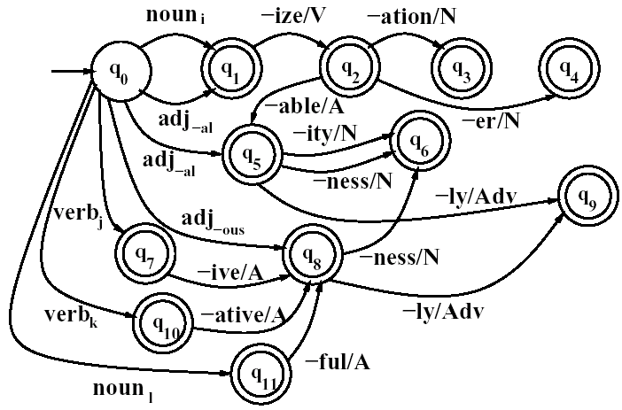
FSA: Derivational Morphology

Slide 58

Morphological Parsing with FSTs
Limitation of FSA:
Accepts or rejects an input… but doesn’t actually provide an analysis
Use FSTs instead!
One tape contains the input, the other tape as the analysis
What if both tapes contain symbols?
What if only one tape contains symbols?

Slide 59
Terminology
Transducer alphabet (pairs of symbols):
a:b = a on the upper tape, b on the lower tape
a:ε = a on the upper tape, nothing on the lower tape
If a:a, write a for shorthand
Special symbols
# = word boundary
^ = morpheme boundary
(For now, think of these as mapping to ε)

Slide 60
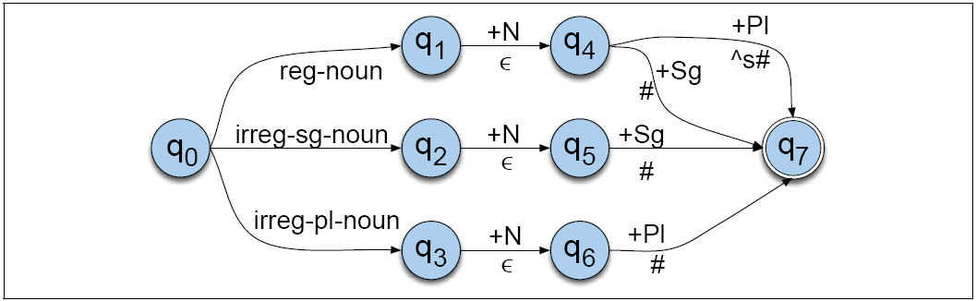
FST for English Nouns
First try:
What’s the problem here?

Slide 61
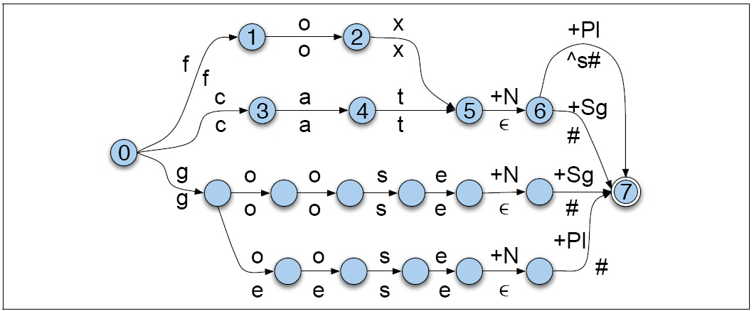
FST for English Nouns

Slide 62
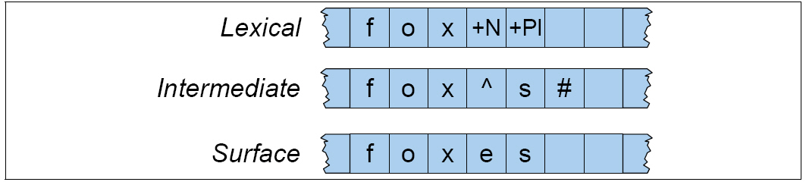
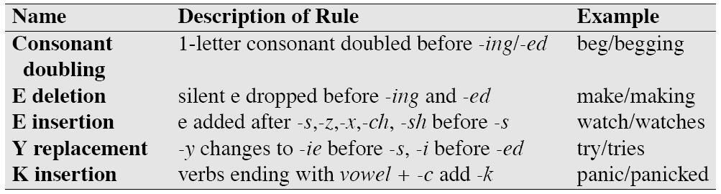
Handling Orthography

Slide 63
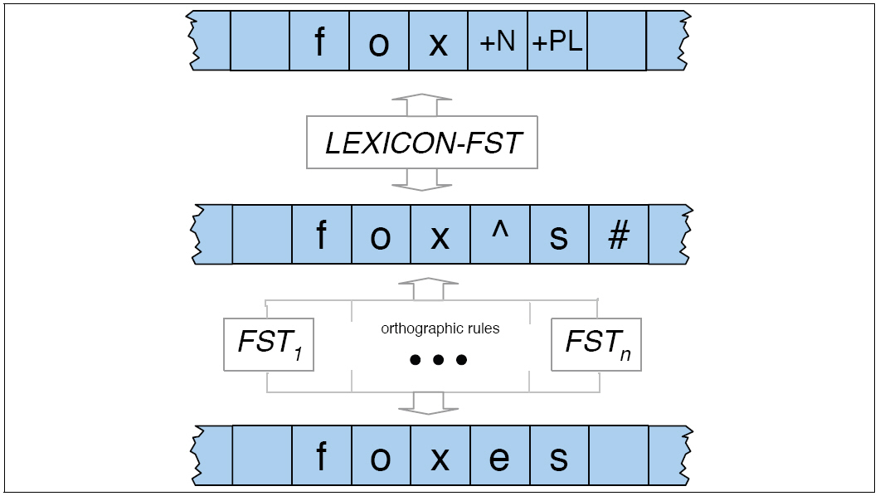
Complete Morphological Parser

Slide 64
FSTs and Ambiguity
unionizable
union +ize +able
un+ ion +ize +able
assess
assess +V
ass +N +essN

Slide 65
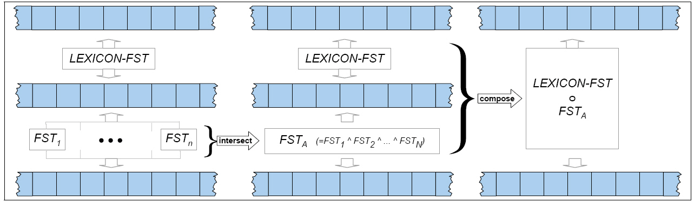
Optimizations

Slide 66
Practical NLP Applications
In practice, it is almost never necessary to write FSTs by hand…
Typically, one writes rules:
Chomsky and Halle Notation: a → b / c__d = rewrite a as b when occurs between c and d
E-Insertion rule
Rule → FST compiler handles the rest…
x
s
z
ε → e /
^ __ s #

Slide 67
What we covered today…
Computational tools
Regular expressions
Finite-state automata (deterministic vs. non-deterministic)
Finite-state transducers
Overview of morphological processes
Computational morphology with finite-state methods
One final question: is morphology actually finite state?

