Slide 1

Part-of-Speech Tagging
CMSC 723: Computational Linguistics I ― Session #4
Jimmy Lin
The iSchool
University of Maryland
Wednesday, September 23, 2009

Slide 2
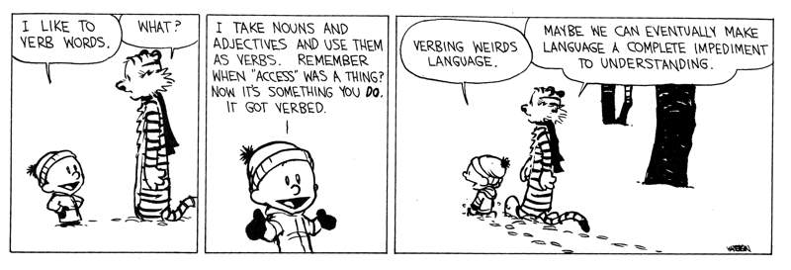
Source: Calvin and Hobbs

Slide 3
Today’s Agenda
What are parts of speech (POS)?
What is POS tagging?
Methods for automatic POS tagging
Rule-based POS tagging
Transformation-based learning for POS tagging
Along the way…
Evaluation
Supervised machine learning

Slide 4
Parts of Speech
“Equivalence class” of linguistic entities
“Categories” or “types” of words
Study dates back to the ancient Greeks
Dionysius Thrax of Alexandria (c. 100 BC)
8 parts of speech: noun, verb, pronoun, preposition, adverb, conjunction, participle, article
Remarkably enduring list!

Slide 5
How do we define POS?
By meaning
Verbs are actions
Adjectives are properties
Nouns are things
By the syntactic environment
What occurs nearby?
What does it act as?
By what morphological processes affect it
What affixes does it take?
Combination of the above
Unreliable! Think back to the comic!

Slide 6
Parts of Speech
Open class
Impossible to completely enumerate
New words continuously being invented, borrowed, etc.
Closed class
Closed, fixed membership
Reasonably easy to enumerate
Generally, short function words that “structure” sentences

Slide 7
Open Class POS
Four major open classes in English
Nouns
Verbs
Adjectives
Adverbs
All languages have nouns and verbs... but may not have the other two

Slide 8
Nouns
Open class
New inventions all the time: muggle, webinar, ...
Semantics:
Generally, words for people, places, things
But not always (bandwidth, energy, ...)
Syntactic environment:
Occurring with determiners
Pluralizable, possessivizable
Other characteristics:
Mass vs. count nouns

Slide 9
Verbs
Open class
New inventions all the time: google, tweet, ...
Semantics:
Generally, denote actions, processes, etc.
Syntactic environment:
Intransitive, transitive, ditransitive
Alternations
Other characteristics:
Main vs. auxiliary verbs
Gerunds (verbs behaving like nouns)
Participles (verbs behaving like adjectives)

Slide 10
Adjectives and Adverbs
Adjectives
Generally modify nouns, e.g., tall girl
Adverbs
A semantic and formal potpourri…
Sometimes modify verbs, e.g., sang beautifully
Sometimes modify adjectives, e.g., extremely hot

Slide 11
Closed Class POS
Prepositions
In English, occurring before noun phrases
Specifying some type of relation (spatial, temporal, …)
Examples: on the shelf, before noon
Particles
Resembles a preposition, but used with a verb (“phrasal verbs”)
Examples: find out, turn over, go on

Slide 12
Particle vs. Prepositions
He came by the office in a hurry
He came by his fortune honestly
We ran up the phone bill
We ran up the small hill
He lived down the block
He never lived down the nicknames
(by = preposition)
(by = particle)
(up = particle)
(up = preposition)
(down = preposition)
(down = particle)

Slide 13
More Closed Class POS
Determiners
Establish reference for a noun
Examples: a, an, the (articles), that, this, many, such, …
Pronouns
Refer to person or entities: he, she, it
Possessive pronouns: his, her, its
Wh-pronouns: what, who

Slide 14
Closed Class POS: Conjunctions
Coordinating conjunctions
Join two elements of “equal status”
Examples: cats and dogs, salad or soup
Subordinating conjunctions
Join two elements of “unequal status”
Examples: We’ll leave after you finish eating. While I was waiting in line, I saw my friend.
Complementizers are a special case: I think that you should finish your assignment

Slide 15


Lest you think it’s an Anglo-centric world,
It’s time to visit ......
The (Linguistic)
Twilight Zone

Slide 16
Digression The (Linguistic)Twilight Zone
Perhaps, not so strange…
Turkish
uygarlaştıramadıklarımızdanmışsınızcasına → uygar+laş+tır+ama+dık+lar+ımız+dan+mış+sınız+casına
behaving as if you are among those whom we could not cause to become civilized
Chinese
No verb/adjective distinction!
漂亮: beautiful/to be beautiful

Slide 17
Digression The (Linguistic)Twilight Zone
Tzeltal (Mayan language spoken in Chiapas)
Only 3000 root forms in the vocabulary
The verb ‘EAT’ has eight variations:
General : TUN
Bananas and soft stuff : LO’
Beans and crunchy stuff : K’UX
Tortillas and bread : WE’
Meat and Chilies : TI’
Sugarcane : TZ’U
Liquids : UCH’

Slide 18
Digression The (Linguistic)Twilight Zone
Riau Indonesian/Malay
No Articles
No Tense Marking
3rd person pronouns neutral to both gender and number
No features distinguishing verbs from nouns

Slide 19
Digression The (Linguistic)Twilight Zone
Riau Indonesian/Malay
Ayam (chicken) Makan (eat)
The chicken is eating
The chicken ate
The chicken will eat
The chicken is being eaten
Where the chicken is eating
How the chicken is eating
Somebody is eating the chicken
The chicken that is eating

Slide 20
Back to regularly scheduled programming…

Slide 21
POS Tagging: What’s the task?
Process of assigning part-of-speech tags to words
But what tags are we going to assign?
Coarse grained: noun, verb, adjective, adverb, …
Fine grained: {proper, common} noun
Even finer-grained: {proper, common} noun ± animate
Important issues to remember
Choice of tags encodes certain distinctions/non-distinctions
Tagsets will differ across languages!
For English, Penn Treebank is the most common tagset
What’s the tradeoff?

Slide 22
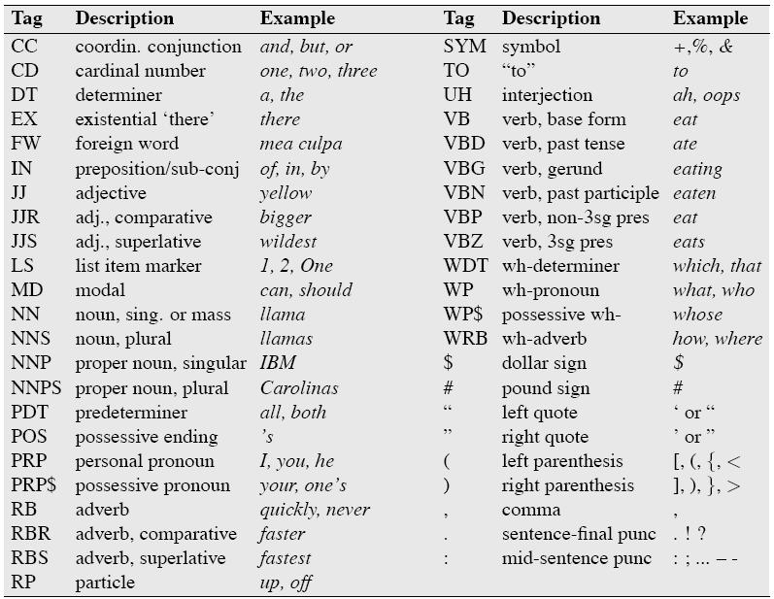
Penn Treebank Tagset: 45 Tags

Slide 23
Penn Treebank Tagset: Choices
Example:
The/DT grand/JJ jury/NN commmented/VBD on/IN a/DT number/NN of/IN other/JJ topics/NNS ./.
Distinctions and non-distinctions
Prepositions and subordinating conjunctions are tagged “IN” (“Although/IN I/PRP..”)
Except the preposition/complementizer “to” is tagged “TO”
Don’t think this is correct? Doesn’t make sense?
Often, must suspend linguistic intuition and defer to the annotation guidelines!

Slide 24
Why do POS tagging?
One of the most basic NLP tasks
Nicely illustrates principles of statistical NLP
Useful for higher-level analysis
Needed for syntactic analysis
Needed for semantic analysis
Sample applications that require POS tagging
Machine translation
Information extraction
Lots more…

Slide 25
Why is it hard?
Not only a lexical problem
Remember ambiguity?
Better modeled as sequence labeling problem
Need to take into account context!

Slide 26
Try your hand at tagging…
The back door
On my back
Win the voters back
Promised to back the bill

Slide 27
Try your hand at tagging…
I thought that you...
That day was nice
You can go that far

Slide 28
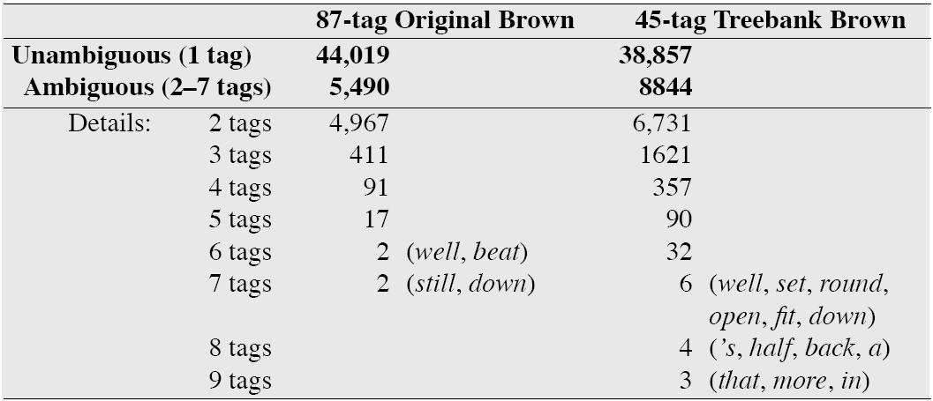
Why is it hard?*

Slide 29
Part-of-Speech Tagging
How do you do it automatically?
How well does it work?
This first

Slide 30
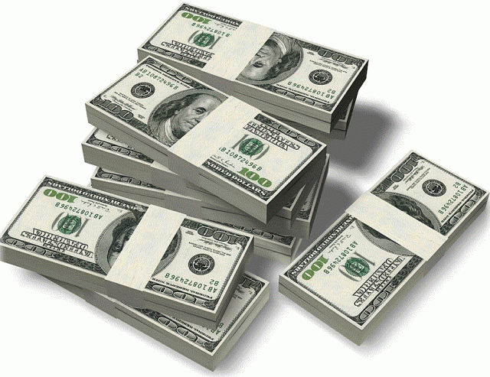
It’s all about the benjamins
evaluation

Slide 31
Evolution of the Evaluation
Evaluation by argument
Evaluation by inspection of examples
Evaluation by demonstration
Evaluation by improvised demonstration
Evaluation on data using a figure of merit
Evaluation on test data
Evaluation on common test data
Evaluation on common, unseen test data

Slide 32
Evaluation Metric
Binary condition (correct/incorrect):
Accuracy
Set-based metrics (illustrated with document retrieval):
Precision = A / (A+B)
Recall = A / (A+C)
Miss = C / (A+C)
False alarm (fallout) = B / (B+D)
F-measure:
 | Relevant | Not relevant
Retrieved | A | B
Not retrieved | C | D
Collection size = A+B+C+D
Relevant = A+C
Retrieved = A+B

Slide 33
Components of a Proper Evaluation
Figures(s) of merit
Baseline
Upper bound
Tests of statistical significance

Slide 34
Part-of-Speech Tagging
How do you do it automatically?
How well does it work?
Now this

Slide 35
Automatic POS Tagging
Rule-based POS tagging (now)
Transformation-based learning for POS tagging (later)
Hidden Markov Models (next week)
Maximum Entropy Models (CMSC 773)
Conditional Random Fields (CMSC 773)

Slide 36
Rule-Based POS Tagging
Dates back to the 1960’s
Combination of lexicon + hand crafted rules
Example: EngCG (English Constraint Grammar)

Slide 37
EngCG Architecture
w₁
w₂
.
.
.
w_{n}
56,000 entries
w1
w2
.
.
.
wN
3,744 rules
w1
w2
.
.
.
wN
t₁
t₂
.
.
.
t_{n}
Lexicon
Lookup
Disambiguation
using
Constraints
Stage 1
Stage 2
sentence
overgenerated
tags
final
tags

Slide 38
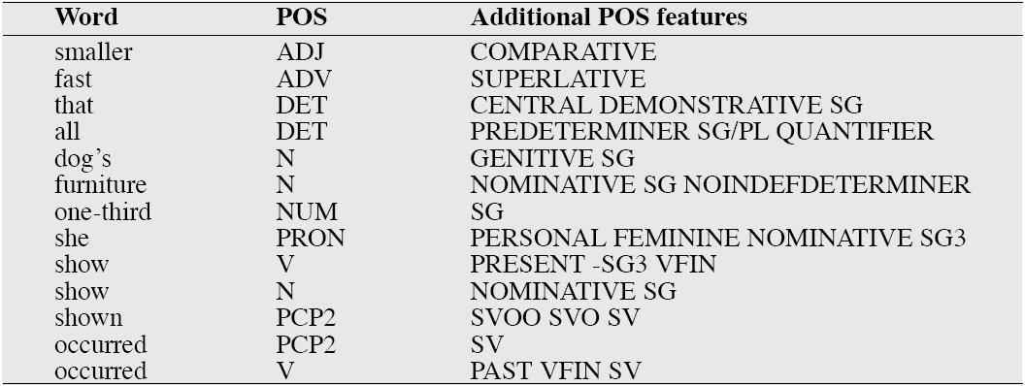
EngCG: Sample Lexical Entries

Slide 39
EngCG: Constraint Rule Application
Example Sentence: Newman had originally practiced that ...
Newman NEWMAN N NOM SG PROPER
had HAVE <SVO> V PAST VFIN
HAVE <SVO> PCP2
originally ORIGINAL ADV
practiced PRACTICE <SVO> <SV> V PAST VFIN
PRACTICE <SVO> <SV> PCP2
that ADV
PRON DEM SG
DET CENTRAL DEM SG
CS
ADVERBIAL-THAT Rule
Given input: that
if
(+1 A/ADV/QUANT);
(+2 SENT-LIM);
(NOT -1 SVOC/A);
then eliminate non-ADV tags
else eliminate ADV tag
disambiguation constraint
overgenerated tags
I thought that you... (subordinating conjunction) That day was nice. (determiner) You can go that far. (adverb)

Slide 40
EngCG: Evaluation
Accuracy ~96%*
A lot of effort to write the rules and create the lexicon
Try debugging interaction between thousands of rules!
Recall discussion from the first lecture?
Assume we had a corpus annotated with POS tags
Can we learn POS tagging automatically?

Slide 41
Supervised Machine Learning
Start with annotated corpus
Desired input/output behavior
Training phase:
Represent the training data in some manner
Apply learning algorithm to produce a system (tagger)
Testing phase:
Apply system to unseen test data
Evaluate output

Slide 42
Three Laws of Machine Learning
Thou shalt not mingle training data with test data
Thou shalt not mingle training data with test data
Thou shalt not mingle training data with test data
But what do you do if you need more test data?

Slide 43
Three Pillars of Statistical NLP
Corpora (training data)
Representations (features)
Learning approach (models and algorithms)

Slide 44
Automatic POS Tagging
Rule-based POS tagging (before)
Transformation-based learning for POS tagging (now)
Hidden Markov Models (next week)
Maximum Entropy Models (CMSC 773)
Conditional Random Fields (CMSC 773)
The problem isn’t with rules per se…
but with manually writing rules!

Slide 45
Learn to automatically paint the next Cubist masterpiece

Slide 46
TBL: Training

Slide 47
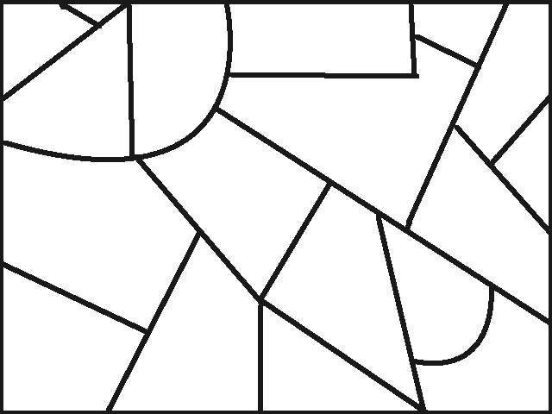

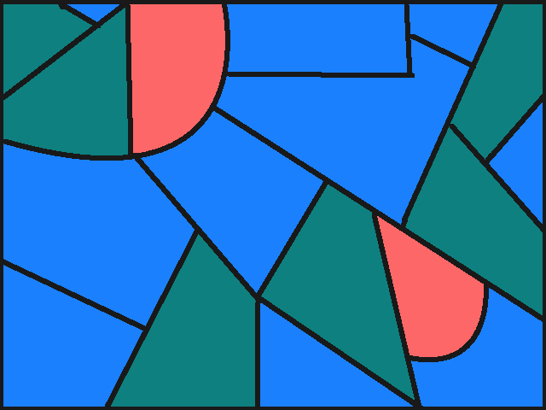
TBL: Training
Error:
100%
Most common: BLUE
Initial Step: Apply Broadest Transformation

Slide 48
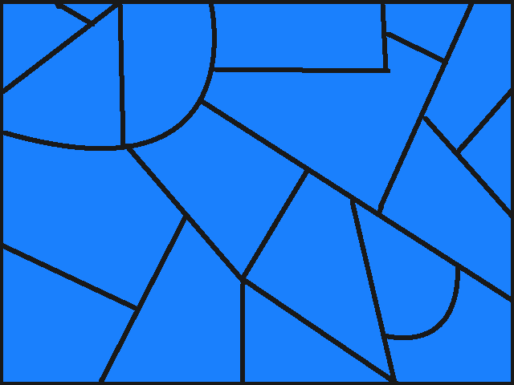
TBL: Training
Error:
44%
change B to G if touching
Step 2: Find transformation that decreases error most

Slide 49
TBL: Training
Error:
44%
change B to G if touching
Step 3: Apply this transformation

Slide 50
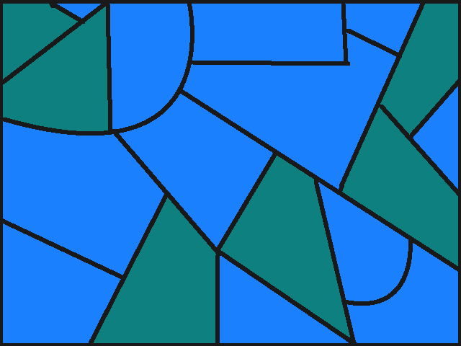
TBL: Training
Error:
11%
change B to R if shape is
Repeat Steps 2 and 3 until “no improvement”

Slide 51
TBL: Training
Error:
0%
Finished !

Slide 52
TBL: Training
What was the point? We already had the right answer!
Training gave us ordered list of transformation rules
Now apply to any empty canvas!
Picasso in a box!

Slide 53
TBL: Testing

Slide 54
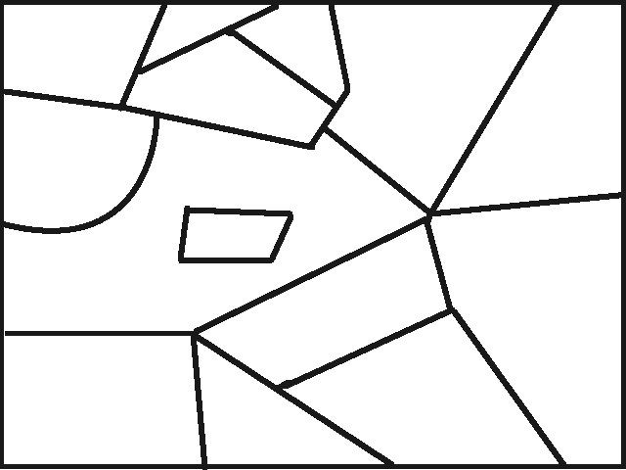
TBL: Testing
Ordered transformations:
Initial: Make all B
change B to G if touching
change B to R if shape is

Slide 55
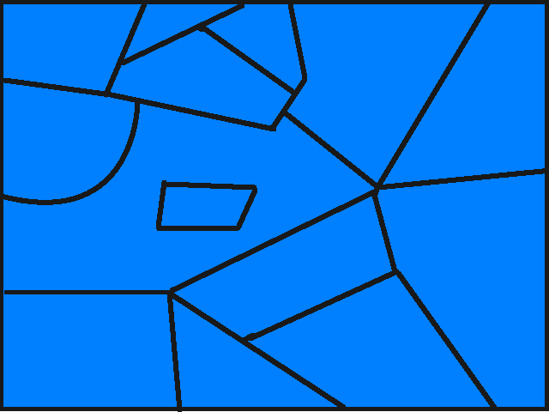
TBL: Testing
Ordered transformations:
Initial: Make all B
change B to G if touching
change B to R if shape is

Slide 56
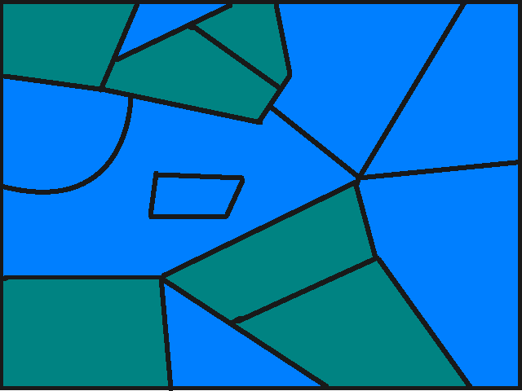
TBL: Testing
Ordered transformations:
Initial: Make all B
change B to G if touching
change B to R if shape is

Slide 57
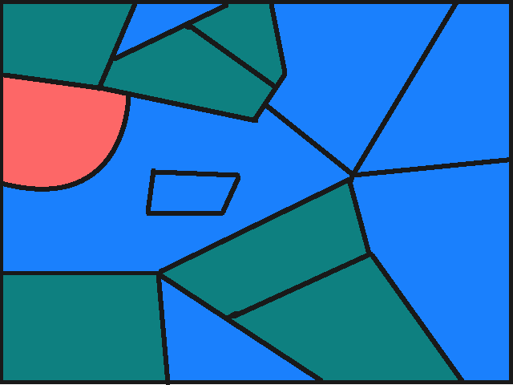
TBL: Testing
Ordered transformations:
Initial: Make all B
change B to G if touching
change B to R if shape is

Slide 58
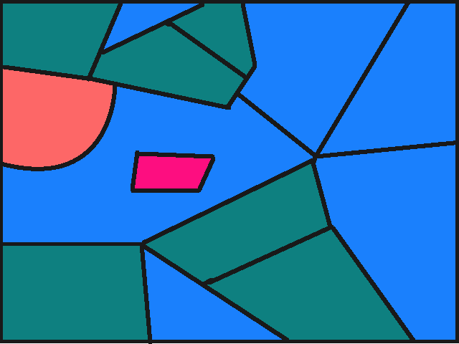
TBL: Testing
Accuracy: 93%

Slide 59
TBL Painting Algorithm
function TBL-Paint (given: empty canvas with goal painting)
begin
apply initial transformation to canvas
repeat
try all color transformation rules
find transformation rule yielding most improvements
apply color transformation rule to canvas
until improvement below some threshold
end

Slide 60
TBL Painting Algorithm
function TBL-Paint (given: empty canvas with goal painting)
begin
apply initial transformation to canvas
repeat
try all color transformation rules
find transformation rule yielding most improvements
apply color transformation rule to canvas
until improvement below some threshold
end
Now, substitute:
‘tag’ for ‘color’
‘corpus’ for ‘canvas’
‘untagged’ for ‘empty’
‘tagging’ for ‘painting’

Slide 61
TBL Painting Algorithm
function TBL-Paint (given: empty canvas with goal painting)
begin
apply initial transformation to canvas
repeat
try all color transformation rules
find transformation rule yielding most improvements
apply color transformation rule to canvas
until improvement below some threshold
end
Impossible!

Slide 62
TBL Templates
Change tag t1 to tag t2 when:
w-1 (w+1) is tagged t3
w-2 (w+2) is tagged t3
w-1 is tagged t3 and w+1 is tagged t4
w-1 is tagged t3 and w+2 is tagged t4
Non-Lexicalized
Change tag t1 to tag t2 when:
w-1 (w+1) is foo
w-2 (w+2) is bar
w is foo and w-1 is bar
w is foo, w-2 is bar and w+1 is baz
Lexicalized
Only try instances of these (and their combinations)

Slide 63
TBL Example Rules
He/PRP is/VBZ as/IN tall/JJ as/IN her/PRP$
Change from IN to RB if w+2 is as
He/PRP is/VBZ as/RB tall/JJ as/IN her/PRP$
He/PRP is/VBZ expected/VBN to/TO race/NN today/NN
Change from NN to VB if w-1 is tagged as TO
He/PRP is/VBZ expected/VBN to/TO race/VB today/NN

Slide 64
TBL POS Tagging
Rule-based, but data-driven
No manual knowledge engineering!
Training on 600k words, testing on known words only
Lexicalized rules: learned 447 rules, 97.2% accuracy
Early rules do most of the work: 100 → 96.8%, 200 → 97.0%
Non-lexicalized rules: learned 378 rules, 97.0% accuracy
Little difference… why?
How good is it?
Baseline: 93-94%
Upper bound: 96-97%
Source: Brill (Computational Linguistics, 1995)

Slide 65
Three Pillars of Statistical NLP
Corpora (training data)
Representations (features)
Learning approach (models and algorithms)

Slide 66
In case you missed it…
Uh… what about this assumption?
Assume we had a corpus annotated with POS tags
Can we learn POS tagging automatically?
Yes, as we’ve just shown…
knowledge engineering vs. manual annotation

Slide 67
Penn Treebank Tagset
Why does everyone use it?
What’s the problem?
How do we get around it?

Slide 68
Turkish Morphology
Remember agglutinative languages?
uygarlaştıramadıklarımızdanmışsınızcasına → uygar+laş+tır+ama+dık+lar+ımız+dan+mış+sınız+casına
behaving as if you are among those whom we could not cause to become civilized
How bad does it get?
uyu – sleep
uyut – make X sleep
uyuttur – have Y make X sleep
uyutturt – have Z have Y make X sleep
uyutturttur – have W have Z have Y make X sleep
uyutturtturt – have Q have W have Z …
…
Source: Yuret and Türe (HLT/NAACL 2006)

Slide 69
Turkish Morphological Analyzer
Example: masalı
masal+Noun+A3sg+Pnon+Acc (= the story)
masal+Noun+A3sg+P3sg+Nom (= his story)
masa+Noun+A3sg+Pnon+Nom^DB+Adj+With (= with tables)
Disambiguation in context:
Uzun masalı anlat (Tell the long story)
Uzun masalı bitti (His long story ended)
Uzun masalı oda (Room with long table)

Slide 70
Morphology Annotation Scheme
How rich is Turkish morphology?
126 unique features
9129 unique IGs
infinite unique tags
11084 distinct tags observed in 1M word training corpus
masa+Noun+A3sg+Pnon+Nom^DB+Adj+With
stem
features
features
inflectional group (IG)
derivational
boundary
IG
tag

Slide 71
How to tackle the problem…
Key idea: build separate decision lists for each feature
Sample rules for +Det:
R1 If (W = çok) and (R1 = +DA)
Then W has +Det
R2 If (L1 = pek)
Then W has +Det
R3 If (W = +AzI)
Then W does not have +Det
R4 If (W = çok)
Then W does not have +Det
R5 If TRUE
Then W has +Det
“pek çok alanda” (R1)
“pek çok insan” (R2)
“insan çok daha” (R4)

Slide 72
Learning Decision Lists
Start with tagged collection
1 million words in the news genre
Apply greedy-prepend algorithm
Rule templates based on words, suffixes, character classes within a five word window
GPA(data)
1 dlist = NIL
2 default-class = Most-Common-Class(data)
3 rule = [If TRUE Then default-class]
4 while Gain(rule, dlist, data) > 0
5 do dlist = prepend(rule, dlist)
6 rule = Max-Gain-Rule(dlist, data)
7 return dlist

Slide 73
Results
Overall accuracy: ~96%!

Slide 74
What we covered today…
What are parts of speech (POS)?
What is POS tagging?
Methods for automatic POS tagging
Rule-based POS tagging
Transformation-based learning for POS tagging
Along the way…
Evaluation
Supervised machine learning

