Slide 1

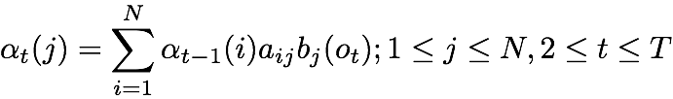
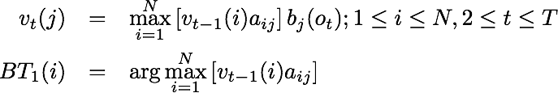
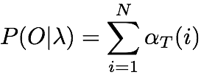
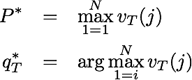
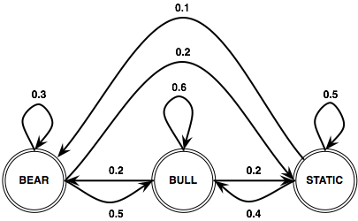



Forward Algorithm
Viterbi Algorithm
Initialization
Initialization
Recursion
Recursion
Termination
Termination
Stock Market HMM
π₁=0.5
π₂=0.2
π₃=0.3

