Slide 1

Hidden Markov Models
CMSC 723: Computational Linguistics I ― Session #5
Jimmy Lin
The iSchool
University of Maryland
Wednesday, September 30, 2009

Slide 2
Today’s Agenda
The great leap forward in NLP
Hidden Markov models (HMMs)
Forward algorithm
Viterbi decoding
Supervised training
Unsupervised training teaser
HMMs for POS tagging

Slide 3
Deterministic to Stochastic
The single biggest leap forward in NLP:
From deterministic to stochastic models
What? A stochastic process is one whose behavior is non-deterministic in that a system’s subsequent state is determined both by the process’s predictable actions and by a random element.
What’s the biggest challenge of NLP?
Why are deterministic models poorly adapted?
What’s the underlying mathematical tool?
Why can’t you do this by hand?

Slide 4
FSM: Formal Specification
Q: a finite set of N states
Q = {q₀, q₁, q₂, q₃, …}
The start state: q₀
The set of final states: q_{F}
Σ: a finite input alphabet of symbols
δ(q,i): transition function
Given state q and input symbol i, transition to new state q'

Slide 5

Finite number of states

Slide 6
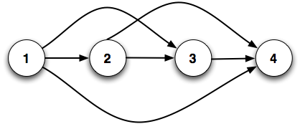
Transitions

Slide 7
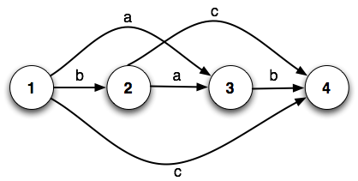
Input alphabet

Slide 8
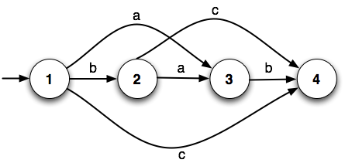
Start state

Slide 9

Final state(s)

Slide 10
The problem with FSMs…
All state transitions are equally likely
But what if we know that isn’t true?
How might we know?

Slide 11
Weighted FSMs
What if we know more about state transitions?
‘a’ is twice as likely to be seen in state 1 as ‘b’ or ‘c’
‘c’ is three times as likely to be seen in state 2 as ‘a’
FSM → Weighted FSM
What do we get of it?
score(‘ab’) = 2 (?)
score(‘bc’) = 3 (?)
2
3
1
1
1
1

Slide 12
Introducing Probabilities
What’s the problem with adding weights to transitions?
What if we replace weights with probabilities?
Probabilities provide a theoretically-sound way to model uncertainly (ambiguity in language)
But how do we assign probabilities?

Slide 13
Probabilistic FSMs
What if we know more about state transitions?
‘a’ is twice as likely to be seen in state 1 as ‘b’ or ‘c’
‘c’ is three times as likely to be seen in state 2 as ‘a’
What do we get of it? What’s the interpretation?
P(‘ab’) = 0.5
P(‘bc’) = 0.1875
This is a Markov chain
0.5
0.75
0.25
0.25
1.0
0.25

Slide 14
Markov Chain: Formal Specification
Q: a finite set of N states
Q = {q₀, q₁, q₂, q₃, …}
The start state
An explicit start state: q₀
Alternatively, a probability distribution over start states: {π₁, π₂, π₃, …}, Σ π_{i} = 1
The set of final states: q_{F}
N × N Transition probability matrix A = [a_{ij}]
a_{ij} = P(q_{j}|q_{i}), Σ a_{ij} = 1 ∀i
0.5
0.75
0.25
0.25
1.0
0.25

Slide 15
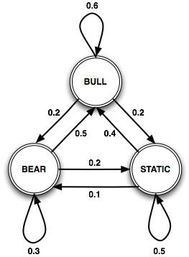
Let’s model the stock market…
What’s special about this FSM?
Present state only depends on the previous state!
The (1st order) Markov assumption
P(q_{i}|q₀…q_{i-1}) = P(q_{i}|q_{i-1})
Each state corresponds to a physical state in the world
0.2
What’s missing?
Add “priors”
0.5
0.3

Slide 16
Are states always observable ?
Day:
1 2 3 4 5 6
Not observable !
Bull: Bull Market
Bear: Bear Market
S: Static Market
Bull
Bear
S
Bear
S
Bull
Here’s what you actually observe:
↑: Market is up
↓: Market is down
↔: Market hasn’t changed
↑ ↓ ↔ ↑ ↓ ↔

Slide 17
Hidden Markov Models
Markov chains aren’t enough!
What if you can’t directly observe the states?
We need to model problems where observations don’t directly correspond to states…
Solution: A Hidden Markov Model (HMM)
Assume two probabilistic processes
Underlying process (state transition) is hidden
Second process generates sequence of observed events

Slide 18
HMM: Formal Specification
Q: a finite set of N states
Q = {q₀, q₁, q₂, q₃, …}
N × N Transition probability matrix A = [a_{ij}]
a_{ij} = P(q_{j}|q_{i}), Σ a_{ij} = 1 ∀i
Sequence of observations O = o₁, o₂, ... o_{T}
Each drawn from a given set of symbols (vocabulary V)
N × |V| Emission probability matrix, B = [b_{it}]
b_{it} = b_{i}(o_{t}) = P(o_{t}|q_{i}), Σ b_{it} = 1 ∀i
Start and end states
An explicit start state q₀ or alternatively, a prior distribution over start states: {π₁, π₂, π₃, …}, Σ π_{i} = 1
The set of final states: q_{F}

Slide 19

Stock Market HMM
States?
✓
Transitions?
Vocabulary?
Emissions?
Priors?

Slide 20
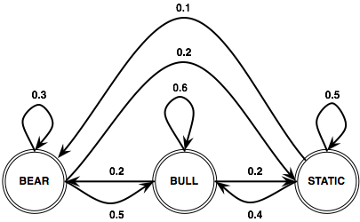
Stock Market HMM
States?
✓
Transitions?
✓
Vocabulary?
Emissions?
Priors?

Slide 21
Stock Market HMM
States?
✓
Transitions?
✓
Vocabulary?
✓
Emissions?
Priors?

Slide 22



Stock Market HMM
States?
✓
Transitions?
✓
Vocabulary?
✓
Emissions?
✓
Priors?

Slide 23
Stock Market HMM
States?
✓
Transitions?
✓
Vocabulary?
✓
Emissions?
✓
Priors?
✓
π₁=0.5
π₂=0.2
π₃=0.3

Slide 24
Properties of HMMs
The (first-order) Markov assumption holds
The probability of an output symbol depends only on the state generating it
The number of states (N) does not have to equal the number of observations (T)

Slide 25
HMMs: Three Problems
Likelihood: Given an HMM λ = (A, B, ∏), and a sequence of observed events O, find P(O|λ)
Decoding: Given an HMM λ = (A, B, ∏), and an observation sequence O, find the most likely (hidden) state sequence
Learning: Given a set of observation sequences and the set of states Q in λ, compute the parameters A and B
Okay, but where did the structure of the HMM come from?

Slide 26
HMM Problem #1: Likelihood

Slide 27
Computing Likelihood
π₁=0.5
π₂=0.2
π₃=0.3
t:
1 2 3 4 5 6
O:
↑ ↓ ↔ ↑ ↓ ↔
λ_{stock}
Assuming λ_{stock} models the stock market, how likely are we to observe the sequence of outputs?

Slide 28


Computing Likelihood
Easy, right?
Sum over all possible ways in which we could generate O from λ
What’s the problem?
Right idea, wrong algorithm!
Takes O(N^{T}) time to compute!

Slide 29
Computing Likelihood
What are we doing wrong?
State sequences may have a lot of overlap…
We’re recomputing the shared subsequences every time
Let’s store intermediate results and reuse them!
Can we do this?
Sounds like a job for dynamic programming!

Slide 30
Forward Algorithm
Use an N × T trellis or chart [α_{tj}]
Forward probabilities: α_{tj} or α_{t}(j)
= P(being in state j after seeing t observations)
= P(o₁, o₂, ... o_{t}, q_{t}=j)
Each cell = ∑ extensions of all paths from other cells α_{t}(j) = ∑_{i} α_{t-1}(i) a_{ij} b_{j}(o_{t})
α_{t-1}(i): forward path probability until (t-1)
a_{ij}: transition probability of going from state i to j
b_{j}(o_{t}): probability of emitting symbol o_{t} in state j
P(O|λ) = ∑_{i} α_{T}(i)
What’s the running time of this algorithm?

Slide 31
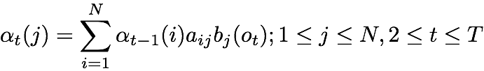
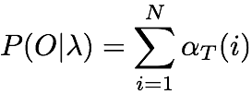
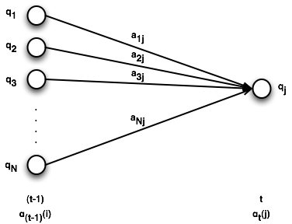
Forward Algorithm: Formal Definition
Initialization
Recursion
Termination

Slide 32
Forward Algorithm
O =
↑ ↓ ↑
find P(O|λ_{stock})

Slide 33
Forward Algorithm
Static
states
Bear
Bull
↑
↓
↑
t=1
t=2
t=3
time

Slide 34
Forward Algorithm: Initialization
0.3×0.3
=0.09
Static
α₁(Static)
states
0.5×0.1
=0.05
Bear
α₁(Bear)
0.2×0.7=0.14
Bull
α₁(Bull)
↑
↓
↑
t=1
t=2
t=3
time

Slide 35
Forward Algorithm: Recursion
0.3×0.3
=0.09
Static
0.5×0.1
=0.05
.... and so on
states
Bear
0.09×0.4×0.1 =0.0036
0.05×0.5×0.1=0.0025
∑
0.2×0.7=0.14
0.0145
Bull
0.14×0.6×0.1=0.0084
α₁(Bull)×a_{BullBull}×b_{Bull}(↓)
↑
↓
↑
t=1
t=2
t=3
time

Slide 36
Forward Algorithm: Recursion
Work through the rest of these numbers…
0.3×0.3
=0.09
?
?
Static
states
0.5×0.1
=0.05
?
?
Bear
0.2×0.7=0.14
0.0145
?
Bull
↑
↓
↑
t=1
t=2
t=3
time
What’s the asymptotic complexity of this algorithm?

Slide 37
Forward Algorithm: Recursion
0.3×0.3
=0.09
0.0249
0.006477
Static
states
0.5×0.1
=0.05
0.0312
0.001475
Bear
0.2×0.7=0.14
0.0145
0.024
Bull
↑
↓
↑
t=1
t=2
t=3
time

Slide 38
Forward Algorithm: Termination
0.3×0.3
=0.09
0.0249
0.006477
Static
states
0.5×0.1
=0.05
0.0312
0.001475
Bear
0.2×0.7=0.14
0.0145
0.024
Bull
P(O) = 0.03195
↑
↓
↑
t=1
t=2
t=3
time

Slide 39
HMM Problem #2: Decoding

Slide 40
Decoding
π₁=0.5
π₂=0.2
π₃=0.3
t:
1 2 3 4 5 6
O:
↑ ↓ ↔ ↑ ↓ ↔
λ_{stock}
Given λ_{stock} as our model and O as our observations, what are the most likely states the market went through to produce O?

Slide 41
Decoding
“Decoding” because states are hidden
First try:
Compute P(O) for all possible state sequences, then choose sequence with highest probability
What’s the problem here?
Second try:
For each possible hidden state sequence, compute P(O) using the forward algorithm
What’s the problem here?

Slide 42
Viterbi Algorithm
“Decoding” = computing most likely state sequence
Another dynamic programming algorithm
Efficient: polynomial vs. exponential (brute force)
Same idea as the forward algorithm
Store intermediate computation results in a trellis
Build new cells from existing cells

Slide 43
Viterbi Algorithm
Use an N × T trellis [v_{tj}]
Just like in forward algorithm
v_{tj} or v_{t}(j)
= P(in state j after seeing t observations and passing through the most likely state sequence so far)
= P(q₁, q₂, ... q_{t-1}, q_{t=j}, o₁, o₂, ... o_{t})
Each cell = extension of most likely path from other cells v_{t}(j) = max_{i} v_{t-1}(i) a_{ij} b_{j}(o_{t})
v_{t-1}(i): Viterbi probability until (t-1)
a_{ij}: transition probability of going from state i to j
b_{j}(o_{t}) : probability of emitting symbol o_{t} in state j
P = max_{i} v_{T}(i)

Slide 44
Viterbi vs. Forward
Maximization instead of summation over previous paths
This algorithm is still missing something!
In forward algorithm, we only care about the probabilities
What’s different here?
We need to store the most likely path (transition):
Use “backpointers” to keep track of most likely transition
At the end, follow the chain of backpointers to recover the most likely state sequence

Slide 45

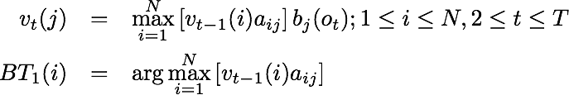

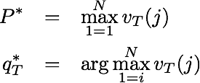
Viterbi Algorithm: Formal Definition
Initialization
Recursion
Termination
But here?
Why no b_{j}(o_{t}) here?
Why no b() ?

Slide 46
Viterbi Algorithm
O =
↑ ↓ ↑
find most likely state sequence given λstock

Slide 47
Viterbi Algorithm
Static
states
Bear
Bull
↑
↓
↑
t=1
t=2
t=3
time

Slide 48
Viterbi Algorithm: Initialization
0.3×0.3
=0.09
Static
α₁(Static)
states
0.5×0.1
=0.05
Bear
α₁(Bear)
0.2×0.7=0.14
Bull
α₁(Bull)
↑
↓
↑
t=1
t=2
t=3
time

Slide 49
Viterbi Algorithm: Recursion
0.3×0.3
=0.09
Static
states
0.5×0.1
=0.05
0.09×0.4×0.1 =0.0036
Bear
0.05×0.5×0.1=0.0025
Max
0.2×0.7=0.14
0.0084
Bull
0.14×0.6×0.1=0.0084
α₁(Bull)×a_{BullBull}×b_{Bull}(↓)
↑
↓
↑
t=1
t=2
t=3
time

Slide 50
Viterbi Algorithm: Recursion
0.3×0.3
=0.09
Static
0.5×0.1
=0.05
.... and so on
states
Bear
store backpointer
0.2×0.7=0.14
0.0084
Bull
↑
↓
↑
t=1
t=2
t=3
time

Slide 51
Viterbi Algorithm: Recursion
Work through the rest of the algorithm…
0.3×0.3
=0.09
?
?
Static
states
0.5×0.1
=0.05
?
?
Bear
0.2×0.7=0.14
0.0084
?
Bull
↑
↓
↑
t=1
t=2
t=3
time

Slide 52
Viterbi Algorithm: Recursion
0.3×0.3
=0.09
0.0135
0.00202
Static
states
0.5×0.1
=0.05
0.0168
0.000504
Bear
0.2×0.7=0.14
0.0084
0.00588
Bull
↑
↓
↑
t=1
t=2
t=3
time

Slide 53
Viterbi Algorithm: Termination
0.3×0.3
=0.09
0.0135
0.00202
Static
states
0.5×0.1
=0.05
0.0168
0.000504
Bear
0.2×0.7=0.14
0.0084
0.00588
Bull
↑
↓
↑
t=1
t=2
t=3
time

Slide 54
Viterbi Algorithm: Termination
0.3×0.3
=0.09
0.0135
0.00202
Static
states
0.5×0.1
=0.05
0.0168
0.000504
Bear
0.2×0.7=0.14
0.0084
0.00588
Bull
↑
↓
↑
t=1
t=2
t=3
Most likely state sequence:
[ Bull, Bear, Bull ], P = 0.00588
time

Slide 55
POS Tagging with HMMs

Slide 56
Modeling the problem
What’s the problem?
The/DT grand/JJ jury/NN commmented/VBD on/IN a/DT number/NN of/IN other/JJ topics/NNS ./.
What should the HMM look like ?
States: part-of-speech tags (t₁, t₂, ..., t_{N})
Output symbols: words (w₁, w₂, ..., w_{|V|})
Given HMM λ (A, B, ∏), POS tagging = reconstructing the best state sequence given input
Use Viterbi decoding (best = most likely)
But wait…

Slide 57
HMM Training
What are appropriate values for A, B, ∏?
Before HMMs can decode, they must be trained…
A: transition probabilities
B: emission probabilities
∏: prior
Two training methods:
Supervised training: start with tagged corpus, count stuff to estimate parameters
Unsupervised training: start with untagged corpus, bootstrap parameter estimates and improve estimates iteratively

Slide 58
HMMs: Three Problems
Likelihood: Given an HMM λ = (A, B, ∏), and a sequence of observed events O, find P(O|λ)
Decoding: Given an HMM λ = (A, B, ∏), and an observation sequence O, find the most likely (hidden) state sequence
Learning: Given a set of observation sequences and the set of states Q in λ, compute the parameters A and B

Slide 59
Supervised Training
A tagged corpus tells us the hidden states!
We can compute Maximum Likelihood Estimates (MLEs) for the various parameters
MLE = fancy way of saying “count and divide”
These parameter estimates maximize the likelihood of the data being generated by the model

Slide 60
Supervised Training
Transition Probabilities
Any P(t_{i} | t_{i-1}) = C(t_{i-1}, t_{i}) / C(t_{i-1}), from the tagged data
Example: for P(NN|VB), count how many times a noun follows a verb and divide by the total number of times you see a verb
Emission Probabilities
Any P(w_{i} | t_{i}) = C(w_{i}, t_{i}) / C(t_{i}), from the tagged data
For P(bank|NN), count how many times bank is tagged as a noun and divide by how many times anything is tagged as a noun
Priors
Any P(q₁ = t_{i}) = π_{i} = C(t_{i})/N, from the tagged data
For π_{NN} , count the number of times NN occurs and divide by the total number of tags (states)
A better way?

Slide 61
Unsupervised Training
No labeled/tagged training data
No way to compute MLEs directly
How do we deal?
Make an initial guess for parameter values
Use this guess to get a better estimate
Iteratively improve the estimate until some convergence criterion is met
Expectation Maximization (EM)

Slide 62
Expectation Maximization
A fundamental tool for unsupervised machine learning techniques
Forms basis of state-of-the-art systems in MT, parsing, WSD, speech recognition and more

Slide 63
Motivating Example
Let observed events be the grades given out in, say, CMSC723
Assume grades are generated by a probabilistic model described by single parameter μ
P(A) = 1/2, P(B) = μ, P(C) = 2 μ, P(D) = 1/2 - 3 μ
Number of ‘A’s observed = ‘a’, ‘b’ number of ‘B’s, etc.
Compute MLE of μ given ‘a’, ‘b’, ‘c’ and ‘d’
Adapted from Andrew Moore’s Slides
http://www.autonlab.org/tutorials/gmm.html

Slide 64
Motivating Example
Recall the definition of MLE: “.... maximizes likelihood of data given the model.”
Okay, so what’s the likelihood of data given the model?
P(Data|Model) = P(a,b,c,d|μ) = (1/2)ª(μ)^{b}(2μ)^{c}(1/2-3μ)^{d}
L = log-likelihood = log P(a,b,c,d|μ) = a log(1/2) + b log μ + c log 2μ + d log(1/2-3μ)
How to maximize L w.r.t μ ? [Think Calculus]
δL/δμ = 0; (b/μ) + (2c/2μ) - (3d/(1/2-3μ)) = 0
μ = (b+c)/6(b+c+d)
We got our answer without EM. Boring!

Slide 65
Motivating Example
Now suppose:
P(A) = 1/2, P(B) = μ, P(C) = 2 μ, P(D) = 1/2 - 3 μ
Number of ‘A’s and ‘B’s = h, c ‘C’s, and d ‘D’s
Part of the observable information is hidden
Can we compute the MLE for μ now?
Chicken and egg:
If we knew ‘b’ (and hence ‘a’), we could compute the MLE for μ
But we need μ to know how the model generates ‘a’ and ‘b’
Circular enough for you?

Slide 66
The EM Algorithm
Start with an initial guess for μ (μ₀)
t = 1; Repeat:
b_{t} = μ_{(t-1)}h/(1/2 + μ_{(t-1)}) [E-step: Compute expected value of b given μ]
μ_{t} = (b_{t} + c)/6(b_{t} + c + d) [M-step: Compute MLE of μ given b]
t = t + 1
Until some convergence criterion is met

Slide 67
The EM Algorithm
Algorithm to compute MLEs for model parameters when information is hidden
Iterate between Expectation (E-step) and Maximization (M-step)
Each iteration is guaranteed to increase the log-likelihood of the data (improve the estimate)
Good news: It will always converge to a maximum
Bad news: It will always converge to a maximum

Slide 68
Applying EM to HMMs
Just the intuition… gory details in CMSC 773
The problem:
State sequence is unknown
Estimate model parameters: A, B & ∏
Introduce two new observation statistics:
Number of transitions from q_{i} to q_{j} (ξ)
Number of times in state q_{i} (ϒ)
The EM algorithm can now be applied

Slide 69
Applying EM to HMMs
Start with initial guesses for A, B and ∏
t = 1; Repeat:
E-step: Compute expected values of ξ, ϒ using A_{t}, B_{t}, ∏_{t}
M-step: Compute MLE of A, B and ∏ using ξ_{t}, ϒ_{t}
t = t + 1
Until some convergence criterion is met

Slide 70
What we covered today…
The great leap forward in NLP
Hidden Markov models (HMMs)
Forward algorithm
Viterbi decoding
Supervised training
Unsupervised training teaser
HMMs for POS tagging

