Slide 1

Syntax and Context-Free Grammars
CMSC 723: Computational Linguistics I ― Session #6
Jimmy Lin
The iSchool
University of Maryland
Wednesday, October 7, 2009

Slide 2
Today’s Agenda
Words… structure… meaning…
Formal Grammars
Context-free grammar
Grammars for English
Treebanks
Dependency grammars
Next week: parsing algorithms

Slide 3
Grammar and Syntax
By grammar, or syntax, we mean implicit knowledge of a native speaker
Acquired by around three years old, without explicit instruction
It’s already inside our heads, we’re just trying to formally capture it
Not the kind of stuff you were later taught in school:
Don’t split infinitives
Don’t end sentences with prepositions

Slide 4
Syntax
Why should you care?
Syntactic analysis is a key component in many applications
Grammar checkers
Conversational agents
Question answering
Information extraction
Machine translation
…

Slide 5
Constituency
Basic idea: groups of words act as a single unit
Constituents form coherent classes that behave similarly
With respect to their internal structure: e.g., at the core of a noun phrase is a noun
With respect to other constituents: e.g., noun phrases generally occur before verbs

Slide 6
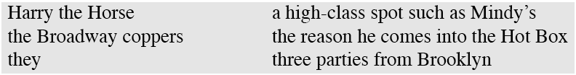
Constituency: Example
The following are all noun phrases in English...
Why?
They can all precede verbs
They can all be preposed
…

Slide 7
Grammars and Constituency
For a particular language:
What are the “right” set of constituents?
What rules govern how they combine?
Answer: not obvious and difficult
That’s why there are so many different theories of grammar and competing analyses of the same data!
Approach here:
Very generic
Focus primarily on the “machinery”
Doesn’t correspond to any modern linguistic theory of grammar

Slide 8
Context-Free Grammars
Context-free grammars (CFGs)
Aka phrase structure grammars
Aka Backus-Naur form (BNF)
Consist of
Rules
Terminals
Non-terminals

Slide 9
Context-Free Grammars
Terminals
We’ll take these to be words (for now)
Non-Terminals
The constituents in a language (e.g., noun phrase)
Rules
Consist of a single non-terminal on the left and any number of terminals and non-terminals on the right

Slide 10
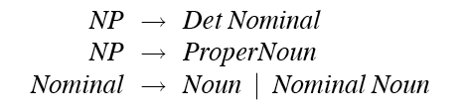
Some NP Rules
Here are some rules for our noun phrases
Rules 1 & 2 describe two kinds of NPs:
One that consists of a determiner followed by a nominal
Another that consists of proper names
Rule 3 illustrates two things:
An explicit disjunction
A recursive definition

Slide 11
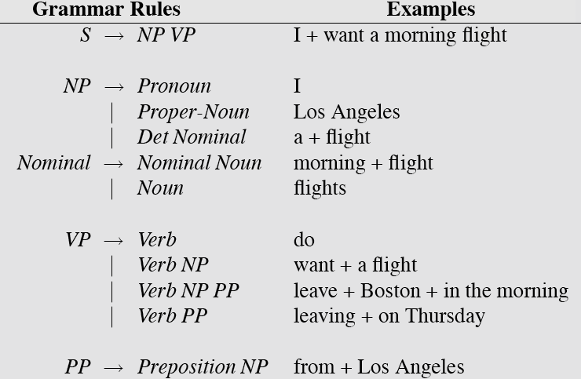
L₀ Grammar

Slide 12
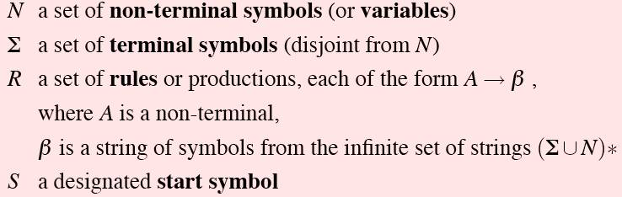
CFG: Formal definition

Slide 13
Three-fold View of CFGs
Generator
Acceptor
Parser

Slide 14
Derivations and Parsing
A derivation is a sequence of rules applications that
Covers all tokens in the input string
Covers only the tokens in the input string
Parsing: given a string and a grammar, recover the derivation
Derivation can be represented as a parse tree
Multiple derivations?

Slide 15
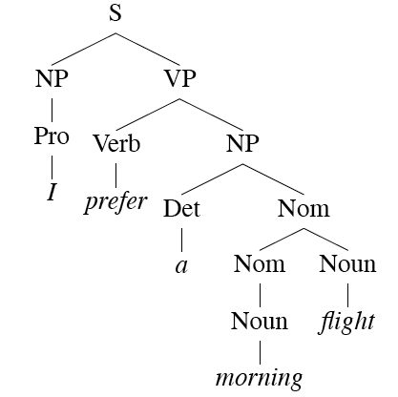
Parse Tree: Example
Note: equivalence between parse trees and bracket notation

Slide 16
Natural vs. Programming Languages
Wait, don’t we do this for programming languages?
What’s similar?
What’s different?

Slide 17
An English Grammar Fragment
Sentences
Noun phrases
Issue: agreement
Verb phrases
Issue: subcategorization

Slide 18
Sentence Types
Declaratives: A plane left.
S → NP VP
Imperatives: Leave!
S → VP
Yes-No Questions: Did the plane leave?
S → Aux NP VP
WH Questions: When did the plane leave?
S → WH-NP Aux NP VP

Slide 19
Noun Phrases
Let’s consider these rules in detail:
NPs are a bit more complex than that!
Consider: “All the morning flights from Denver to Tampa leaving before 10”

Slide 20
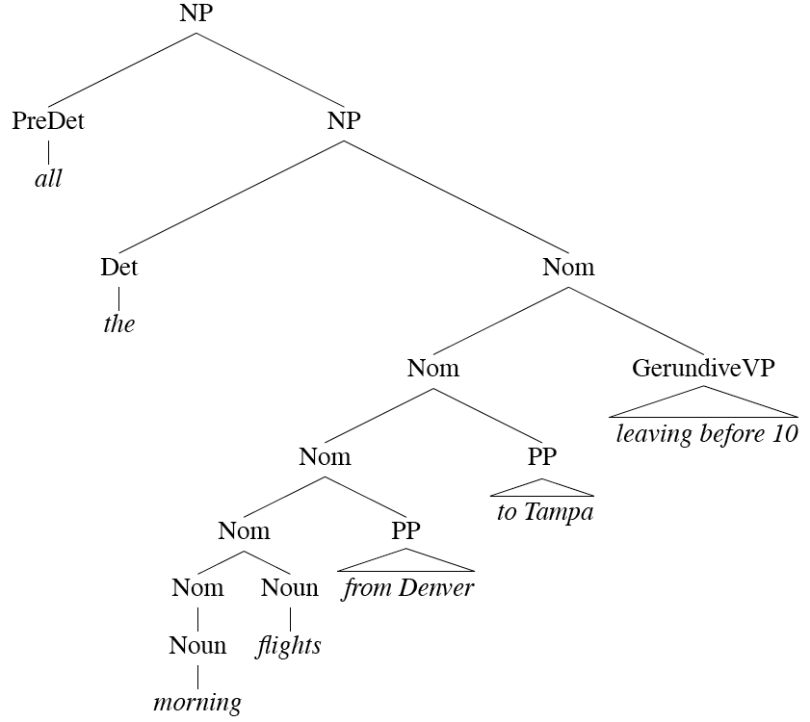
A Complex Noun Phrase
“stuff that comes after”
“stuff that comes before”
“head” = central, most critical part of the NP

Slide 21
Determiners
Noun phrases can start with determiners...
Determiners can be
Simple lexical items: the, this, a, an, etc. (e.g., “a car”)
Or simple possessives (e.g., “John’s car”)
Or complex recursive versions thereof (e.g., John’s sister’s husband’s son’s car)

Slide 22
Premodifiers
Come before the head
Examples:
Cardinals, ordinals, etc. (e.g., “three cars”)
Adjectives (e.g., “large car”)
Ordering constraints
“three large cars” vs. “?large three cars”

Slide 23
Postmodifiers
Naturally, come after the head
Three kinds
Prepositional phrases (e.g., “from Seattle”)
Non-finite clauses (e.g., “arriving before noon”)
Relative clauses (e.g., “that serve breakfast”)
Similar recursive rules to handle these
Nominal → Nominal PP
Nominal → Nominal GerundVP
Nominal → Nominal RelClause

Slide 24
A Complex Noun Phrase Revisited

Slide 25
Agreement
Agreement: constraints that hold among various constituents
Example, number agreement in English
This flight
Those flights
One flight
Two flights
*This flights
*Those flight
*One flights
*Two flight

Slide 26
Problem
Our NP rules don’t capture agreement constraints
Accepts grammatical examples (this flight)
Also accepts ungrammatical examples (*these flight)
Such rules overgenerate
We’ll come back to this later

Slide 27
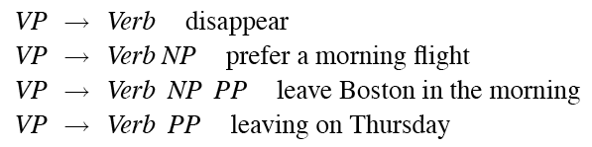
Verb Phrases
English verb phrases consists of
Head verb
Zero or more following constituents (called arguments)
Sample rules:

Slide 28
Subcategorization
Not all verbs are allowed to participate in all VP rules
We can subcategorize verbs according to argument patterns (sometimes called “frames”)
Modern grammars may have 100s of such classes
This is a finer-grained articulation of traditional notions of transitivity

Slide 29
Subcategorization
Sneeze: John sneezed
Find: Please find [a flight to NY]_{NP}
Give: Give [me]_{NP} [a cheaper fare]_{NP}
Help: Can you help [me]_{NP} [with a flight]_{PP}
Prefer: I prefer [to leave earlier]_{TO-VP}
Told: I was told [United has a flight]_{S}
…

Slide 30
Subcategorization
Subcategorization at work:
*John sneezed the book
*I prefer United has a flight
*Give with a flight
But some verbs can participate in multiple frames:
I ate
I ate the apple
How do we formally encode these constraints?

Slide 31
Why?
As presented, the various rules for VPs overgenerate:
John sneezed [the book]_{NP}
Allowed by the second rule…

Slide 32
Possible CFG Solution
Encode agreement in non-terminals:
SgS → SgNP SgVP
PlS → PlNP PlVP
SgNP → SgDet SgNom
PlNP → PlDet PlNom
PlVP → PlV NP
SgVP → SgV Np
Can use the same trick for verb subcategorization

Slide 33
Possible CFG Solution
Critique?
It works…
But it’s ugly…
And it doesn’t scale (explosion of rules)
Alternatives?
Multi-pass solutions

Slide 34
Three-fold View of CFGs
Generator
Acceptor
Parser

Slide 35
The Point
CFGs have about just the right amount of machinery to account for basic syntactic structure in English
Lot’s of issues though...
Good enough for many applications!
But there are many alternatives out there…

Slide 36
Treebanks
Treebanks are corpora in which each sentence has been paired with a parse tree
Hopefully the right one!
These are generally created:
By first parsing the collection with an automatic parser
And then having human annotators correct each parse as necessary
But…
Detailed annotation guidelines are needed
Explicit instructions for dealing with particular constructions

Slide 37
Penn Treebank
Penn TreeBank is a widely used treebank
1 million words from the Wall Street Journal
Treebanks implicitly define a grammar for the language

Slide 38
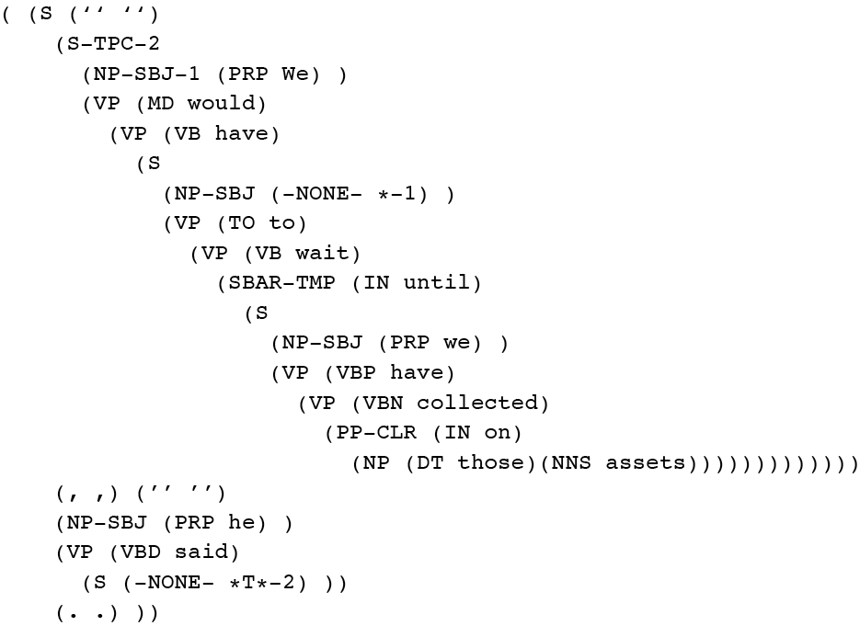
Penn Treebank: Example

Slide 39
Treebank Grammars
Such grammars tend to be very flat
Recursion avoided to ease annotators burden
Penn Treebank has 4500 different rules for VPs, including…
VP → VBD PP
VP → VBD PP PP
VP → VBD PP PP PP
VP → VBD PP PP PP PP

Slide 40
Why treebanks?
Treebanks are critical to training statistical parsers
Also valuable to linguist when investigating phenomena

Slide 41
Dependency Grammars
CFGs focus on constituents
Non-terminals don’t actually appear in the sentence
So what if you got rid of them?
In dependency grammar, a parse is a graph where:
Nodes represent words
Edges represent dependency relations between words (typed or untyped, directed or undirected)

Slide 42
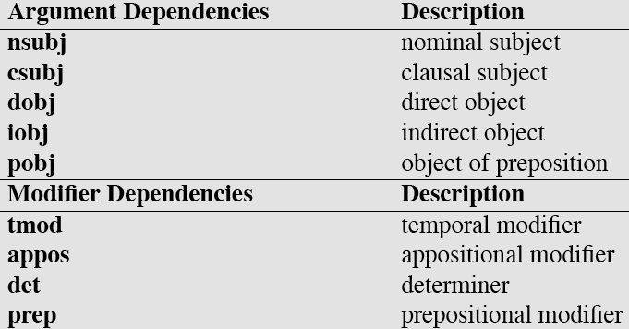
Dependency Relations

Slide 43
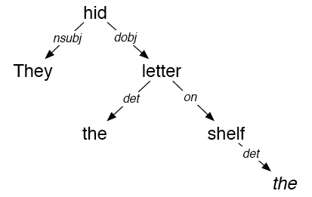
Example Dependency Parse
They hid the letter on the shelf
Compare with constituent parse… What’s the relation?

Slide 44
Summary
CFG can be used to capture various facts about the structure of language
Agreement and subcategorization cause problems…
And there are alternative formalisms
Treebanks as an important resource for NLP
Next week: parsing

