Slide 1

Syntactic Parsing with CFGs
CMSC 723: Computational Linguistics I ― Session #7
Jimmy Lin
The iSchool
University of Maryland
Wednesday, October 14, 2009

Slide 2
Today’s Agenda
Words… structure… meaning…
Last week: formal grammars
Context-free grammars
Grammars for English
Treebanks
Dependency grammars
Today: parsing with CFGs
Top-down and bottom-up parsing
CKY parsing
Earley parsing

Slide 3
Parsing
Problem setup:
Input: string and a CFG
Output: parse tree assigning proper structure to input string
“Proper structure”
Tree that covers all and only words in the input
Tree is rooted at an S
Derivations obey rules of the grammar
Usually, more than one parse tree…
Unfortunately, parsing algorithms don’t help in selecting the correct tree from among all the possible trees

Slide 4
Parsing Algorithms
Parsing is (surprise) a search problem
Two basic (= bad) algorithms:
Top-down search
Bottom-up search
Two “real” algorithms:
CKY parsing
Earley parsing
Simplifying assumptions:
Morphological analysis is done
All the words are known

Slide 5
Top-Down Search
Observation: trees must be rooted with an S node
Parsing strategy:
Start at top with an S node
Apply rules to build out trees
Work down toward leaves

Slide 6
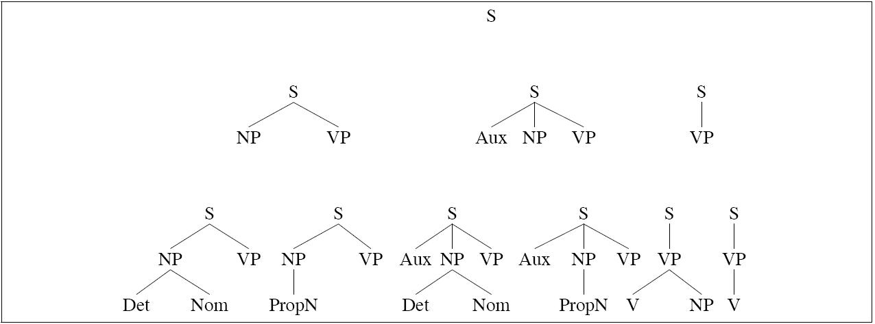
Top-Down Search

Slide 7
Top-Down Search

Slide 8
Top-Down Search

Slide 9
Bottom-Up Search
Observation: trees must cover all input words
Parsing strategy:
Start at the bottom with input words
Build structure based on grammar
Work up towards the root S

Slide 10
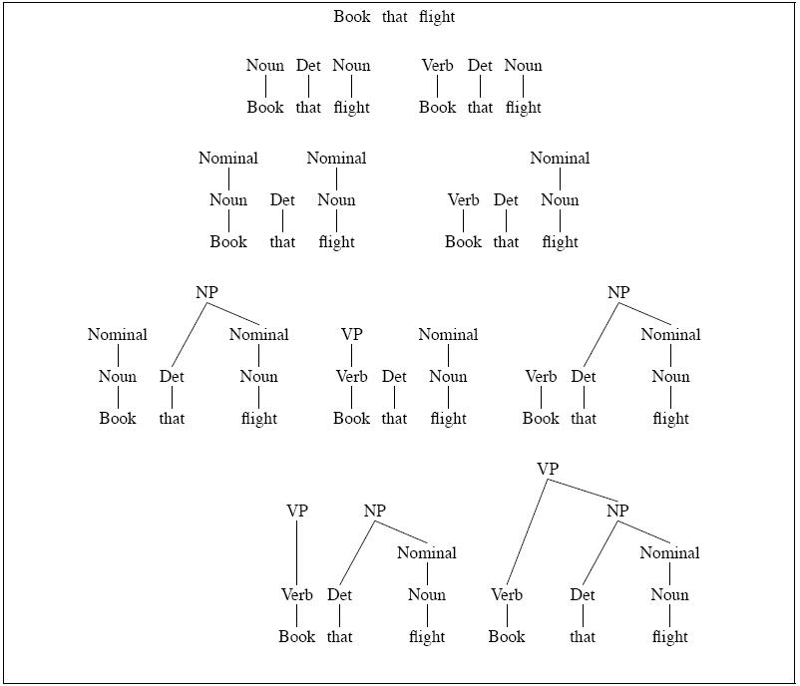
Bottom-Up Search

Slide 11
Bottom-Up Search

Slide 12
Bottom-Up Search

Slide 13
Bottom-Up Search

Slide 14
Bottom-Up Search

Slide 15
Top-Down vs. Bottom-Up
Top-down search
Only searches valid trees
But, considers trees that are not consistent with any of the words
Bottom-up search
Only builds trees consistent with the input
But, considers trees that don’t lead anywhere

Slide 16
Parsing as Search
Search involves controlling choices in the search space:
Which node to focus on in building structure
Which grammar rule to apply
General strategy: backtracking
Make a choice, if it works out then fine
If not, then back up and make a different choice
Remember DFS/BFS for NDFSA recognition?

Slide 17
Backtracking isn’t enough!
Ambiguity
Shared sub-problems

Slide 18
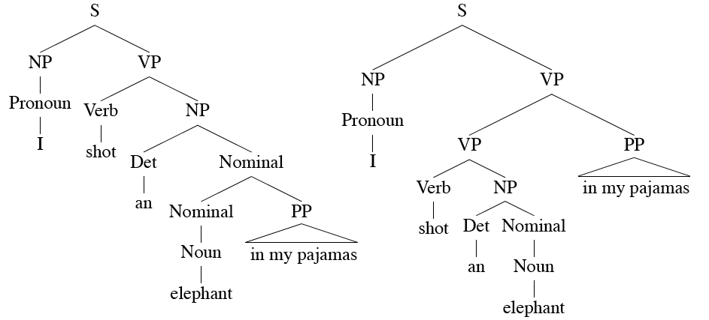
Ambiguity
Or consider: I saw the man on the hill with the telescope.

Slide 19
Shared Sub-Problems
Observation: ambiguous parses still share sub-trees
We don’t want to redo work that’s already been done
Unfortunately, naïve backtracking leads to duplicate work

Slide 20
Shared Sub-Problems: Example
Example: “A flight from Indianapolis to Houston on TWA”
Assume a top-down parse making choices among the various nominal rules:
Nominal → Noun
Nominal → Nominal PP
Statically choosing the rules in this order leads to lots of extra work...

Slide 21
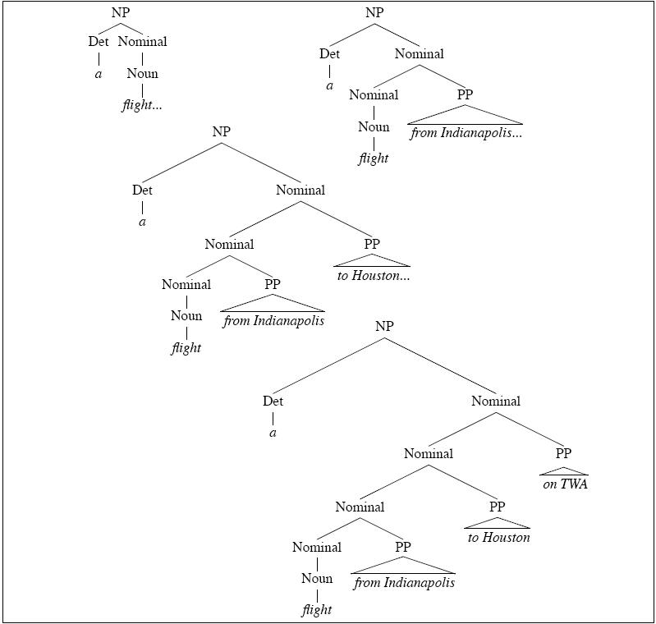
Shared Sub-Problems: Example

Slide 22
Efficient Parsing
Dynamic programming to the rescue!
Intuition: store partial results in tables, thereby:
Avoiding repeated work on shared sub-problems
Efficiently storing ambiguous structures with shared sub-parts
Two algorithms:
CKY: roughly, bottom-up
Earley: roughly, top-down

Slide 23
CKY Parsing: CNF
CKY parsing requires that the grammar consist of ε-free, binary rules = Chomsky Normal Form
All rules of the form:
What does the tree look like?
What if my CFG isn’t in CNF?
A → B C
D → w

Slide 24
CKY Parsing with Arbitrary CFGs
Problem: my grammar has rules like VP → NP PP PP
Can’t apply CKY!
Solution: rewrite grammar into CNF
Introduce new intermediate non-terminals into the grammar
What does this mean?
= weak equivalence
The rewritten grammar accepts (and rejects) the same set of strings as the original grammar…
But the resulting derivations (trees) are different
A → X D
X → B C
(Where X is a symbol that doesn’t occur anywhere else in the grammar)
A → B C D

Slide 25
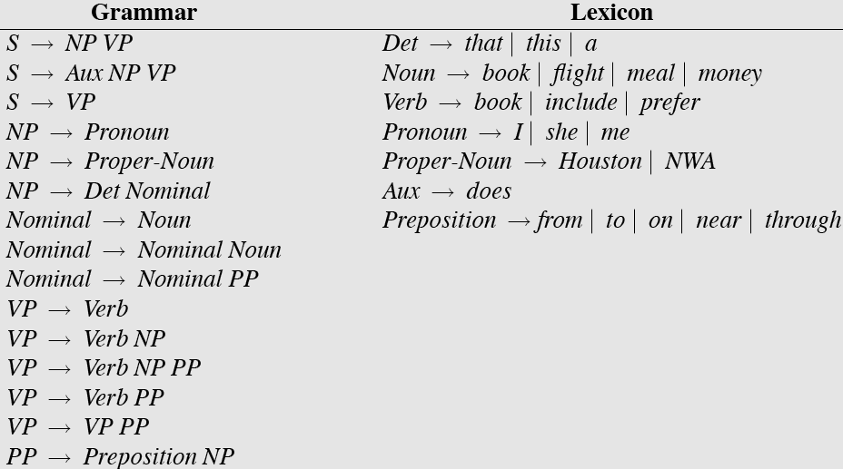
Sample L₁ Grammar

Slide 26
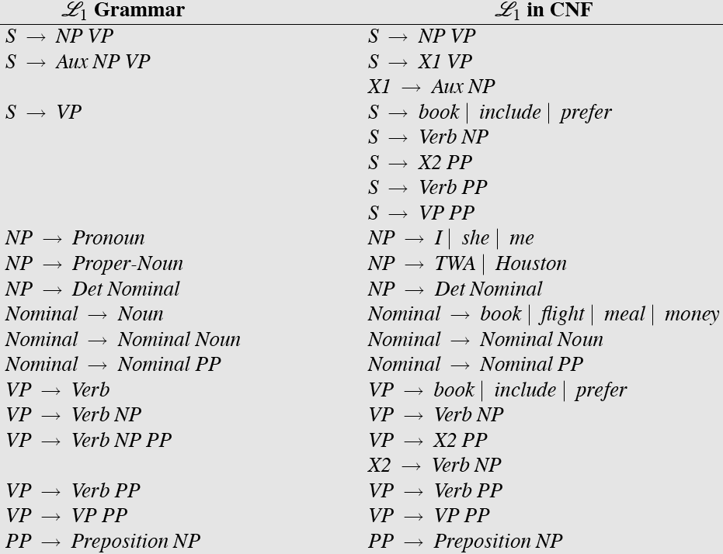
L₁ Grammar: CNF Conversion

Slide 27
CKY Parsing: Intuition
Consider the rule D → w
Terminal (word) forms a constituent
Trivial to apply
Consider the rule A → B C
If there is an A somewhere in the input then there must be a B followed by a C in the input
First, precisely define span [ i, j ]
If A spans from i to j in the input then there must be some k such that i<k<j
Easy to apply: we just need to try different values for k
i
j
A
B
C
k

Slide 28
CKY Parsing: Table
Any constituent can conceivably span [ i, j ] for all 0≤i<j≤N, where N = length of input string
We need an N × N table to keep track of all spans…
But we only need half of the table
Semantics of table: cell [ i, j ] contains A iff A spans i to j in the input string
Of course, must be allowed by the grammar!

Slide 29
CKY Parsing: Table-Filling
So let’s fill this table…
And look at the cell [ 0, N ]: which means?
But how?

Slide 30
CKY Parsing: Table-Filling
In order for A to span [ i, j ]:
A → B C is a rule in the grammar, and
There must be a B in [ i, k ] and a C in [ k, j ] for some i<k<j
Operationally:
To apply rule A → B C, look for a B in [ i, k ] and a C in [ k, j ]
In the table: look left in the row and down in the column

Slide 31
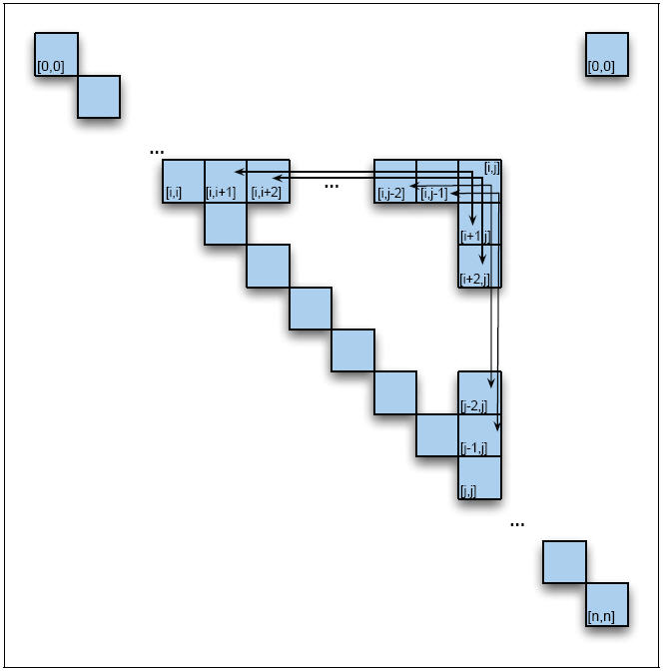
CKY Parsing: Rule Application
note: mistake in book (Figure 13.11, p 441), should be [0,n]

Slide 32
CKY Parsing: Cell Ordering
CKY = exercise in filling the table representing spans
Need to establish a systematic order for considering each cell
For each cell [ i, j ] consider all possible values for k and try applying each rule
What constraints do we have on the ordering of the cells?

Slide 33
CKY Parsing: Canonical Ordering
Standard CKY algorithm:
Fill the table a column at a time, from left to right, bottom to top
Whenever we’re filling a cell, the parts needed are already in the table (to the left and below)
Nice property: processes input left to right, word at a time

Slide 34
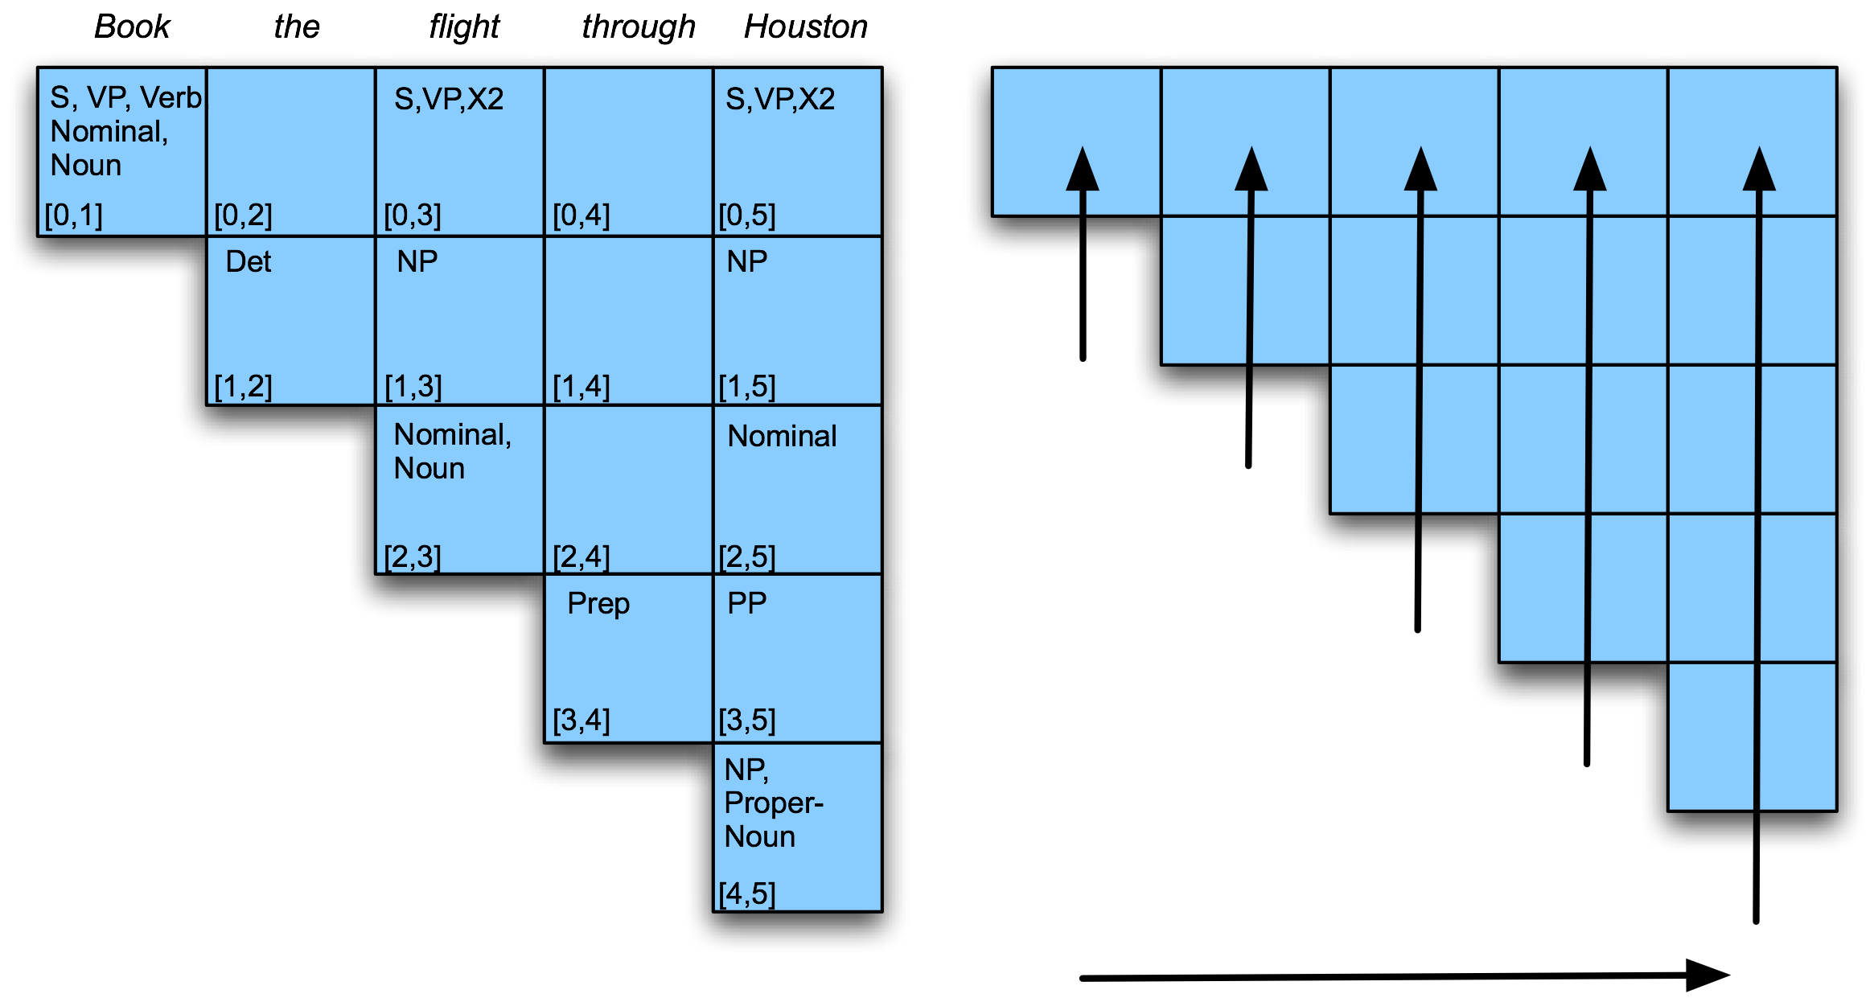
CKY Parsing: Ordering Illustrated

Slide 35
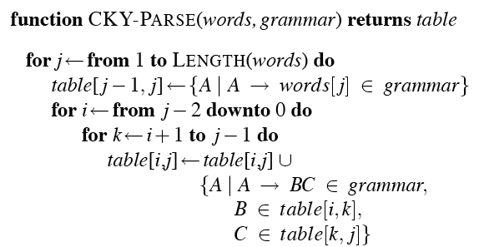
CKY Algorithm

Slide 36
CKY Parsing: Recognize or Parse
Is this really a parser?
Recognizer to parser: add backpointers!

Slide 37
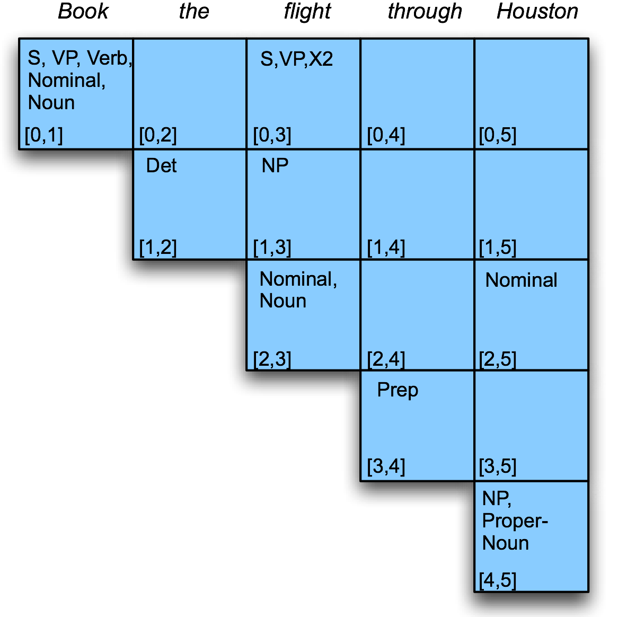
CKY: Example
?
?
?
?
Filling column 5

Slide 38
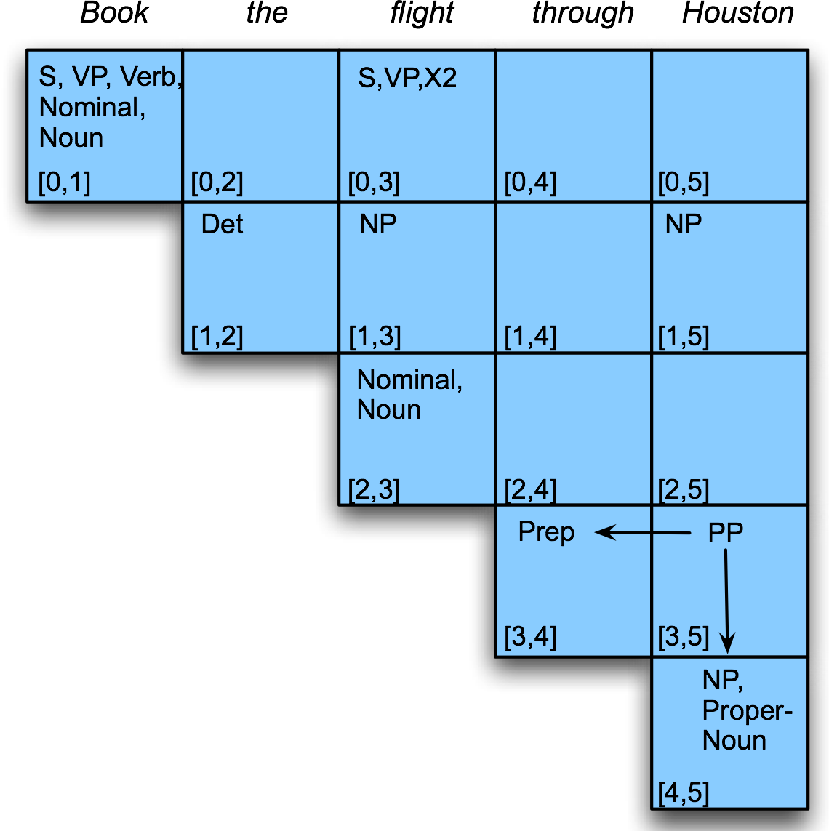
CKY: Example
?
?
?

Slide 39
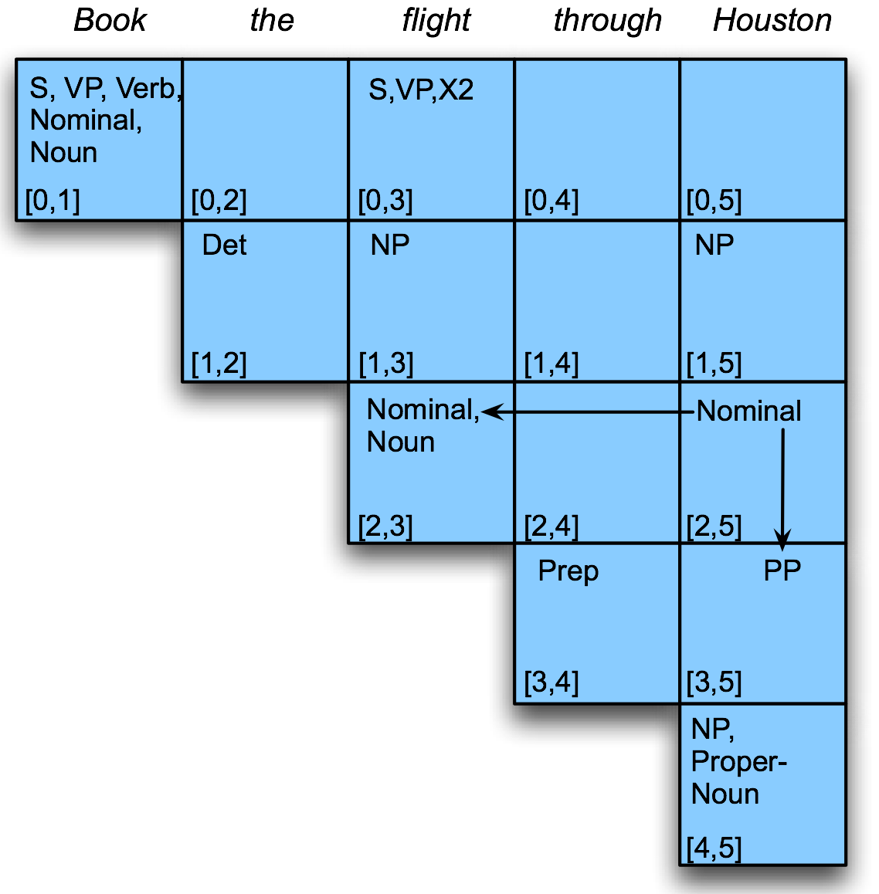
CKY: Example
?
?

Slide 40
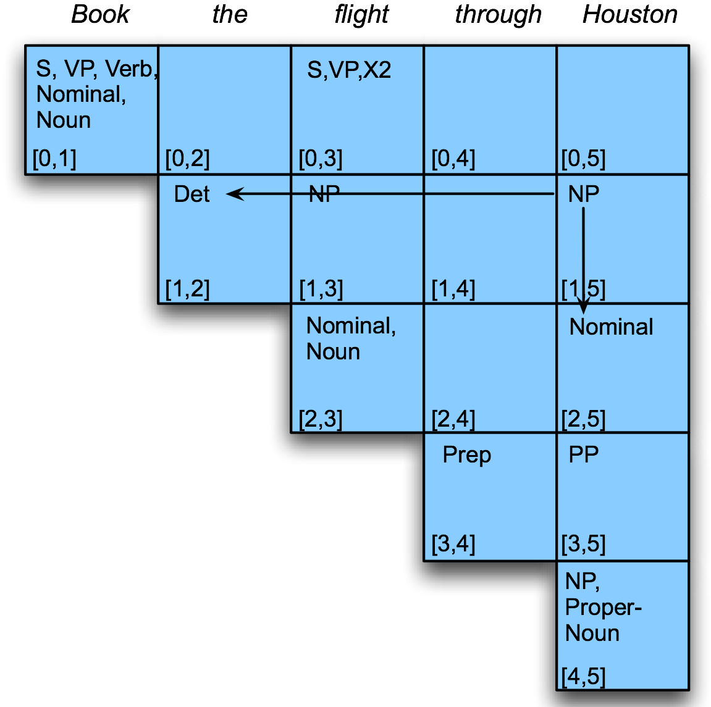
CKY: Example
?

Slide 41
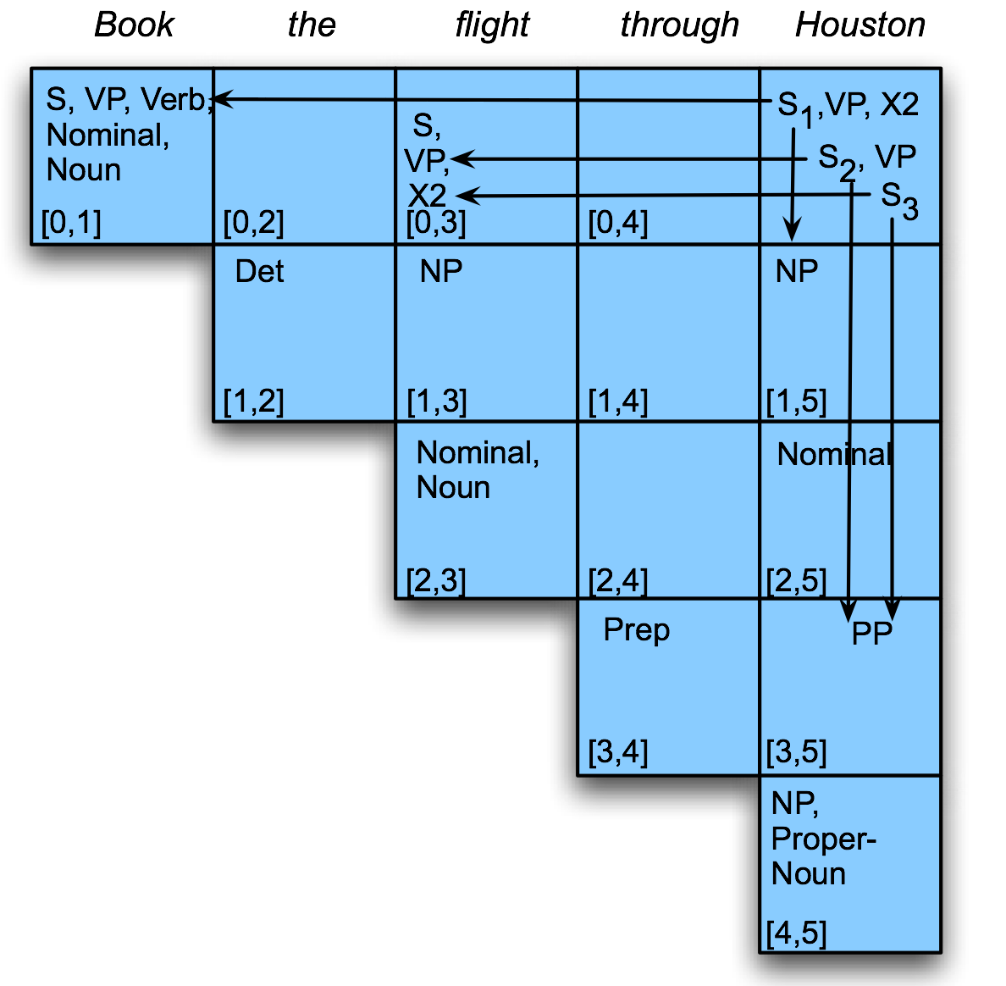
CKY: Example

Slide 42
CKY: Algorithmic Complexity
What’s the asymptotic complexity of CKY?

Slide 43
CKY: Analysis
Since it’s bottom up, CKY populates the table with a lot of “phantom constituents”
Spans that are constituents, but cannot really occur in the context in which they are suggested
Conversion of grammar to CNF adds additional non-terminal nodes
Leads to weak equivalence wrt original grammar
Additional terminal nodes not (linguistically) meaningful: but can be cleaned up with post processing
Is there a parsing algorithm for arbitrary CFGs that combines dynamic programming and top-down control?

Slide 44
Earley Parsing
Dynamic programming algorithm (surprise)
Allows arbitrary CFGs
Top-down control
But, compare with naïve top-down search
Fills a chart in a single sweep over the input
Chart is an array of length N + 1, where N = number of words
Chart entries represent states:
Completed constituents and their locations
In-progress constituents
Predicted constituents

Slide 45
Chart Entries: States
Charts are populated with states
Each state contains three items of information:
A grammar rule
Information about progress made in completing the sub-tree represented by the rule
Span of the sub-tree

Slide 46
Chart Entries: State Examples
S → • VP [0,0]
A VP is predicted at the start of the sentence
NP → Det • Nominal [1,2]
An NP is in progress; the Det goes from 1 to 2
VP → V NP • [0,3]
A VP has been found starting at 0 and ending at 3

Slide 47
Earley in a nutshell
Start by predicting S
Step through chart:
New predicted states are created from current states
New incomplete states are created by advancing existing states as new constituents are discovered
States are completed when rules are satisfied
Termination: look for S → α • [ 0, N ]

Slide 48
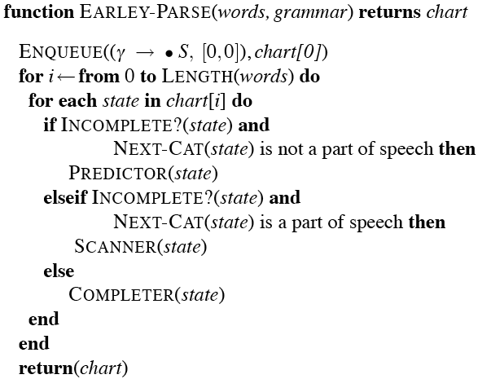
Earley Algorithm

Slide 49
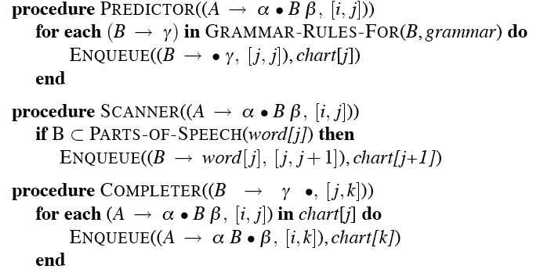
Earley Algorithm

Slide 50
Earley Example
Input: Book that flight
Desired end state: S → α • [0,3]
Meaning: S spanning from 0 to 3, completed rule

Slide 51
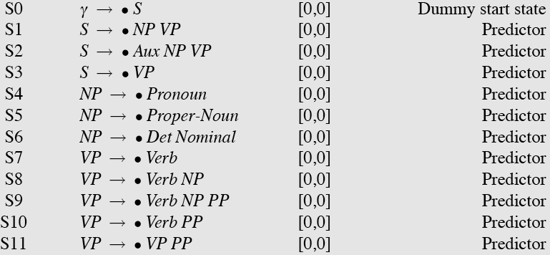
Earley: Chart[0]
Note that given a grammar, these entries are the same for all inputs; they can be pre-loaded…

Slide 52
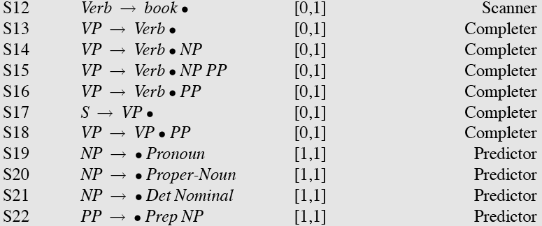
Earley: Chart[1]

Slide 53
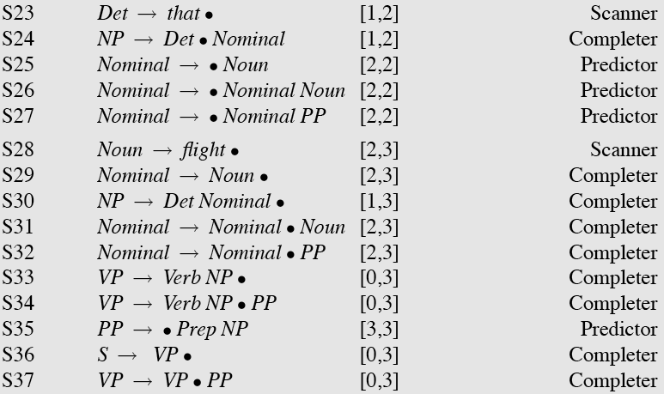
Earley: Chart[2] and Chart[3]

Slide 54
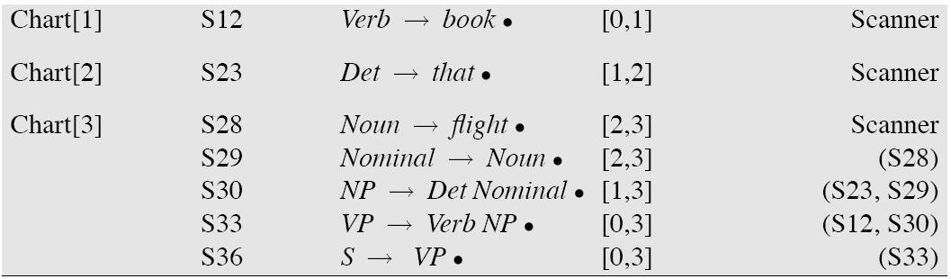
Earley: Recovering the Parse
As with CKY, add backpointers…

Slide 55
Earley: Efficiency
For such a simple example, there seems to be a lot of useless stuff…
Why?

Slide 56
Back to Ambiguity
Did we solve it?
No: both CKY and Earley return multiple parse trees…
Plus: compact encoding with shared sub-trees
Plus: work deriving shared sub-trees is reused
Minus: neither algorithm tells us which parse is correct

Slide 57
Ambiguity
Why don’t humans usually encounter ambiguity?
How can we improve our models?

Slide 58
What we covered today..
Parsing is (surprise) a search problem
Two important issues:
Ambiguity
Shared sub-problems
Two basic (= bad) algorithms:
Top-down search
Bottom-up search
Two “real” algorithms:
CKY parsing
Earley parsing

